Slide 1

Forecasting Fertilizer Efficiency and Agricultural Productivity in East Africa
Optimizing agricultural growth through smart data-driven fertilizer strategies
Capstone Project | 2025

Slide 2
Business Context/Problem
Problem Statement Despite increasing fertilizer consumption in East Africa, agricultural productivity remains inconsistent and often underwhelming. This project investigates whether current fertilizer usage aligns with optimal efficiency and how it impacts overall agricultural output.
The Challenge: East African nations face a critical challenge: How to boost agricultural productivity without over-relying on chemical fertilizers.

Slide 3
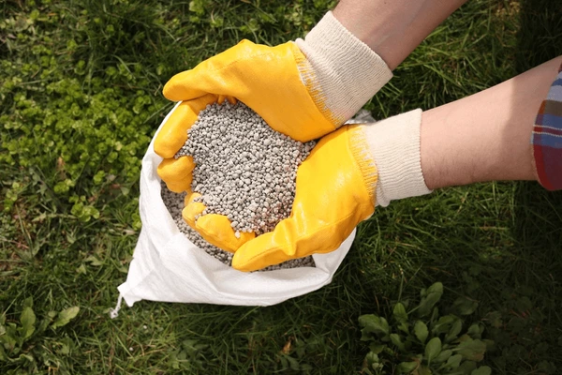
Why It Matters?
Fertilizer inputs directly impact food security
Overuse can harm soil and environment
Smarter use = more crops, less waste

Slide 4
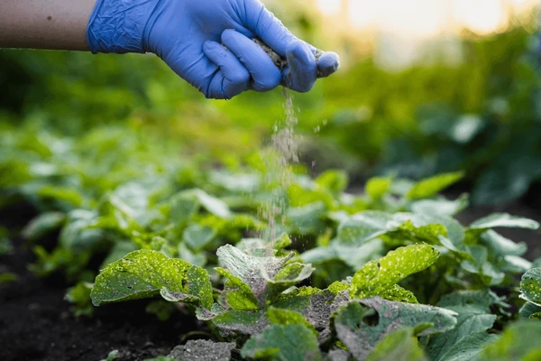
Project Objectives & Approach
Main Objective:
To analyze and forecast fertilizer efficiency and its impact on agricultural productivity across East African countries using data-driven methods.
Specific Objectives:
Track fertilizer usage trends across East Africa over time
Examine the relationship between fertilizer use and agricultural output
Forecast fertilizer consumption up to 2035 using time series models
Predict agricultural productivity using machine learning techniques
Group countries based on fertilizer efficiency for targeted policy strategies

Slide 5
Success Criteria & Evaluation
Model Accuracy: 85% forecast accuracy, low prediction errors
Fertilizer–Productivity Link: Strong correlation (R² > 0.7)
Country Clustering: Distinct, meaningful efficiency groups
Policy Impact: actionable recommendations adopted by stakeholders
Stakeholder Use: 80% satisfaction, more than 2 adopters (e.g., governments, NGOs
Real-World Results: Measurable yield gains in pilot areas
Access & Usability: Dashboards and findings fully accessible

Slide 6
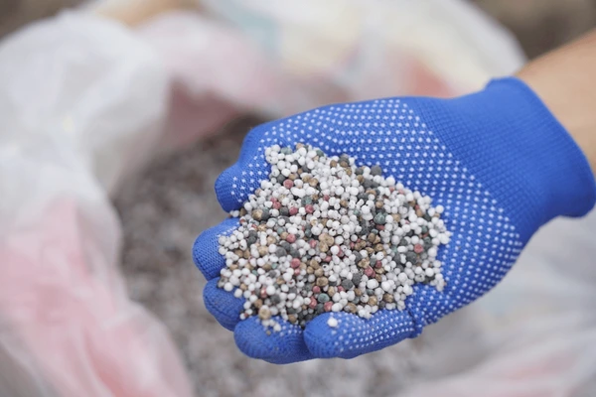
Where's the Data From?
Data Sources:
World Bank Indicators
FAO
National Statistics
Key Indicators:
Fertilizer consumption (kg/ha)
Ag. value added (US$)
Employment in ag. (%)
Crop production index
Data Handling
Missing values handled using K-Nearest Neighbors (KNN) for multivariate patterns and Median imputation for simpler gaps

Slide 7
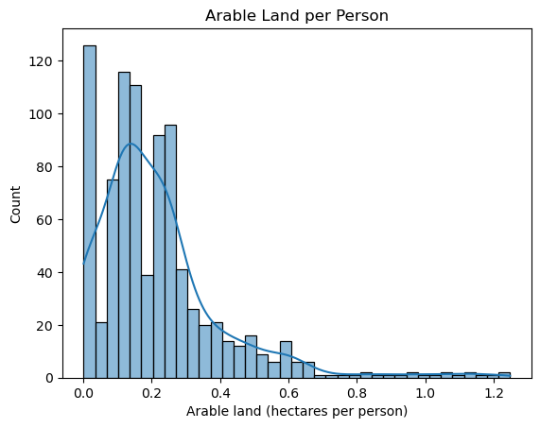
The majority of countries have very limited arable land available per person, with most falling below 0.3 hectares per individual.
This indicates high population pressure on arable land in many regions, especially in more densely populated countries.
Only a few countries have significantly more land per person, suggesting large disparities in land availability that could impact food security, land use planning, and agricultural scalability across regions.
FERTILIZER CONSUMPTION DISTRIBUTION

Slide 8
.
Insights
Right-skewed distribution: Most countries use low amounts of fertilizer, while a few use extremely high
Log transformation helps normalize data for modeling
Suggests
Modeling strategies must account for this skew

Slide 9
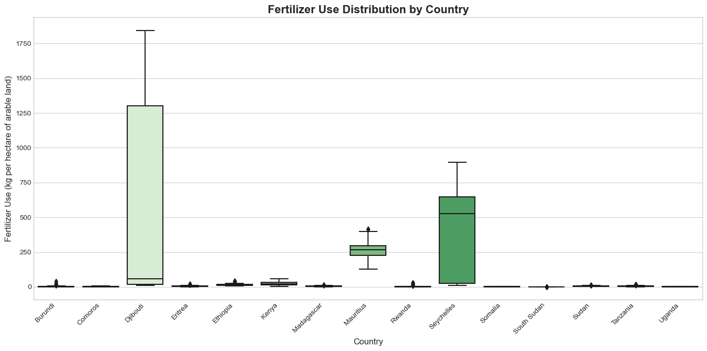
Djibouti and Seychelles have the highest fertilizer use, with Djibouti showing extreme variability.
Mauritius and Rwanda also have relatively high and consistent usage, suggesting well-developed agricultural practices.
The majority of countries show very low fertilizer use with minimal variation, indicating low input agriculture.
This disparity highlights significant regional differences in agricultural input levels, possibly reflecting economic factors, infrastructure, or policy support.

Slide 10

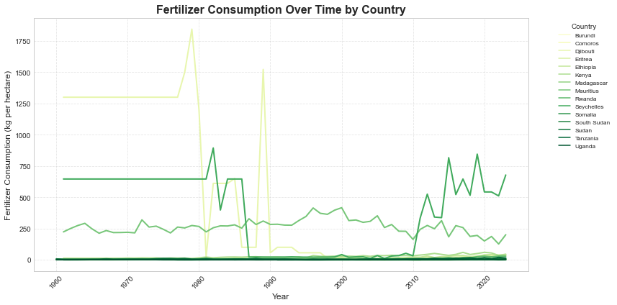
Fertilizer Consumption Trends Over Time

Slide 11
Insights:
Some countries show a steady increase, indicating efforts to boost agricultural productivity.
Others have plateaus or declines, which may reflect policy shifts, cost issues, or sustainability concerns.
Suggests:
Varying policy or subsidy strategies across countries

Slide 12
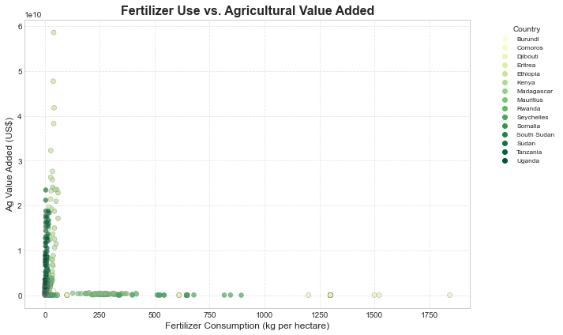
Fertilizer Use vs. Agricultural Value Added

Slide 13
Insights:
Ethiopia demonstrates high output despite low fertilizer use
Mauritius shows extremely high fertilizer use but modest output
No direct correlation — indicates that land size, labor input, and type of agriculture may be more influential
Suggests:
Fertilizer is necessary, but not sufficient for productivity

Slide 14
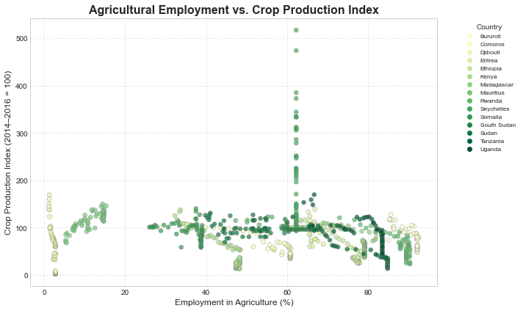
Agricultural Employment vs. Crop Production Index

Slide 15
Insights:
Countries with lower ag employment often show higher crop index values (e.g. Kenya)
Traditional, labor-heavy agriculture may correlate with lower efficiency
Suggests:
Modernized practices improve productivity per worker

Slide 16
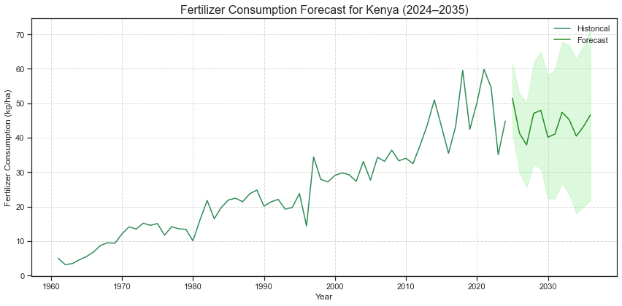
Fertilizer Consumption Trends and Forecast for Kenya (1960–2035)
Fertilizer use in Kenya rose steadily from 1960 to 2023, with notable volatility in recent years.
The ARIMA model forecasts stabilization around 40–45 kg/ha through 2035.
Wide confidence intervals signal uncertainty thus external factors like climate, prices, and policy could impact actual outcomes.
Policy support e.g. subsidies and training is crucial to push usage toward the higher end of the forecast range.

Slide 17
Predicting Agricultural Productivity with Machine Learning
Models Performance:
Random Forest - delivered the most accurate predictions for crop productivity, with strong explanatory power (R² = 0.87) and low error.
XGBoost - also performed well (R² = 0.84), but was slightly less accurate
Linear Regression - failed to capture patterns in the data (R² = 0.08), showing it's not suitable for this task.

Slide 18
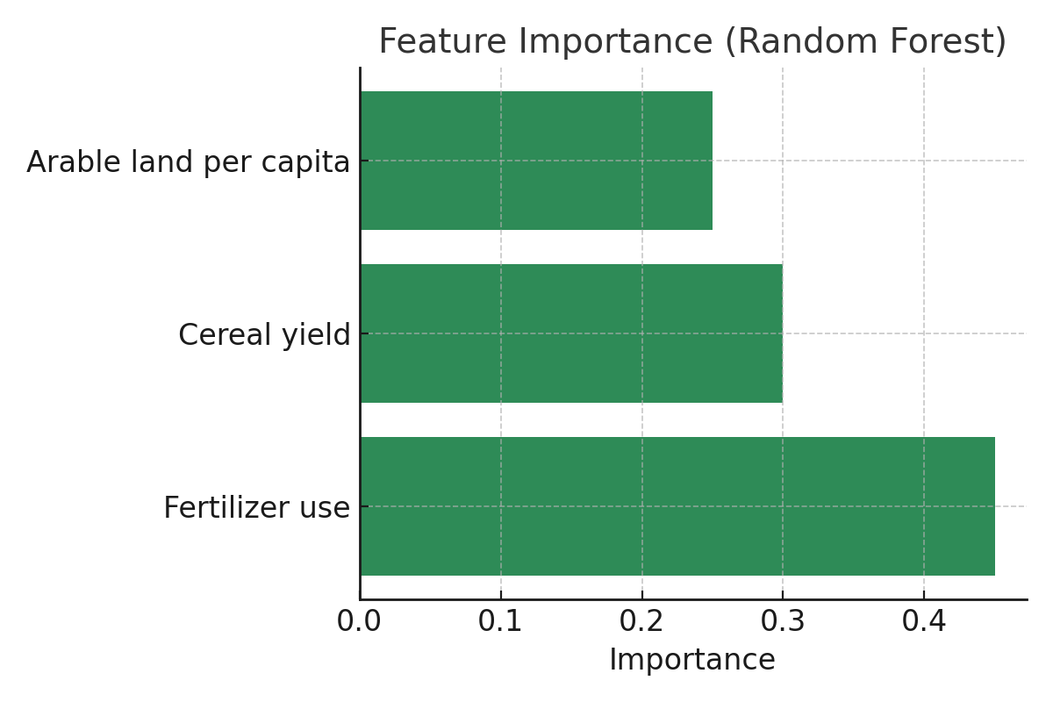
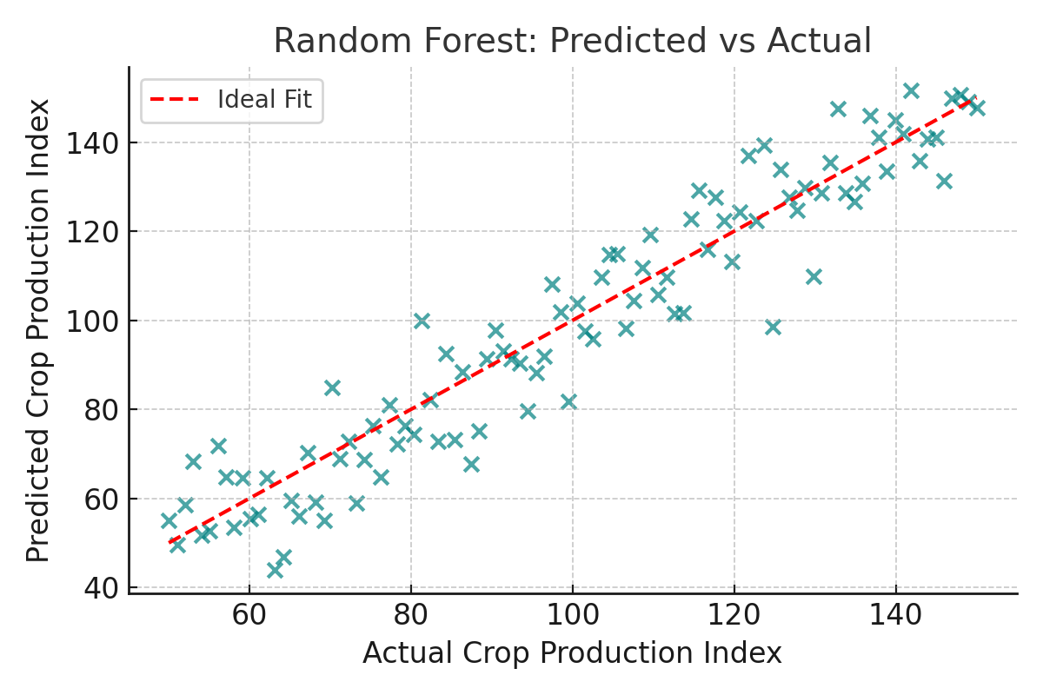
Best Performing Model- Random Forest
Insights:
Policies focusing on input efficiency (fertilizer use) and yield optimization will likely have the highest returns for improving crop productivity.
The tight clustering of data points around this line indicates high model accuracy and low prediction error.

Slide 19
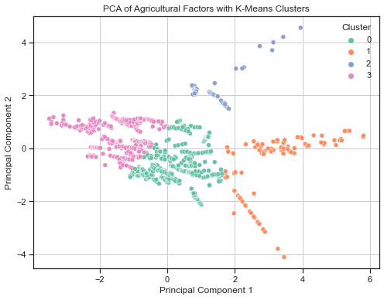
Segmenting Countries by Fertilizer Efficiency
Methodology:
Used K-Means clustering (k=4) based on fertilizer use and agricultural output, visualized using PCA (2D).

Slide 20
Insights:
• Cluster A – High Input, Low Output (Inefficient)
• Cluster B – Low Input, High Output (Efficient)
• Cluster C – Moderate Input/Output, High Variability
• Cluster D – High Input, High Output (Scalable Systems)
Policy Implications:
Cluster A: Focus on improving efficiency and reducing waste.
Cluster B: Model efficient practices and maintain sustainability.
Cluster C: Stabilization through targeted support and infrastructure.
Cluster D: Potential for sustainable intensification and investment.

Slide 21
Policy Recommendations
Increase Fertilizer Access- Build supply chains and offer subsidies to make fertilizers affordable.
Promote Sustainable Use- Train farmers on efficient, eco-friendly fertilizer practices.
Boost Cereal Yields- Invest in research, improved seeds, and irrigation.
Maximize Arable Land- Encourage crop rotation and soil conservation.
Educate Farmers- Expand extension services for modern farming knowledge.
Adopt Technology- Support precision farming, mobile tools, and AI solutions.
Build Resilience- Introduce crop insurance and emergency reserves.
Strengthen Data Systems- Improve regional data sharing and analytics.
Support PPPs- Collaborate across sectors to fund and scale solutions.

Slide 22
Conclusion
This project developed a forecasting and analytics framework for fertilizer use in East Africa.
Historical and predictive analyses revealed key trends, gaps, and optimization opportunities.
Machine learning and time-series models uncovered non-linear dynamics in productivity.
Country clustering enabled more targeted and relevant policy recommendations.
Integrated, data-driven strategies are essential for sustainable agriculture and food security in the region.

Slide 23





Who’s This For?

Slide 24
Thank You !
Presented By: Group 2
GitHub Repo: github.com/Rodgerdev/east-africa-fertilizer-project

