Slide 1

Forecasting Fertilizer Efficiency and Agricultural Productivity in East Africa
Optimizing agricultural growth through smart data-driven fertilizer strategies
Capstone Project | 2025

Slide 2

What's the Challenge?
Problem Statement Despite increasing fertilizer consumption in East Africa, agricultural productivity remains inconsistent and often underwhelming. This project investigates whether current fertilizer usage aligns with optimal efficiency and how it impacts overall agricultural output.

Slide 3
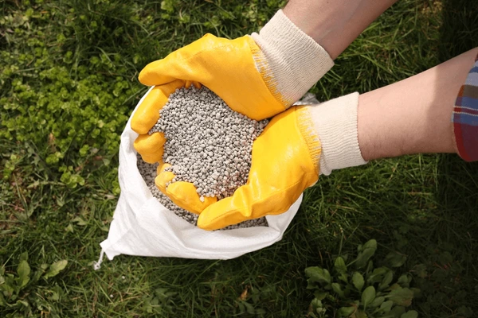
Why It Matters?
The Challenge: East African nations face a critical challenge: How to boost agricultural productivity without over-relying on chemical fertilizers.
Why it Matters:
Fertilizer inputs directly impact food security
Overuse can harm soil and environment
Smarter use = more crops, less waste

Slide 4

What Are We Trying to Do?
Main Objective:
To analyze and forecast fertilizer efficiency and its impact on agricultural productivity across East African countries using data-driven methods.
Specific Objectives:
Track fertilizer usage trends across East Africa over time
Examine the relationship between fertilizer use and agricultural output
Forecast fertilizer consumption up to 2035 using time series models
Predict agricultural productivity using machine learning techniques
Group countries based on fertilizer efficiency for targeted policy strategies

Slide 5
What Success Looks Like
Success Criteria:
Clear trends in fertilizer use & productivity
Meaningful correlations backed by data
Accurate forecasts to support planning
Country clusters for strategic targeting

Slide 6
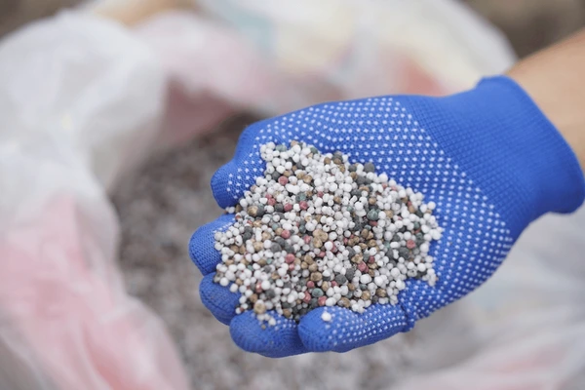
Who's This For?
Stakeholders:
Ministry of Agriculture
Development Organizations
Farmer Cooperatives
Agri tech Companies
Donors & NGO s

Slide 7
Where's the Data From?
Data Sources:
World Bank Indicators
FAO
National Statistics
Key Indicators:
Fertilizer consumption (kg/ha)
Ag. value added (US$)
Employment in ag. (%)
Crop production index

Slide 8
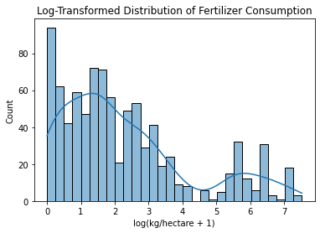
Fertilizer Consumption Distribution

Slide 9
Insights
Right-skewed distribution: Most countries use low amounts of fertilizer, while a few use extremely high
Log transformation helps normalize data for modeling
Suggests
Modeling strategies must account for this skew

Slide 10
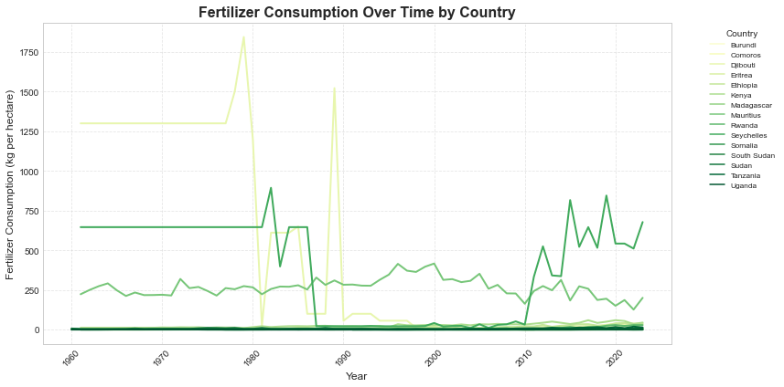
Fertilizer Consumption Trends Over Time

Slide 11
Insights:
Some countries show a steady increase, indicating efforts to boost agricultural productivity.
Others have plateaus or declines, which may reflect policy shifts, cost issues, or sustainability concerns.
Suggests:
Varying policy or subsidy strategies across countries

Slide 12
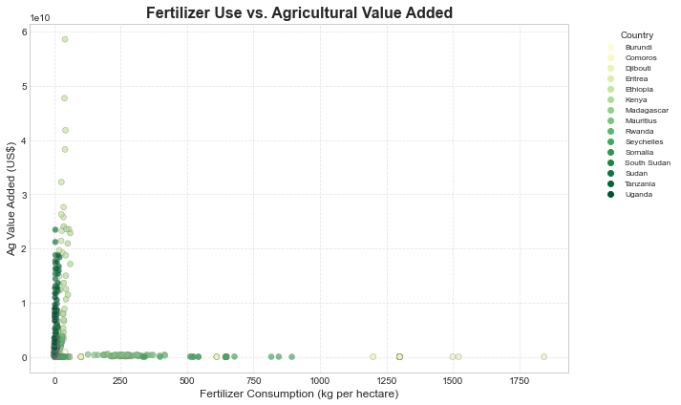
Fertilizer Use vs. Agricultural Value Added

Slide 13
Insights:
Ethiopia demonstrates high output despite low fertilizer use
Mauritius shows extremely high fertilizer use but modest output
No direct correlation — indicates that land size, labor input, and type of agriculture may be more influential
Suggests:
Fertilizer is necessary, but not sufficient for productivity

Slide 14
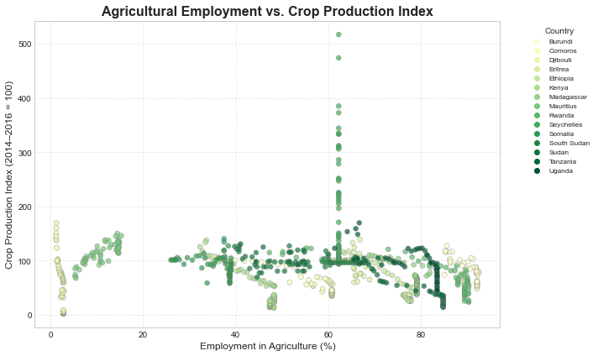
Agricultural Employment vs. Crop Production Index

Slide 15
Insights:
Countries with lower ag employment often show higher crop index values (e.g. Kenya)
Traditional, labor-heavy agriculture may correlate with lower efficiency
Suggests:
Modernized practices improve productivity per worker

Slide 18
Thank You !
• Questions?
• Presented By: Group 2
• GitHub: https://github.com/Rodgerdev/east-africa-
fertilizer-project

