Slide 1
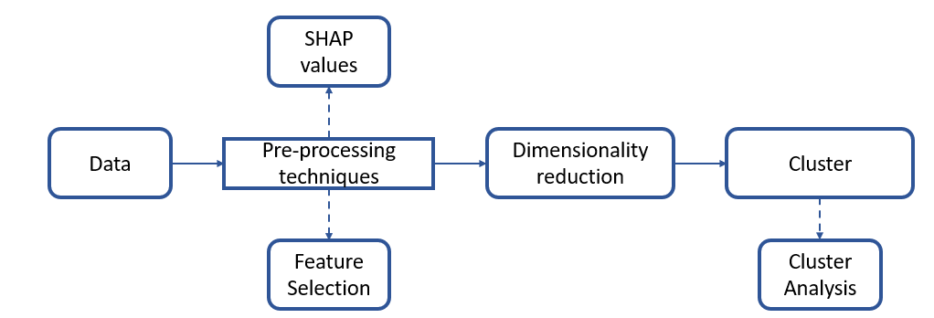
Pre-processing techniques
Data
Feature Selection
SHAP values
Dimensionality reduction
Cluster
…
Cluster Analysis

