Slide 1
CAPSTONE PROJECT
Predicting Online Shoppers’
Purchase Intention
A k-Nearest Neighbors Classifier
Dataset: UCI Online Shoppers Purchasing Intention • 12,330 sessions • 17 features
May 2026

Slide 2
01 • Roadmap
How This Talk Is Organized
From the question to the answer to the caveats.
1
Problem
What are we trying to predict?
2
Data
What does the dataset look like?
3
EDA
What do the features tell us?
4
Method
How does kNN work, and how did we build it?
5
Tuning
How did we choose the value of k?
6
Results
How well does it actually perform?
7
Validation
Cross-validation and baseline comparison.
8
Limits
Where the model breaks down.
9
Conclusion
What we learned and what comes next.
Online Shoppers Purchase-Intention Capstone | kNN
Slide 2

Slide 3
02 • Problem
The Problem
Most online sessions never become a purchase. Can we predict which ones will?
Business Question
ML Framing
• E-commerce sites get millions of sessions, but only a small fraction convert.
• Knowing in advance which sessions are likely to buy lets the business intervene — discounts, live chat, retargeting.
• Goal: given a session’s behavior and metadata, predict whether it will end in a purchase.
• Binary classification: 1 = purchase, 0 = no purchase.
• Highly imbalanced — only 15.47% of sessions are positives.
• Therefore: accuracy alone is misleading. Must report precision, recall, and F1.
• Algorithm of choice: k-Nearest Neighbors, implemented from scratch in NumPy.
Online Shoppers Purchase-Intention Capstone | kNN
Slide 3

Slide 4
03 • Data
The Dataset
UCI Online Shoppers Purchasing Intention — 12,330 real e-commerce sessions.
12,330
17
15.47%
5.46 : 1
Sessions in dataset
Predictor features
Sessions that purchase
No-buy : Buy ratio
Feature categories
Page visits
Administrative, Informational, ProductRelated
How many pages of each kind were viewed.
Time spent
*_Duration columns
Total seconds on each page type.
Google Analytics
BounceRates, ExitRates, PageValues
Site-side metrics; PageValues is highly predictive.
Calendar
SpecialDay, Month
Closeness to holidays; visit month.
Tech metadata
OperatingSystems, Browser, Region, TrafficType
User connection profile.
Visitor info
VisitorType, Weekend
Returning vs. new; weekend flag.
Online Shoppers Purchase-Intention Capstone | kNN
Slide 4

Slide 5
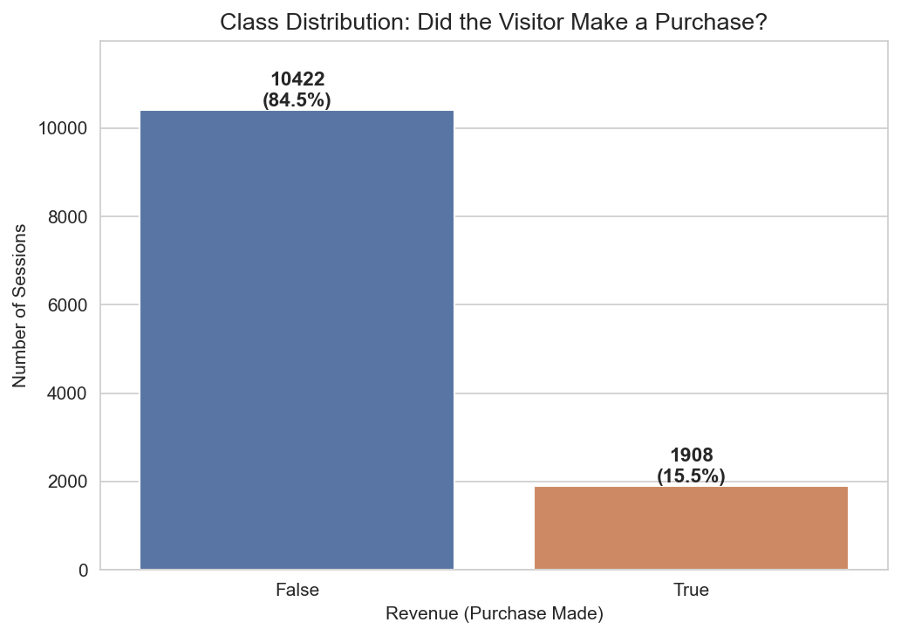
04 • EDA — Class imbalance
For Every 1 Buyer, ~5.5 People Just Browsed and Left
This is normal for e-commerce, but it shapes the entire evaluation strategy.
The "Accuracy Trap"
• A model that always says "No-Buy" is right 84.5% of the time.
• That’s an 84% accuracy with zero learning.
• So accuracy alone is not a passing grade.
• We commit upfront to reporting precision, recall, F1, and the confusion matrix.
Online Shoppers Purchase-Intention Capstone | kNN
Slide 5

Slide 6
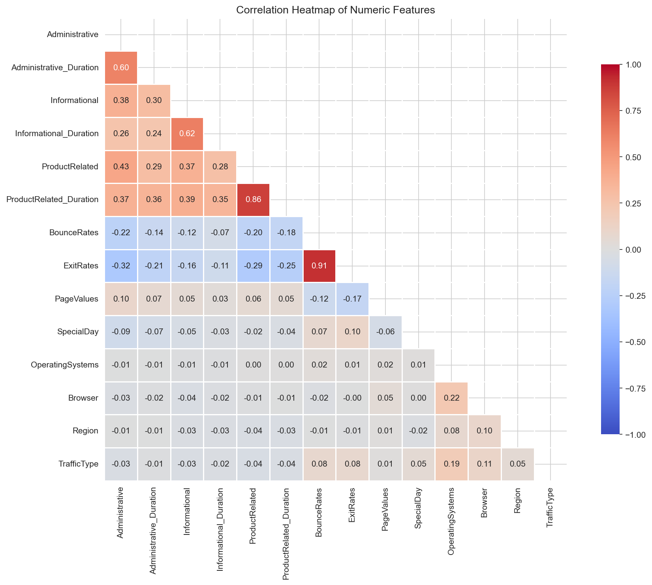
04 • EDA — Feature relationships
Some Features Are Saying the Same Thing
Multicollinearity matters for kNN — duplicate signals get double-counted in distance.
Notable Pairs
• BounceRates ↔ ExitRates: r = 0.913
• ProductRelated
↔
ProductRelated_Duration: r = 0.861
Why It Matters
• kNN measures distance using all features at once.
• Duplicate features inflate that behavior’s influence on neighbor selection.
Online Shoppers Purchase-Intention Capstone | kNN
Slide 6

Slide 7
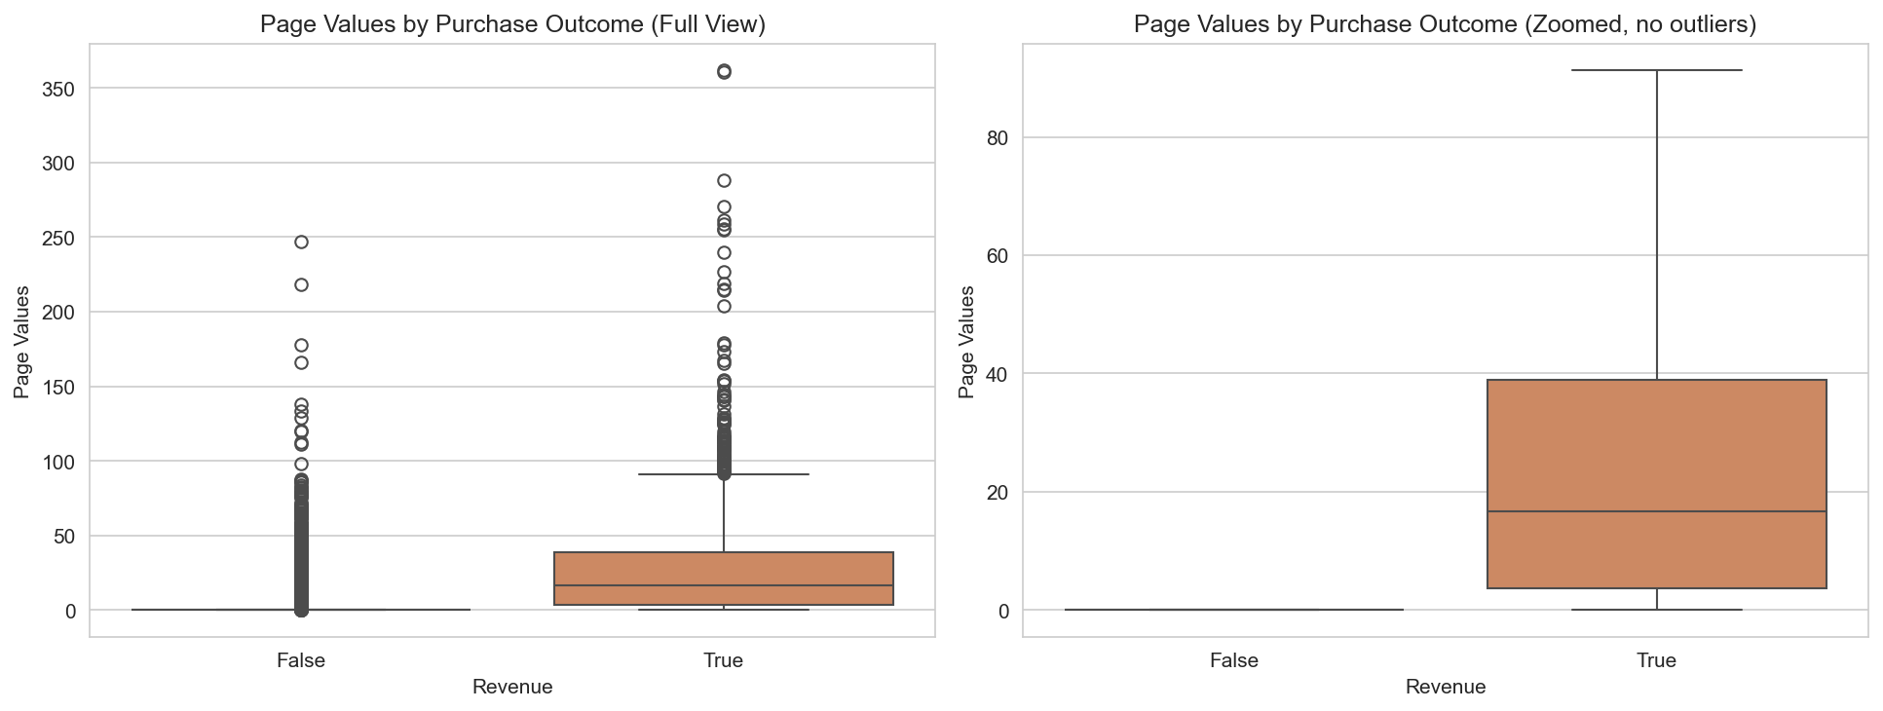
04 • EDA — Strongest signal
PageValues: The Single Most Predictive Feature
Buyers arrive at high-value pages; non-buyers don’t.
The Numbers
• Buyer mean: 27.26
• Non-buyer mean: 1.98
• 13.8× difference
• Non-buyer median: literally 0
Why It Matters
• Strong class separability is exactly what kNN exploits.
Online Shoppers Purchase-Intention Capstone | kNN
Slide 7

Slide 8
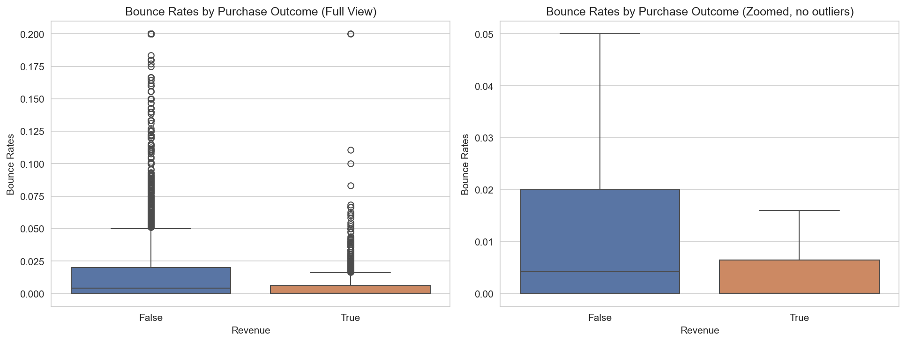
04 • EDA — Engagement signal
Buyers Stay. Non-Buyers Drift Away.
BounceRate captures the difference between intent and casual browsing.
Engagement Gap
• Buyer mean bounce: 0.0051
• Non-buyer mean: 0.0253
• Roughly 5× higher for non-buyers
• Buyer median: 0
Implication
• Engagement depth is strongly tied to purchase completion.
Online Shoppers Purchase-Intention Capstone | kNN
Slide 8

Slide 9
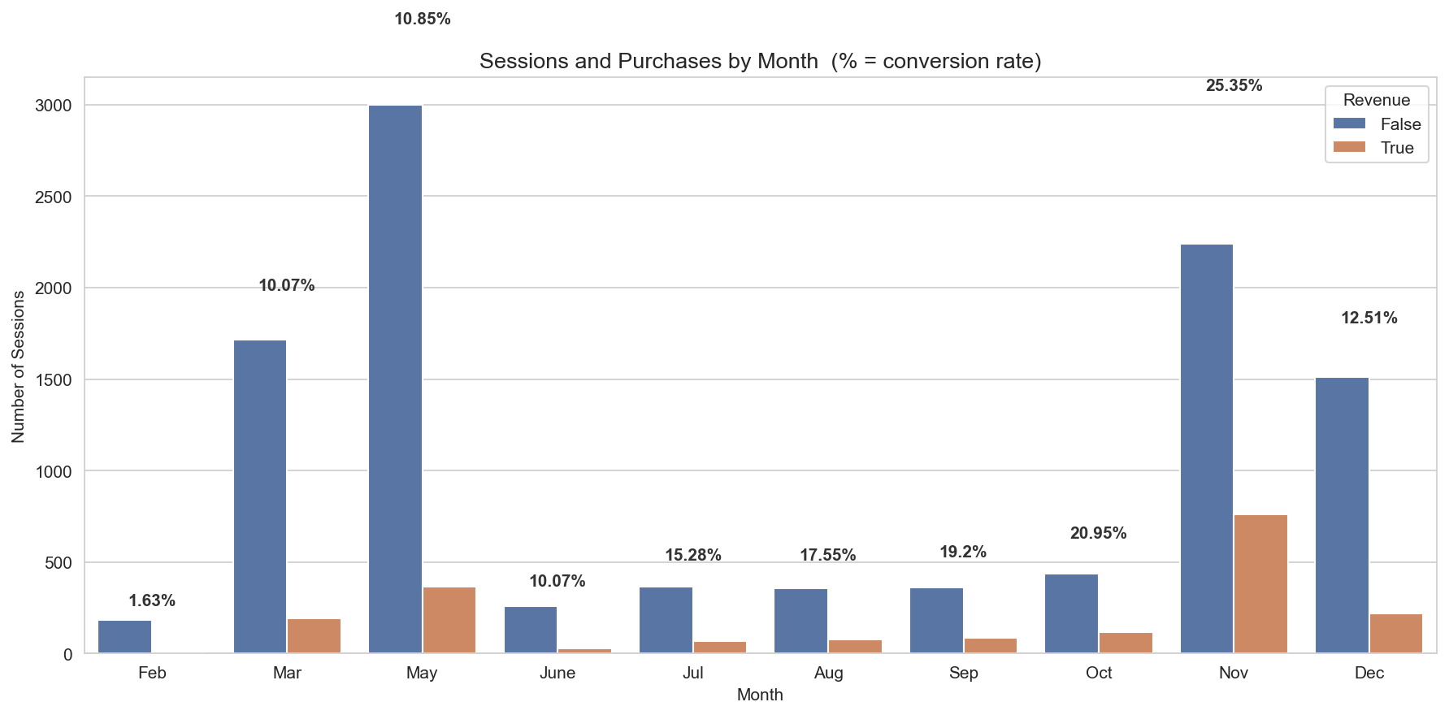
04 • EDA — Temporal pattern
November Is the Month That Matters
Conversion rate isn’t flat across the year. It spikes during holiday shopping.
Conversion by Month
• Feb: 1.63%
• Mar: 10.03%
• May: 10.85%
• Jul: 15.28%
• Sep: 19.07%
• Nov: 25.35% ← peak
Takeaway
• Month one-hots give the model a strong prior.
Online Shoppers Purchase-Intention Capstone | kNN
Slide 9

Slide 10
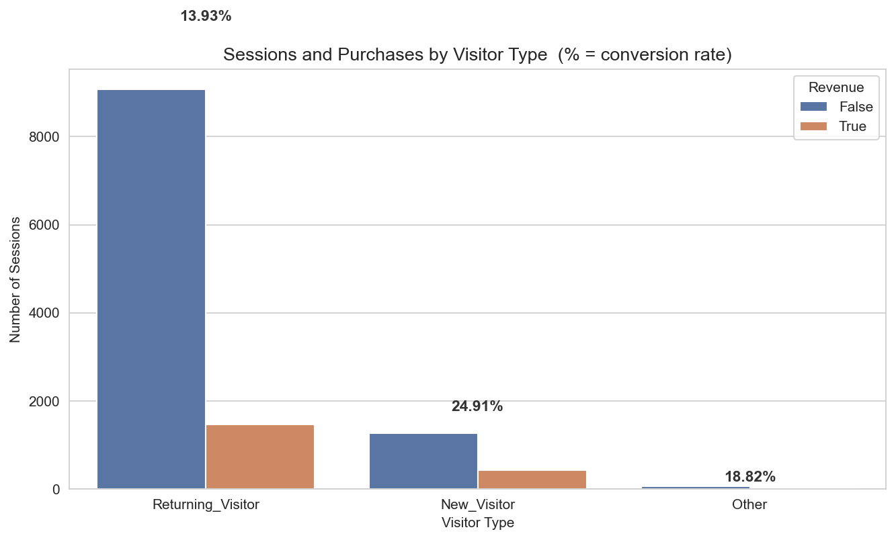
04 • EDA — Counter-intuitive insight
New Visitors Convert Better Than Returning Visitors
A surprising result — and exactly the kind of insight a stakeholder would ask about.
Conversion Rate
• New visitors: 24.91%
• Returning visitors: 13.93%
• Almost 2× higher for new visitors
Why?
• New visitors arrive with high intent (clicked an ad, searched for the product).
• Returning visitors include a lot of casual browsers who keep coming back.
Online Shoppers Purchase-Intention Capstone | kNN
Slide 10

Slide 11
05 • Method — How kNN works
k-Nearest Neighbors in One Picture
No training step. Just measure distance to every known example and vote.
1
Standardize
Subtract the training mean and divide by the training std for every feature, so no feature dominates by sheer scale.
2
Measure distance
For a new session, compute Euclidean distance to every training point: √Σ(xᵢ − tᵢ)².
3
Pick the k closest
Sort by distance and keep the k smallest — those are the k most similar past sessions.
4
Majority vote
Look at their Revenue labels. Whichever class appears more often wins. That’s the prediction.
Online Shoppers Purchase-Intention Capstone | kNN
Slide 11

Slide 12
05 • Method — Implementation pipeline
The Pipeline We Built — Seven Scripts Estimators
Every step was implemented from NumPy to make the algorithm visible.
Inspect
EDA
Preprocess
Split + Scale
kNN model
Tune k
Final eval
data_inspect.py
eda.py
preprocessing.py
train_test_split.py
knn_model.py
knn_tune_k.py
final_evaluation.py
Key engineering choices
• Stratified 80 / 20 split — preserves the 84.5 / 15.5 class ratio in both partitions.
• Standardization fitted on train ONLY — no test-set information leaks into the scaler.
• Vectorized Euclidean distance with NumPy broadcasting — fast even at 9,865 × 28.
• Manual confusion matrix and metrics — no sklearn.metrics shortcut.
Online Shoppers Purchase-Intention Capstone | kNN
Slide 12

Slide 13
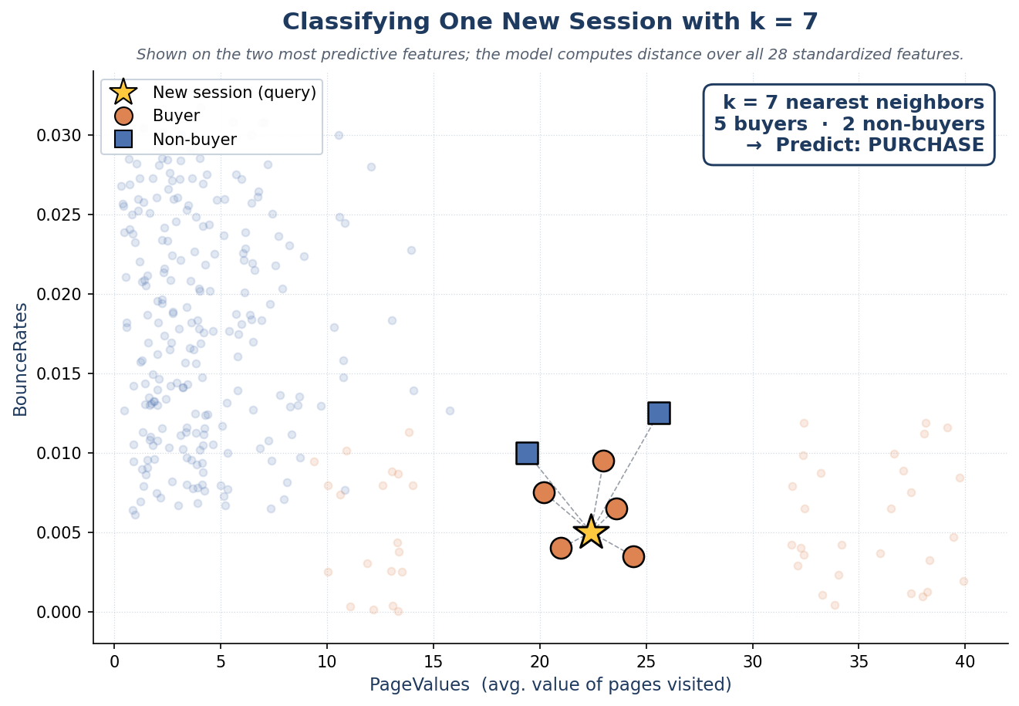
05 • Method — Worked example
One Prediction, Walked Through
The same algorithm on a single new session — its seven closest neighbors cast the vote.
The Vote
• New session: PageValues = 22.4, BounceRates = 0.005, Month = Nov, VisitorType = New.
• Find the 7 most similar past sessions by standardized distance.
• They split 5 buyers vs. 2 non-buyers.
• Majority wins → predict PURCHASE.
• Actual label: Purchase ✓ — the prediction is correct.
Online Shoppers Purchase-Intention Capstone | kNN

Slide 14
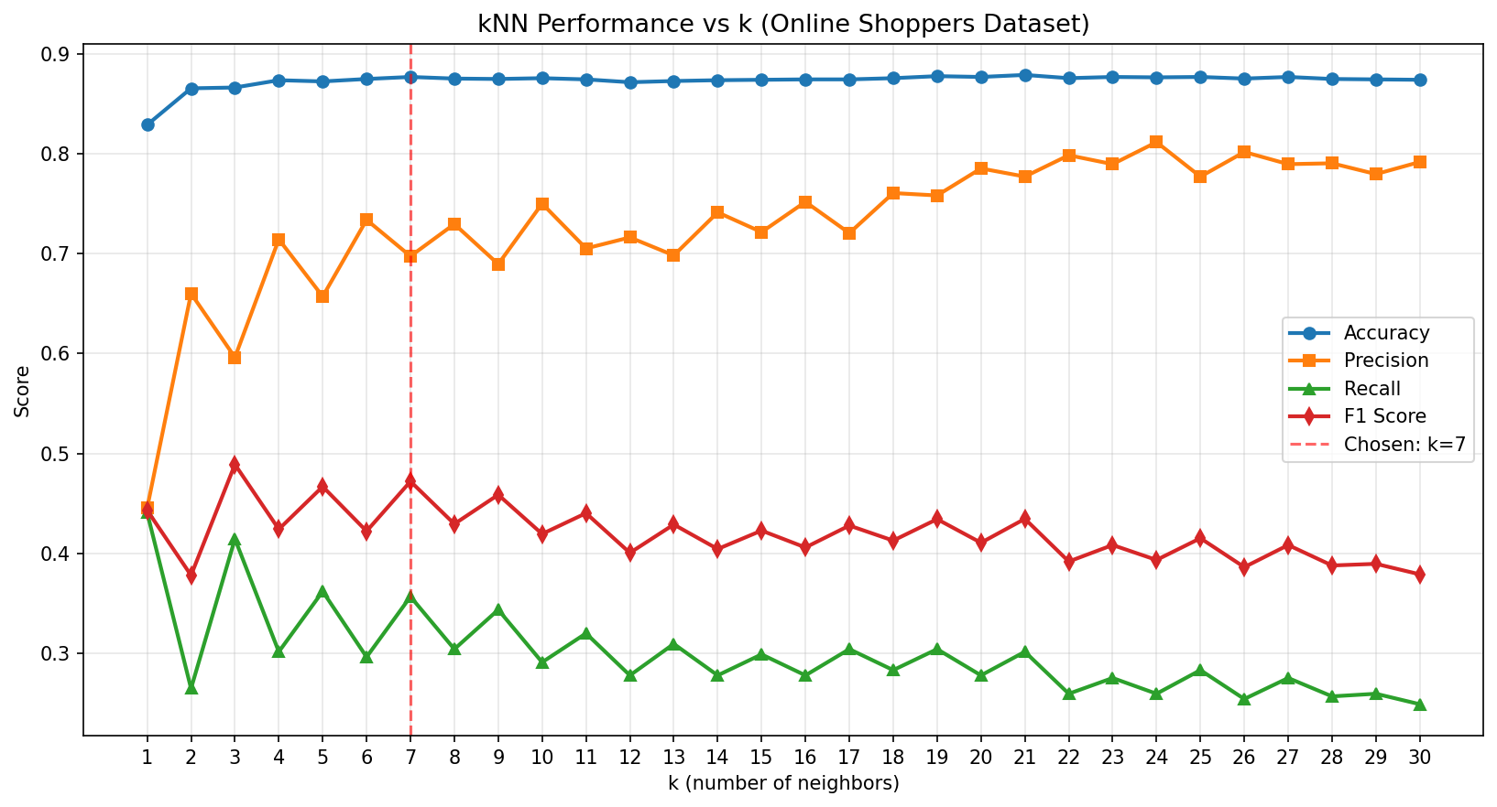
06 • Tuning
Sweeping k from 1 to 30
F1 peaks at k = 3; we chose k = 7 for its higher precision. Recall and precision pull in opposite directions.
Best k by metric
• Best Accuracy: k = 21
• Best Precision: k = 24
• Best Recall: k = 1
• Best F1: k = 3
Chosen: k = 7 (higher precision)
How we chose k
• F1 to find the peak region (k ≈ 3–9), avoiding both extremes.
• Precision to pick within it → k = 7 — a confident, conservative classifier.
Online Shoppers Purchase-Intention Capstone | kNN
Slide 13

Slide 15
07 • Results
Final Test-Set Performance (k = 7)
Held-out 20% test set, 2,465 sessions, never seen during tuning preparation.
87.67%
0.6974
0.3570
0.4722
Accuracy
Precision
Recall
F1 Score
How to read these numbers
Confusion matrix counts
• Precision 0.70 → when we say "buyer", we’re right 70% of the time.
• Recall 0.36 → we catch only 36% of the actual buyers.
• High precision, lower recall — a conservative classifier.
• TP = 136 (correctly flagged buyers)
• FP = 59 (predicted buy, didn’t)
• FN = 245 (missed buyers — recall pain)
• TN = 2,025 (correctly excluded non-buyers)
Online Shoppers Purchase-Intention Capstone | kNN
Slide 14

Slide 16
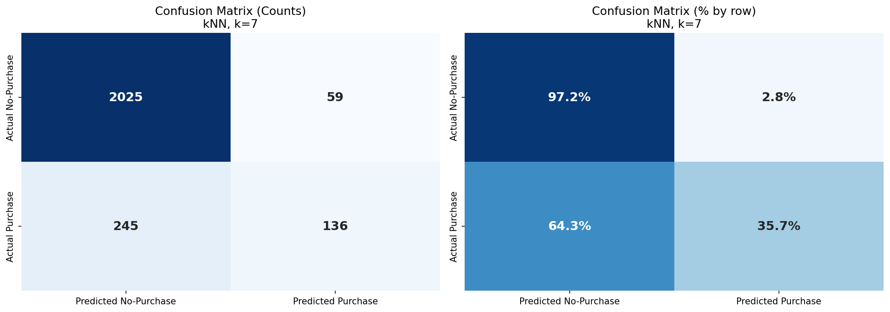
07 • Results — Confusion matrix
Confusion Matrix — Counts and Row Percentages
Where the model is right, and where it pays the cost of class imbalance.
In Plain English
• Most non-buyers are correctly identified (97.2%).
• Most buyers slip through (we catch only 35.7%).
• When we do flag a buyer, we’re usually right.
Online Shoppers Purchase-Intention Capstone | kNN
Slide 15

Slide 17
08 • Validation
Validation: Stable Across Folds — but a Simple Rule Beats Us
5-fold stratified CV confirms stability; but a one-feature PageValues rule outperforms our kNN.
5-fold Stratified Cross-Validation
Baseline Comparison
• Stratified folds preserve the 84.5 / 15.5 class ratio in every fold.
• Each fold gets its own train-only standardization (no leakage).
• Per-fold metrics are tightly clustered.
• Conclusion: the test-set numbers are not a lucky split.
Model
Accuracy
F1
Always "No-Purchase"
0.8454
0.0000
Rule on PageValues
0.8929
0.6819
kNN (k = 7) — our model
0.8767
0.4722
The PageValues rule beats kNN on F1 — kNN dilutes the dominant signal across 28 features. A humbling, instructive result.
Online Shoppers Purchase-Intention Capstone | kNN
Slide 16

Slide 18
09 • Discussion
What the Numbers Mean for the Business
A high-precision, lower-recall classifier — useful for some interventions, weak for others.
Good Fit If…
Bad Fit If…
• Acting on a non-buyer is expensive (e.g., heavy discount, live agent).
• You want fewer-but-confident alerts, not blanket coverage.
• You can pair this model with low-cost site-wide nudges that catch the rest.
• Missed buyers are far more costly than wasted offers.
• The product needs blanket personalization (recall matters more than precision).
• You need calibrated probabilities, not hard predictions.
Online Shoppers Purchase-Intention Capstone | kNN
Slide 17

Slide 19
10 • Limitations
Honest Limitations of This Model
A capstone is judged by candor as much as by score.
Imbalance not treated
No SMOTE, no class weighting, no threshold tuning, no distance-weighted voting. The recall ceiling is largely a consequence of this.
Multicollinearity left in
BounceRates / ExitRates (r = 0.913) and ProductRelated / *_Duration (r = 0.861) double-count behavior in distance.
One-hot inflates the distance space
13 binary one-hot columns sit alongside 14 continuous ones in the same Euclidean geometry — distorts neighbor selection slightly.
A one-feature PageValues rule beats the full model
kNN doesn't do feature selection.
Only Euclidean + uniform vote
No Manhattan / Mahalanobis / weighted-vote experiments. Distance-weighted voting in particular is known to help on imbalanced data.
No ROC / probability output
Reported only point classification metrics. ROC + AUC would visualize the full precision-recall trade-off.
Online Shoppers Purchase-Intention Capstone | kNN
Slide 18

Slide 20
11 • Future work
What We Would Try Next
Concrete improvements that follow directly from the limitations on the previous slide.
1
Distance-weighted voting
Closer neighbors count more. Cheap to add; usually the single biggest win on imbalanced data.
2
Threshold tuning on the kNN score
Use k_pos / k as a soft probability and pick the threshold by Youden’s J or by business cost.
3
Resampling
SMOTE oversampling of the minority class (or principled under-sampling of the majority).
4
Feature redundancy cleanup
Drop ExitRates (keep BounceRates) and ProductRelated_Duration (keep ProductRelated), or run PCA.
5
Cleaner tuning protocol
Hold out a true validation split or use nested CV so the test set is touched exactly once.
6
Compare against tuned baselines
Logistic regression, random forest, gradient boosting — to position kNN against the literature on this dataset.
Online Shoppers Purchase-Intention Capstone | kNN
Slide 19

Slide 21
12 • Takeaways
Five Things to Take Away
1
A kNN classifier can learn real, transferable signal from web-session data.
2
On the UCI Online Shoppers data, k = 7 gave 87.67% accuracy and 0.47 F1 on a held-out test set.
3
Class imbalance is the single most important factor shaping these numbers.
4
High precision (0.70), low recall (0.36) — choose the algorithm that matches your cost structure.
5
The biggest improvements aren’t in tuning more k values. They are in handling imbalance, removing redundant features, and using a clean validation protocol.
Online Shoppers Purchase-Intention Capstone | kNN
Slide 20

Slide 22
Thank You
Questions & Discussion
Predicting Online Shoppers’ Purchase Intention • kNN

