Slide 1
MACHINE LEARNING WALKTHROUGH
K-Nearest Neighbors
& K-Means Clustering
A step-by-step walkthrough on a customer dataset — distances, neighbors, centroids, and clusters.
GROUP 14
Martin · Apal · Bolansoy

Slide 2
OVERVIEW
Group 14
What we'll walk through
K-Nearest Neighbors
K-Means Clustering
The dataset & the new entry
Compute distance individually
Sort by distance (ascending)
Choose K — vote among neighbors
Update the dataset with the new point
Visualize the classification
1. Transform to table
2. Initialize centroids
3. Compute distances → assign cluster
4. Recompute centroids
Repeat steps 2–4 until stable
Final clusters — K-Means in action
2 / 21

Slide 3
PART 01
K-Nearest Neighbors
Classify a new customer by looking at the K most similar customers we already know.

Slide 4
K-NN · STEP 0
Group 14
The dataset & the new entry
Customer dataset (24 rows shown abbreviated)
ID | Income (k) | Visits/mo | Tier
1 | 25 | 2 | Basic
3 | 22 | 1 | Basic
5 | 35 | 4 | Basic
9 | 60 | 5 | Silver
10 | 65 | 6 | Silver
13 | 62 | 4 | Silver
15 | 68 | 5 | Silver
17 | 100 | 12 | Gold
20 | 95 | 10 | Gold
22 | 115 | 13 | Gold
… | … | … | 24 rows
THE NEW ENTRY
Customer to classify
ANNUAL INCOME
$65k
STORE VISITS / MONTH
5
TIER
?
Goal: predict the customer tier using the K nearest neighbors.
4 / 21

Slide 5
K-NN · STEP 1
Group 14
Compute the distance individually
EUCLIDEAN DISTANCE
WORKED EXAMPLE — vs Customer #10
d = √( (X₂ − X₁)² + (Y₂ − Y₁)² )
d₁₀ = √( (65 − 65)² + (5 − 6)² ) = √(0 + 1) = 1.00
X = Annual Income (k) · Y = Store Visits / month
New point (65, 5) is just 1 unit from customer #10.
Distance to each customer (sample)
ID | Income | Visits | Tier | Computation | Distance
1 | 25 | 2 | Basic | √((65−25)² + (5−2)²) | 40.11
5 | 35 | 4 | Basic | √((65−35)² + (5−4)²) | 30.02
9 | 60 | 5 | Silver | √((65−60)² + (5−5)²) | 5.00
10 | 65 | 6 | Silver | √((65−65)² + (5−6)²) | 1.00
15 | 68 | 5 | Silver | √((65−68)² + (5−5)²) | 3.00
17 | 100 | 12 | Gold | √((65−100)² + (5−12)²) | 35.69
21 | 120 | 15 | Gold | √((65−120)² + (5−15)²) | 55.90
…repeat for all 24 customers in the dataset.
5 / 21

Slide 6
K-NN · STEP 2
Group 14
Sort the dataset by distance (ascending)
Smallest distance = most similar customer. The top of the list is who we'll vote with.
Rank | ID | Income (k) | Visits | Tier | Distance
1 | 10 | 65 | 6 | Silver | 1.00
2 | 16 | 64 | 7 | Silver | 2.24
3 | 15 | 68 | 5 | Silver | 3.00
4 | 13 | 62 | 4 | Silver | 3.16
5 | 9 | 60 | 5 | Silver | 5.00
6 | 12 | 70 | 7 | Silver | 5.39
7 | 14 | 58 | 6 | Silver | 7.07
8 | 11 | 55 | 5 | Silver | 10.00
9 | 5 | 35 | 4 | Basic | 30.02
10 | 20 | 95 | 10 | Gold | 30.41
… 14 more rows below …
Highlighted rows = the 3 closest customers, candidates for our vote on the next slide.
6 / 21

Slide 7
K-NN · STEP 3
Group 14
Choose K — vote among the nearest neighbors
#1
#2
#3
Customer 10
Customer 16
Customer 15
K =
DISTANCE
DISTANCE
DISTANCE
3
1.00
2.24
3.00
TIER
TIER
TIER
Silver
Silver
Silver
nearest neighbors
VOTE TALLY
Silver: 3 · Basic: 0 · Gold: 0
Predicted tier: SILVER — the majority among the 3 nearest neighbors.
7 / 21

Slide 8
K-NN · STEP 4
Group 14
Updated dataset — insert the new point
BEFORE — 24 customers
AFTER — 25 customers
ID | Income | Visits | Tier
13 | 62 | 4 | Silver
15 | 68 | 5 | Silver
16 | 64 | 7 | Silver
17 | 100 | 12 | Gold
20 | 95 | 10 | Gold
22 | 115 | 13 | Gold
23 | 108 | 12 | Gold
24 | 98 | 11 | Gold
ID | Income | Visits | Tier
13 | 62 | 4 | Silver
15 | 68 | 5 | Silver
16 | 64 | 7 | Silver
17 | 100 | 12 | Gold
20 | 95 | 10 | Gold
22 | 115 | 13 | Gold
23 | 108 | 12 | Gold
24 | 98 | 11 | Gold
25 | 65 | 5 | Silver ★
Insert
(showing rows 13–24)
New customer #25 added with predicted tier Silver
The dataset grows. Next time we classify, this customer also gets a vote.
8 / 21

Slide 9
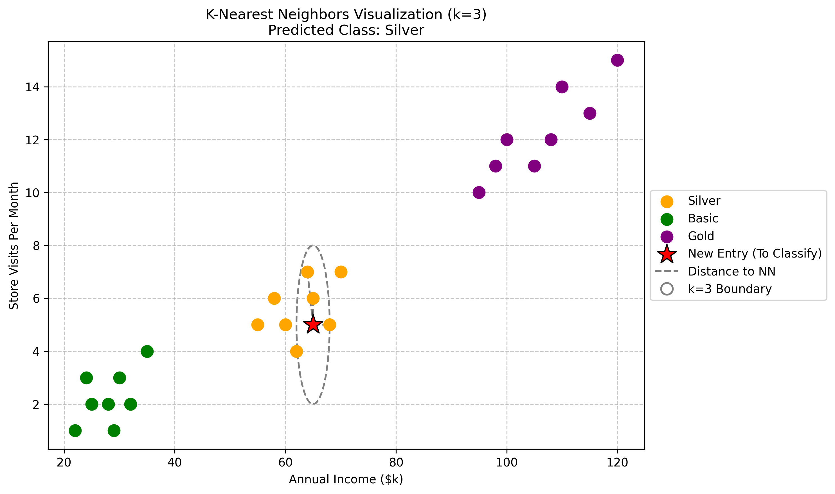
K-NN · VISUAL
Group 14
K-Nearest Neighbors in action
PREDICTED CLASS
Silver
All 3 nearest neighbors are Silver tier.
K VALUE
3
The dashed circle bounds the 3 closest points.
NEW POINT
(65, 5)
The red ★ — the customer to classify.
9 / 21

Slide 10
PART 02
K-Means Clustering
Group customers into K segments by repeatedly assigning points to the nearest centroid and recomputing the centroid.

Slide 11
K-MEANS · STEP 1
Group 14
Transform the dataset into a working table
30 customers, two features: Annual Income and Spending Score.
Pt | X (Income) | Y (Spend)
P1 | 15 | 39
P2 | 15 | 81
P3 | 16 | 6
P4 | 16 | 77
P5 | 17 | 40
P6 | 17 | 76
P7 | 18 | 6
P8 | 18 | 94
P9 | 19 | 3
P10 | 19 | 72
Pt | X (Income) | Y (Spend)
P11 | 40 | 55
P12 | 42 | 50
P13 | 45 | 45
P14 | 48 | 51
P15 | 50 | 49
P16 | 55 | 55
P17 | 60 | 45
P18 | 62 | 51
P19 | 65 | 55
P20 | 68 | 50
Pt | X (Income) | Y (Spend)
P21 | 70 | 10
P22 | 72 | 90
P23 | 75 | 15
P24 | 78 | 85
P25 | 80 | 20
P26 | 85 | 95
P27 | 88 | 18
P28 | 95 | 90
P29 | 100 | 15
P30 | 110 | 88
11 / 21

Slide 12
K-MEANS · STEP 2
Group 14
Initialize K centroids
We pick K = 5 starting centers — randomly chosen from the dataset (seed = 42 for reproducibility).
C1
C2
C3
C4
C5
X (Income)
X (Income)
X (Income)
X (Income)
X (Income)
70.0
16.0
15.0
78.0
19.0
Y (Spending)
Y (Spending)
Y (Spending)
Y (Spending)
Y (Spending)
10.0
77.0
39.0
85.0
3.0
DISTANCE FORMULA — same Euclidean distance we used for K-NN
$$d\left(P,C\right)=\sqrt{\left({\left(X_{P}−X_{C}\right)}^{2}+{\left(Y_{P}−Y_{C}\right)}^{2}\right)}$$
12 / 21

Slide 13
K-MEANS · STEP 3
Group 14
Compute the distance & determine cluster
For every point, measure the distance to every centroid. The smallest distance wins — that point joins that cluster.
Point | d→C1 (70,10) | d→C2 (16,77) | d→C3 (15,39) | d→C4 (78,85) | d→C5 (19,3) | Cluster
P1 (15,39) | 62.18 | 38.01 | 0 | 78.01 | 36.22 | C3
P2 (15,81) | 89.81 | 4.12 | 42 | 63.13 | 78.1 | C2
P3 (16,6) | 54.15 | 71 | 33.02 | 100.42 | 4.24 | C5
P4 (16,77) | 86.05 | 0 | 38.01 | 62.51 | 74.06 | C2
P11 (40,55) | 54.08 | 32.56 | 29.68 | 48.41 | 56.08 | C3
P17 (60,45) | 36.4 | 54.41 | 45.4 | 43.86 | 58.69 | C1
P21 (70,10) | 0 | 86.05 | 62.18 | 75.43 | 51.48 | C1
P22 (72,90) | 80.02 | 57.49 | 76.49 | 7.81 | 101.87 | C4
P24 (78,85) | 75.43 | 62.51 | 78.01 | 0 | 101.02 | C4
P26 (85,95) | 86.31 | 71.31 | 89.64 | 12.21 | 113.23 | C4
… computed for all 30 points …
Highlighted cells = the smallest distance for that row → that point joins that cluster.
13 / 21

Slide 14
K-MEANS · STEP 4
Group 14
Compute again — determine new centroids
Each new centroid is the average (mean) X and Y of all points assigned to its cluster.
$C_{new}$= ( mean(X) of cluster points, mean(Y) of cluster points )
Centroid | Old (X, Y) |  | New (X, Y) | How it moved
C1 | (70.00, 10.00) | → | (78.83, 20.50) | Pulled right & up
C2 | (16.00, 77.00) | → | (17.00, 80.00) | Slight nudge upward
C3 | (15.00, 39.00) | → | (36.71, 47.00) | Pulled toward middle cluster
C4 | (78.00, 85.00) | → | (76.67, 73.22) | Pulled downward
C5 | (19.00, 3.00) | → | (17.67, 5.00) | Barely moved
↻ Loop: Now go back to Step 2 with these new centroids and repeat. We stop when no point changes cluster.
14 / 21

Slide 15
K-MEANS · ITERATION 2
Group 14
Repeat Step 2 → Step 3
STEP 2 — Centroids (updated)
STEP 3 — Re-assign each point to its nearest new centroid
C1
( 78.83, 20.50 )
Point | d→C1 | d→C2 | d→C3 | d→C4 | d→C5 | Cluster
P1 (15,39) | 66.46 | 41.05 | 23.14 | 70.53 | 34.1 | C3
P2 (15,81) | 87.95 | 2.24 | 40.34 | 62.16 | 76.05 | C2
P3 (16,6) | 64.48 | 74.01 | 45.93 | 90.55 | 1.95 | C5
P11 (40,55) | 48.69 | 33.3 | 8.73 | 40.07 | 53.79 | C3
P17 (60,45) | 31.71 | 57.18 | 23.41 | 32.18 | 58.43 | C3
P21 (70,10) | 13.93 | 86.97 | 50.4 | 63.65 | 52.55 | C1
P24 (78,85) | 64.5 | 61.2 | 53.73 | 11.84 | 102.04 | C4
… continues for all 30 points …
C2
( 17.00, 80.00 )
C3
( 36.71, 47.00 )
C4
( 76.67, 73.22 )
C5
( 17.67, 5.00 )
Some points changed cluster — so we have to keep going.
15 / 21

Slide 16
K-MEANS · ITERATION 2
Group 14
Compute again — determine new centroids
After re-assigning all 30 points, average the X and Y again to get the next set of centroids.
Centroid | After Iter 1 |  | After Iter 2 | Notes
C1 | (78.83, 20.50) | → | (82.50, 16.50) | Tightening on low-spend cluster
C2 | (17.00, 80.00) | → | (17.00, 80.00) | Already stable
C3 | (36.71, 47.00) | → | (47.25, 48.75) | Sliding toward middle group
C4 | (76.67, 73.22) | → | (86.40, 88.20) | Settling on high-spend group
C5 | (17.67, 5.00) | → | (17.67, 5.00) | Already stable
PROGRESS
Iter 1
Iter 2
Iter 3
Iter 4
Converged
16 / 21

Slide 17
K-MEANS · ITERATION 3
Group 14
Repeat — and watch the changes shrink
Step 2 — Centroids (after Iter 2 → used in Iter 3)
STEP 3 — Re-assignment
C1
( 82.50, 16.50 )
Most points stay in the same cluster as Iteration 2.
POINTS THAT CHANGED CLUSTER
C2
( 17.00, 80.00 )
a few
C3
( 47.25, 48.75 )
STEP 4 — New centroids drift only slightly from Iteration 2 values.
C4
( 86.40, 88.20 )
→ One more iteration and the centroids stop changing entirely. That's convergence.
C5
( 17.67, 5.00 )
17 / 21

Slide 18
K-MEANS · ITERATION 4
Group 14
Compute again — and converge
In Iteration 4 the cluster assignments are identical to Iteration 3 → K-Means has converged.
Centroid | Final X | Final Y | Cluster Meaning
C1 | 82.60 | 15.60 | High income · low spending
C2 | 17.00 | 80.00 | Low income · high spending
C3 | 47.25 | 48.75 | Middle income · middle spending
C4 | 88.00 | 89.60 | High income · high spending (target)
C5 | 17.67 | 5.00 | Low income · low spending
CONVERGED
✓
No point switched clusters between iterations 3 and 4 — the algorithm stops.
18 / 21

Slide 19
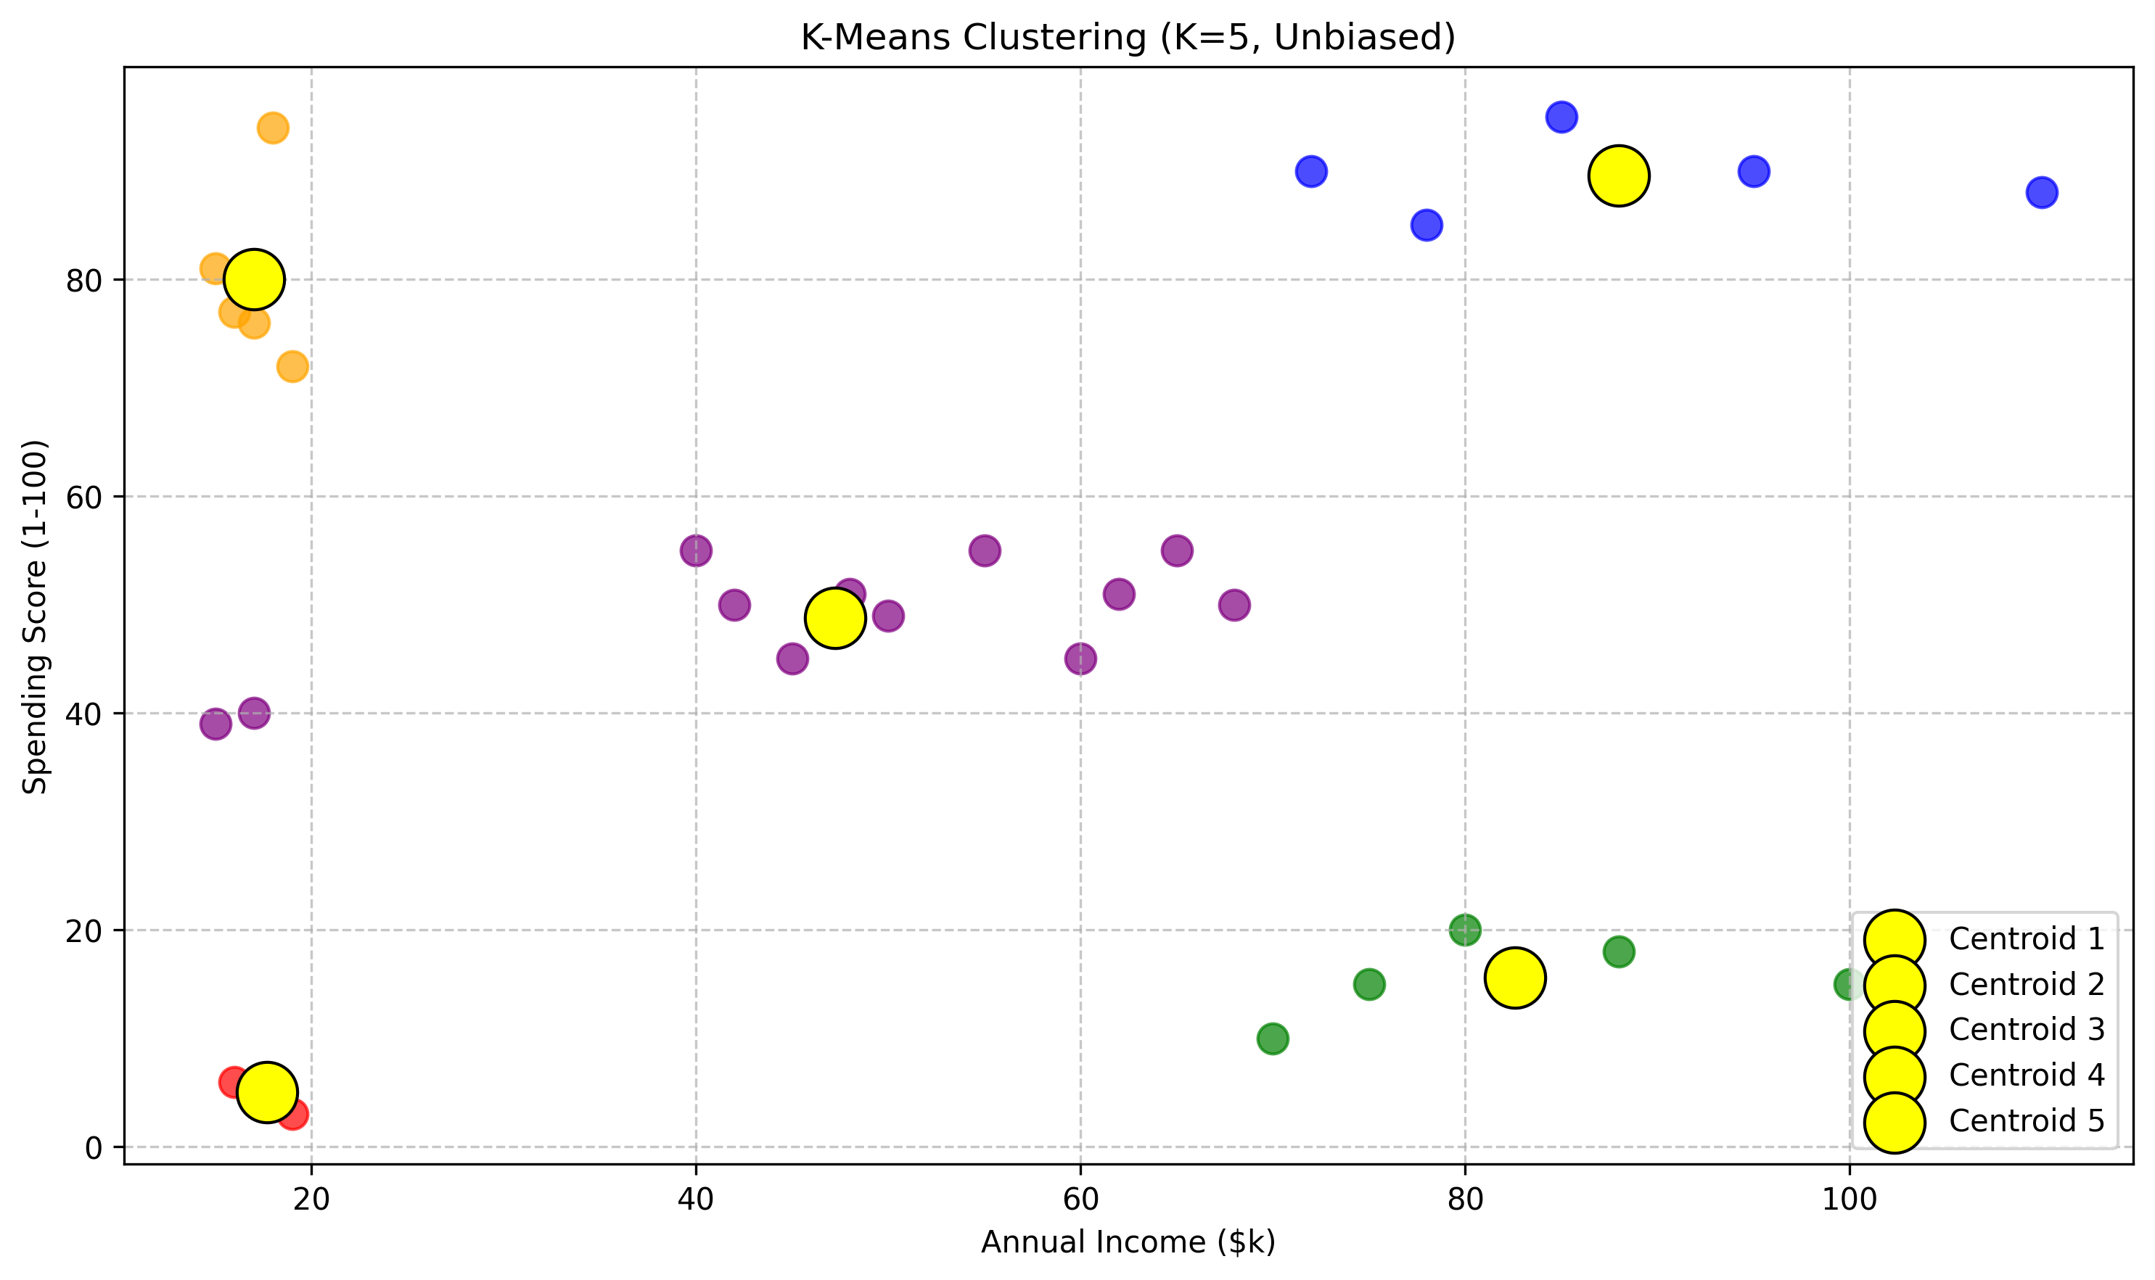
K-MEANS · FINAL
Group 14
Final clusters — K-Means in action
5 CUSTOMER SEGMENTS
Cluster 1
High income · low spending
Cluster 2
Low income · high spending
Cluster 3
Middle income · middle spending
Cluster 4
High income · high spending
Cluster 5
Low income · low spending
19 / 21

Slide 20
RECAP
Group 14
K-NN vs K-Means — at a glance
 | K-Nearest Neighbors | K-Means
Type of learning | Supervised — labels exist | Unsupervised — no labels
What it does | Predicts the class of one new point | Groups all points into K clusters
Uses 'K' for | Number of neighbors that vote | Number of clusters to find
Training step | None — just remembers the data | Iterates until centroids stabilize
Output | A label for the new entry | Centroids + cluster assignments
Our example | Customer (65k, 5 visits) → Silver | 30 customers → 5 segments
Same Euclidean distance under the hood — but very different goals.
20 / 21

Slide 21
THANK YOU
Group 14 · K-NN & K-Means walkthrough
Martin
Apal
Bolansoy
Group 14 — Member
Group 14 — Member
Group 14 — Member

