Slide 1
K-NN & K-Means
CLASSIFICATION & CLUSTERING ON REAL AUTO DATA
GROUP 14 PRESENTATION
Earl Lenser B. Bolansoy
Renier P. Apal
Rodnee Glen A. Martin
Dataset: Automobile (193 cars · 3 features · price-tier classes)

Slide 2
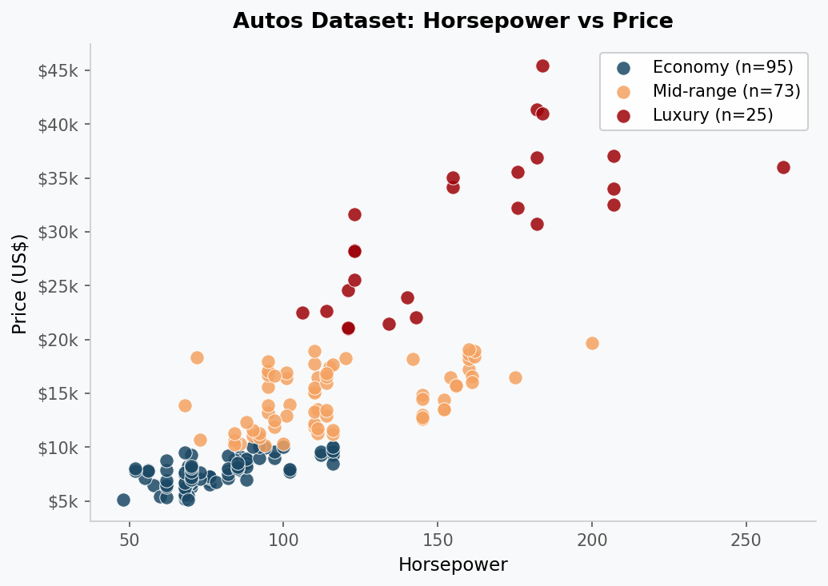
DATASET OVERVIEW
193
Cars in dataset (full file)
3
Features: HP · MPG · Price
3
Classes: Economy · Mid · Luxury
Real-world dataset → values span widely (Price 5K–45K, HP 48–262), so we apply min-max scaling before computing distances.

Slide 3
K-NEAREST NEIGHBOURS — HOW IT WORKS
1
Compute Distance
Euclidean Distance
Calculate Euclidean distance from the new car to every training car.
d(p, q) = √ Σᵢ (pᵢ − qᵢ)²
Applied here over 3 features:
horsepower, highway_mpg, price (all min-max scaled to [0, 1])
2
Sort by Distance
Rank all training cars by how close they are (ascending order).
3
Select k Neighbours
💡 Key Properties
Pick the k closest cars. We use k = 5 in this project.
▸ Supervised — needs labelled training data
▸ Non-parametric — no model is trained
▸ Lazy learner — computes at prediction time
▸ Sensitive to feature scale — we min-max normalised
▸ Odd k avoids ties when classes split evenly
4
Majority Vote
Count class labels among the k neighbours. Most frequent label wins.
5
Assign Class
Assign the winning class (Economy / Mid-range / Luxury) to the new car.

Slide 4
K-NN — CODE IMPLEMENTATION
# ① Euclidean distance (n-dim)
def euclidean(a, b):
return math.sqrt(sum(
(ai-bi)**2 for ai,bi in zip(a,b)))
# ② Predict a single car
def knn_predict(train_X, train_y,
test_pt, k=5):
distances = [
(euclidean(test_pt, tx), ty)
for tx, ty in zip(train_X, train_y)]
distances.sort(key=lambda x: x[0])
k_nearest = distances[:k]
votes = {}
for _, label in k_nearest:
votes[label] = votes.get(label,0)+1
return max(votes, key=votes.get)
# ③ Min-max scale (price ≫ mpg!)
def min_max_scale(X):
mins = [min(r[j] for r in X)
for j in range(len(X[0]))]
maxs = [max(r[j] for r in X)
for j in range(len(X[0]))]
return [[(r[j]-mins[j])/(maxs[j]-mins[j])
for j in range(len(r))] for r in X]
# ④ Evaluate on test set
def knn_evaluate(tr_X, tr_y,
te_X, te_y, k=5):
preds = [knn_predict(tr_X, tr_y, tp, k)
for tp in te_X]
correct = sum(p==t for p,t
in zip(preds, te_y))
return preds, correct/len(te_y)

Slide 5
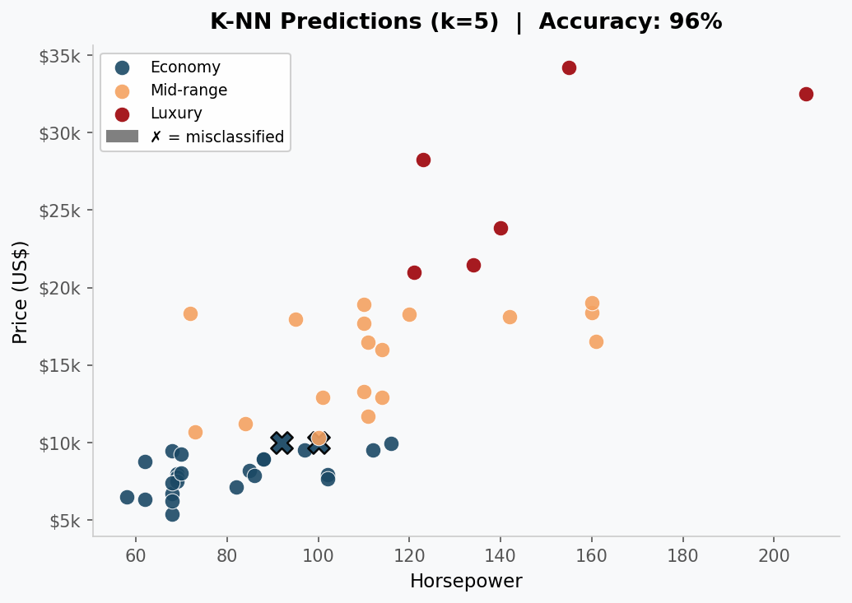
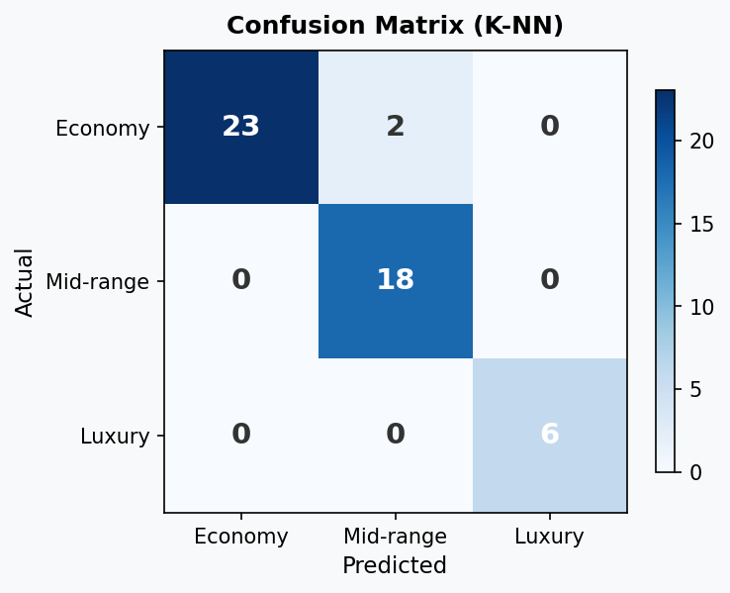
K-NN RESULTS (k = 5)
95.9%
144
49
5
Accuracy on test set
Train samples (75%)
Test samples (25%)
k (neighbours)

Slide 6
K-MEANS CLUSTERING — HOW IT WORKS
1
Choose k
WCSS Objective
Select the number of clusters k. We use k = 3.
J = Σᵢ Σₖ wᵢₖ ‖xᵢ − cₖ‖²
Minimise Within-Cluster Sum of Squares.
Lower WCSS = tighter, better clusters.
2
Init Centroids
Randomly pick k cars as initial centroids.
3
Assign Points
Assign each car to the nearest centroid (Euclidean distance).
💡 Key Properties
4
Update Centroids
▸ Unsupervised — no labelled data needed
▸ Centroid-based clustering approach
▸ Pre-specify k (use Elbow Method to choose)
▸ Results may vary with random initialisation
Recompute each centroid as the mean of its assigned cars.
5
Repeat Until Stable
Iterate steps ③–④ until no car changes cluster.

Slide 7
K-MEANS — CODE IMPLEMENTATION
def kmeans(X, k=3, max_iter=100):
# ① Random initialisation
centroids = [list(X[i]) for i in
random.sample(range(len(X)), k)]
history = []
for iteration in range(max_iter):
# ② Assign each car
assignments = [
min(range(k),
key=lambda c:
euclidean(x, centroids[c]))
for x in X]
# ③ Recompute centroids
new_centroids = []
for c in range(k):
members = [X[i] for i
in range(len(X))
if assignments[i]==c]
if members:
new_centroids.append([
sum(m[d] for m in members)
/ len(members)
for d in range(len(X[0]))])
else:
new_centroids.append(
centroids[c])
history.append({'iteration':
iteration+1, 'centroids':
[list(c) for c in new_centroids]})
# ④ Check convergence
if new_centroids == centroids:
break
centroids = new_centroids
return centroids, assignments, history

Slide 8
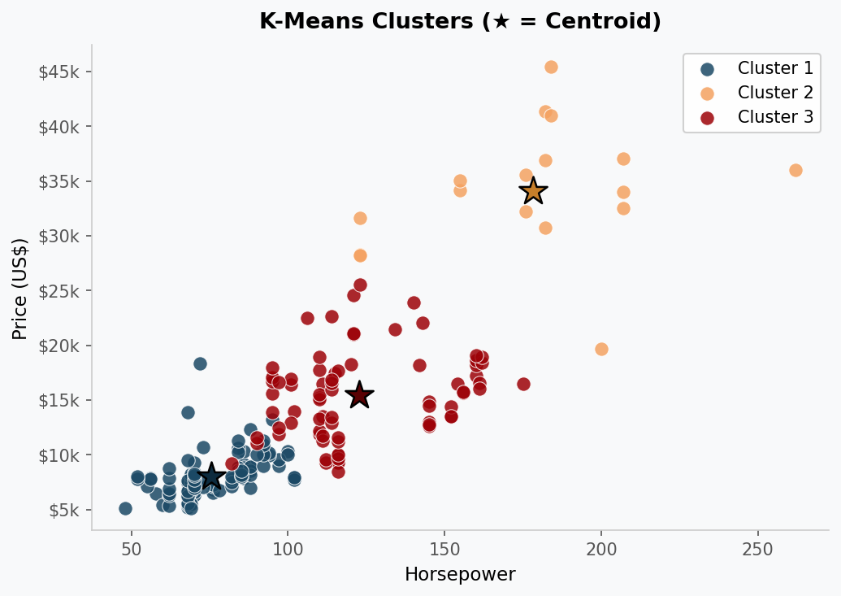
K-MEANS RESULTS (k = 3)
193
12
5.20
Cars Clustered
Iterations
Final WCSS (scaled)
Cluster | HP | MPG | Price
C1 (Economy) | 75.6 | 35.9 | $8,036
C3 (Mid-range) | 122.8 | 26.3 | $15,439
C2 (Luxury) | 178.1 | 21.2 | $34,098
Discovered clusters align almost perfectly with the price-tier classes — K-Means rediscovered the segments without using labels.

Slide 9
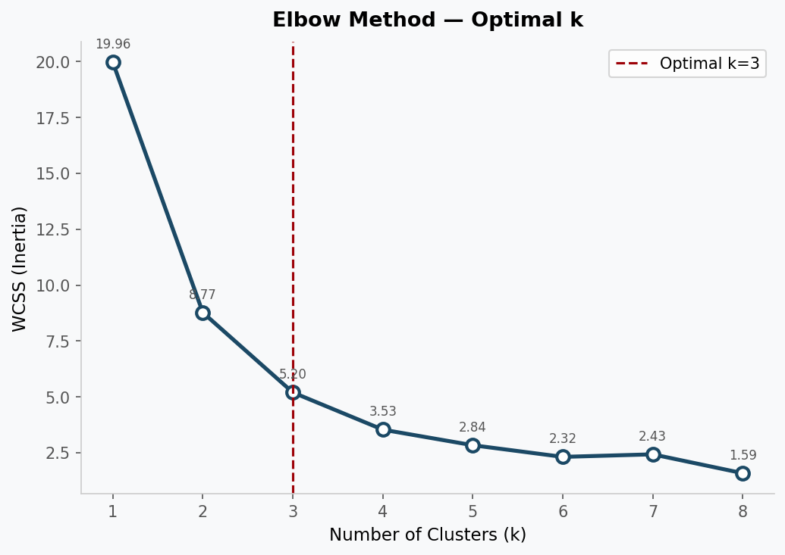
ELBOW METHOD — CHOOSING OPTIMAL k
What is WCSS?
Within-Cluster Sum of Squares measures total variance inside clusters. Lower = tighter clusters.
Why k = 3?
WCSS drops sharply 19.96 → 8.77 → 5.20, then flattens. The bend at k=3 marks diminishing returns.
How to use it?
Run K-Means for k = 1..N, plot WCSS, pick the elbow point. Aligns with our 3 price tiers.

Slide 10
ALGORITHM COMPARISON
K-Nearest Neighbours
K-Means Clustering
Type:
Supervised Classification
Type:
Unsupervised Clustering
Input:
Labelled training data
Input:
Unlabelled data
Output:
Class label for new cars
Output:
Cluster assignments
Distance:
Euclidean (default)
Distance:
Euclidean to centroid
Parameter:
k = number of neighbours
Parameter:
k = number of clusters
Accuracy:
95.9% on test set
Convergence:
12 iterations
Complexity:
O(n·d) per prediction
Inertia:
5.20 WCSS (scaled)

Slide 11
Key Takeaways
Key Takeaways
✓
K-NN achieved 95.9% accuracy
Real auto data has overlap between Economy and Mid-range — most errors happen at this boundary.
✓
K-Means converged in 12 iterations
Three clusters found centroids near $8K, $15K, $34K — matching the natural price tiers.
✓
Min-max scaling was essential
Without scaling, price (in thousands) would have dominated distance over HP and MPG.
✓
Elbow at k=3 confirmed
WCSS dropped from 19.96 to 5.20 (k=1→3) then flattened, validating our 3-segment model.
Built with Python · matplotlib · Dataset: autos-k-means.csv (193 cars)

