Slide 1



Broken Team building event. 17 Feb 2023
And we are succeeded... it is really BROKEN

Slide 2
The Team
Móni
Attila
Beni
Dani
Gábor

Slide 3
Stack
Spring boot
H2
Swing
Angular
Integration with REST

Slide 4
Idea: show the value of Your shares, which You have invested earlier. PS: Maybe it is not the best time to check Your stock ☺

Slide 5

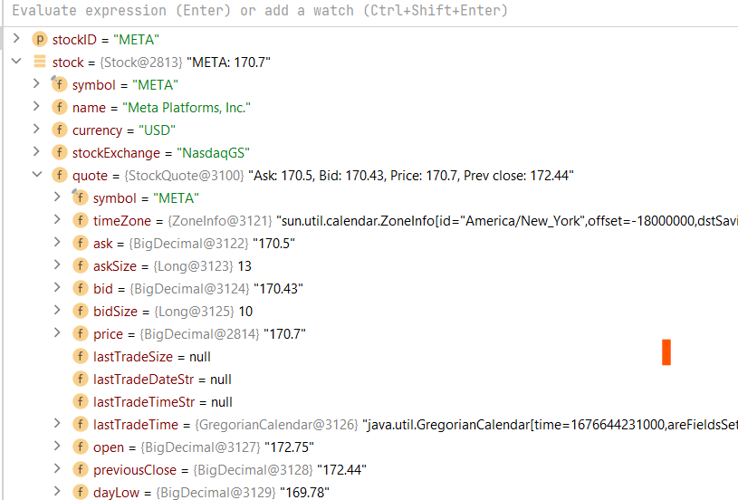
We use Yahoo

Slide 6
We store for You
Stock id
Amount
Buy price, cost, date
Sell price, cost, date

Slide 7
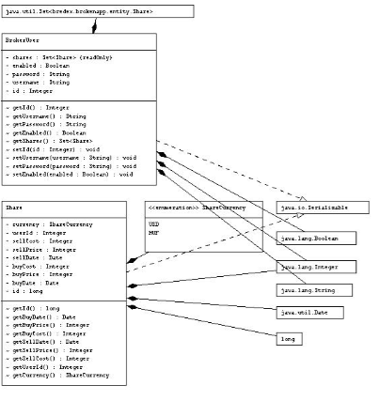

Slide 8
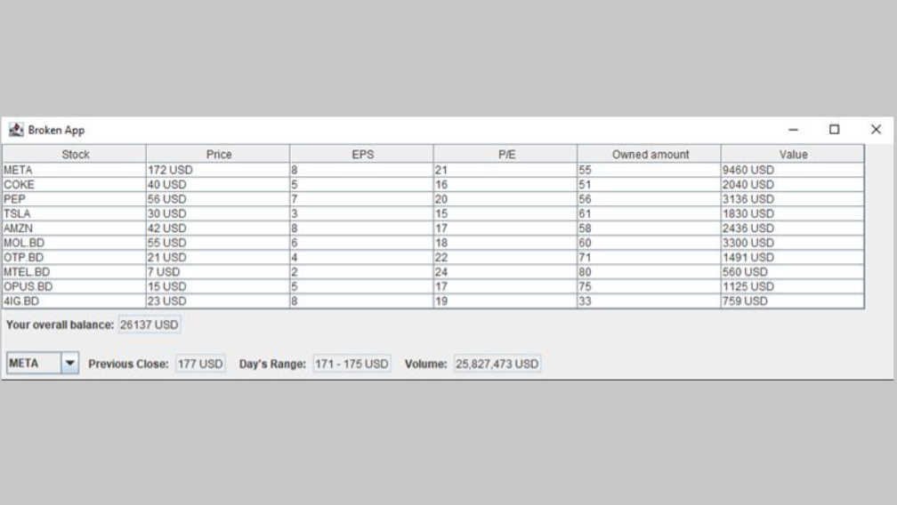
Swing

Slide 9
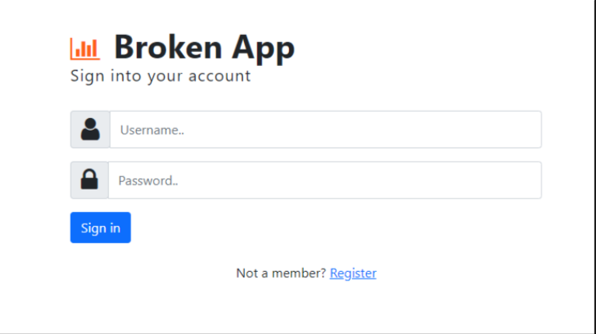
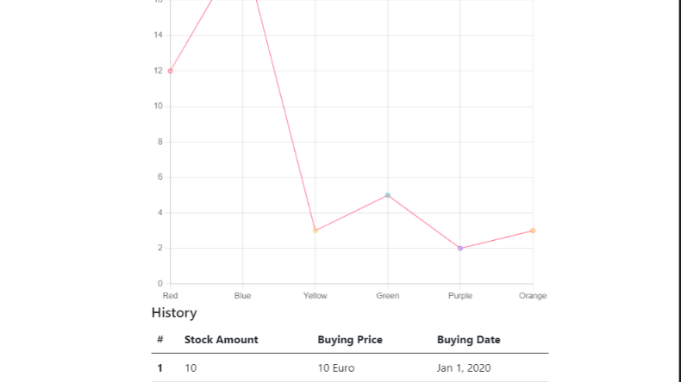
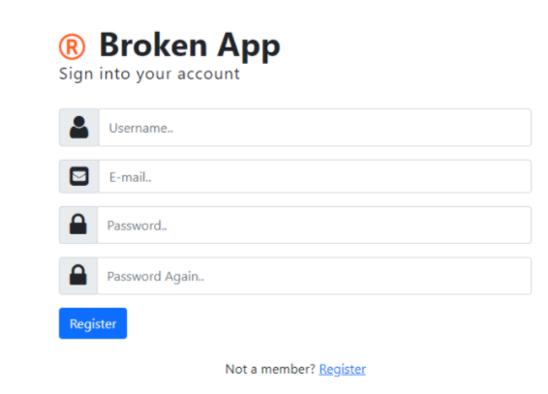
Angular

Slide 10
We loved to work in the team of Broken. ❤️

