Slide 1
Introduction to Light and it’s Interactions with Matter
Brent Smith
Rodolfo Ferro
Clubes de Ciencia Guanajuato 2019
07/29/2019

Slide 2
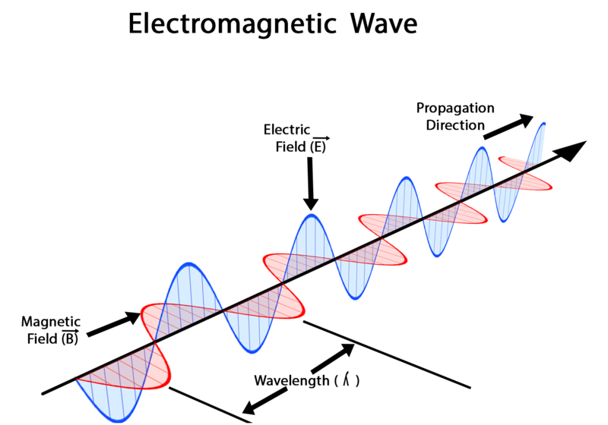
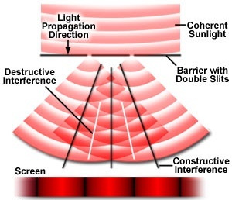
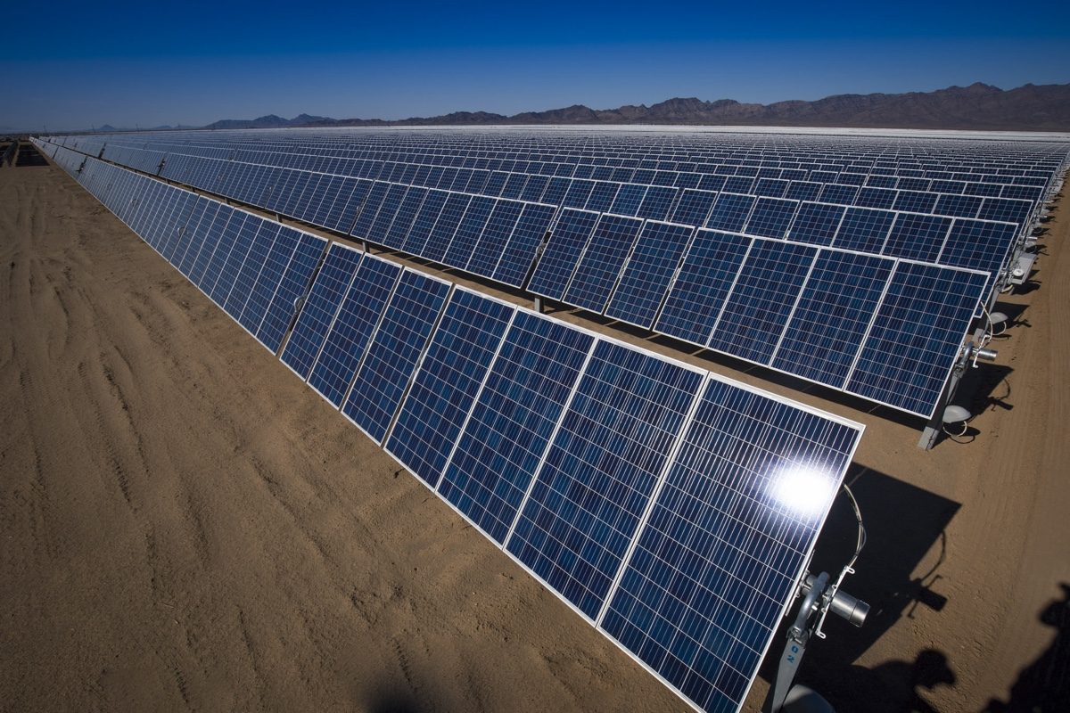

What is light?
$c=λν$
Waves:
Energy:
Particles: “photons” can interact with atoms one at a time
c=speed
λ=wavelength
ν=frequency
$E=hν$

Slide 3
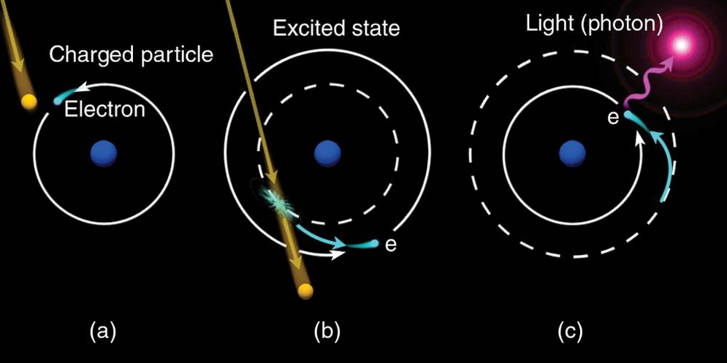
Creation
Atoms with extra energy can emit photons
Accelerating electrons radiate light

Slide 4
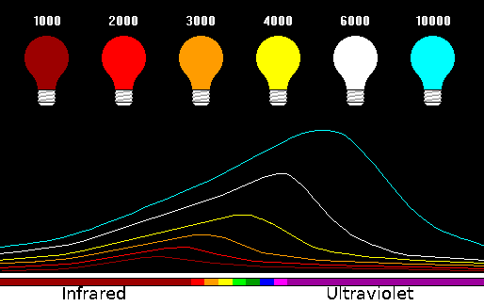
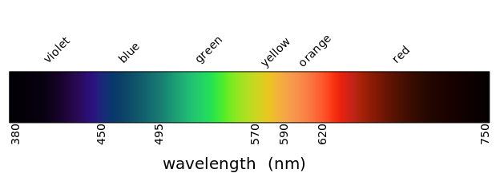
Creation
Electrons accelerate when heated: Thermal radiation
Electrons vibrate randomly in a material at some temperature
Random motions fall into a distribution defined by the temp
A distribution of brightness over all wavelengths is a spectrum

Slide 5
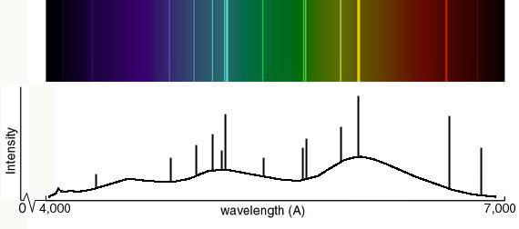
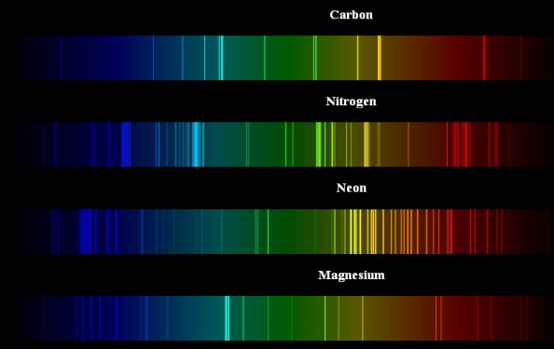
Spectra
Much can be learned from the spectra of objects
Which atoms or molecules exist in the object
It’s temperature, microscopic structures, magnetic/electric fields
Much can be inferred from spectra
With physical models: age, sizes, mass,
distance, speed

Slide 6
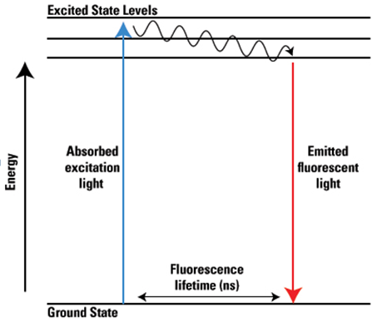
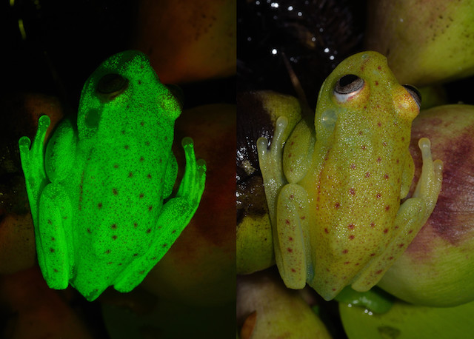

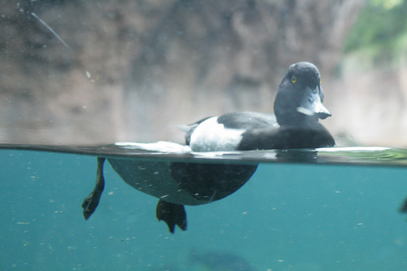
Interactions of Atoms and Light
Absorption
Atoms absorb exact wavelengths of light (can re-emit)
Fluorescence, lasers:
Scattering
1) Reflection 2) Refraction

Slide 7
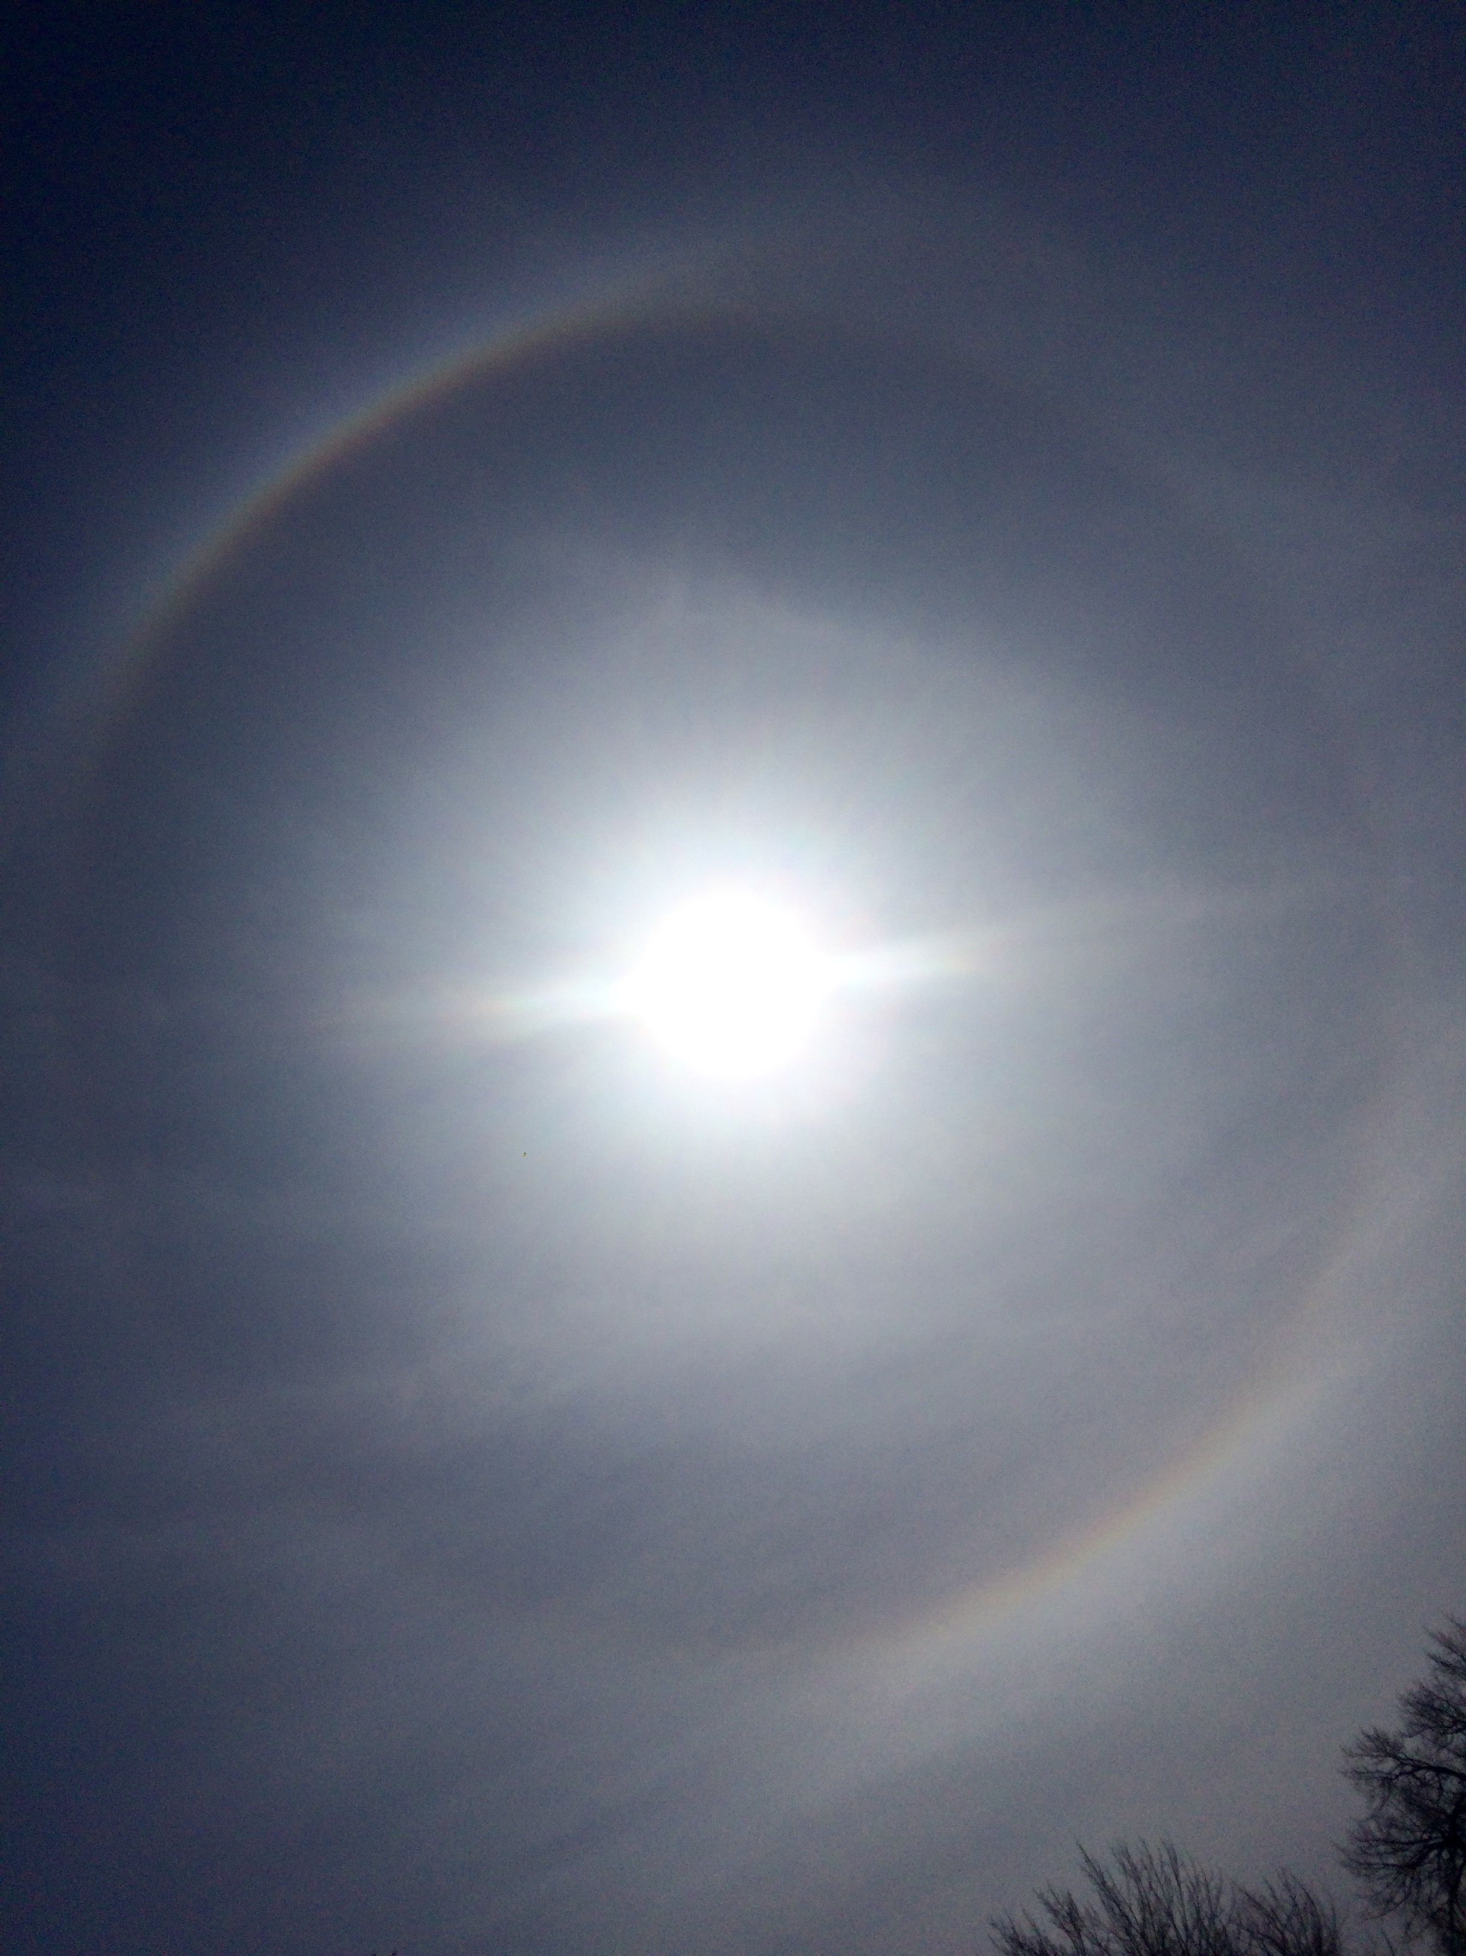
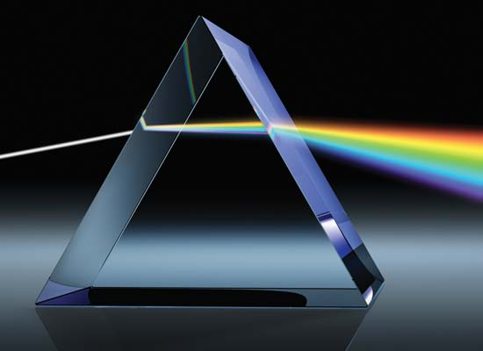
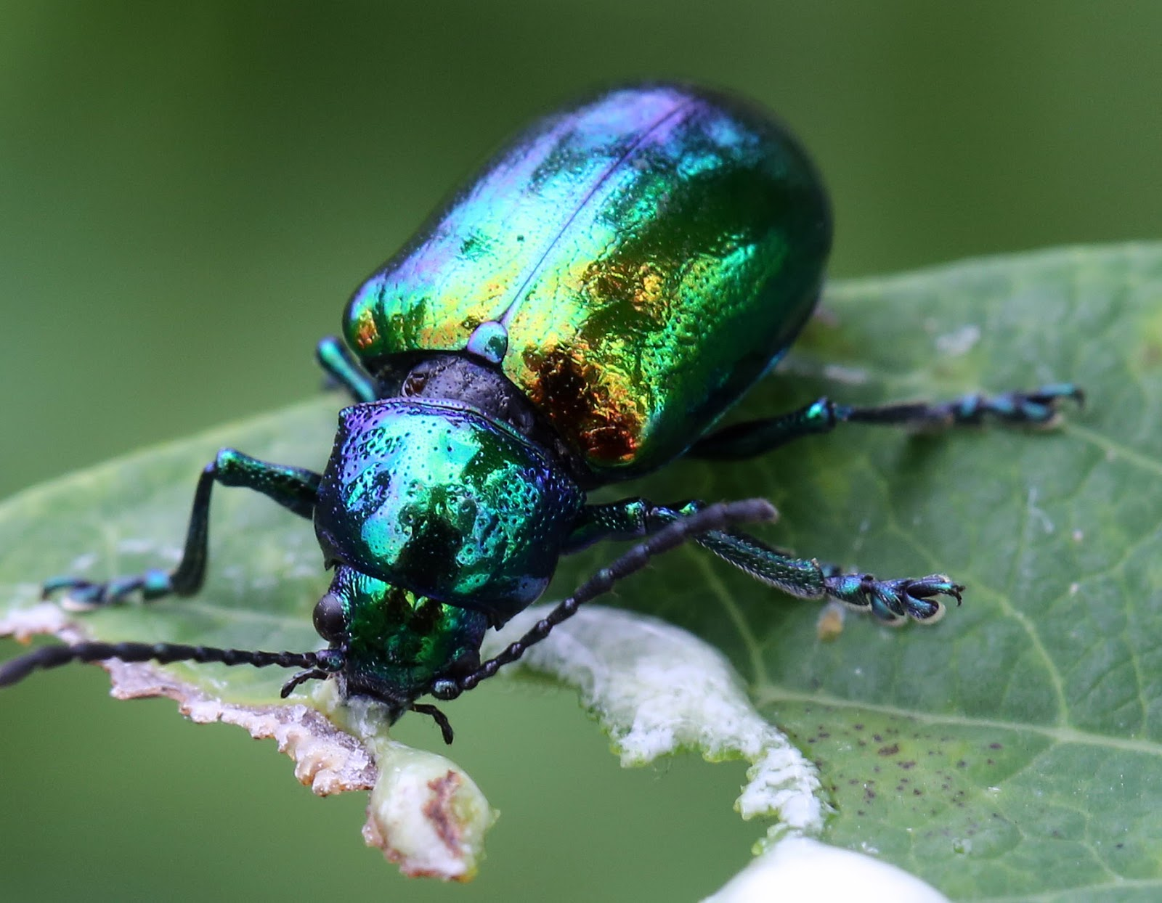
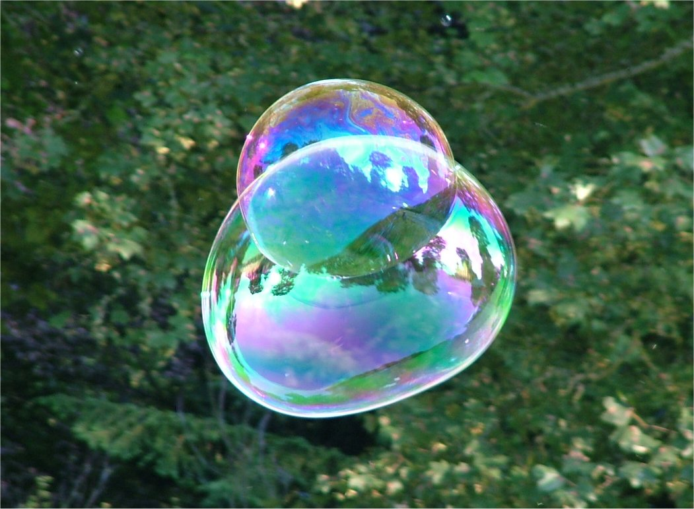

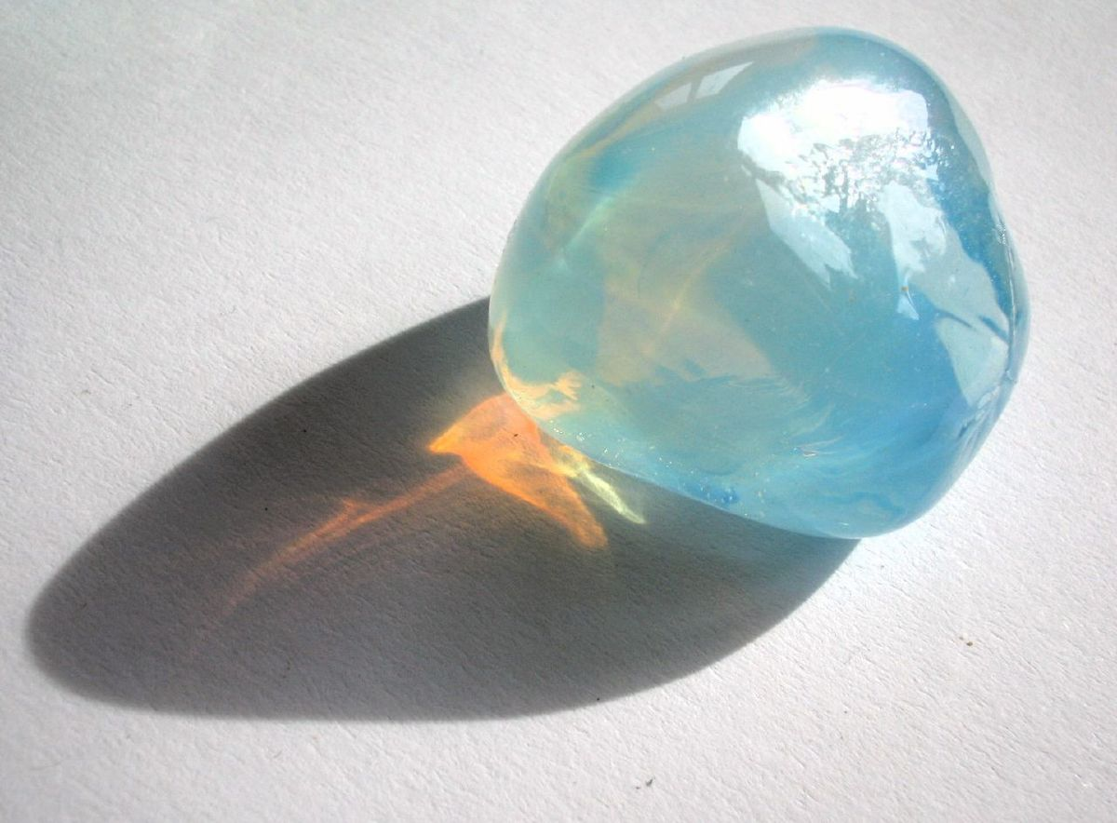
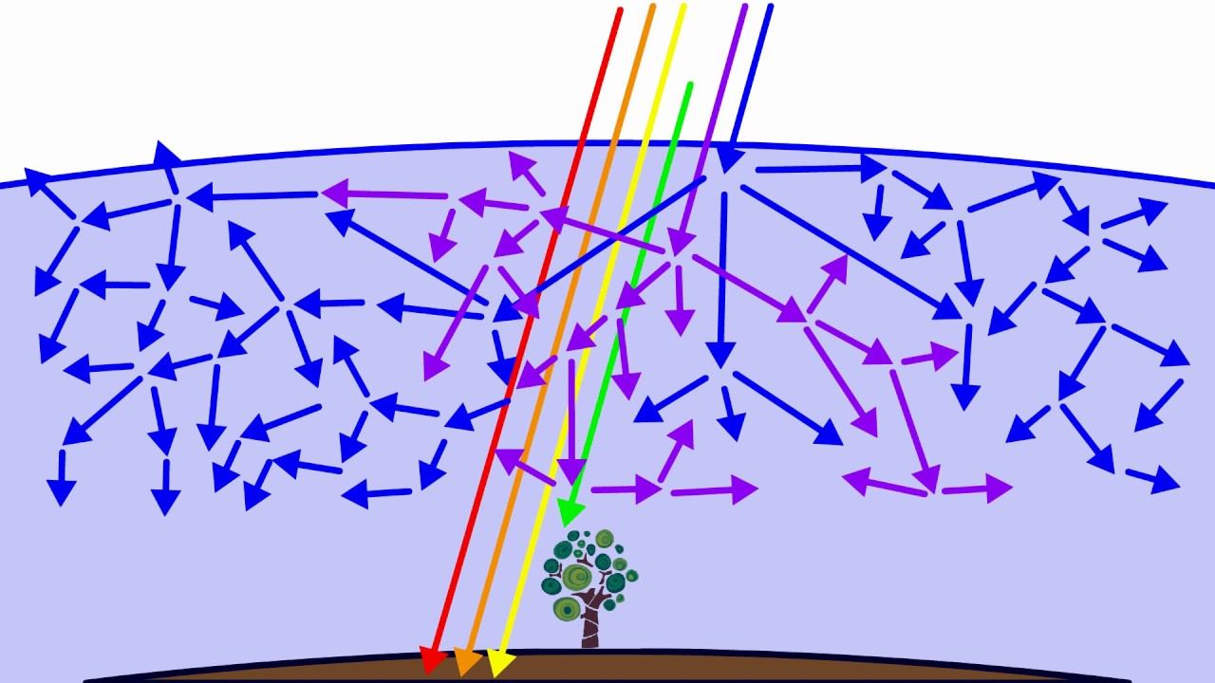
Scattering Based on Wavelength
Dispersion (scattering at different angles)
Iridescence (interference of light waves)
Rayleigh Scattering (Why the sky is blue, and sunsets are orange)

Slide 8
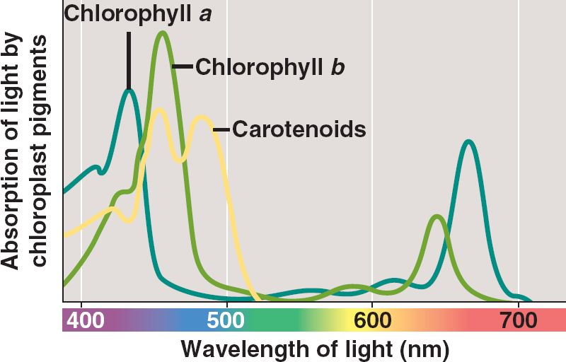
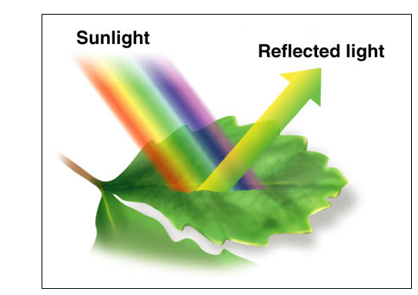
Absorption and Reflection
In spectra
In pictures

