Slide 1
Brent Smith
Arizona State University
Rodolfo Ferro
Universidad de Guanajuato
Hyperspectral Cameras:
Technology and Application
Clubes de Ciencia
Guanajuato 2019
July 29 2019

Slide 2
Outline
Part 1:
Opitcs: Lenses, Filters,
CCD physics: photoelectric effect, semiconductor bandgaps, digitization
Hyperspectral cameras and applications
The MCAW hyperspectral camera and demonstration
How eyes see light: humans and other animals
Part 2:
Introduction to programming in Python
Importing images into Python, manipulation with numpy, skimage, and opencv
Displaying, adjusting, and saving images with matplotlib

Slide 3
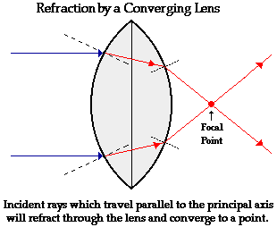
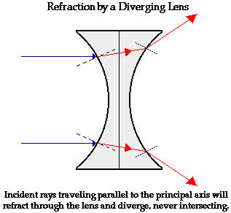
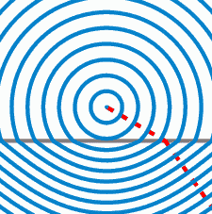
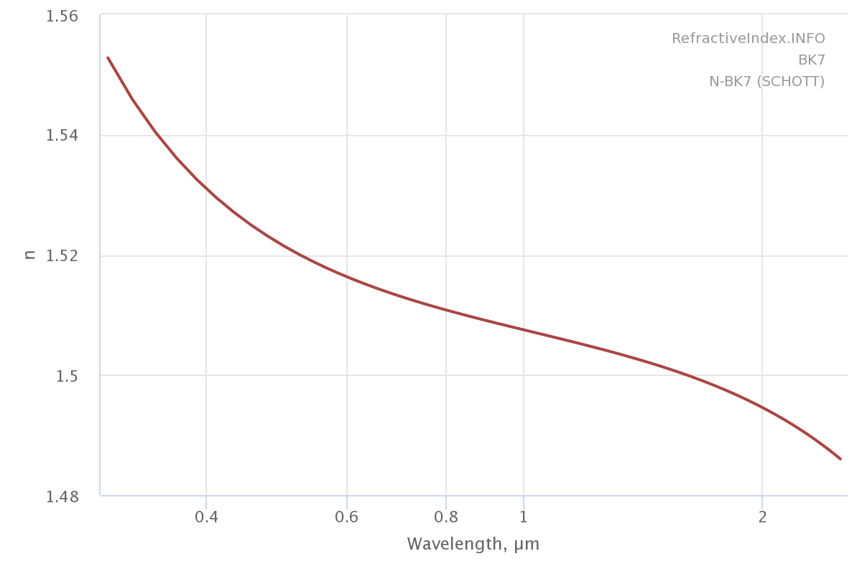
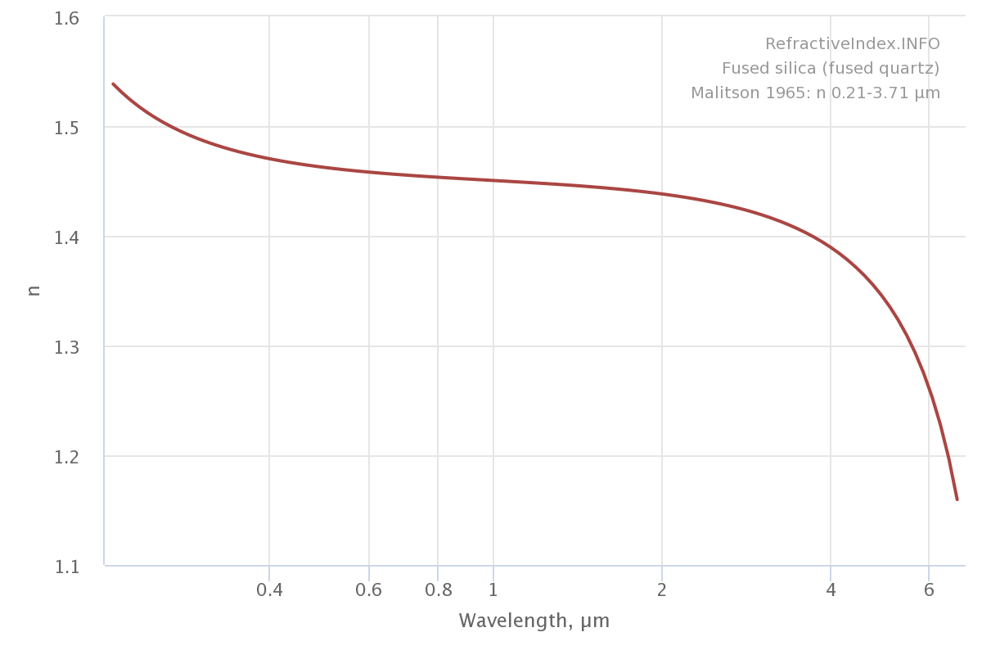
Lenses
How do lenses work? Refraction
Refractive index:

Slide 4
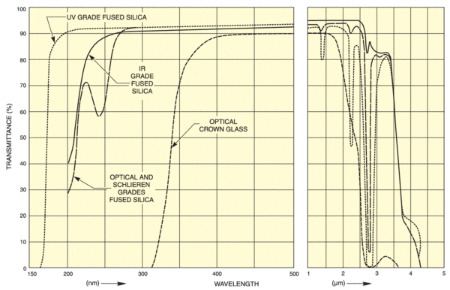
Lenses
Transmission

Slide 5
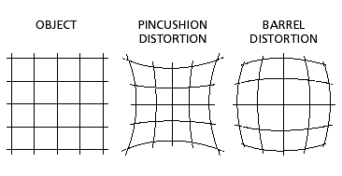
Lenses
Distortion
Cause: light at the edge of the lens bends more than it does in the center of the lens

Slide 6
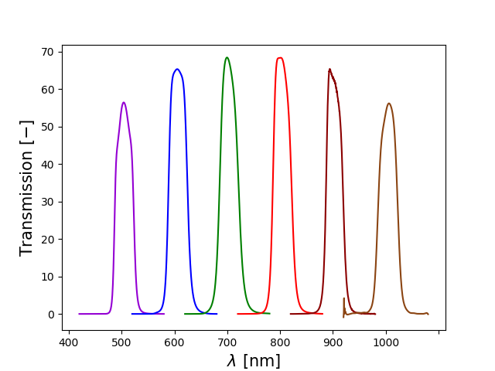
Filters
Dichroic filters are made by coating a glass with a series of coatings that reflect or destructively interfere the unwanted light and transmit the rest.

Slide 7
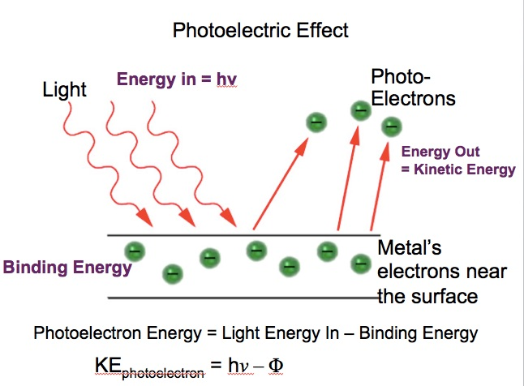
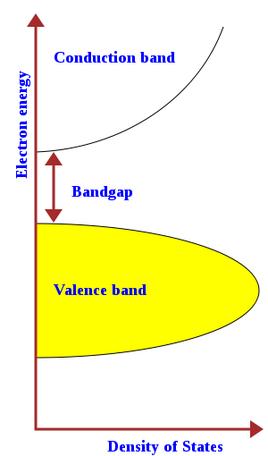
Photoelectric Effect
Light causes electrons to leave the surface of solids

Slide 8
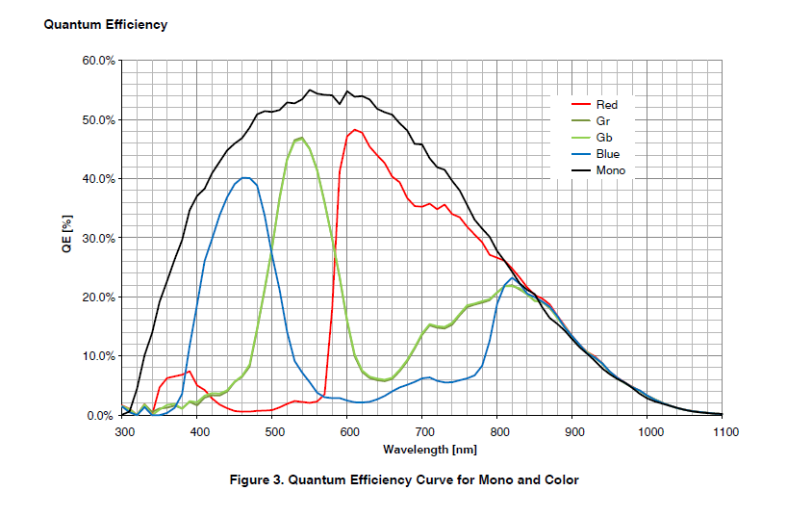
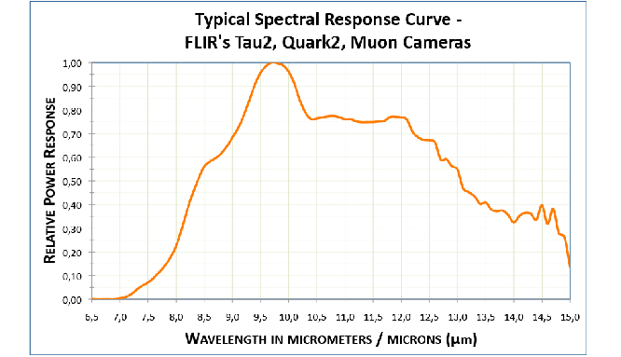
Spectral Response

Slide 9
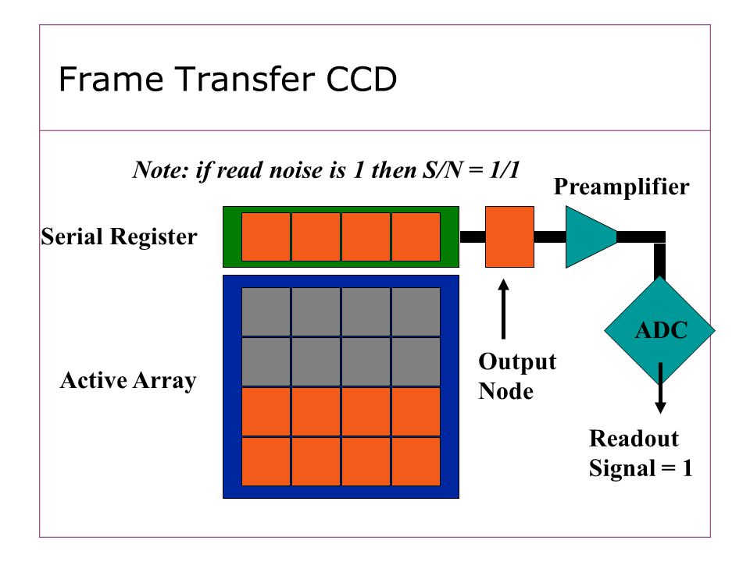
CCD Readout and Digitization
CCDs then convert electrons into digits

Slide 10
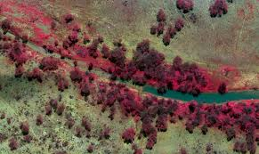
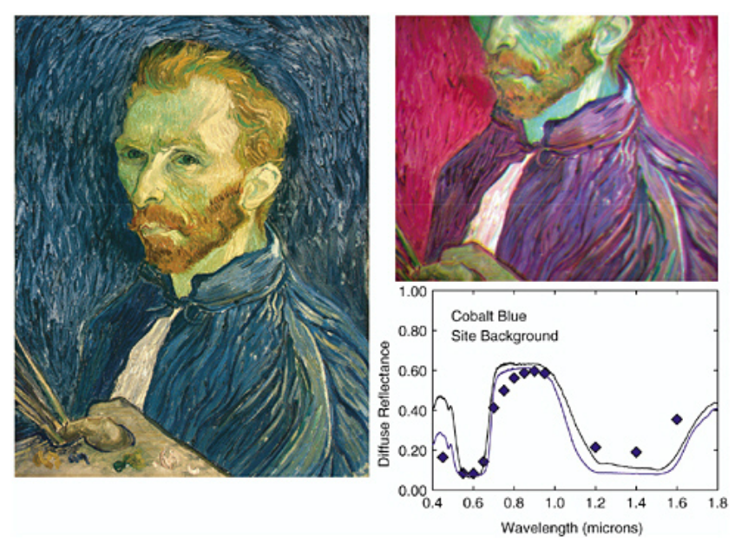
Hyperspectral Cameras
Collect several colors of light in one area
Measure low resolution spectrum in images
Best for absorption and reflection spectra
Used primarily in remote sensing, botany, and agriculture

Slide 11
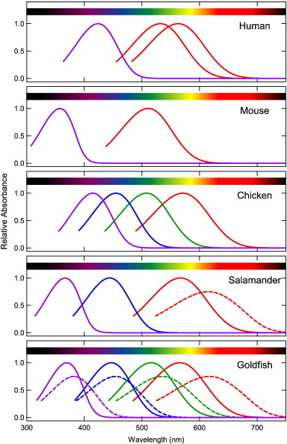
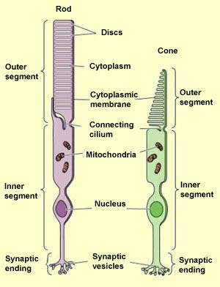
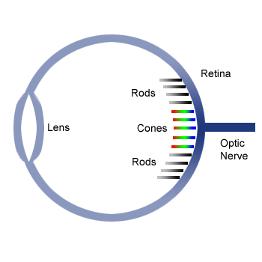
How eyes see light
Cones produce colors, rods see black and white
Contain photo-sensitive chemicals called color pigments, rods contain rhodopsin
Humans have 3 color pigments, exact
chemicals vary between people

Slide 12
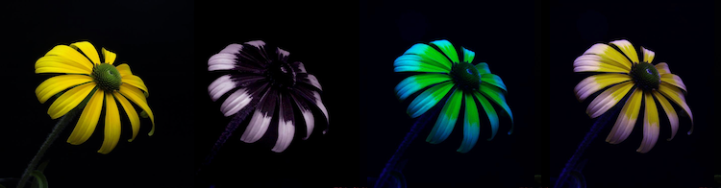
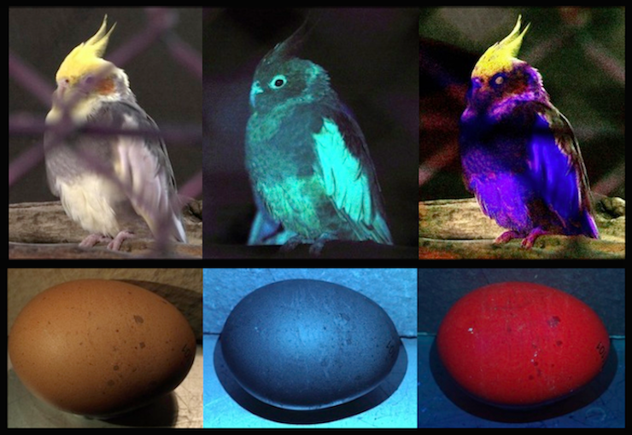
How birds and bees see
From Left to Right: Human vision, only UV vision, simulated bee vision (UV+G+B), simulated bird vision (tetrachromatcic: UV+R+G+B).
From Left to Right: human vision (R+G+B),
only UV vision, simulated bird vision
(tetrachromatcic: UV+R+G+B)
the egg on the bottom right is not true bird
vision, but UV simulated vision
Photos: (c) Dr Klaus Schmitt, Weinheim,
Germany, uvir.eu

Slide 13
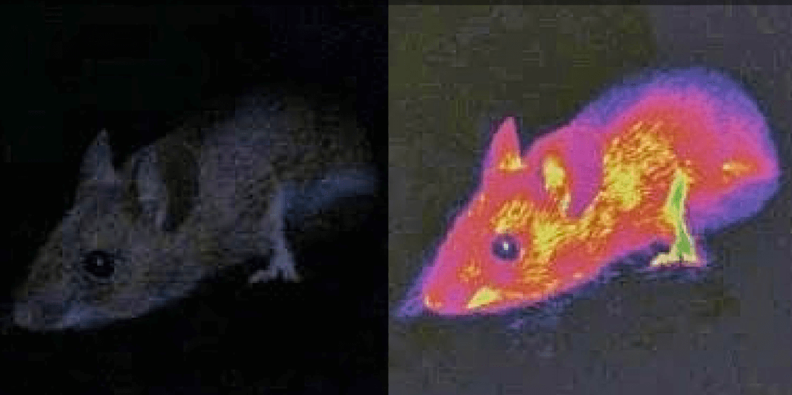
How snakes see

