Slide 1
Microproject - 2
JavaScript Frameworks
Github link: https://github.com/Rodolfowolf/Microproject2.git

Slide 2
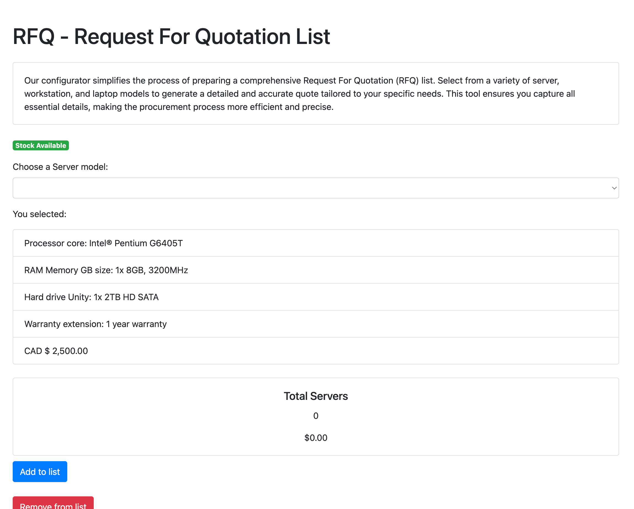
index.html
The user can choose the server by model, add items or remove items from list:

Slide 3
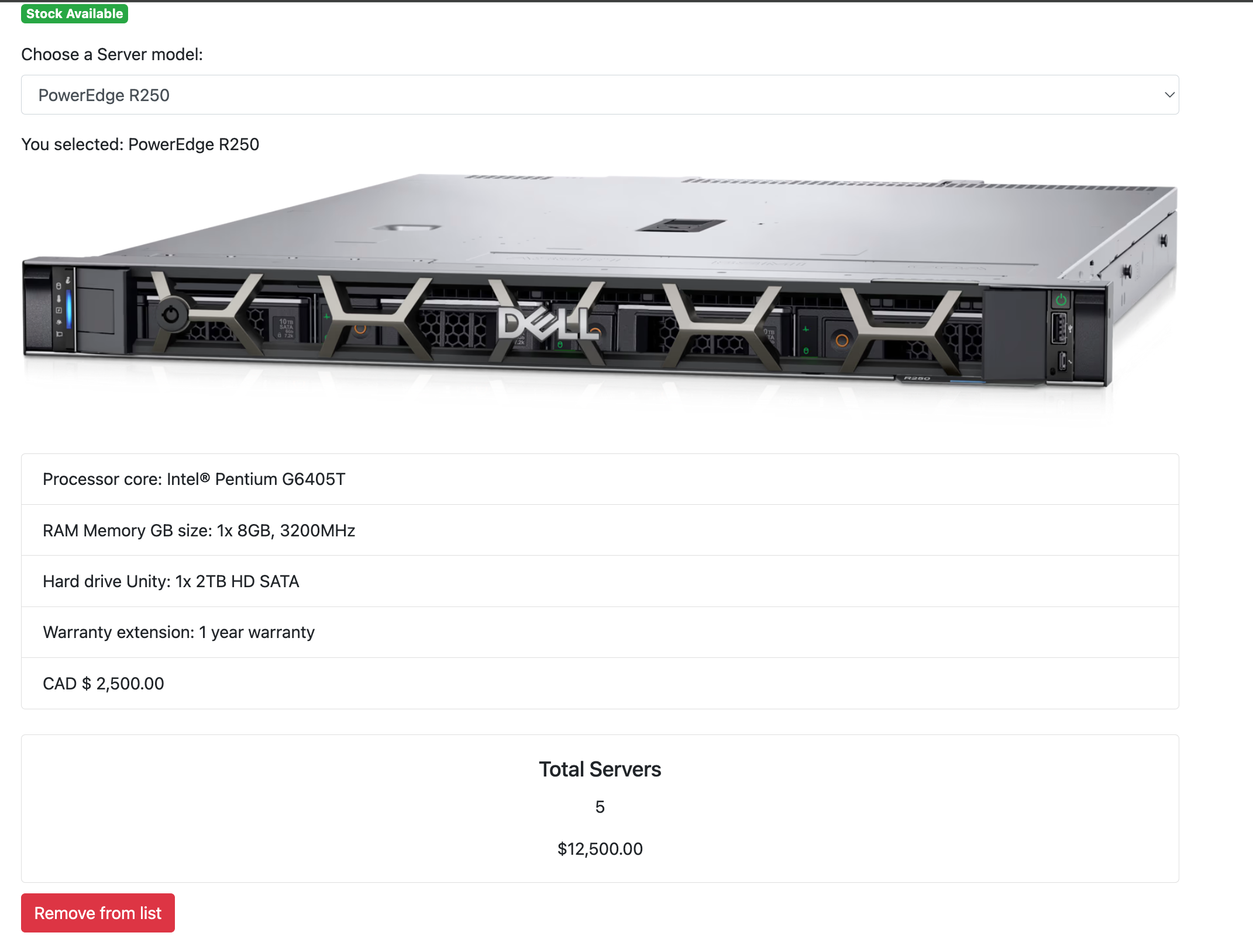
index.html
After choose, the user can see the total server price:

Slide 4
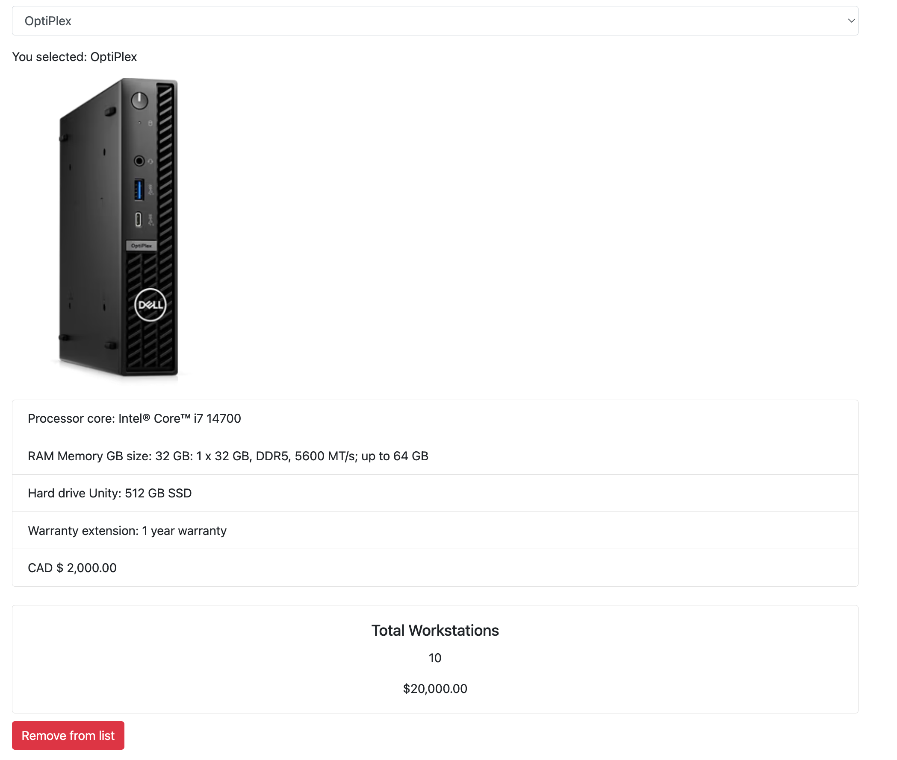
index.html
The user can choose the workstation by model, add items or remove items from list:

Slide 5
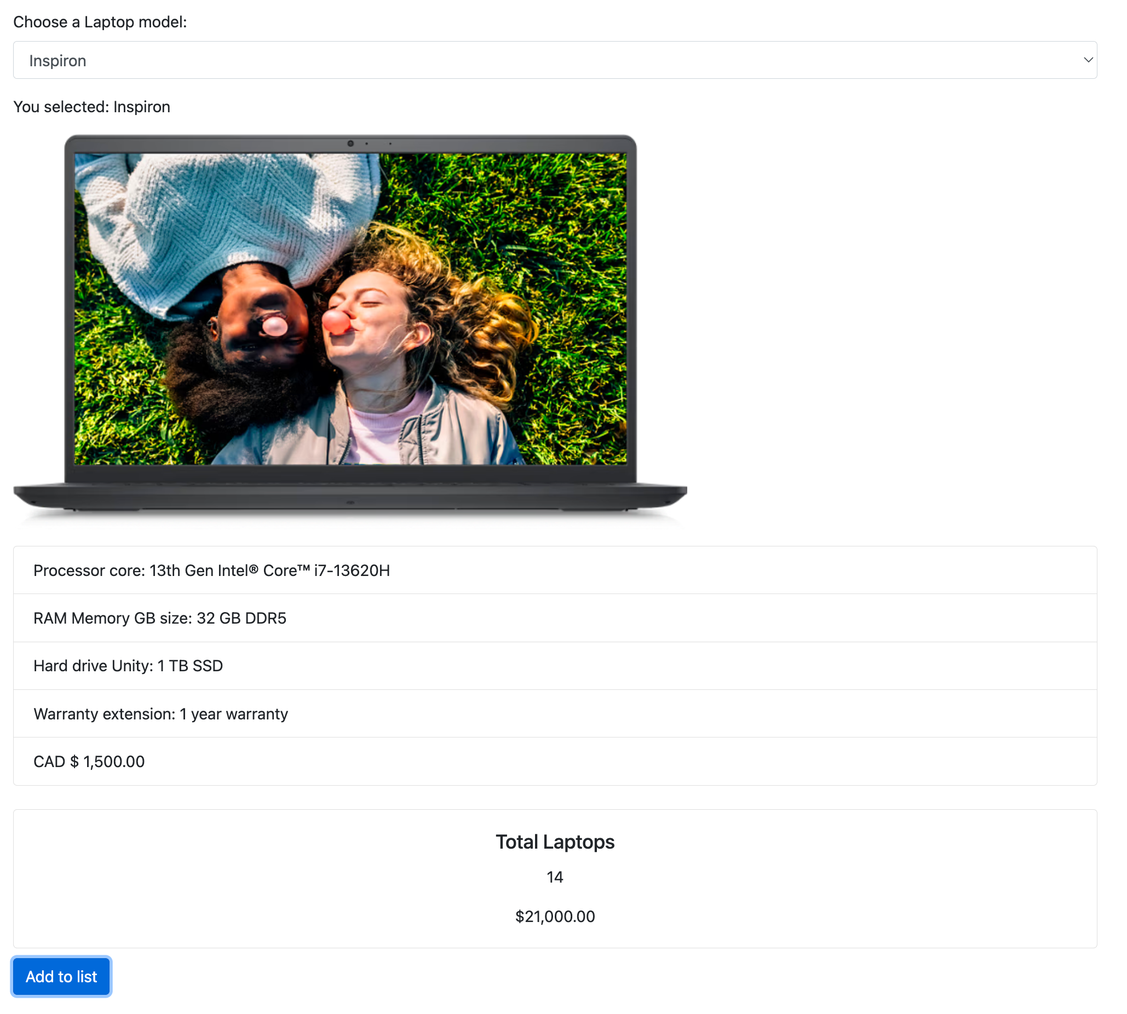
index.html
The user can choose the laptop by model, add items or remove items from list:

Slide 6
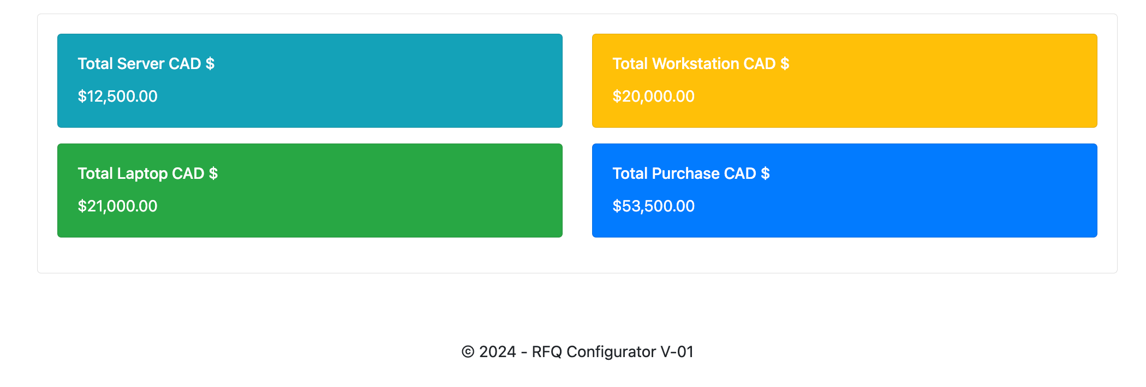
index.html
After choose all equipments, the user can see the total price by equipments and the total price by purchase process:

