Slide 1
GET /api/v1/keys/sae-2/enc_keys?number=2&size=1024 HTTP/1.1
Accept-Encoding: identity
Host: kme-1.acct-4627.etsi-qkd-api.qukaydee.com
User-Agent: Python-urllib/3.12
Accept: application/json
Connection: close
HTTP/1.1 200 OK
Server: nginx/1.18.0 (Ubuntu)
Date: Wed, 05 Aug 2026 14:50:20 GMT
Content-Type: application/json
Content-Length: 472
Connection: close
Vary: Accept, Cookie
Allow: GET, POST, HEAD, OPTIONS
[…]
{"keys":[{"key_ID":"4449fe18-f661-42cb-8480-a19f79a53116","key":"Fy7k1XC … rddSj0="},{"key_ID":"38673 … f06","key":"EbSIb2n … 4Es="}]}

Slide 2
GET /api/v1/keys/sae-1/dec_keys?key_ID=4449fe18-f661-42cb-8480-a19f79a53116 HTTP/1.1
Accept-Encoding: identity
Host: kme-2.acct-4627.etsi-qkd-api.qukaydee.com
User-Agent: Python-urllib/3.12
Accept: application/json
Connection: close
HTTP/1.1 200 OK
Server: nginx/1.18.0 (Ubuntu)
Date: Wed, 05 Aug 2026 14:50:21 GMT
Content-Type: application/json
Content-Length: 241
Connection: close
Vary: Accept, Cookie
Allow: GET, POST, HEAD, OPTIONS
[…]
{"keys":[{"key_ID":"4449fe18-f661-42cb-8480-a19f79a53116","key":"Fy7k1XC … IrddSj0="}]}

Slide 3
GET /api/v1/keys/sae-1/dec_keys?key_ID=4449fe18-f661-42cb-8480-a19f79a53116 HTTP/1.1
Accept-Encoding: identity
Host: kme-2.acct-4627.etsi-qkd-api.qukaydee.com
User-Agent: Python-urllib/3.12
Accept: application/json
Connection: close
HTTP/1.1 404 Not Found
Server: nginx/1.18.0 (Ubuntu)
Date: Wed, 05 Aug 2026 14:50:21 GMT
Content-Type: application/json
Content-Length: 89
Connection: close
Vary: Accept, Cookie
Allow: GET, POST, HEAD, OPTIONS
[…]
{"message":"Key not found","details":[{"key_ID":"4449fe18-f661-42cb-8480-a19f79a53116"}]}

Slide 4
GET /api/v1/keys/sae-2/enc_keys?number=1&size=100008 HTTP/1.1
Accept-Encoding: identity
Host: kme-1.acct-4627.etsi-qkd-api.qukaydee.com
User-Agent: Python-urllib/3.12
Accept: application/json
Connection: close
HTTP/1.1 400 Bad Request
Server: nginx/1.18.0 (Ubuntu)
Date: Wed, 05 Aug 2026 14:50:22 GMT
Content-Type: application/json
Content-Length: 151
Connection: close
Vary: Accept, Cookie
Allow: GET, POST, HEAD, OPTIONS
[…] {"message":"Invalid parameter value","details":[{"parameter_name":"size","parameter_value":"100008","allowed_values":"Integer, between 1 and 100000"}]}

Slide 5
GET /api/v1/keys/sae-2/status HTTP/1.1
Accept-Encoding: identity
Host: kme-1.acct-4627.etsi-qkd-api.qukaydee.com
User-Agent: Python-urllib/3.12
Accept: application/json
Connection: close
HTTP/1.1 200 OK
Server: nginx/1.18.0 (Ubuntu)
Date: Sat, 08 Aug 2026 11:58:21 GMT
Content-Type: application/json
Content-Length: 264
Connection: close
Vary: Accept, Cookie
Allow: GET, HEAD, OPTIONS
[…]
{"source_KME_ID":"kme-1","target_KME_ID":"kme-2","master_SAE_ID":"sae-1","slave_SAE_ID":"sae-2","key_size":512,"stored_key_count":1665,"max_key_count":1953,"max_key_per_request":100,"max_key_size":100000,"min_key_size":1,"max_SAE_ID_count":9,"status_extension":{}}

Slide 6
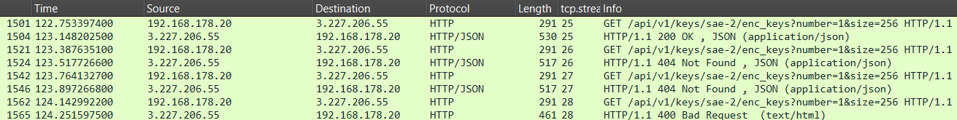
A
B
C
D

Slide 7
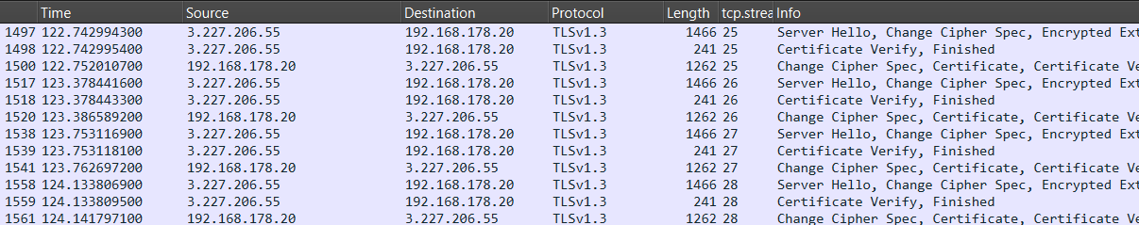
A
B
C
D

Slide 8
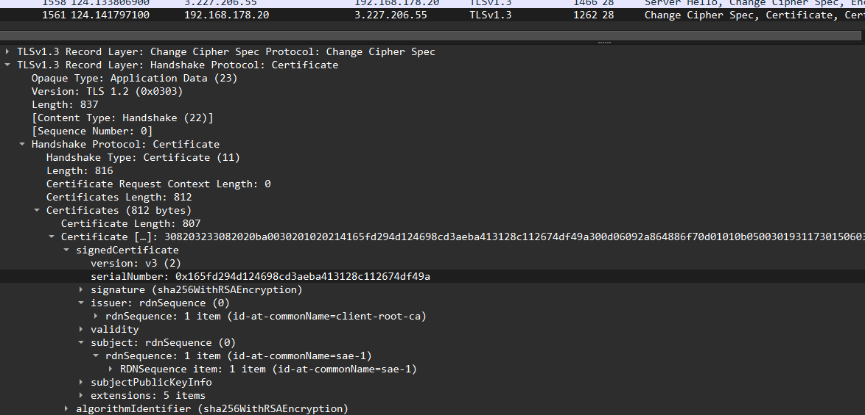

Slide 9
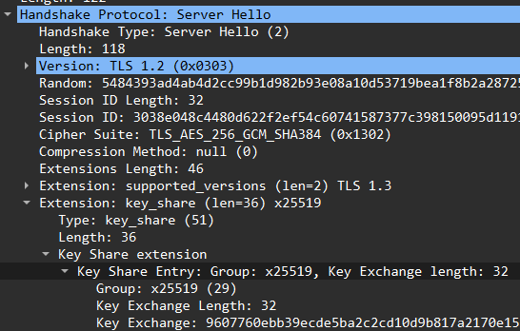

Slide 10
A
C
D
B

Slide 11
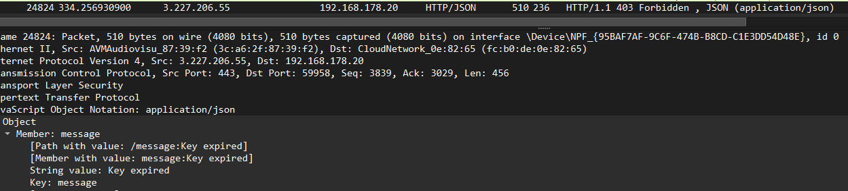
B

Slide 12
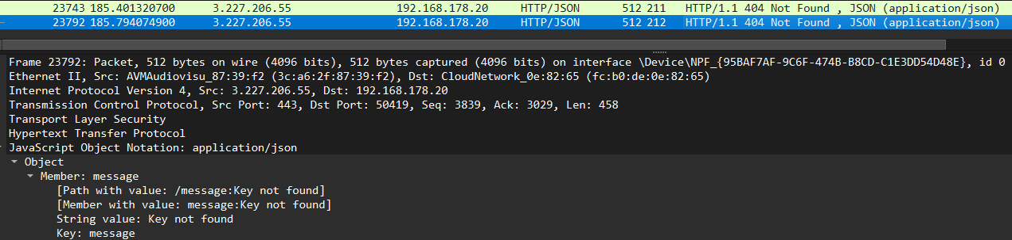
A
C

Slide 13
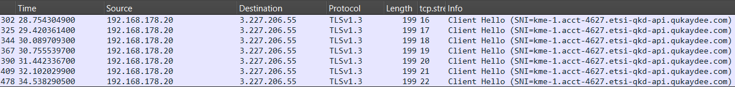

Slide 14
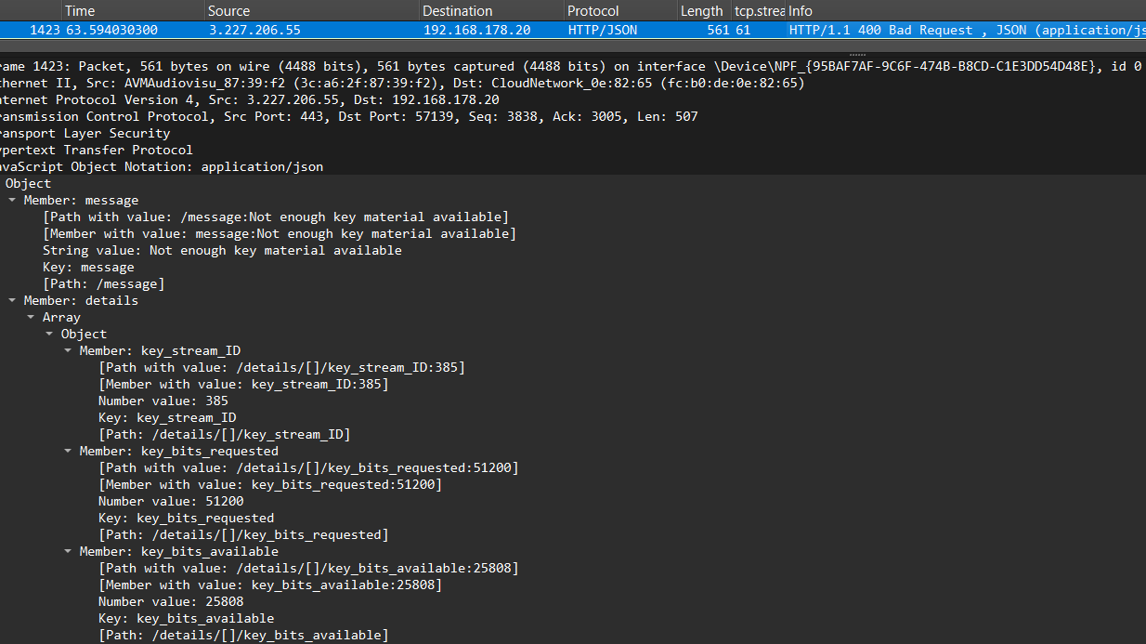

Slide 15
POST /api/v1/keys/sae-2/enc_keys HTTP/1.1
Accept-Encoding: identity
Content-Length: 96
Host: kme-1.acct-4627.etsi-qkd-api.qukaydee.com
User-Agent: Python-urllib/3.12
Accept: application/json
Content-Type: application/json
Connection: close
{"number": 1, "size": 512, "extension_mandatory": [{"eclaireur_test_mandatory": "must-reject"}]}
HTTP/1.1 400 Bad Request
Server: nginx/1.18.0 (Ubuntu)
Date: Sat, 08 Aug 2026 13:46:54 GMT
Content-Type: application/json
Content-Length: 115
Connection: close
Vary: Accept, Cookie
Allow: GET, POST, HEAD, OPTIONS
[…]
{"message":"Unknown mandatory extension","details":[{"extension_item":{"eclaireur_test_mandatory":"must-reject"}}]}

Slide 16
POST /api/v1/keys/sae-2/enc_keys HTTP/1.1
Accept-Encoding: identity
Content-Length: 65
Host: kme-1.acct-4627.etsi-qkd-api.qukaydee.com
User-Agent: Python-urllib/3.12
Accept: application/json
Content-Type: application/json
Connection: close
{"number": 1, "size": 512, "additional_slave_SAE_IDs": ["sae-3"]}
HTTP/1.1 200 OK
Server: nginx/1.18.0 (Ubuntu)
Date: Sat, 08 Aug 2026 13:50:32 GMT
Content-Type: application/json
Content-Length: 157
Connection: close
Vary: Accept, Cookie
Allow: GET, POST, HEAD, OPTIONS
[…]
{"keys":[{"key_ID":"b2a7f18f-5a72-43cb-a008-f5d82b71b77b","key":"I+uuu+DaE9cl5529RzQrFyA2jmf00HPBXmsOFE9mWxCduStLJV/iWTA91AFOt23ZHJnjgZxsbB62oJbUa+f03A=="}]}

Slide 17
GET /api/v1/keys/sae-1/dec_keys?key_ID=b2a7f18f-5a72-43cb-a008-f5d82b71b77b HTTP/1.1
Accept-Encoding: identity
Host: kme-2.acct-4627.etsi-qkd-api.qukaydee.com
User-Agent: Python-urllib/3.12
Accept: application/json
Connection: close
HTTP/1.1 200 OK
Server: nginx/1.18.0 (Ubuntu)
Date: Sat, 08 Aug 2026 13:50:32 GMT
Content-Type: application/json
Content-Length: 157
Connection: close
Vary: Accept, Cookie
Allow: GET, POST, HEAD, OPTIONS
[…]
{"keys":[{"key_ID":"b2a7f18f-5a72-43cb-a008-f5d82b71b77b","key":"I+uuu+DaE9cl5529RzQrFyA2jmf00HPBXmsOFE9mWxCduStLJV/iWTA91AFOt23ZHJnjgZxsbB62oJbUa+f03A=="}]}

Slide 18
GET /api/v1/keys/sae-1/dec_keys?key_ID=b2a7f18f-5a72-43cb-a008-f5d82b71b77b HTTP/1.1
Accept-Encoding: identity
Host: kme-3.acct-4627.etsi-qkd-api.qukaydee.com
User-Agent: Python-urllib/3.12
Accept: application/json
Connection: close
HTTP/1.1 200 OK
Server: nginx/1.18.0 (Ubuntu)
Date: Sat, 08 Aug 2026 13:50:33 GMT
Content-Type: application/json
Content-Length: 157
Connection: close
Vary: Accept, Cookie
Allow: GET, POST, HEAD, OPTIONS
[…]
{"keys":[{"key_ID":"b2a7f18f-5a72-43cb-a008-f5d82b71b77b","key":"I+uuu+DaE9cl5529RzQrFyA2jmf00HPBXmsOFE9mWxCduStLJV/iWTA91AFOt23ZHJnjgZxsbB62oJbUa+f03A=="}]}

