Slide 1
Hashing: Hash Functions

Slide 2


Outline
Phone Book Data Structure
Universal Family
Hashing Phone Numbers
Hashing Names
Analysis of Polynomial Hashing

Slide 3
Phone Book
Design a data structure to store your contacts: names of people along with their phone numbers. The following operations should be fast:
Add and delete contacts, Call person by name,
Determine who is calling given their phone number.

Slide 4
We need two Maps:
(phone number → name) and (name → phone number)

Slide 5
We need two Maps:
(phone number → name) and (name → phone number)
Implement these Maps as hash tables

Slide 6
We need two Maps:
(phone number → name) and (name → phone number)
Implement these Maps as hash tables First, we will focus on the Map from phone numbers to names

Slide 7
Chaining for Phone Book
Select hash function h of cardinality m
Create array Chains of size m Each element of Chains is a list of pairs (name, phoneNumber), called chain
Pair (name, phoneNumber) goes into chain at position h(ConvertToInt(phoneNumber)) in the array Chains

Slide 8
Chaining for Phone Book
0
1
2
3
4
5
6
7
Sasha
14052391717
Maria
01707773331
Helen
15025757575

Slide 9
Parameters
n contacts stored

Slide 10
Parameters
n contacts stored
m — cardinality of the hash function

Slide 11
Parameters
n contacts stored
m — cardinality of the hash function Note: hash table size for chaining should be equal to m

Slide 12
Parameters
n contacts stored
m — cardinality of the hash function Note: hash table size for chaining should be equal to m
c — length of the longest chain

Slide 13
Parameters
n contacts stored
m — cardinality of the hash function Note: hash table size for chaining should be equal to m
c — length of the longest chain
Θ(n + m) memory is used

Slide 14
Parameters
n contacts stored
m — cardinality of the hash function Note: hash table size for chaining should be equal to m
c — length of the longest chain Θ(n + m) memory is used Operations run in time Θ(c + 1)

Slide 15
Parameters
n contacts stored
m — cardinality of the hash function Note: hash table size for chaining should be equal to m
c — length of the longest chain Θ(n + m) memory is used Operations run in time Θ(c + 1)
You want small m and c! (but c ≥ ^{n} )
m

Slide 16
Good Example
0
1
2
3
4
5
6
7
O₃
O₇
O₁
c = 2
O₈
O₄
m = 8
O₂
O₆
O₅

Slide 17
Bad Example
0
1
2
3
4
5
6
7
O₁ O₂ O₃ O₄ O₅ O₆ O₇ O₈
c = 8
m = 8

Slide 18
First Digits
For the map from phone numbers to names, select m = 1000

Slide 19
First Digits
For the map from phone numbers to names, select m = 1000
Hash function: take first three digits

Slide 20
First Digits
For the map from phone numbers to names, select m = 1000
Hash function: take first three digits
h(800-123-45-67) = 800

Slide 21
First Digits
For the map from phone numbers to names, select m = 1000
Hash function: take first three digits
h(800-123-45-67) = 800
Problem: area code

Slide 22
First Digits
For the map from phone numbers to names, select m = 1000
Hash function: take first three digits
h(800-123-45-67) = 800
Problem: area code h(425-234-55-67) = h(425-123-45-67) =
h(425-223-23-23) = · · · = 425

Slide 23
Last Digits
Select m = 1000

Slide 24
Last Digits
Select m = 1000
Hash function: take last three digits

Slide 25
Last Digits
Select m = 1000
Hash function: take last three digits
h(800-123-45-67) = 567

Slide 26
Last Digits
Select m = 1000
Hash function: take last three digits
h(800-123-45-67) = 567
Problem if many phone numbers end with three zeros

Slide 27
Random Value
Select m = 1000

Slide 28
Random Value
Select m = 1000
Hash function: random number between 0 and 999

Slide 29
Random Value
Select m = 1000
Hash function: random number between 0 and 999
Uniform distribution of hash values

Slide 30
Random Value
Select m = 1000
Hash function: random number between 0 and 999
Uniform distribution of hash values Different value when hash function called again — we won’t be able to find anything!

Slide 31
Random Value
Select m = 1000
Hash function: random number between 0 and 999
Uniform distribution of hash values Different value when hash function called again — we won’t be able to find anything!
Hash function must be deterministic

Slide 32
Good Hash Functions
Deterministic Fast to compute
Distributes keys well into different cells Few collisions

Slide 33
No Universal Hash Function
Lemma
If the number of possible keys is big
(|S| ≫ m), for any hash function h there is a bad input resulting in many collisions.

Slide 34
S

Slide 35
m = 3
S
h(k) = 2
h(k) = 0
h(k) = 1

Slide 36
m = 3
S
h(k) = 2
h(k) = 0
h(k) = 1

Slide 37
m = 3
S
h(k) = 1
42%
h(k) = 2
h(k) = 0

Slide 38
Outline
Phone Book Data Structure
Universal Family
Hashing Phone Numbers
Hashing Names
Analysis of Polynomial Hashing

Slide 39
Idea
Remember QuickSort?

Slide 40
Idea
Remember QuickSort? Choosing random pivot helped

Slide 41
Idea
Remember QuickSort? Choosing random pivot helped Use randomization!

Slide 42
Idea
Remember QuickSort? Choosing random pivot helped Use randomization!
Define a family (set) of hash functions

Slide 43
Idea
Remember QuickSort? Choosing random pivot helped Use randomization!
Define a family (set) of hash functions Choose random function from the family

Slide 44
Universal Family
Definition
Let U be the universe — the set of all possible keys.

Slide 45
Universal Family
Definition
Let U be the universe — the set of all possible keys. A set of hash functions
H = {h : U → {0, 1, 2, . . . , m − 1}}

Slide 46
Universal Family
Definition
Let U be the universe — the set of all possible keys. A set of hash functions
H = {h : U → {0, 1, 2, . . . , m − 1}}
is called a universal family if

Slide 47
Universal Family
Definition
Let U be the universe — the set of all possible keys. A set of hash functions
H = {h : U → {0, 1, 2, . . . , m − 1}}
is called a universal family if for any two keys
x, y ∈ U, x ̸= y the probability of collision
1
Pr[h(x) = h(y)] ≤ _{m}

Slide 48
Universal Family
1
Pr[h(x) = h(y)] ≤ _{m}
means that a collision h(x) = h(y) for any fixed pair of different keys x and y happens
for no more than ¹ of all hash functions
m
h ∈ H.

Slide 49
How Randomization Works
h(x) = random({0, 1, 2, . . . , m − 1})
gives probability of collision exactly ¹ .
m

Slide 50
How Randomization Works
h(x) = random({0, 1, 2, . . . , m − 1})
gives probability of collision exactly ¹ .
m
It is not deterministic — can’t use it.

Slide 51
How Randomization Works
h(x) = random({0, 1, 2, . . . , m − 1})
gives probability of collision exactly ¹ .
m
It is not deterministic — can’t use it.
All hash functions in H are deterministic

Slide 52
How Randomization Works
h(x) = random({0, 1, 2, . . . , m − 1})
gives probability of collision exactly ¹ .
m
It is not deterministic — can’t use it.
All hash functions in H are deterministic Select a random function h from H

Slide 53
How Randomization Works
h(x) = random({0, 1, 2, . . . , m − 1})
gives probability of collision exactly ¹ .
m
It is not deterministic — can’t use it.
All hash functions in H are deterministic Select a random function h from H Fixed h is used throughout the algorithm

Slide 54
Load Factor
Definition
The ratio α = ^{n} between number of objects
m
n stored in the hash table and the size of the hash table m is called load factor.

Slide 55
Running Time
Lemma
If h is chosen randomly from a universal family, the average length of the longest
chain c is O(1 + α), where α = ^{n} is the load
m
factor of the hash table.
Corollary
If h is from universal family, operations with hash table run on average in time O(1 + α).

Slide 56
Choosing Hash Table Size
Control amount of memory used with m

Slide 57
Choosing Hash Table Size
Control amount of memory used with m
Ideally, load factor 0.5 < α < 1

Slide 58
Choosing Hash Table Size
Control amount of memory used with m
Ideally, load factor 0.5 < α < 1
Use O(m) = O( ^{n} ) = O(n) memory to
α
store n keys

Slide 59
Choosing Hash Table Size
Control amount of memory used with m
Ideally, load factor 0.5 < α < 1
Use O(m) = O( ^{n} ) = O(n) memory to
α
store n keys Operations run in time
O(1 + α) = O(1) on average

Slide 60
Dynamic Hash Tables
What if number of keys n is unknown in advance?

Slide 61
Dynamic Hash Tables
What if number of keys n is unknown in advance?
Start with very big hash table?

Slide 62
Dynamic Hash Tables
What if number of keys n is unknown in advance?
Start with very big hash table? You will waste a lot of memory

Slide 63
Dynamic Hash Tables
What if number of keys n is unknown in advance?
Start with very big hash table? You will waste a lot of memory Copy the idea of dynamic arrays!

Slide 64
Dynamic Hash Tables
What if number of keys n is unknown in advance?
Start with very big hash table? You will waste a lot of memory Copy the idea of dynamic arrays!
Resize the hash table when α becomes too large

Slide 65
Dynamic Hash Tables
What if number of keys n is unknown in advance?
Start with very big hash table? You will waste a lot of memory Copy the idea of dynamic arrays!
Resize the hash table when α becomes too large
Choose new hash function and rehash all the objects

Slide 66
Rehashing
Keep load factor below 0.9:
Rehash(T)
_{loadFactor ←} T.numberOfKeys
T.size
if loadFactor > 0.9:
Create T_{new} of size 2 × T.size
Choose h_{new} with cardinality T_{new}.size
For each object in T:
Insert object in T_{new} using h_{new}
T ← T_{new},
h ← h_{new}

Slide 67
Rehashing
Keep load factor below 0.9:
Rehash(T)
_{loadFactor ←} T.numberOfKeys
T.size
if loadFactor > 0.9:
Create T_{new} of size 2 × T.size
Choose h_{new} with cardinality T_{new}.size For each object in T:
Insert object in T_{new} using h_{new} T ← T_{new}, h ← h_{new}

Slide 68
Rehashing
Keep load factor below 0.9:
Rehash(T)
_{loadFactor ←} T.numberOfKeys
T.size
if loadFactor > 0.9:
Create T_{new} of size 2 × T.size
Choose h_{new} with cardinality T_{new}.size For each object in T:
Insert object in T_{new} using h_{new} T ← T_{new}, h ← h_{new}

Slide 69
Rehashing
Keep load factor below 0.9:
Rehash(T)
_{loadFactor ←} T.numberOfKeys
T.size
if loadFactor > 0.9:
Create T_{new} of size 2 × T.size
Choose h_{new} with cardinality T_{new}.size For each object in T:
Insert object in T_{new} using h_{new} T ← T_{new}, h ← h_{new}

Slide 70
Rehashing
Keep load factor below 0.9:
Rehash(T)
_{loadFactor ←} T.numberOfKeys
T.size
if loadFactor > 0.9:
Create T_{new} of size 2 × T.size
Choose h_{new} with cardinality T_{new}.size For each object in T:
Insert object in T_{new} using h_{new} T ← T_{new}, h ← h_{new}

Slide 71
Rehashing
Keep load factor below 0.9:
Rehash(T)
_{loadFactor ←} T.numberOfKeys
T.size
if loadFactor > 0.9:
Create T_{new} of size 2 × T.size
Choose h_{new} with cardinality T_{new}.size For each object in T:
Insert object in T_{new} using h_{new} T ← T_{new}, h ← h_{new}

Slide 72
Rehashing
Keep load factor below 0.9:
Rehash(T)
_{loadFactor ←} T.numberOfKeys
T.size
if loadFactor > 0.9:
Create T_{new} of size 2 × T.size
Choose h_{new} with cardinality T_{new}.size For each object in T:
Insert object in T_{new} using h_{new} T ← T_{new}, h ← h_{new}

Slide 73
Rehashing
Keep load factor below 0.9:
Rehash(T)
_{loadFactor ←} T.numberOfKeys
T.size
if loadFactor > 0.9:
Create T_{new} of size 2 × T.size
Choose h_{new} with cardinality T_{new}.size For each object in T:
Insert object in T_{new} using h_{new}
T ← T_{new}, h ← h_{new}

Slide 74
Rehash Running Time
You should call Rehash after each operation with the hash table
Similarly to dynamic arrays, single rehashing takes O(n) time, but amortized running time of each operation with hash table is still O(1) on average, because rehashing will be rare

Slide 75
Outline
Phone Book Data Structure
Universal Family
Hashing Phone Numbers
Hashing Names
Analysis of Polynomial Hashing

Slide 76
Hashing Phone Numbers
We can convert phone numbers to integers, for example
148-25-67 → 1482567

Slide 77
Hashing Phone Numbers
We can convert phone numbers to integers, for example
148-25-67 → 1482567
As a result, any phone number will be converted to an integer less than 10¹⁵

Slide 78
Hashing Phone Numbers
We can convert phone numbers to integers, for example
148-25-67 → 1482567
As a result, any phone number will be converted to an integer less than 10¹⁵ If we come up with a universal family for integers up to 10¹⁵, we will be able
to map phone numbers to names efficiently using chaining

Slide 79
Hashing Integers
Lemma
{
a,b
}
H = h (x
) = ((ax + b) mod p) mod m
p p
for all a, b : 1≤ a ≤ p − 1, 0 ≤ b ≤ p − 1 is a universal family for the set of integers between 0 and p − 1, for any prime p.

Slide 80
Hashing Phone Numbers
Example
Select a = 34, b = 2, so h = h
34,2
and
p
consider x = 1 482 567 corresponding to
phone number 148-25-67. p = 10 000 019.

Slide 81
Hashing Phone Numbers
Example
Select a = 34, b = 2, so h = h
34,2
and
p
consider x = 1 482 567 corresponding to
phone number 148-25-67. p = 10 000 019.
(34 × 1482567 + 2) mod 10000019 = 407185

Slide 82
Hashing Phone Numbers
Example
Select a = 34, b = 2, so h = h
34,2
and
p
consider x = 1 482 567 corresponding to
phone number 148-25-67. p = 10 000 019.
(34 × 1482567 + 2) mod 10000019 = 407185
407185 mod 1000 = 185

Slide 83
Hashing Phone Numbers
Example
Select a = 34, b = 2, so h = h
34,2
and
p
consider x = 1 482 567 corresponding to
phone number 148-25-67. p = 10 000 019.
(34 × 1482567 + 2) mod 10000019 = 407185
407185 mod 1000 = 185
h(x) = 185

Slide 84
General Case
Define maximum length L of a phone number

Slide 85
General Case
Define maximum length L of a phone number
Convert phone numbers to integers from 0 to 10^{L} − 1

Slide 86
General Case
Define maximum length L of a phone number
Convert phone numbers to integers from 0 to 10^{L} − 1
Choose prime number p > 10^{L}

Slide 87
General Case
Define maximum length L of a phone number
Convert phone numbers to integers from 0 to 10^{L} − 1
Choose prime number p > 10^{L} Choose hash table size m

Slide 88
General Case
Define maximum length L of a phone number
Convert phone numbers to integers from 0 to 10^{L} − 1
Choose prime number p > 10^{L} Choose hash table size m
Choose random hash function from universal family H_{p} (choose random a ∈ [1, p − 1] and b ∈ [0, p − 1])

Slide 89
Outline
Phone Book Data Structure
Universal Family
Hashing Phone Numbers
Hashing Names
Analysis of Polynomial Hashing

Slide 90
Lookup Phone Numbers by Name
Time to implement Map from names to phone numbers

Slide 91
Lookup Phone Numbers by Name
Time to implement Map from names to phone numbers
Use chaining again

Slide 92
Lookup Phone Numbers by Name
Time to implement Map from names to phone numbers
Use chaining again
Need a hash function for names

Slide 93
Lookup Phone Numbers by Name
Time to implement Map from names to phone numbers
Use chaining again
Need a hash function for names
Hash arbitrary strings of bounded length

Slide 94
Lookup Phone Numbers by Name
Time to implement Map from names to phone numbers
Use chaining again
Need a hash function for names
Hash arbitrary strings of bounded length You will learn how string hashing is implemented in Java!

Slide 95
String Length Notation
Definition
Denote by |S| the length of string S.
Examples
|“edx”| = 3
|“ucsd”| = 4
|“chaining”| = 8

Slide 96
Hashing Strings
Given a string S, compute its hash value

Slide 97
Hashing Strings
Given a string S, compute its hash value
S = S[0]S[1] . . . S[|S| − 1], where S[i]
are individual characters

Slide 98
Hashing Strings
Given a string S, compute its hash value
S = S[0]S[1] . . . S[|S| − 1], where S[i]
are individual characters
We should use all the characters in the hash function

Slide 99
Hashing Strings
Given a string S, compute its hash value
S = S[0]S[1] . . . S[|S| − 1], where S[i]
are individual characters
We should use all the characters in the hash function
Otherwise there will be many collisions

Slide 100
Hashing Strings
Given a string S, compute its hash value
S = S[0]S[1] . . . S[|S| − 1], where S[i]
are individual characters
We should use all the characters in the hash function
Otherwise there will be many collisions For example, if S[0] is not used, then h(“aa”) = h(“ba”) = · · · = h(“za”)

Slide 101
Preparation
Convert each character S[i] to integer

Slide 102
Preparation
Convert each character S[i] to integer ASCII encoding, Unicode, etc.

Slide 103
Preparation
Convert each character S[i] to integer ASCII encoding, Unicode, etc.
Choose big prime number p

Slide 104
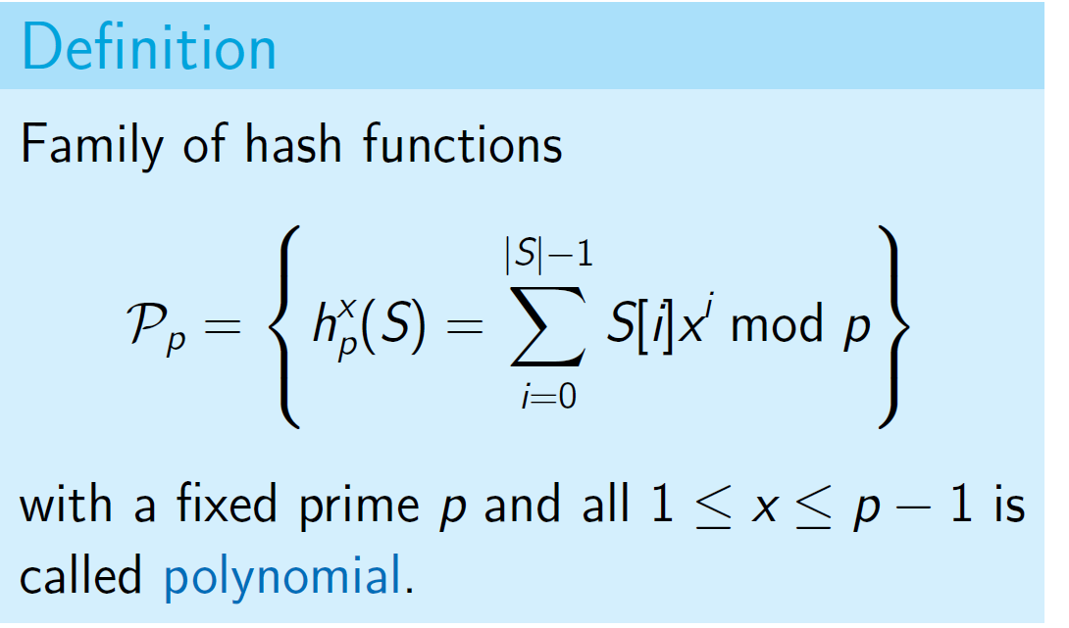
Polynomial Hashing
Definition
Family of hash functions



|S|−1
∑
x
i
P_{p} = h_{p}(S) =
S[i]x mod p


i=0
with a fixed prime p and all 1 ≤ x ≤ p − 1 is called polynomial.

Slide 105
PolyHash(S, p, x)
hash ← 0
for i from |S| − 1 down to 0: hash ← (hash · x + S[i]) mod p
return hash

Slide 106
PolyHash(S, p, x)
hash ← 0
for i from |S| − 1 down to 0: hash ← (hash · x + S[i]) mod p
return hash

Slide 107
PolyHash(S, p, x)
hash ← 0
for i from |S| − 1 down to 0: hash ← (hash · x + S[i]) mod p
return hash

Slide 108
PolyHash(S, p, x)
hash ← 0
for i from |S| − 1 down to 0: hash ← (hash · x + S[i]) mod p
return hash

Slide 109
PolyHash(S, p, x)
hash ← 0
for i from |S| − 1 down to 0: hash ← (hash · x + S[i]) mod p
return hash

Slide 110
PolyHash(S, p, x)
hash ← 0
for i from |S| − 1 down to 0: hash ← (hash · x + S[i]) mod p
return hash
Example: |S| = 3

Slide 111
PolyHash(S, p, x)
hash ← 0
for i from |S| − 1 down to 0: hash ← (hash · x + S[i]) mod p
return hash
Example: |S| = 3
1 hash ← 0

Slide 112
PolyHash(S, p, x)
hash ← 0
for i from |S| − 1 down to 0: hash ← (hash · x + S[i]) mod p
return hash
Example: |S| = 3
1 hash ← 0
2 hash ← S[2] mod p

Slide 113
PolyHash(S, p, x)
hash ← 0
for i from |S| − 1 down to 0: hash ← (hash · x + S[i]) mod p
return hash
Example: |S| = 3
1 hash ← 0
2 hash ← S[2] mod p
3 hash ← S[1] + S[2]x mod p

Slide 114
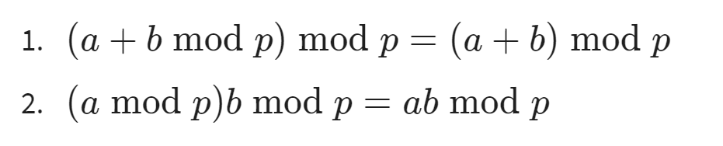
PolyHash(S, p, x)
hash ← 0
for i from |S| − 1 down to 0: hash ← (hash · x + S[i]) mod p
return hash
Example: |S| = 3
1 hash ← 0
2 hash ← S[2] mod p
3 hash ← S[1] + S[2]x mod p
4 hash ← S[0] + S[1]x + S[2]x² mod p

Slide 115
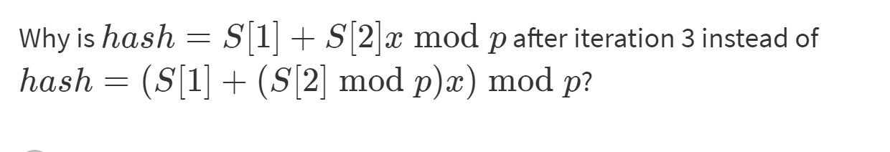
why

Slide 116
Java Implementation
The method hashCode of the built-in Java class String is very similar to our PolyHash, it just uses x = 31 and for technical reasons avoids the (mod p) operator.

Slide 117
Java Implementation
The method hashCode of the built-in Java class String is very similar to our PolyHash, it just uses x = 31 and for technical reasons avoids the (mod p) operator.
You now know the implementation of the function that is used trillions of times a day in many thousands of programs!

Slide 118
Outline
Phone Book Data Structure
Universal Family
Hashing Phone Numbers
Hashing Names
Analysis of Polynomial Hashing

Slide 119
Lemma
For any two different strings s₁ and s₂ of length at most L + 1, if you choose h from P_{p} at random (by selecting a random
x ∈ [1, p − 1]), the probability of collision
Pr[h(s₁) = h(s₂)] is at most ^{L} .
p

Slide 120
Cardinality Fix
For use in a hash table of size m, we need a hash function of cardinality m.

Slide 121
Cardinality Fix
For use in a hash table of size m, we need a hash function of cardinality m.
First, apply random h_{x} from P_{p}, and then hash the resulting value again using universal family for integers. Denote the resulting function by h_{m}.

Slide 122
Cardinality Fix
For use in a hash table of size m, we need a hash function of cardinality m.
First, apply random h_{x} from P_{p}, and then hash the resulting value again using universal family for integers. Denote the resulting function by h_{m}.
h_{m}(S) = h_{a,b}(h_{x}(S)) mod m

Slide 123
Cardinality Fix
For use in a hash table of size m, we need a hash function of cardinality m.
First, apply random h_{x} from P_{p}, and then hash the resulting value again using universal family for integers. Denote the resulting function by h_{m}.
h_{m}(S) = h_{a,b}(h_{x}(S)) mod m

Slide 124
Cardinality Fix
For use in a hash table of size m, we need a hash function of cardinality m.
First, apply random h_{x} from P_{p}, and then hash the resulting value again using universal family for integers. Denote the resulting function by h_{m}.
h_{m}(S) = h_{a,b}(h_{x}(S)) mod m

Slide 125
Cardinality Fix
For use in a hash table of size m, we need a hash function of cardinality m.
First, apply random h_{x} from P_{p}, and then hash the resulting value again using universal family for integers. Denote the resulting function by h_{m}.
h_{m}(S) = h_{a,b}(h_{x}(S)) mod m

Slide 126
Lemma
For any two different strings s₁ and s₂ of length at most L + 1 and cardinality m, the probability of collision Pr[h_{m}(s₁) = h_{m}(s₂)] is
at most ¹ + ^{L} .
m p

Slide 127
Polynomial Hashing
Corollary
If p > mL, for any two different strings s₁ and s₂ of length at most L + 1 the probability
of collision Pr[h_{m}(s₁) = h_{m}(s₂)] is O( ¹ ).
m

Slide 128
Running Time
For p > mL we have
c = O(1 + ^{n} ) = O(1 + α) again
m

Slide 129
Running Time
For p > mL we have
c = O(1 + ^{n} ) = O(1 + α) again
m
Computing PolyHash(S) runs in O(|S|)

Slide 130
Running Time
For p > mL we have
c = O(1 + ^{n} ) = O(1 + α) again
m
Computing PolyHash(S) runs in O(|S|)
If lengths of the names in the phone book are bounded by constant L, computing h(S) takes O(L) = O(1) time

Slide 131
Conclusion
You learned how to hash integers and strings
Phone book can be implemented as two hash tables
Mapping phone numbers to names and back
Search and modification run in O(1) on average!

Slide 132
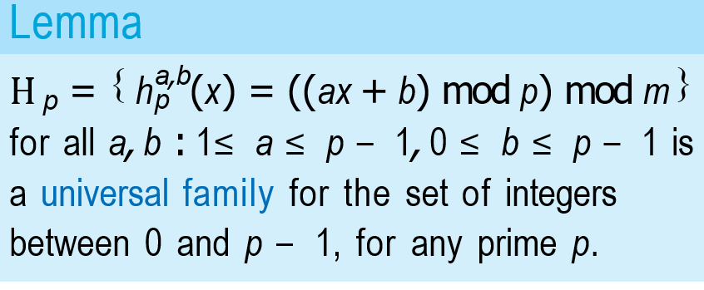
Mapping the to families

Slide 133
