Slide 1
Recursion

Slide 2
Objectives
become familiar with the idea of recursion
learn to use recursion as a programming tool
become familiar with the binary search algorithm as an example of recursion
become familiar with the merge sort algorithm as an example of recursion

Slide 3
How do you look up a name in the phone book?

Slide 4
One Possible Way
Search:
  middle page = (first page + last page)/2
  Go to middle page;
  If (name is on middle page)
  done; //this is the base case
  else if (name is alphabetically before middle page)
  last page = middle page //redefine search area to front half
  Search //same process on reduced number of pages
  else //name must be after middle page
  first page = middle page //redefine search area to back half
  Search //same process on reduced number of pages

Slide 5
Overview
Recursion: a definition in terms of itself.
Recursion in algorithms:
Natural approach to some (not all) problems
A recursive algorithm uses itself to solve one or more smaller identical problems

Slide 6
Recursive Methods
Must Eventually Terminate
A recursive method must have
at least one base, or stopping, case.
A base case does not execute a recursive call
  stops the recursion
Each successive call to itself must be a "smaller version of itself”
  an argument that describes a smaller problem
  a base case is eventually reached

Slide 7
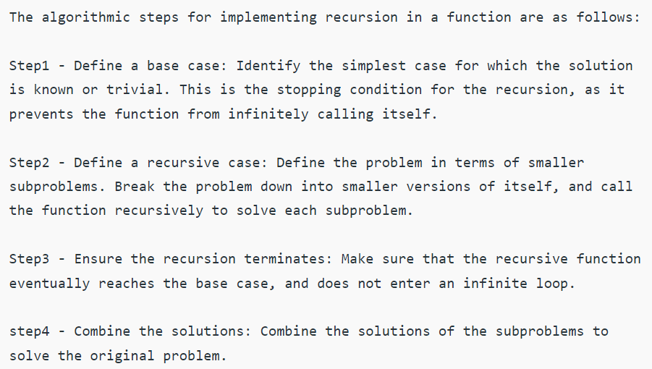
Key Components of a Recursive Algorithm Design

Slide 8
Examples in Recursion
Usually quite confusing the first time
Start with some simple examples
  recursive algorithms might not be best
Later with inherently recursive algorithms
  harder to implement otherwise

Slide 9
Example 1 (implement this program)
Determine the sum of first n natural numbers
approach(1) – Simply adding one by one
f(n) = 1 + 2 + 3 +……..+ n
Recursive approach
1 n=1
f(n) = n + f(n-1) n>1
Find the sum of the first 5 natural numbers

Slide 10
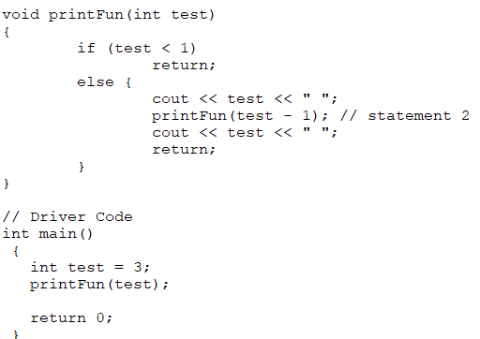
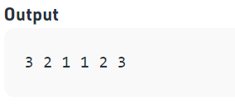
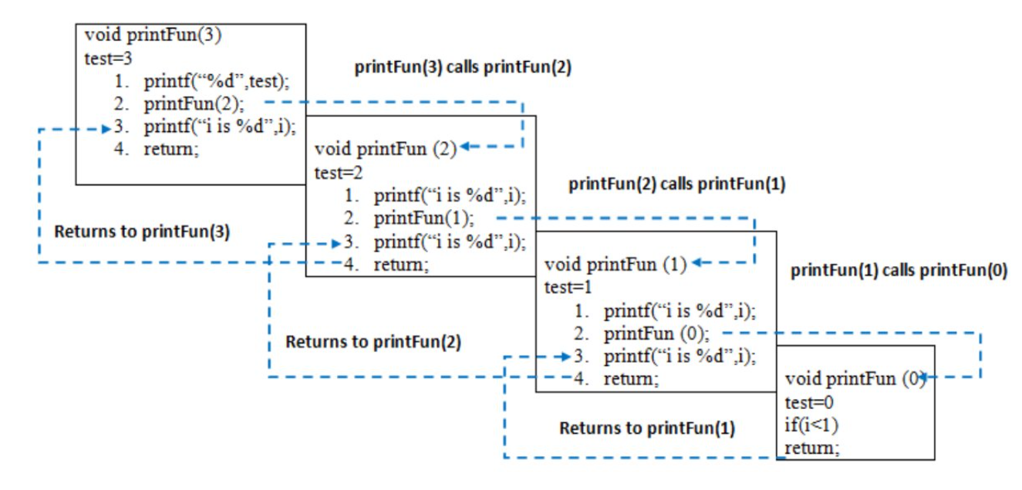
Example 3

Slide 11
Example 4: Fibonacci series
n if n == 0, n == 1;
fib(n) =
fib(n-1) + fib(n-2) if n>1
Recurrence Relation:
T(n) = T(n-1) + T(n-2)

Slide 12
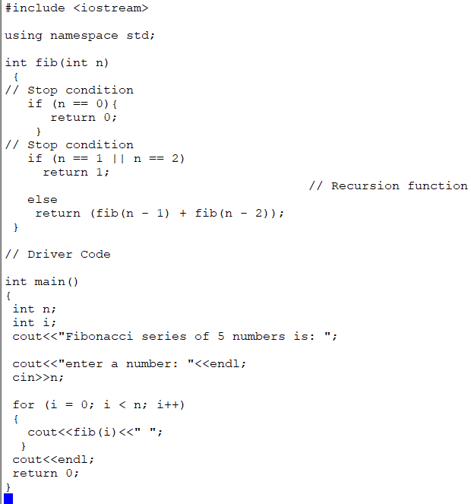


Slide 13
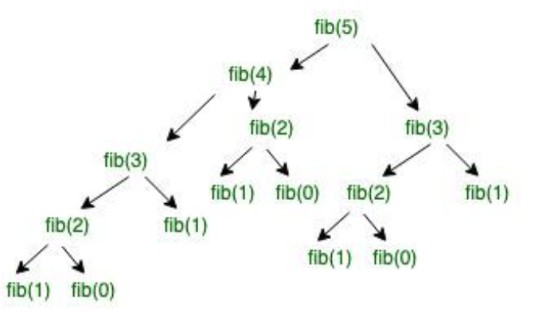
Consuming much memory (Redundancy)

Slide 14
Example 2: Let’s implement this program.
int fact(int n)
{
if (n < = 1) // base case
return 1;
else
return n*fact(n-1);
}

Slide 15

#include <iostream>
using namespace std;
// Factorial function
int f(int n)
{
// Stop condition
if (n == 0 || n == 1)
return 1;
// Recursive condition
else
return n * f(n - 1);
}
// Driver code
int main()
{
int n = 5;
cout<<"factorial of "<<n<<" is: "<<f(n);
return 0;
}

Slide 16
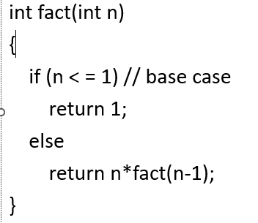
Execution Trace (decomposition)
factorial(4)
factorial(3) 4

Slide 17
Execution Trace (decomposition)
factorial(4)
factorial(3) 4
factorial(2) 3

Slide 18
Execution Trace (decomposition)
factorial(4)
factorial(3) 4
factorial(2) 3
factorial(1) 2

Slide 19
Execution Trace (composition)
factorial(4)
*
factorial(3) 4
*
factorial(2) 3
*
factorial(1)->1 2

Slide 20
Execution Trace (composition)
factorial(4)
*
factorial(3) 4
*
factorial(2)->2 3

Slide 21
Execution Trace (composition)
factorial(4)
*
factorial(3)->6 4

Slide 22
Execution Trace (composition)
factorial(4)->24

Slide 23
Template
… method(…)
{
if ( … )// base case
{
}
else // decomposition & composition
{
}
return … ; // if not void method
}

Slide 24
Template (only one base case)
… method(…)
{
… result = … ;//base case
if ( … ) // not base case
{ //decomposition & composition
result = …
}
return result;
}

Slide 25
Mistakes in recursion
No composition -> ?
Bad composition -> ?

Slide 26
numberOfZeros method
public static int numberOfZeros(int n)
{
int zeroCount;
if (n==0)
zeroCount = 1;
else if (n < 10) // and not 0
zeroCount = 0; // 0 for no zeros
else if (n%10 == 0)
zeroCount = numberOfZeros(n/10) + 1;
else // n%10 != 0
zeroCount = numberOfZeros(n/10);
return zeroCount;
}
Which is (are) the base case(s)? Why?
Decompostion, Why?
Composition, why?

Slide 27

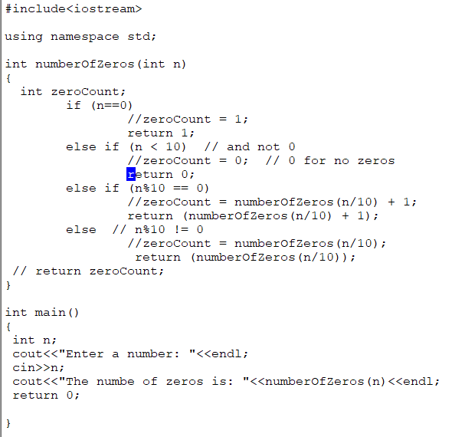
A matter of style

Slide 28
public static int numberOfZeros(int n)
{
int zeroCount;
if (n==0)
zeroCount = 1;
else if (n < 10) // and not 0
zeroCount = 0; // 0 for no zeros
else if (n%10 == 0)
zeroCount = numberOfZeros(n/10) + 1;
else // n%10 != 0
zeroCount = numberOfZeros(n/10);
return zeroCount;
}
Execution Trace (decomposition)
Each method invocation will execute one of the if-else cases shown at right.
numberOfZeros(2005)
numberOfZeros(200) 5
numberOfZeros(20) 0
numberOfZeros(2) 0

Slide 29
public static int numberOfZeros(int n)
{
int zeroCount;
if (n==0)
zeroCount = 1;
else if (n < 10) // and not 0
zeroCount = 0; // 0 for no zeros
else if (n%10 == 0)
zeroCount = numberOfZeros(n/10) + 1;
else // n%10 != 0
zeroCount = numberOfZeros(n/10);
return zeroCount;
}
Execution Trace (composition)
Recursive calls return
numberOfZeros(2005)->2
numberOfZeros(200)->2 5->0
numberOfZeros(20)->1 0->1
numberOfZeros(2)->0 0->1
+
+
+

Slide 30
Number in English Words
Process an integer and print out its digits in words
  Input: 123
  Output: "one two three”
RecursionDemo class

Slide 31
inWords Resursive Design
inWords prints a number N in English words
K = number of digits in N
Decomposition:
  inWords for the first K – 1 digits
  Print the last digit
Composition:
  Execution order of composed steps [more later]
Base case:
  N has one digit (K = 1)

Slide 32
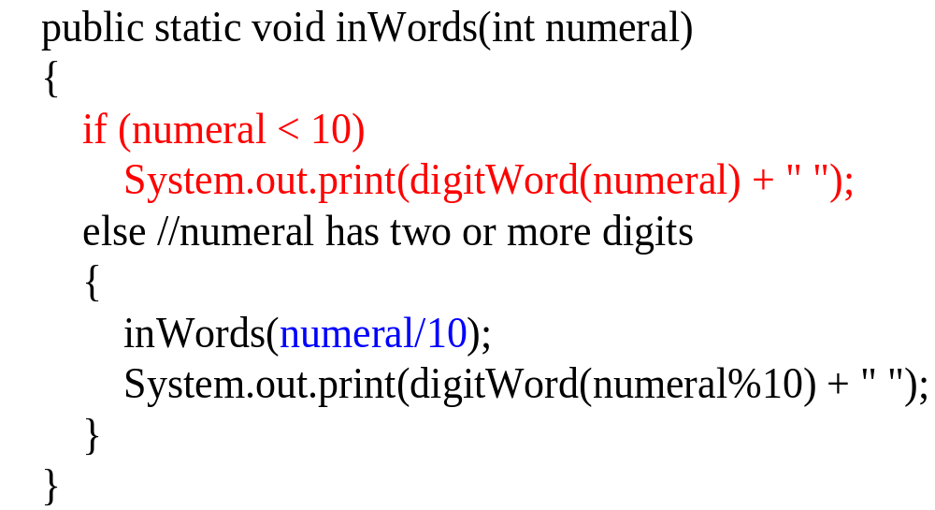
inWords method
Base case executes when only 1 digit is left
Size of problem is reduced for each recursive call

Slide 33
Execution Trace (decomposition)
inwords(987)
inwords(98) [print “seven”]
inwords(9) [print “eight”]
[print “nine”]
No output yet, why?

Slide 34
Execution Trace (composition)
inwords(987)
inwords(98) print “seven”
inwords(9) print “eight”
print “nine”
Output: nine eight seven

Slide 35
What Happens with a Recursive Call
1
inWords(987)
if (987 < 10)
// print digit here
else //two or more digits left
{
inWords(987/10);
// print digit here
}
inWords (slightly simplified) with argument 987

Slide 36
Execution
Trace
inWords(987)
if (987 < 10)
// print digit here
else //two or more digits left
{
inWords(987/10);
// print digit here
}
The argument is getting shorter and will eventually get to the base case.
2
inWords(98)
if (98 < 10)
// print digit here
else //two or more digits left
{
inWords(98/10);
// print digit here
}
Computation waits here until recursive call returns
The if condition is false
recursive call to inWords, with 987/10 or 98 as the argument

Slide 37
Execution Trace
inWords(987)
if (987 < 10)
// print digit here
else //two or more digits left
{
inWords(987/10);
// print digit here
}
inWords(98)
if (98 < 10)
// print digit here
else //two or more digits left
{
inWords(98/10);
// print digit here
}
inWords(9)
if (9 < 10)
// print digit here
else //two or more digits left
{
inWords(numeral/10);
// print digit here
}
3
the if condition is false
another recursive call is made.

Slide 38
Execution Trace
inWords(987)
if (987 < 10)
// print digit here
else //two or more digits left
{
inWords(987/10);
// print digit here
}
Output: nine
inWords(98)
if (98 < 10)
// print digit here
else //two or more digits left
{
inWords(98/10);
// print 98 % 10
}
4
inWords(9)
if (9 < 10)
// print nine
else //two or more digits left
{
inWords(numeral/10);
// print digit here
}
if condition is true (base case)
prints nine and returns
no recursive call

Slide 39
Execution Trace
inWords(987)
if (987 < 10)
// print out digit here
else //two or more digits left
{
inWords(987/10);
// print digit here
}
5
inWords(98)
if (98 < 10)
// print out digit here
else //two or more digits left
{
inWords(98/10);
// print out 98 % 10 here
}
Output: nine eight
executes the next statement after the recursive call
prints eight and then returns

Slide 40
Execution Trace
inWords(987)
if (987 < 10)
// print out digit here
else //two or more digits left
{
inWords(987/10);
// print 987 % 10
}
6
6
Output: nine eight seven
executes the next statement after the recursive method call.
prints seven and returns

Slide 41
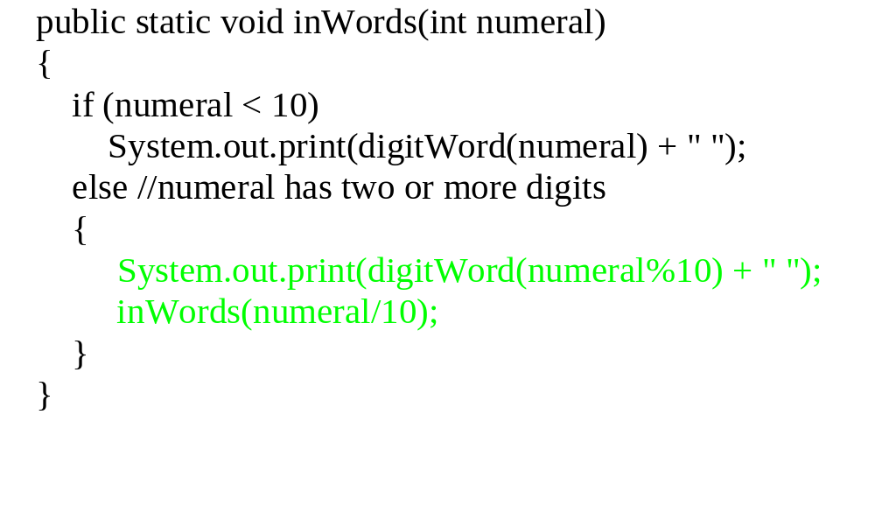
Composition Matters
Print before
making the recursive call
Recursive Design:
Print the last digit
inWords for the first K – 1 digits

Slide 42
Execution Trace (decomposition)
inwords(987)
print “seven” inwords(98)
Output: seven

Slide 43
Execution Trace (decomposition)
inwords(987)
print “seven” inwords(98)
print “eight” inwords(9)
Output: seven eight

Slide 44
Execution Trace (decomposition)
inwords(987)
print “seven” inwords(98)
print “eight” inwords(9)
print “nine”
Output: seven eight nine

Slide 45
Execution Trace (composition)
inwords(987)
print “seven” inwords(98)
print “eight” inwords(9)
print “nine”
No additional output

Slide 46
"Name in the Phone Book" Revisited
  Search:
    middle page = (first page + last page)/2
    Go to middle page;
    If (name is on middle page)
    done;//this is the base case
    else if (name is alphabetically before middle page)
    last page = middle page//redefine to front half
    Search//recursive call
    else //name must be after middle page
    first page = middle page//redefine to back half
    Search//recursive call

Slide 47
Binary Search Algorithm
Searching a list for a particular value
  sequential and binary are two common algorithms
Sequential search (aka linear search):
  Not very efficient
  Easy to understand and program
Binary search:
  more efficient than sequential
  but the list must be sorted first!

Slide 48
Why Is It Called "Binary" Search?
Compare sequential and binary search algorithms:
How many elements are eliminated from the list each time a value is read from the list and it is not the "target" value?
Sequential search: only one item
Binary search: half the list!
That is why it is called binary -
each unsuccessful test for the target value
reduces the remaining search list by 1/2.

Slide 49
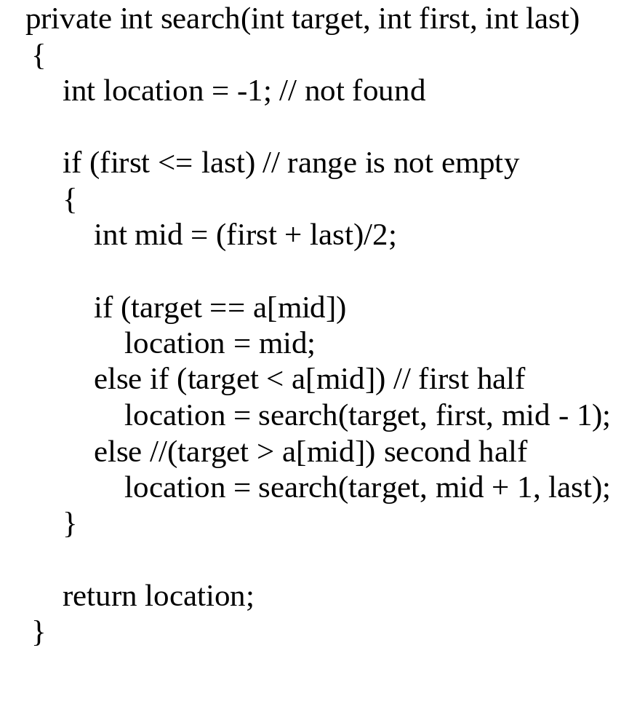
Binary Search Method

Slide 50
Where is the composition?
If no items
  not found (-1)
Else if target is in the middle
  middle location
Else
  location found by search(first half) or search(second half)

Slide 51
Binary Search Example
target is 33
The array a looks like this:
Indices
Contents
0 1 2 3 4 5 6 7 8 9
5 7 9 13 32 33 42 54 56 88
mid = (0 + 9) / 2 (which is 4)
33 > a[mid] (that is, 33 > a[4])
So, if 33 is in the array, then 33 is one of:
5 6 7 8 9
33 42 54 56 88
Eliminated half of the remaining elements from consideration because array elements are sorted.

Slide 52
Binary Search Example
target is 33
The array a looks like this:
Indexes
Contents
0 1 2 3 4 5 6 7 8 9
5 7 9 13 32 33 42 54 56 88
mid = (5 + 9) / 2 (which is 7)
33 < a[mid] (that is, 33 < a[7])
So, if 33 is in the array, then 33 is one of:
Eliminate half of the remaining elements
5 6
33 42
mid = (5 + 6) / 2 (which is 5)
33 == a[mid]
So we found 33 at index 5:
5
33

Slide 53
Tips
Don’t throw away answers (return values)--need to compose the answers
  Common programming mistake: not capturing and composing answers (return values)
Only one return statement at the end
  Easier to keep track of and debug return values
  “One entry, one exit”
www.cs.fit.edu/~pkc/classes/cse1001/BinarySearch/BinarySearch.java

Slide 54
Worst-case Analysis
Item not in the array (size N)
T(N) = number of comparisons with array elements
T(1) = 1
T(N) = 1 + T(N / 2)

Slide 55
Worst-case Analysis
Item not in the array (size N)
T(N) = number of comparisons with array elements
T(1) = 1
T(N) = 1 + T(N / 2)
= 1 + [1 + T(N / 4)]

Slide 56
Worst-case Analysis
Item not in the array (size N)
T(N) = number of comparisons with array elements
T(1) = 1
T(N) = 1 + T(N / 2)
= 1 + [1 + T(N / 4)]
= 2 + T(N / 4)
= 2 + [1 + T(N / 8)]

Slide 57
Worst-case Analysis
Item not in the array (size N)
T(N) = number of comparisons with array elements
T(1) = 1
T(N) = 1 + T(N / 2) ←
= 1 + [1 + T(N / 4)]
= 2 + T(N / 4) ←
= 2 + [1 + T(N / 8)]
= 3 + T(N / 8) ←
= …

Slide 58
Worst-case Analysis
Item not in the array (size N)
T(N) = number of comparisons with array elements
T(1) = 1
T(N) = 1 + T(N / 2) ←
= 1 + [1 + T(N / 4)]
= 2 + T(N / 4) ←
= 2 + [1 + T(N / 8)]
= 3 + T(N / 8) ←
= …
= k + T(N / 2^{k} ) [1]

Slide 59
Worst-case Analysis
T(N) = k + T(N / 2^{k} ) [1]
T(N / 2^{k} ) gets smaller until the base case: T(1)
  2^{k} = N
  k = log₂N
Replace terms with k in [1]:
T(N) = log₂N + T(N / N)
= log₂N + T(1)
= log₂N + 1
“log₂N” algorithm
We used recurrence equations

Slide 60
Main steps for analysis
Set up the recurrence equations for the recursive algorithm
Expand the equations a few times
Look for a pattern
Introduce a variable to describe the pattern
Find the value for the variable via the base case
Get rid of the variable via substitution

Slide 61
Binary vs. Sequential Search
Binary Search
  log₂N + 1 comparisons (worst case)
Sequential/Linear Search
  N comparisons (worst case)
Binary Search is faster but
  array is assumed to be sorted beforehand
Faster searching algorithms for “non-sorted arrays”
  More sophisticated data structures than arrays
  Later courses

Slide 62
Recursive Versus Iterative Methods
All recursive algorithms/methods
can be rewritten without recursion.
Iterative methods use loops instead of recursion
Iterative methods generally run faster and use less memory--less overhead in keeping track of method calls

Slide 63
So When Should You Use Recursion?
Solutions/algorithms for some problems are inherently recursive
  iterative implementation could be more complicated
When efficiency is less important
  it might make the code easier to understand
Bottom line is about:
  Algorithm design
  Tradeoff between readability and efficiency

Slide 64
Pages 807 NOT a good tip [Programming Tip: Ask Until the User Gets It Right]
Recursion continues until user enters valid input.
public void getCount()
{
System.out.println("Enter a positive number:");
count = SavitchIn.readLineInt();
if (count <= 0)
{
System.out.println("Input must be positive.
System.out.println("Try again.");
getCount(); //start over
}
}
read a number
Use a recursive call to get another number.
No notion of a smaller problem for recursive design
Easily implemented using iteration without loss
of readability

Slide 65
Merge Sort—
A Recursive Sorting Algorithm
Example of divide and conquer algorithm
Recursive design:
  Divides array in half and merge sorts the halves (decomposition)
  Combines two sorted halves (composition)
  Array has only one element (base case)
Harder to implement iteratively

Slide 66
Execution Trace (decomposition)
3 | 6 | 8 | 2 | 5 | 4 | 7 | 1
3 | 6 | 8 | 2
5 | 4 | 7 | 1
3 | 6
8 | 2
5 | 4
7 | 1
3
6
8
2
5
4
7
1

Slide 67
Execution Trace (composition)
1 | 2 | 3 | 4 | 5 | 6 | 7 | 8
2 | 3 | 6 | 8
1 | 4 | 5 | 7
3 | 6
2 | 8
4 | 5
1 | 7
3
6
8
2
5
4
7
1

Slide 68
Merging Two Sorted Arrays
2
3 | 6
2 | 8

Slide 69
Merging Two Sorted Arrays
2 | 3
3 | 6
2 | 8

Slide 70
Merging Two Sorted Arrays
2 | 3 | 6
3 | 6
2 | 8

Slide 71
Merging Two Sorted Arrays
2 | 3 | 6 | 8
3 | 6
2 | 8

Slide 72
Merge Sort Algorithm
If array a has more than one element:
  Copy the first half of the elements in a to array front
  Copy the rest of the elements in a to array tail
  Merge Sort front
  Merge Sort tail
  Merge the elements in front and tail into a
Otherwise, do nothing

Slide 73
Merge Sort
public static void sort(int[] a)
{
if (a.length >= 2)
{
int halfLength = a.length / 2;
int[] front = new int[halfLength];
int[] tail = new int[a.length – halfLength];
divide(a, front, tail);
sort(front);
sort(tail);
merge(a, front, tail);
}
// else do nothing.
}
do recursive case if true, base case if false
recursive calls
make "smaller" problems by dividing array
Combine the two sorted arrays
base case: a.length == 1 so a is sorted and no recursive call is necessary.

Slide 74
Worst-case Theoretical Analysis
Comparisons of array elements
None during decomposition
Only during merging two sorted arrays (composition)
  To get an array of size N from two sorted arrays of size N/2
  N - 1 comparisons (worst case: the largest two elements are in different halves)

Slide 75
Analysis: Array of size N
Let T(N) be the number of comparisons
T(1) = 0
T(N) = 2 T(N / 2) + (N – 1)

Slide 76
Analysis: Array of size N
Let T(N) be the number of comparisons
T(1) = 0
T(N) = 2 T(N / 2) + (N – 1)
= 2 [2 T(N / 4) + (N / 2 – 1)] + (N – 1)

Slide 77
Analysis: Array of size N
Let T(N) be the number of comparisons
T(1) = 0
T(N) = 2 T(N / 2) + (N – 1)
= 2 [2 T(N / 4) + (N / 2 – 1)] + (N – 1)
= 4 T(N / 4) + (N – 2) + (N – 1)
= 4 [ 2 T(N / 8) + (N / 4 – 1) ] + (N – 2) + (N – 1)

Slide 78
Analysis: Array of size N
Let T(N) be the number of comparisons
T(1) = 0
T(N) = 2 T(N / 2) + (N – 1) ←
= 2 [2 T(N / 4) + (N / 2 – 1)] + (N – 1)
= 4 T(N / 4) + (N – 2) + (N – 1) ←
= 4 [ 2 T(N / 8) + (N / 4 – 1) ] + (N – 2) + (N – 1)
= 8 T(N / 8) + (N – 4) + (N – 2) + (N – 1) ←

Slide 79
Analysis: Array of size N
Let T(N) be the number of comparisons
T(1) = 0
T(N) = 2 T(N / 2) + (N – 1) ←
= 2 [2 T(N / 4) + (N / 2 – 1)] + (N – 1)
= 4 T(N / 4) + (N – 2) + (N – 1) ←
= 4 [ 2 T(N / 8) + (N / 4 – 1) ] + (N – 2) + (N – 1)
= 8 T(N / 8) + (N – 4) + (N – 2) + (N – 1) ←
= 8 T(N / 8) + 3N – (1 + 2 + 4)

Slide 80
Analysis: Array of size N
Let T(N) be the number of comparisons
T(1) = 0
T(N) = 2 T(N / 2) + (N – 1) ←
= 2 [2 T(N / 4) + (N / 2 – 1)] + (N – 1)
= 4 T(N / 4) + (N – 2) + (N – 1) ←
= 4 [ 2 T(N / 8) + (N / 4 – 1) ] + (N – 2) + (N – 1)
= 8 T(N / 8) + (N – 4) + (N – 2) + (N – 1) ←
= 8 T(N / 8) + 3N – (1 + 2 + 4)
= …
= 2^{k} T(N / 2^{k} ) + kN – (1 + 2 + … 2^{k-1} ) [1]

Slide 81
Analysis Continued
T(N) = 2^{k} T(N / 2^{k} ) + kN – (1 + 2 + … 2^{k-1} ) [1]
= 2^{k} T(N / 2^{k} ) + kN – (2^{k} - 1) [2]
T(N / 2^{k} ) gets smaller until the base case T(1):
  2^{k} = N
  k = log₂N
Replace terms with k in [2]:
T(N) = N T(N / N) + log₂N*N – (N – 1)
= N T(1) + Nlog₂N – (N – 1)
= Nlog₂N – N + 1
“Nlog₂N” algorithm

Slide 82
Geometric Series and Sum
1 + 2 + 4 + 8 + … + 2^{k}
  1 + 2 = 3
  1 + 2 + 4 = 7
  1 + 2 + 4 + 8 = 15

Slide 83
Geometric Series and Sum
1 + 2 + 4 + 8 + … + 2^{k}
  1 + 2 = 3 (4 – 1)
  1 + 2 + 4 = 7 (8 – 1)
  1 + 2 + 4 + 8 = 15 (16 – 1)

Slide 84
Geometric Series and Sum
1 + 2 + 4 + 8 + … + 2^{k}
  1 + 2 = 3 (4 – 1)
  1 + 2 + 4 = 7 (8 – 1)
  1 + 2 + 4 + 8 = 15 (16 – 1)
1 + 2 + 4 + 8 + … + 2^{k}
= 2^{k+1} - 1
1 + r + r² + r³ + … + r^{k}
= r⁰ + r¹ + r² + r³ + … + r^{k}
= (r^{k+1} – 1) / (r – 1) [for r > 1]

Slide 85
Merge Sort Vs. Selection/Insertion/Bubble Sort
Merge Sort
  “NlogN” algorithm (in comparisons)
Selection/Insertion/Bubble Sort
  “N²” algorithm (in comparisons)
“NlogN” is “optimal” for sorting
  Proven that the sorting problem cannot be solved with fewer comparisons
  Other NlogN algorithms exist, many are recursive

Slide 86
Real Data Set: Web Server Log
http://www.cs.fit.edu/~pkc/classes/writing/data/jan99.log
4.6 MB (44057 entries)
Example entry in log:
ip195.dca.primenet.com - - [04/Jan/1999:09:16:51 -0500] "GET / HTTP/1.0" 200 762
Extracted features
  remote-host names (strings)
  file-size (integers)
List size - 100 to 44000 entries

Slide 87
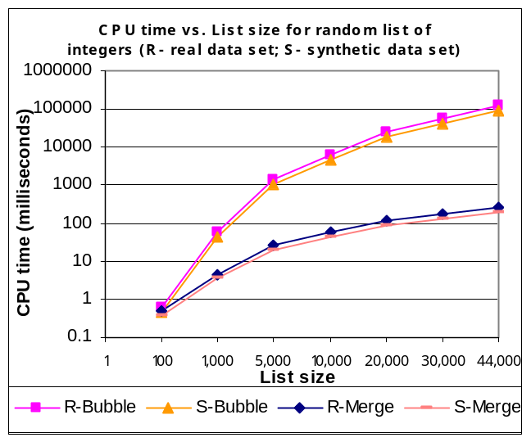
CPU Time: Randomly Ordered Integers

Slide 88
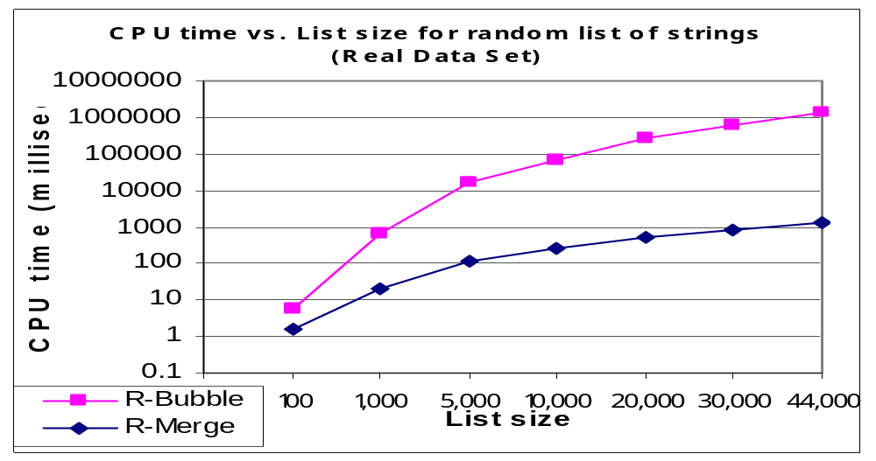
CPU Time: Randomly Ordered Strings

Slide 89
Google’s PageRank (1998)
PageRank(x) depends on:
  How many pages (y’s) linking to x
    how many incoming links (citations) from y’s to x
  How important those pages (y’s) are:
    PageRank(y)’s
How to determine PageRank(y)’s?
What is the base case?

Slide 90
Summary
Recursive call: a method that calls itself
Powerful for algorithm design at times
Recursive algorithm design:
    Decomposition (smaller identical problems)
    Composition (combine results)
    Base case(s) (smallest problem, no recursive calls)
Implementation
  Conditional (e.g. if) statements to separate different cases
  Avoid infinite recursion
    Problem is getting smaller (decomposition)
    Base case exists and reachable
  Composition could be tricky

Slide 91
Summary
Binary Search
  Given an ordered list
  “logN” algorithm (in comparisons)
  “Optimal”
Merge Sort
  Recursive sorting algorithm
  “NlogN” algorithm (in comparisons)
  “Optimal”

