Slide 1
3. Graphs
basic definitions and applications
graph connectivity and graph traversal
testing bipartiteness
connectivity in directed graphs
DAGs and topological ordering

Slide 2
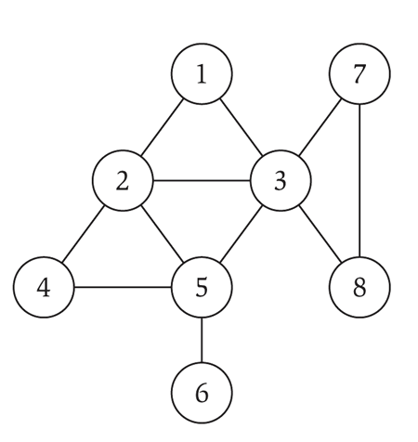
Undirected graphs
Notation. G = (V, E)
・V = nodes (or vertices).
・E = edges (or arcs) between pairs of nodes.
・Captures pairwise relationship between objects.
・Graph size parameters: n = | V |, m = | E |.
V = { 1, 2, 3, 4, 5, 6, 7, 8 }
E = { 1–2, 1–3, 2–3, 2–4, 2–5, 3–5, 3–7, 3–8, 4–5, 5–6, 7–8 }
m = 11, n = 8

Slide 3
Graph representation: adjacency matrix
Adjacency matrix. n-by-n matrix with A_{uv} = 1 if (u, v) is an edge.
・Two representations of each edge.
・Space proportional to n².
・Checking if (u, v) is an edge takes Θ(1) time.
・Identifying all edges takes Θ(n²) time.
 | 1 | 2 | 3 | 4 | 5 | 6 | 7 | 8
1 | 0 | 1 | 1 | 0 | 0 | 0 | 0 | 0
2 | 1 | 0 | 1 | 1 | 1 | 0 | 0 | 0
3 | 1 | 1 | 0 | 0 | 1 | 0 | 1 | 1
4 | 0 | 1 | 0 | 0 | 1 | 0 | 0 | 0
5 | 0 | 1 | 1 | 1 | 0 | 1 | 0 | 0
6 | 0 | 0 | 0 | 0 | 1 | 0 | 0 | 0
7 | 0 | 0 | 1 | 0 | 0 | 0 | 0 | 1
8 | 0 | 0 | 1 | 0 | 0 | 0 | 1 | 0

Slide 4
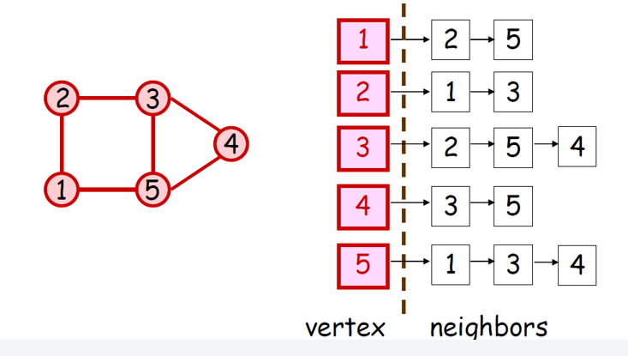
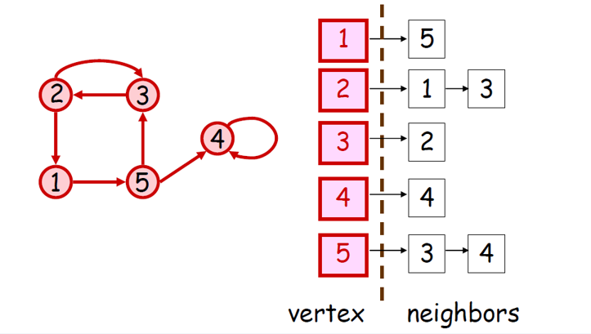
Graph representation: adjacency lists
Adjacency lists. Node-indexed array of lists.
・Two representations of each edge.
・Space is Θ(m + n).
degree = number of neighbors of u
・Checking if (u, v) is an edge takes O(degree(u)) time.
・Identifying all edges takes Θ(m + n) time.

Slide 5
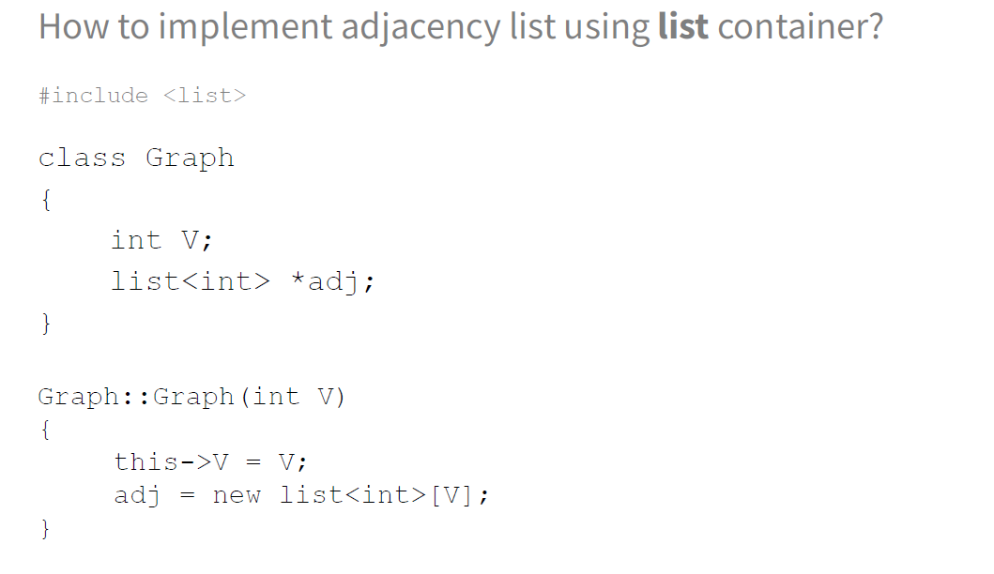
Graph implementation using lists (next lecture)

Slide 6
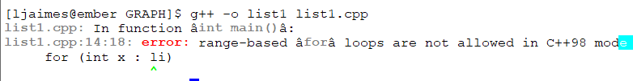
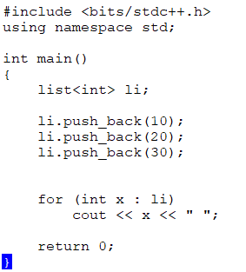
Programming with list
https://www.guru99.com/cpp-list.html
Extra instruction to compile in the ember system
g++ -std=c++11 -o list2 list2.cpp otherwise you will get
https://www.geeksforgeeks.org/list-cpp-stl/
Here, a nice description of the list of containers based on double linked list

Slide 7
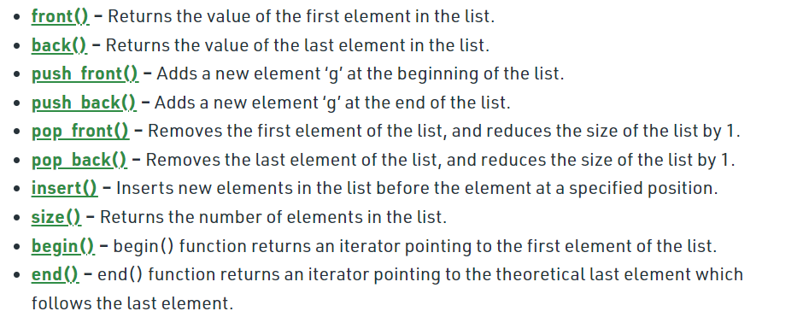
Operations std::list
g++ -std=c++11 -o list2 list2.cpp otherwise you will get

Slide 8
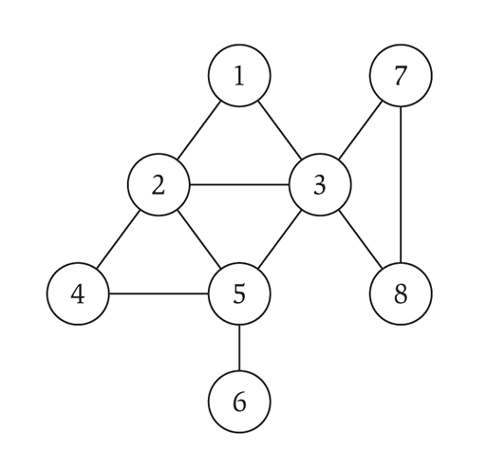
Cycles
Def. A cycle is a path v1, v2, …, vk in which v₁ = v_{k} and k ≥ 2.
Def. A cycle is simple if all nodes are distinct (except for v₁ and v_{k} ).
cycle C = 1-2-4-5-3-1

Slide 9
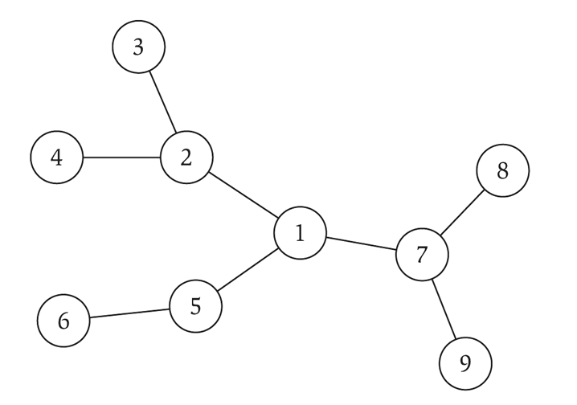
Trees
Def. An undirected graph is a tree if it is connected and does not contain a cycle.
Theorem. Let G be an undirected graph on n nodes. Any two of the following statements imply the third:
・G is connected.
・G does not contain a cycle.
・G has n – 1 edges.

Slide 10
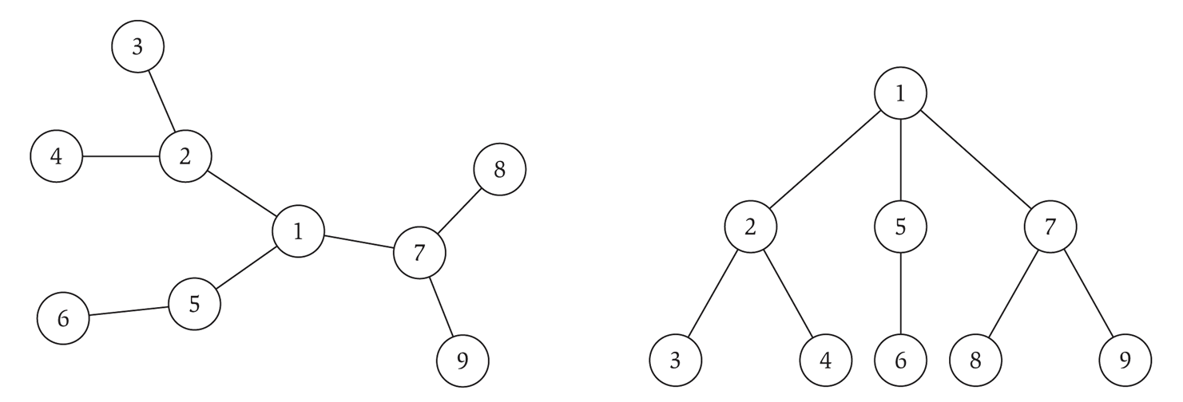
Rooted trees
Given a tree T, choose a root node r and orient each edge away from r.
Importance. Models hierarchical structure.
root r
the parent of v
v
a child of v
a tree
the same tree, rooted at 1

Slide 11
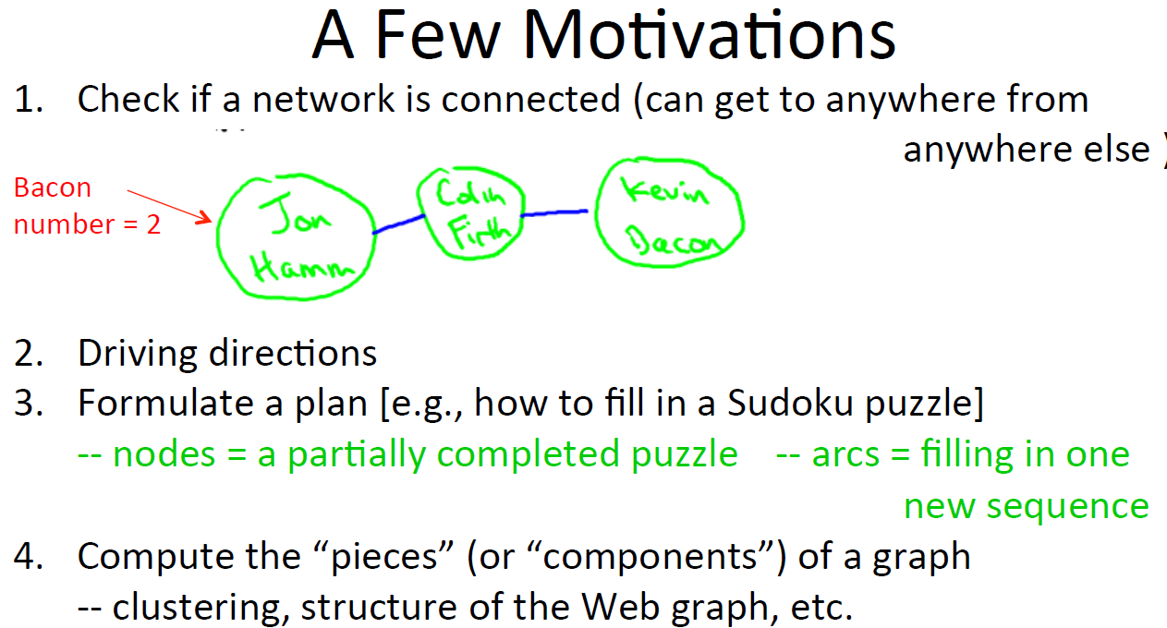
Graph search

Slide 12

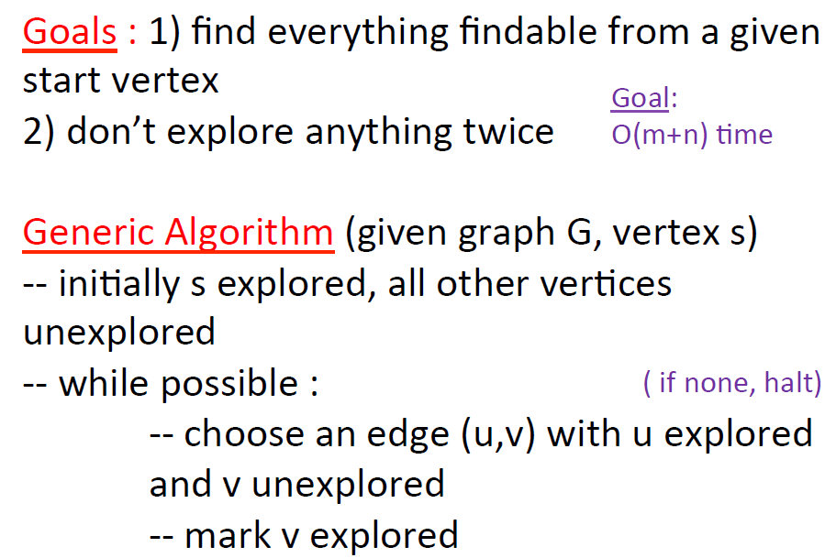

Slide 13
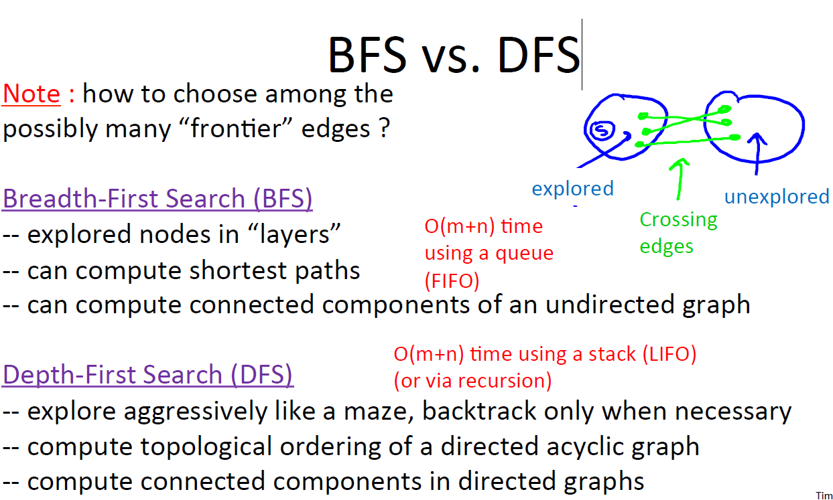

Slide 14
How to explore a graph
BSF: Breadth First Search
DFS: Depth First Search (Next set of slides)

Slide 15
Breadth-first search
BFS intuition. Explore outward from s in all possible directions, adding nodes one “layer” at a time.
BFS algorithm.
・L₀ = { s }.
s
L₁
L₂
^{L}n–1
・L₁ = all neighbors of L₀.
・L₂ = all nodes that do not belong to L₀ or L₁, and that have an edge to a node in L₁.
・L_{i+1} = all nodes that do not belong to an earlier layer, and that have an edge to a node in L_{i}.
Theorem. For each i, L_{i} consists of all nodes at distance exactly i
from s. There is a path from s to t iff t appears in some layer.

Slide 16
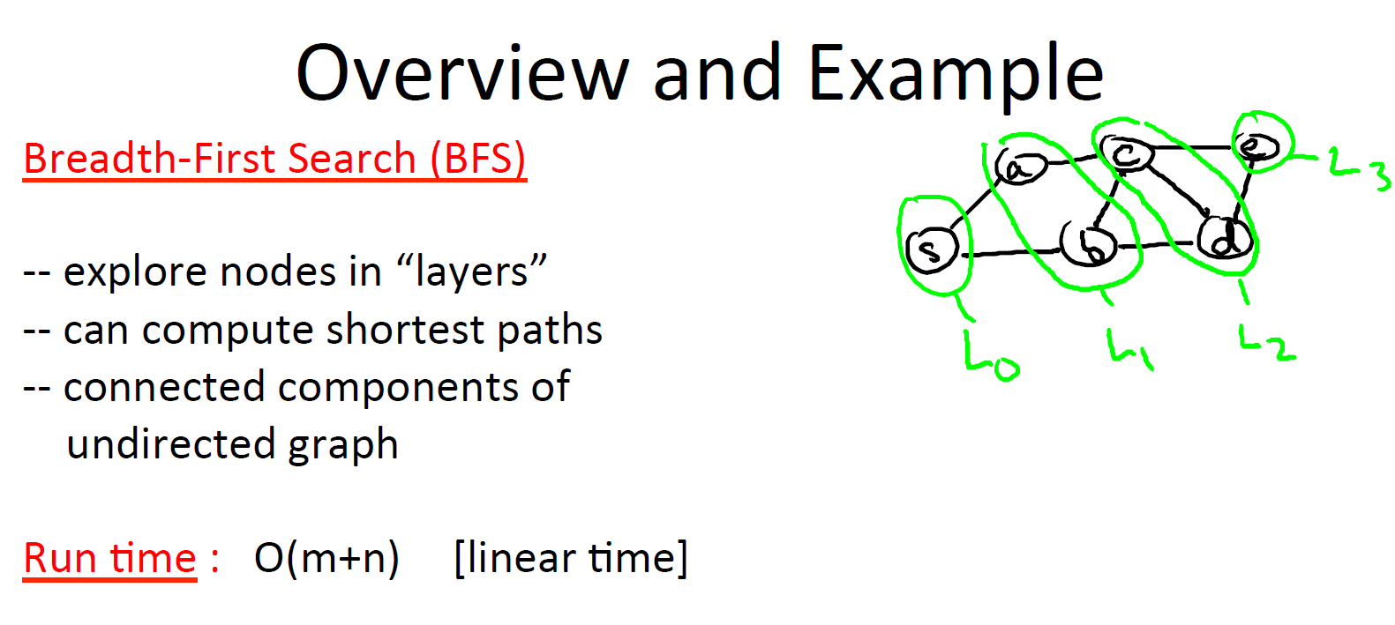

Slide 17
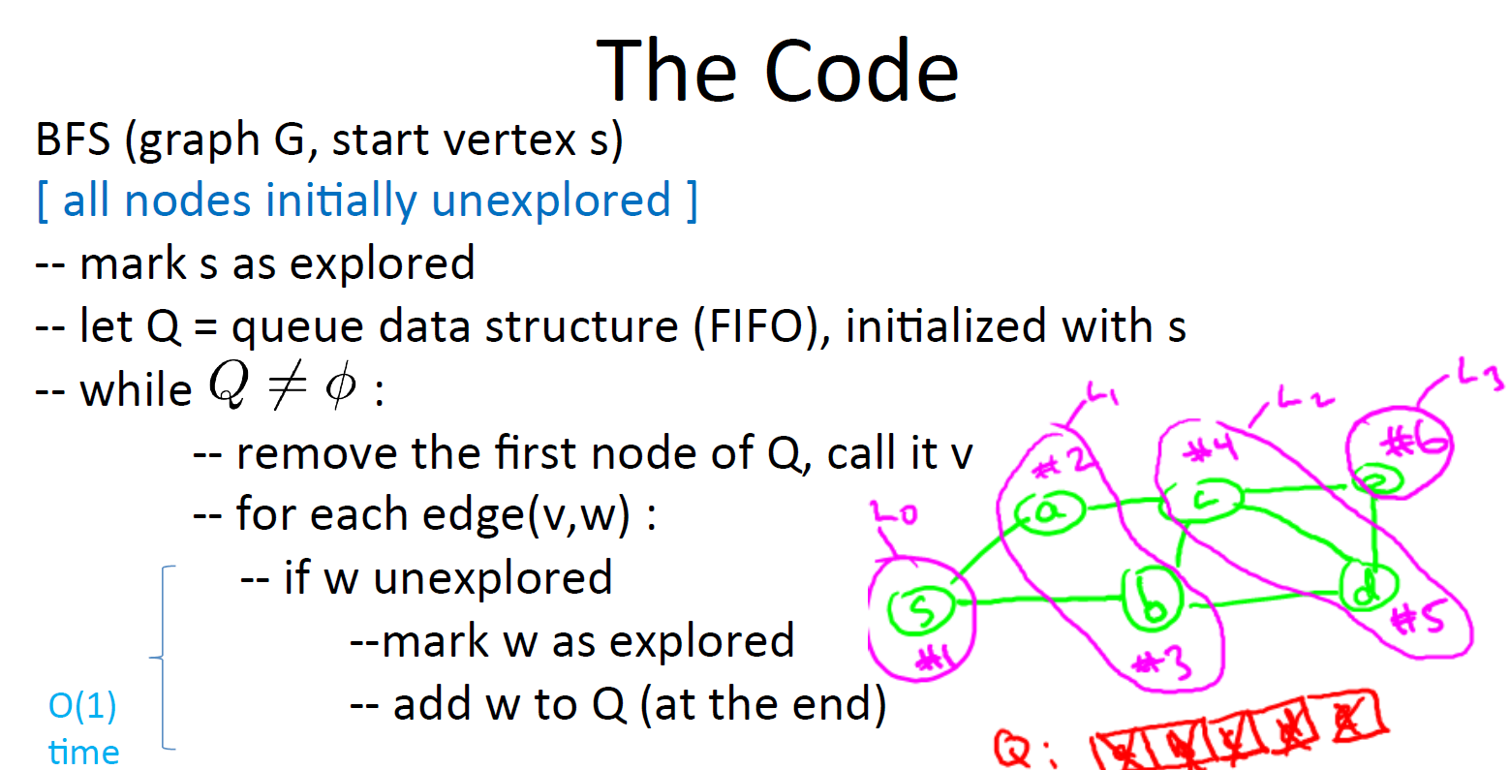

Slide 18
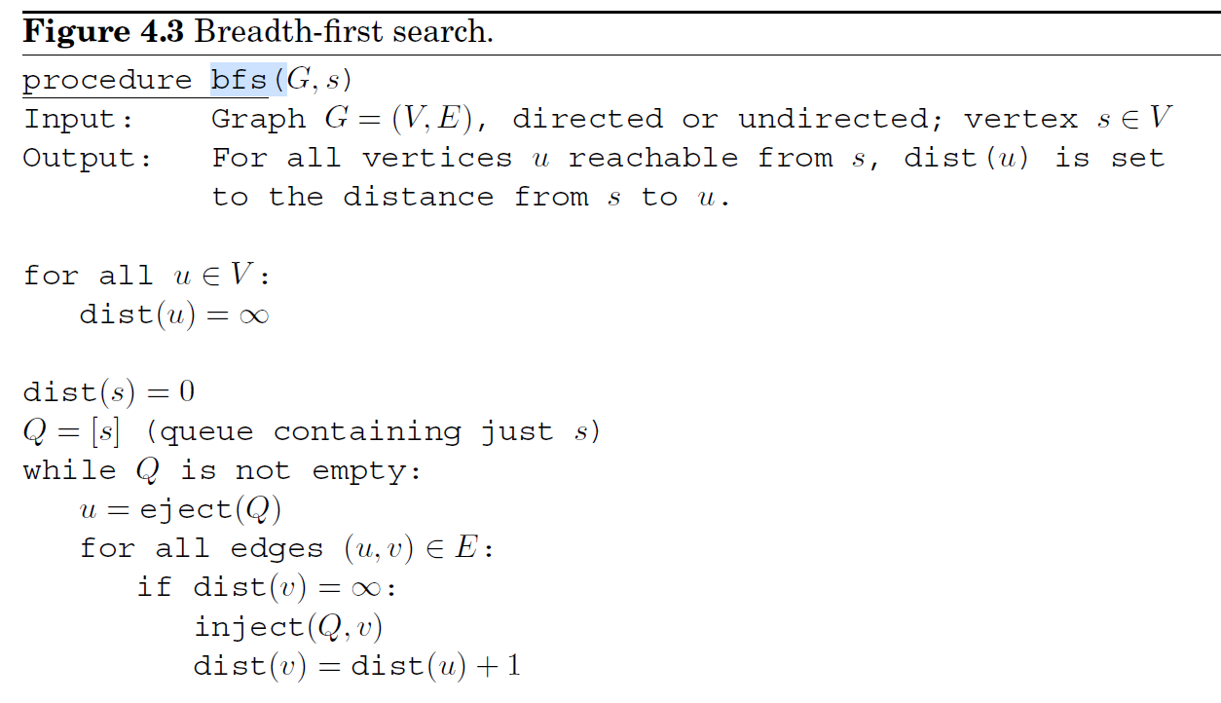
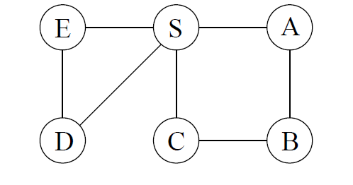
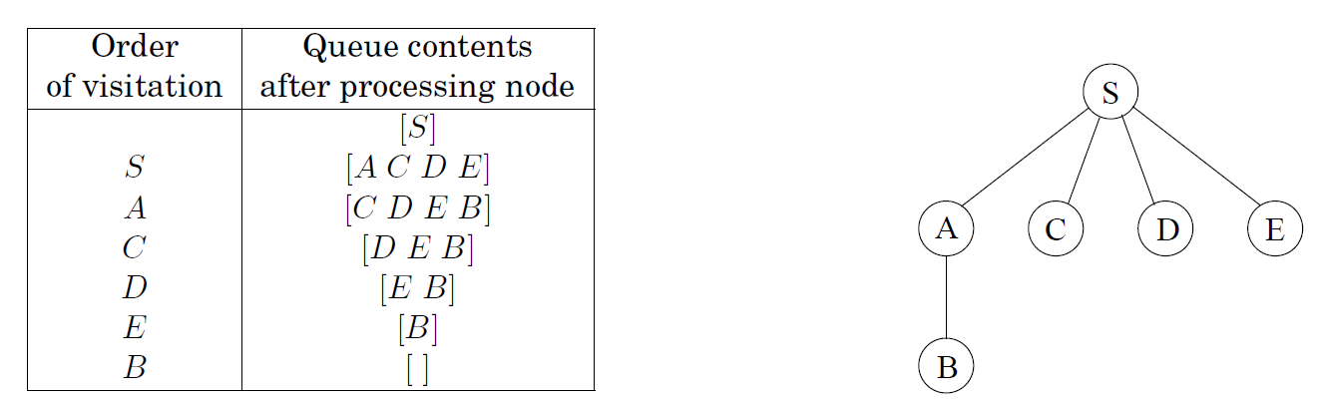

Slide 19
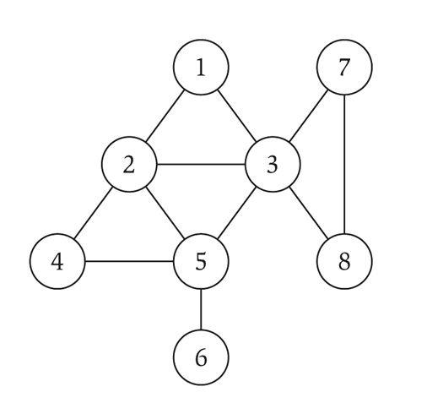
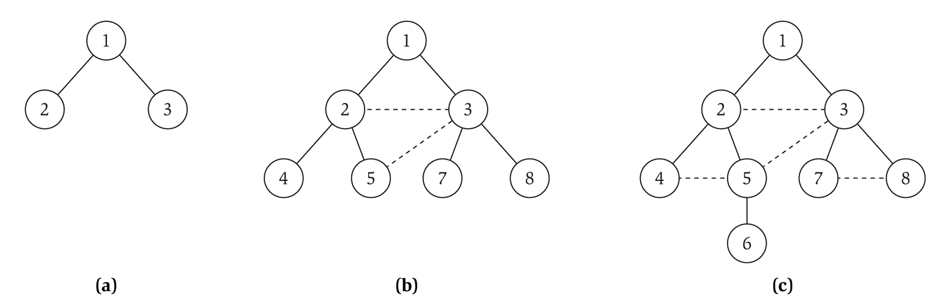
Breadth-first search
Property. Let T be a BFS tree of G = (V, E), and let (x, y) be an edge of G. Then, the levels of x and y differ by at most 1.
L₀
L₁
L₂
L₃

Slide 20
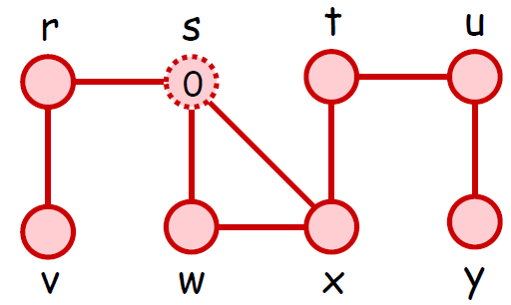
BFS (Example)

Slide 21
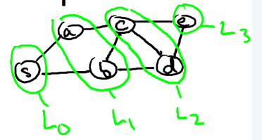
BFS (Example)

