Slide 1
Greedy Approach Dijkstra’s Algorithm for Single-Source Shortest Paths

Slide 2
Greedy Approach
Initially the solution is an empty set
At each iteration, items added to the solution set until the set represents a solution to that instance of the problem
Steps:
Selection procedure: Choose the next item to add to the solution set according to the greedy criterion satisfying the locally optimal consideration.
The selection procedure simply consists of greedily grabbing the next-item without considering the potential drawbacks of making such a choice
Feasibility Check: Determine if the new set is feasible by determining if it is possible to complete this set to provide a solution to the problem instance
Solution Check: Determine whether the new set produced is a solution to the problem instance.

Slide 3
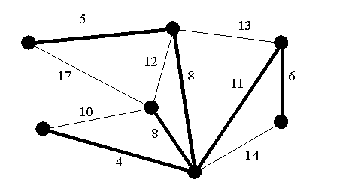
Minimum Spanning Tree
It is a spanning tree whose sum of edge weights is as small as possible.
It is a subset of the edges of a connected, edge-weighted undirected graph that connects all the vertices together, without any cycles and with the minimum possible total edge weight.

Slide 4
Minimum Spanning Tree for G
Let G = (V , E)
Let T be a spanning tree for G:
T = (V, F) where F ⊆ E
Find T such that the sum of the weights of the edges in F is minimal

Slide 5
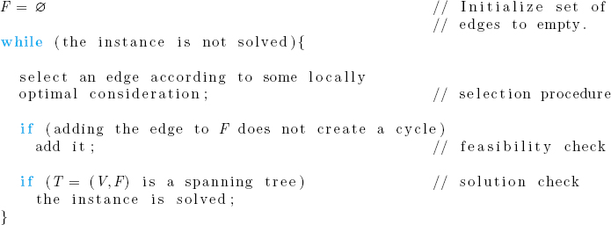
Greedy Algorithms for finding a Minimum Spanning Tree
Prim’s Algorithm
Kruskal’s Algorithm

Slide 6
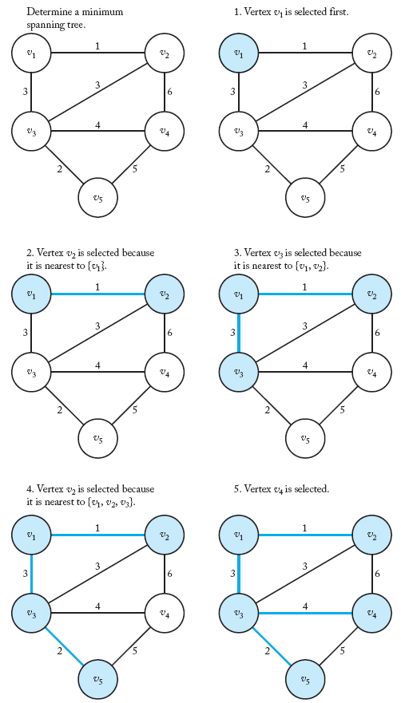
Prim’s Algorithm
A weighted graph (in upper-left corner) and the steps in Prim's algorithm for that graph.
The vertices in Y and the edges in F are shaded at each step.

Slide 7
Prim’s Algorithm
Empty subset of edges F
Subset of vertices Y initialized to an arbitrary vertex
Y = {v ₁}
Select a vertex nearest to Y from V-Y connected to a vertex in Y by a minimum weight edge
Add the selected vertex to Y
Add the edge connecting the selected vertex to F
Ties broken arbitrarily
Repeat the process until Y = V

Slide 8
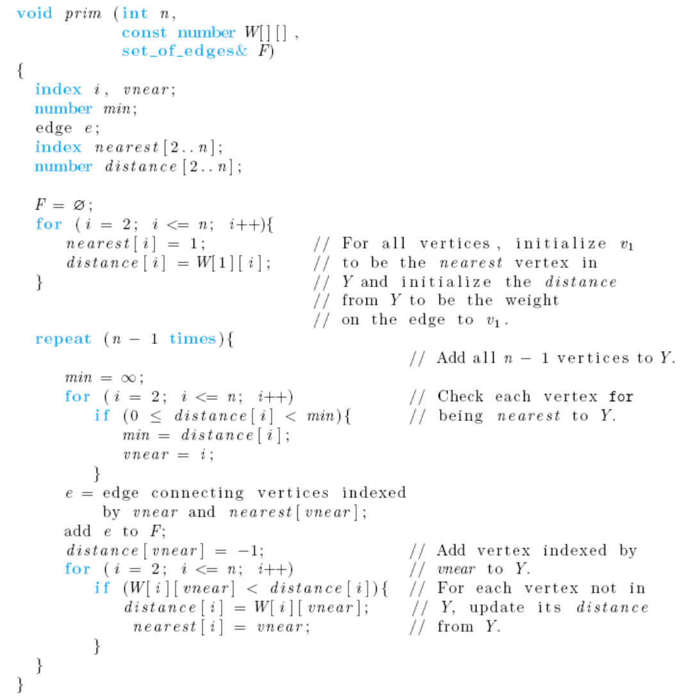
Prim’s Algorithm
Nearest is a one dimensional array that keeps the vertices added to the solution set
Distance is a one dimensional array that keeps track of the current minimum distances of vertices from the vertices that has already been added to the solution set
Notes:
Distance is a one dimensional array that keeps track of the distance of vertices from the vertices that has already been added to the solution set
Nearest is a one dimensional array that keeps the vertices added to the solution set

Slide 9
Dijkstra’s Algorithm for Single-Source Shortest Paths
Given a graph and a source vertex in the graph, find shortest paths from source to all vertices in the given graph.
Similar to Prim’s algorithm for the Minimum Spanning Tree.
Dijsktra's algorithm finds the minimum distance from node i to all nodes (you specify i). So, you get the minimum distance tree from node i.
Prims algorithm gets you the minimum spanning tree for a given graph. A tree that connects all nodes while the sum of all costs is the minimum possible.
With Dijkstra, you can go from the selected node to any other with the minimum cost, you don't get this with Prim's.

Slide 10
Dijkstra’s Algorithm for Single-Source Shortest Paths
We initialize a set Y to contain only the vertex whose shortest paths are to be determined.
For focus, we say that the vertex is v1. We initialize a set F of edges to being empty.
First we choose a vertex v that is nearest to v1, add it to Y , and add the edge < v1, v > to F.
Next we check the paths from v1 to the vertices in V − Y that allow only vertices in Y as intermediate vertices and get the path with the shortest path.
The vertex at the end of such a path is added to Y , and the edge (on the path) that touches that vertex is added to F.
This procedure is continued until Y equals V , the set of all vertices. At this point, F contains the edges in shortest paths.

Slide 11
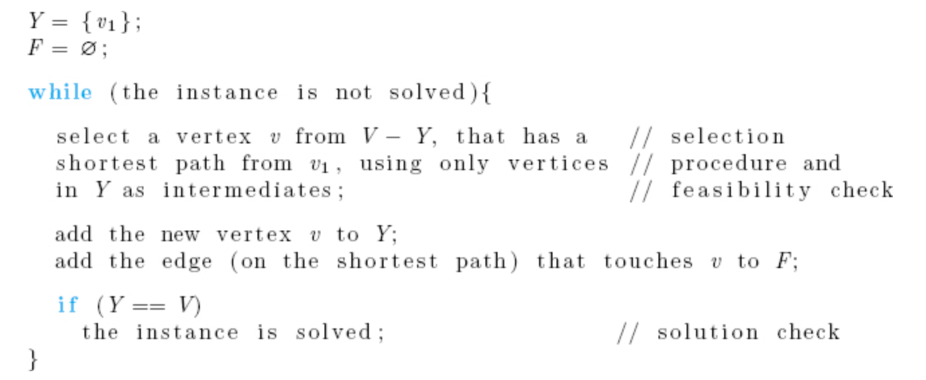
Dijkstra’s Algorithm for Single-Source Shortest Paths
.
Difference in selection procedure between Prim’s and Dijkstra’s:
Prim’s: Select a vertex from V-Y that has the shortest distance (weight) to Y
Dijkstra’s: Select a vertex from V-Y that has the shortest path from v1 (single source) using only vertices in Y as intermediates

Slide 12
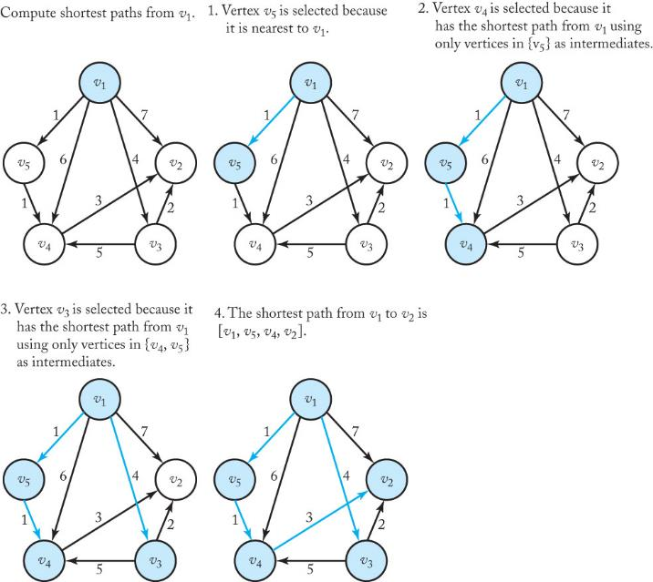
A weighted, directed graph (in upper-left corner) and the steps in Dijkstra's algorithm for that graph. The vertices in Y and the edges in F are shaded in color at each step.
Source is v1, initially:
length[2]=7
length[3]=4
length[4]=6
length[5]=1
After adding v5:
length[2]=7
length[3]=4
length[4]=2
length[5]=1
After adding v4:
length[2]=5
length[3]=4
length[4]=2
length[5]=1
length[4]=2
length[2]=5
After adding v3:
length[2]=5
length[3]=4
length[4]=2
length[5]=1

Slide 13
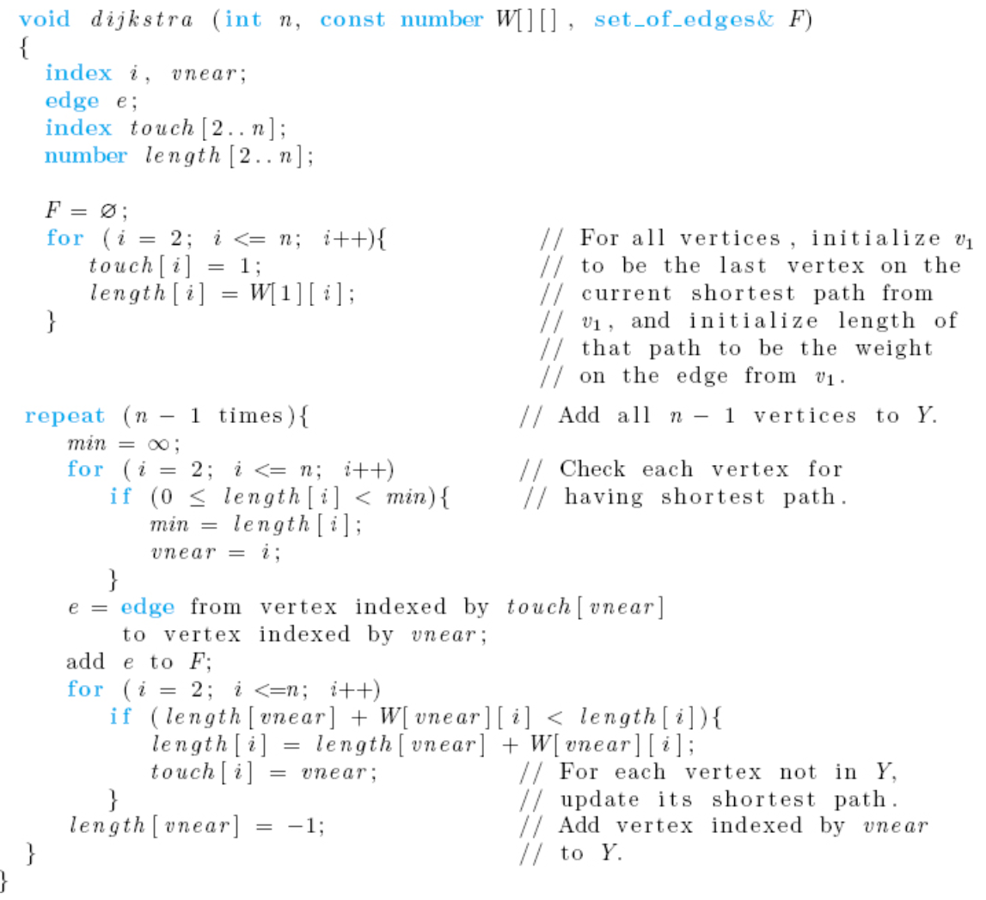
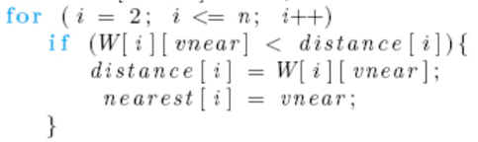
Dijkstra’s Algorithm for Single-Source Shortest Paths
touch[i] = index of vertex v in Y such that the edge is the last edge on the current shortest path from v1 to vi using only vertices in Y as intermediates.
length[i] = length of the current shortest path from v1 to vi using only vertices in Y as intermediates.
.
Code from Prim’s:
Check the difference
Notes:
Because we are assuming that there is a path from v₁ to every other vertex, the variable vnear has a new value in each iteration of the repeat loop. If this were not the case, the algorithm, as written, would end up adding the last edge over and over until n − 1 iterations of the repeat loop were completed.
This algorithm only returns the edges in the shortest paths. It does not return the lengths of those paths. These lengths could be obtained from the edges. Alternatively, a simple modification of the algorithm would enable it to compute the lengths and store them in an array as well.
Although we do not do it here, it is possible to prove that Algorithm always produces shortest paths. The proof uses an induction argument similar to the one used to prove that Prim’s

Slide 14
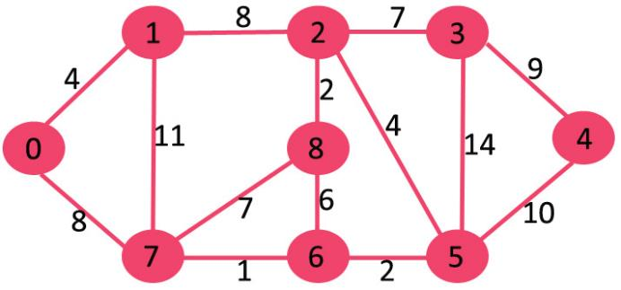

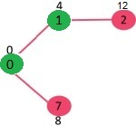
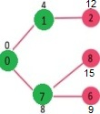
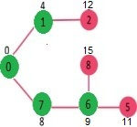
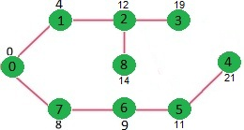
SP - Example
The set sptSet is initially empty and distances assigned to vertices are {0, INF, INF, INF, INF, INF, INF, INF} where INF indicates infinite
{0}
{0, 1}
{0, 1, 7}
{0, 1, 7, 6}
…
.
Add v1, update
length[2]=12
Add v7, update
length[6]=9
length[8]=15
Add v6, update
length[5]=11
Notes:
Reference:
https://www.geeksforgeeks.org/dijkstras-shortest-path-algorithm-greedy-algo-7/

Slide 15
dist[1] = 4
dist [7] =8
add v1
dist[2] =12
dist[7] =8
add v7
dist[2] =12
dist[6] =9
dist[8]=15
add v6
dist[5] =11
dist[2] =12
dist[8]=15
add v5
dist[4] =21
dist[8]=15
dist[3] =25
dist[2] =12
add v2
dist[4] = 21
dist[8]=14
dist[3]=19
add v8
dist[4] = 21
dist[3]=19
add v3
add v4

Slide 16
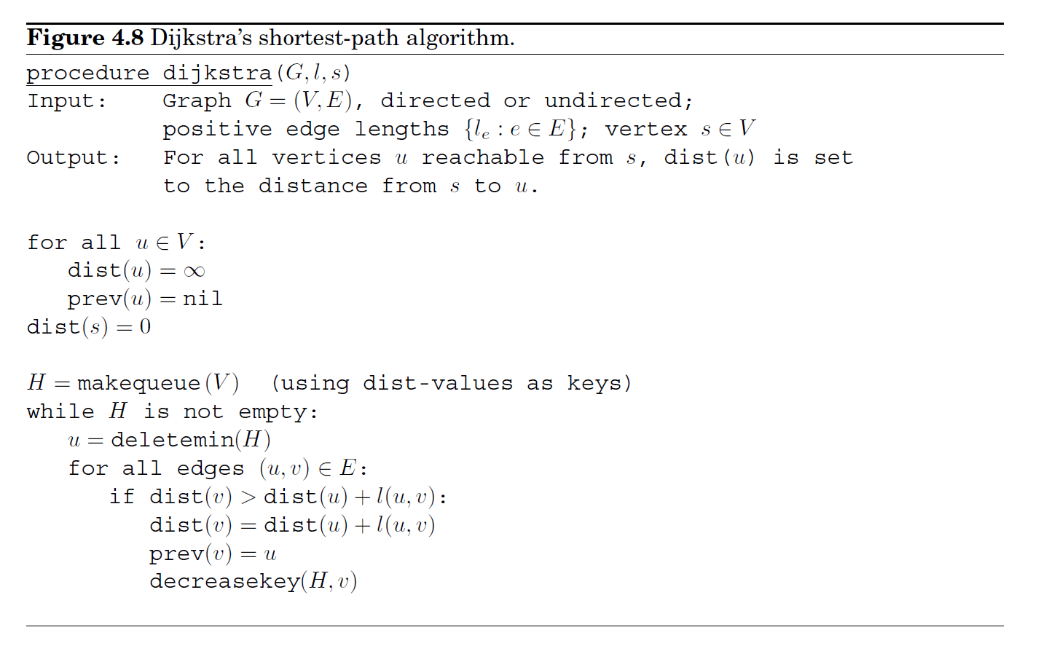

Slide 17
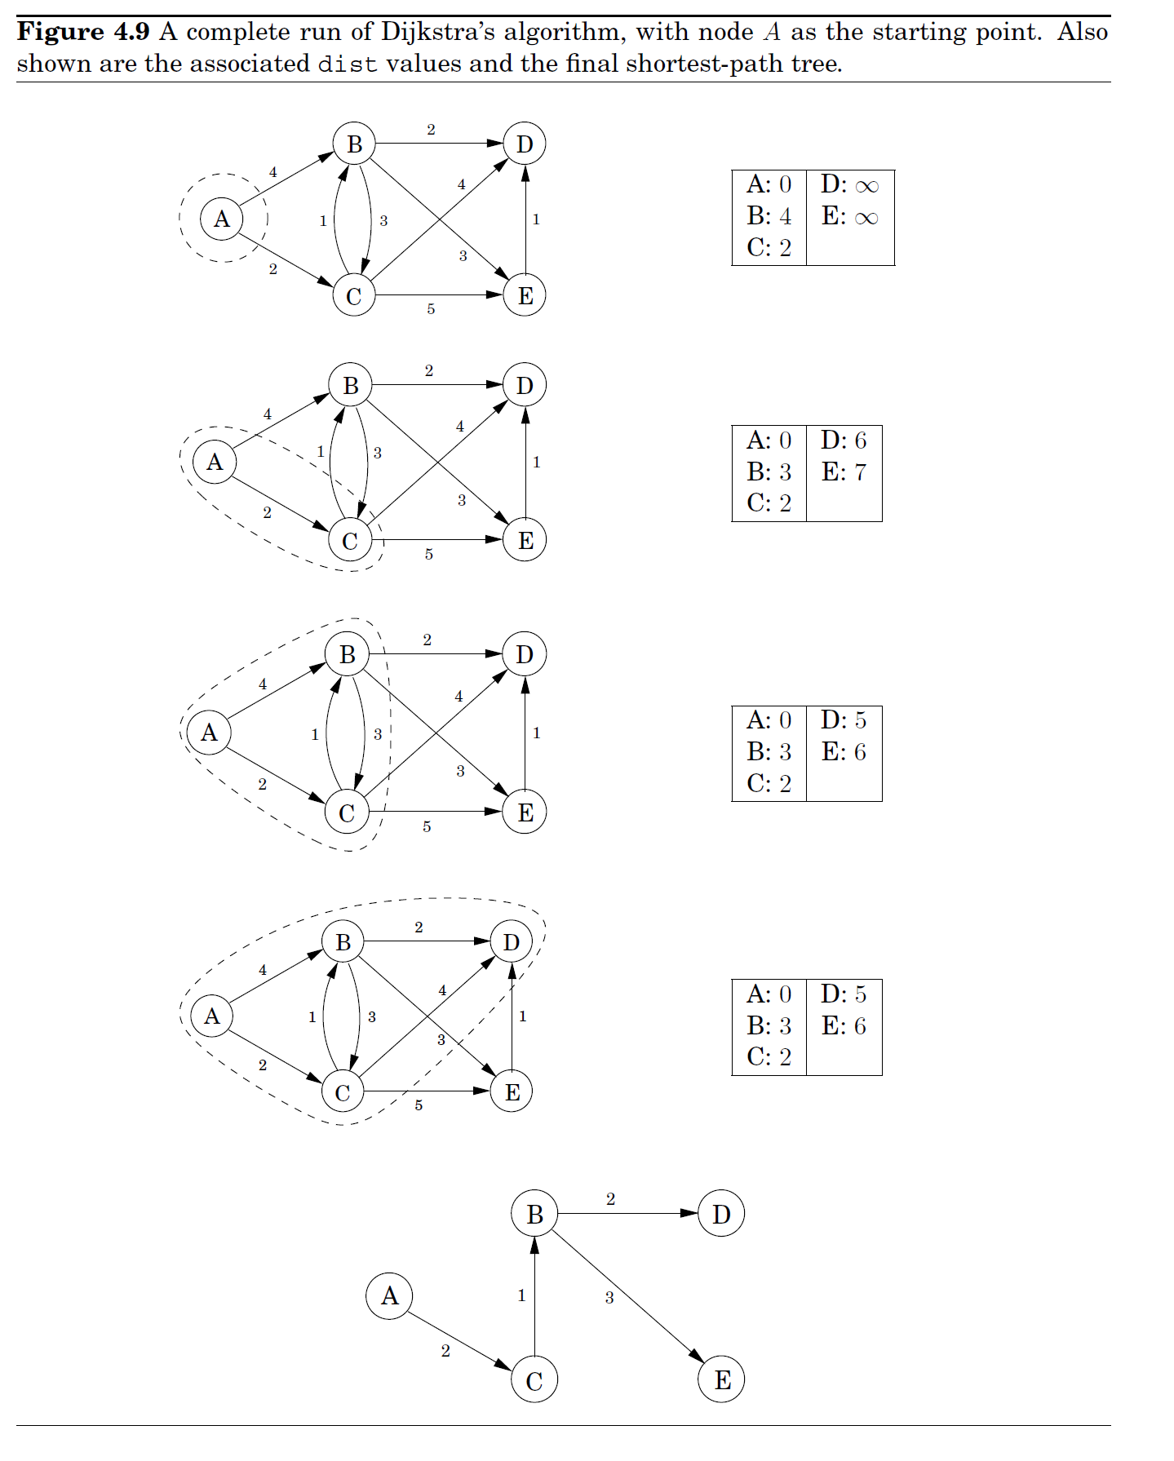

Slide 18
Visualizations
Minimal Spanning Tree and Shortest Path Tree Problems
https://www.me.utexas.edu/~jensen/exercises/mst_spt/mst_spt.html
https://www.me.utexas.edu/~jensen/exercises/mst_spt/mst_demo/mst1.html
https://visualgo.net/en/sssp

Slide 19
Java Implementation
void dijkstra(int graph[][], int src)
{
int dist[] = new int[V]; // The output array. dist[i] will hold
// the shortest distance from src to i
// sptSet[i] will true if vertex i is included in shortest
// path tree or shortest distance from src to i is finalized
Boolean sptSet[] = new Boolean[V];
// Initialize all distances as INFINITE and stpSet[] as false
for (int i = 0; i < V; i++)
{
dist[i] = Integer.MAX_VALUE;
sptSet[i] = false;
}
// Distance of source vertex from itself is always 0
dist[src] = 0;
// Find shortest path for all vertices
for (int count = 0; count < V-1; count++)
{
// Pick the minimum distance vertex from the set of vertices
// not yet processed. u is always equal to src in first
// iteration.
int u = minDistance(dist, sptSet); //O(n) compexity
// Mark the picked vertex as processed
sptSet[u] = true;
// Update dist value of the adjacent vertices of the
// picked vertex.
for (int v = 0; v < V; v++)
// Update dist[v] only if is not in sptSet, there is an
// edge from u to v, and total weight of path from src to
// v through u is smaller than current value of dist[v]
if (!sptSet[v] && graph[u][v]!=0 &&
dist[u] != Integer.MAX_VALUE &&
dist[u]+graph[u][v] < dist[v])
dist[v] = dist[u] + graph[u][v];
}
}
int graph[][] = new int[][]
{{0, 4, 0, 0, 0, 0, 0, 8, 0},
{4, 0, 8, 0, 0, 0, 0, 11, 0},
{0, 8, 0, 7, 0, 4, 0, 0, 2},
{0, 0, 7, 0, 9, 14, 0, 0, 0},
{0, 0, 0, 9, 0, 10, 0, 0, 0},
{0, 0, 4, 14, 10, 0, 2, 0, 0},
{0, 0, 0, 0, 0, 2, 0, 1, 6},
{8, 11, 0, 0, 0, 0, 1, 0, 7},
{0, 0, 2, 0, 0, 0, 6, 7, 0}
};
Call the method by calling:
dijkstra(graph, 0);
Time Complexity of the implementation is O(V²)
Notes:
Code refence: https://www.geeksforgeeks.org/dijkstras-shortest-path-algorithm-greedy-algo-7/
int minDistance(int dist[], Boolean sptSet[])
{
// Initialize min value
int min = Integer.MAX_VALUE, min_index=-1;
for (int v = 0; v < V; v++)
if (sptSet[v] == false && dist[v] <= min)
{
min = dist[v];
min_index = v;
}
return min_index;
}

Slide 20
Dijkstra’s Algorithm – Explanation of the code in the previous slide
1) Create a set sptSet (shortest path tree set) that keeps track of vertices included in shortest path tree, i.e., whose minimum distance from source is calculated and finalized. Initially, this set is empty.
2) Assign a distance value to all vertices in the input graph. Initialize all distance values as INFINITE. Assign distance value as 0 for the source vertex so that it is picked first.
3) While sptSet doesn’t include all vertices ….a) Pick a vertex u which is not there in sptSet and has minimum distance value. ….b) Include u to sptSet. ….c) Update distance value of all adjacent vertices of u. To update the distance values, iterate through all adjacent vertices. For every adjacent vertex v, if sum of distance value of u (from source) and weight of edge u-v, is less than the distance value of v, then update the distance value of v.

Slide 21
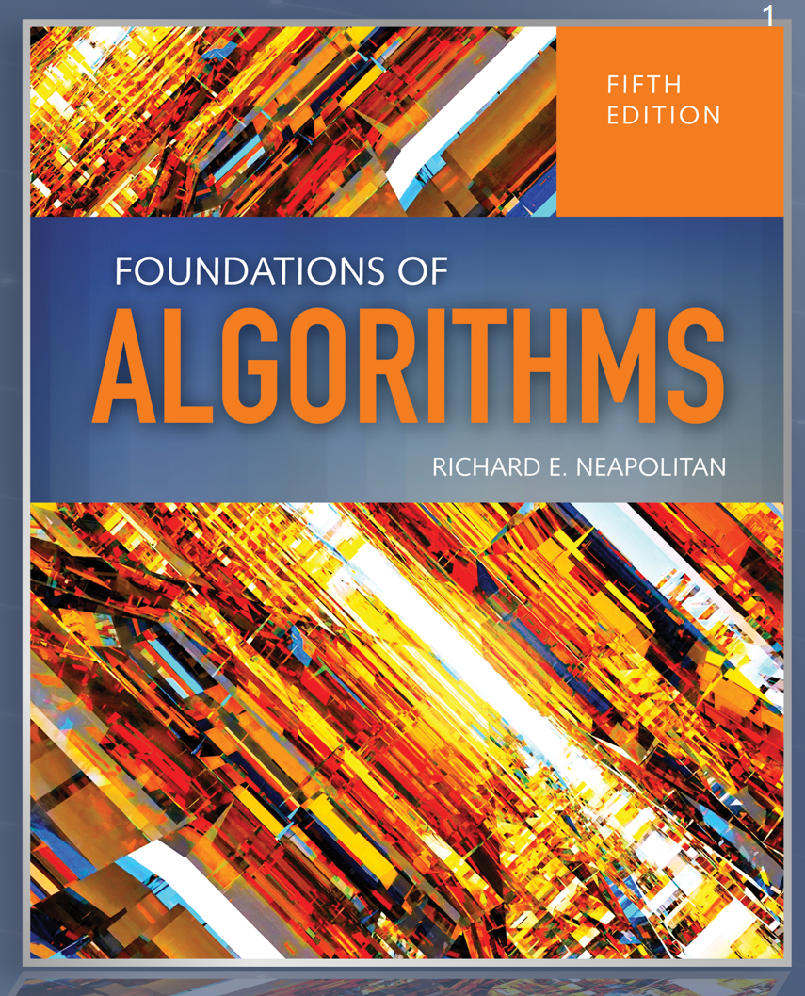
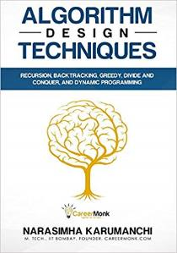
References
Outline
Foundations of Algorithms
by Richard Neapolitan
Algorithm Design Techniques: Recursion, Backtracking, Greedy, Divide and Conquer, and Dynamic Programming
by Narasimha Karumanchi

