Slide 1
Greedy Approach Minimum Spanning Tree Prim’s Algorithm

Slide 2
Greedy Approach
Initially the solution is an empty set
At each iteration, items added to the solution set until the set represents a solution to that instance of the problem
Steps:
Selection procedure: Choose the next item to add to the solution set according to the greedy criterion satisfying the locally optimal consideration.
The selection procedure simply consists of greedily grabbing the next-item without considering the potential drawbacks of making such a choice
Feasibility Check: Determine if the new set is feasible by determining if it is possible to complete this set to provide a solution to the problem instance
Solution Check: Determine whether the new set produced is a solution to the problem instance.

Slide 3
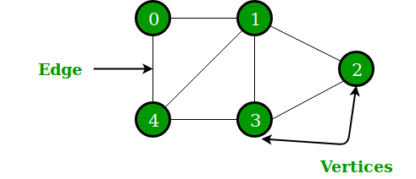
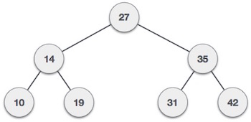
Graph & Tree
A tree is a connected undirected graph with no cycles.

Slide 4
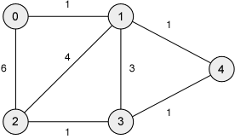
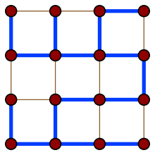
Spanning Tree
It is a spanning tree of a graph G if it spans G (that is, it includes every vertex of G)
It is a subgraph of G (every edge in the tree belongs to G).

Slide 5
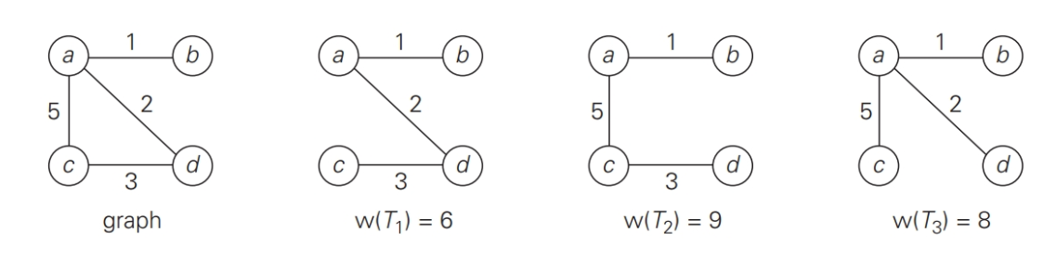
Spanning Tree
Graph and its spanning trees, with T₁ being the minimum spanning tree.

Slide 6
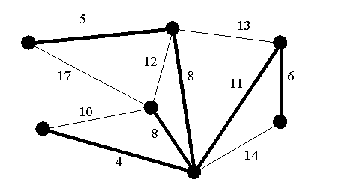
Minimum Spanning Tree
It is a spanning tree whose sum of edge weights is as small as possible.
It is a subset of the edges of a connected, edge-weighted undirected graph that connects all the vertices together, without any cycles and with the minimum possible total edge weight.

Slide 7
Minimum Spanning Tree for G
Let G = (V , E)
Let T be a spanning tree for G:
T = (V, F) where F ⊆ E
Find T such that the sum of the weights of the edges in F is minimal

Slide 8
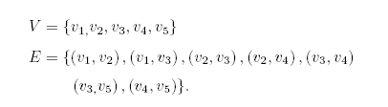
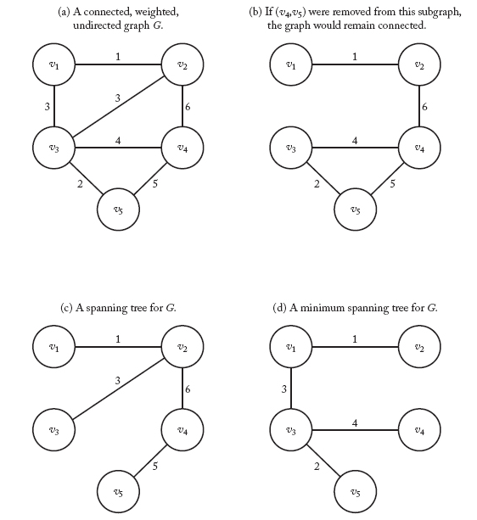
Minimum Spanning Tree
Graph and its spanning trees
We denote a spanning tree for G by T = (V , F).
T has the same vertices V as G,
F (the set of edges of T) is a subset of E.
Problem: Find a subset F of E such that T = (V , F) is a minimum spanning tree for G

Slide 9
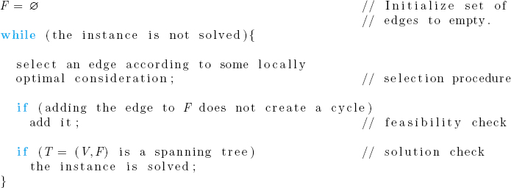
Greedy Algorithms for finding a Minimum Spanning Tree
Prim’s Algorithm
Kruskal’s Algorithm

Slide 10
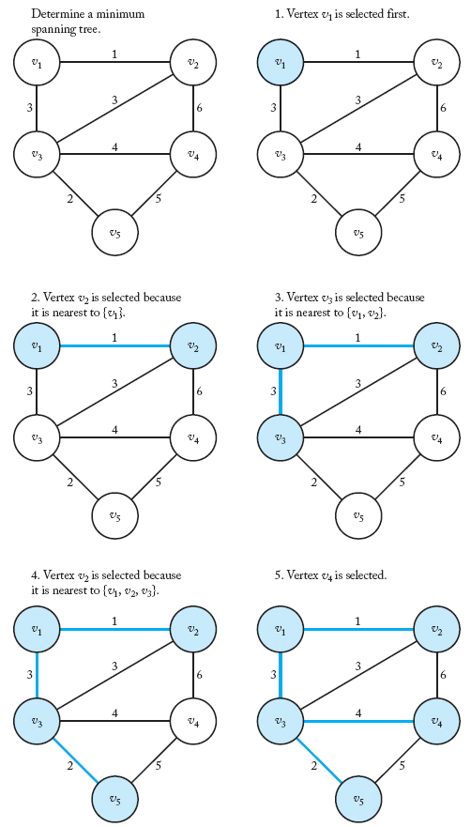
Prim’s Algorithm
A weighted graph (in upper-left corner) and the steps in Prim's algorithm for that graph.
The vertices in Y and the edges in F are shaded at each step.

Slide 11
Prim’s Algorithm
Empty subset of edges F
Subset of vertices Y initialized to an arbitrary vertex
Y = {v ₁}
Select a vertex nearest to Y from V-Y connected to a vertex in Y by a minimum weight edge
Add the selected vertex to Y
Add the edge connecting the selected vertex to F
Ties broken arbitrarily
Repeat the process until Y = V

Slide 12
Prim’s Algorithm
Write the pseudo code of the prim’s algorithm

Slide 13
Prim’s Algorithm
F = ∅
Y = {v ₁}
while (instance not solved)
{
select vertex in V – Y nearest to Y;
//selection procedure
check if forms a cycle //feasibility check
if feasible
add the vertex to Y;
add the edge to F:
if (Y == V)
the instance is solved; //solution check
}

Slide 14
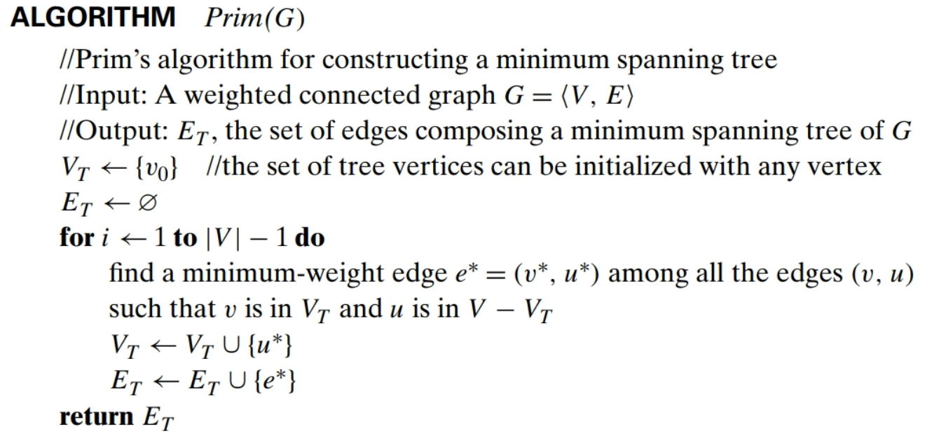
Prim’s Algorithm

Slide 15
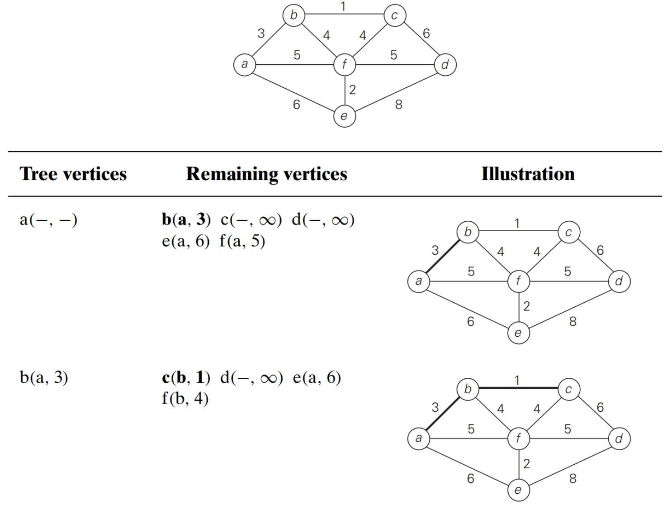
Prim’s Algorithm

Slide 16
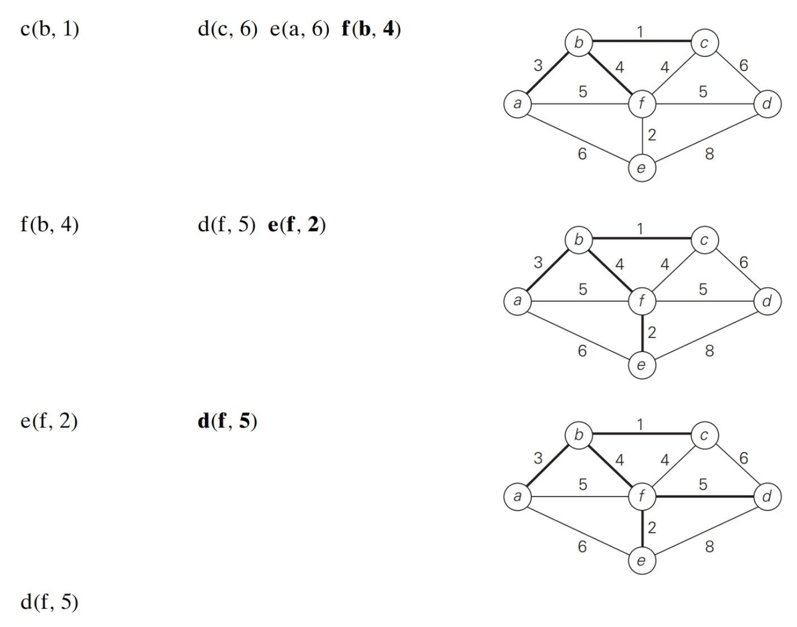
Prim’s Algorithm

Slide 17
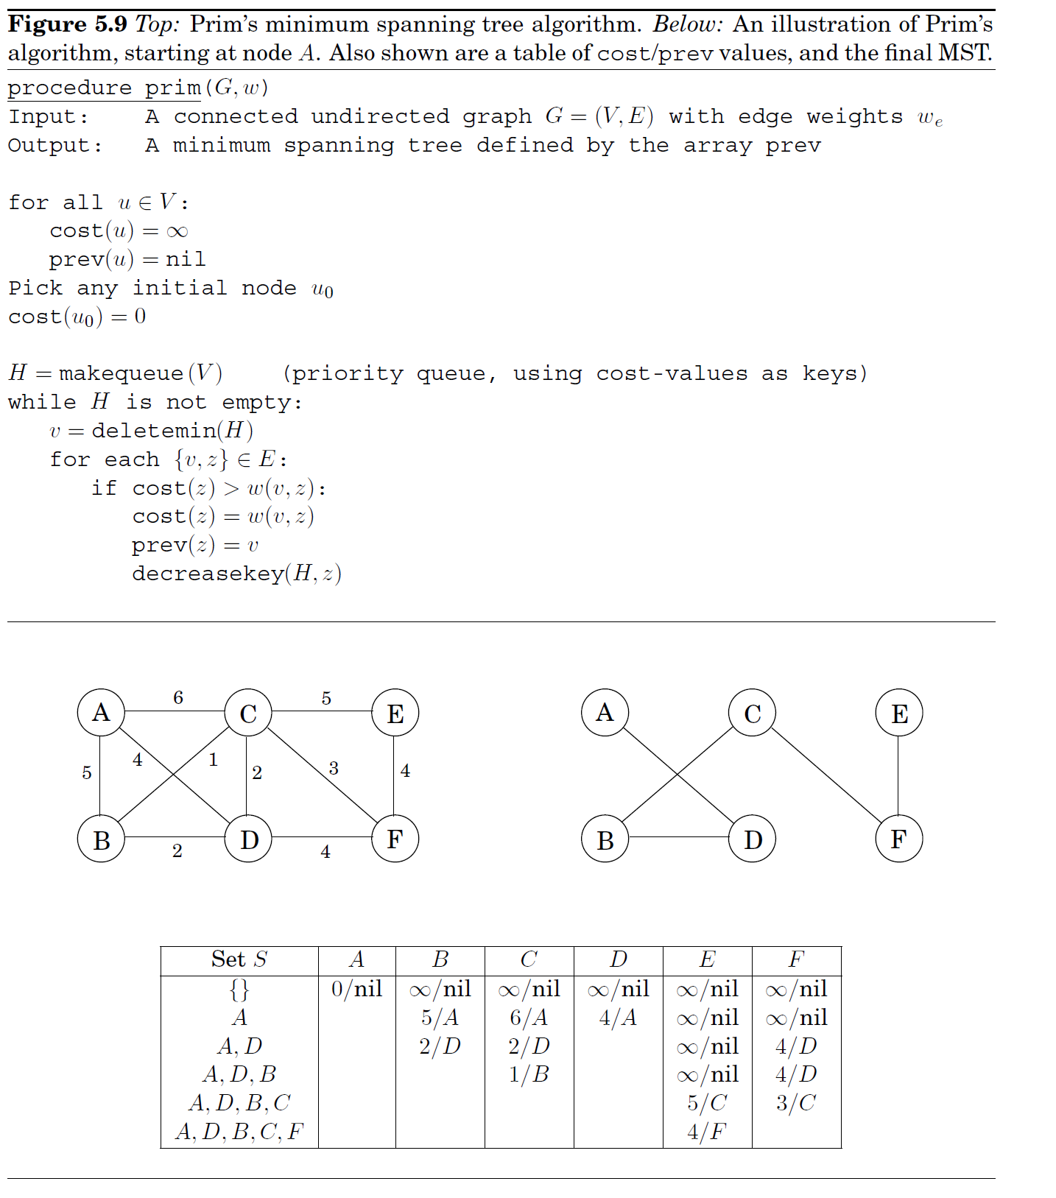

Slide 18
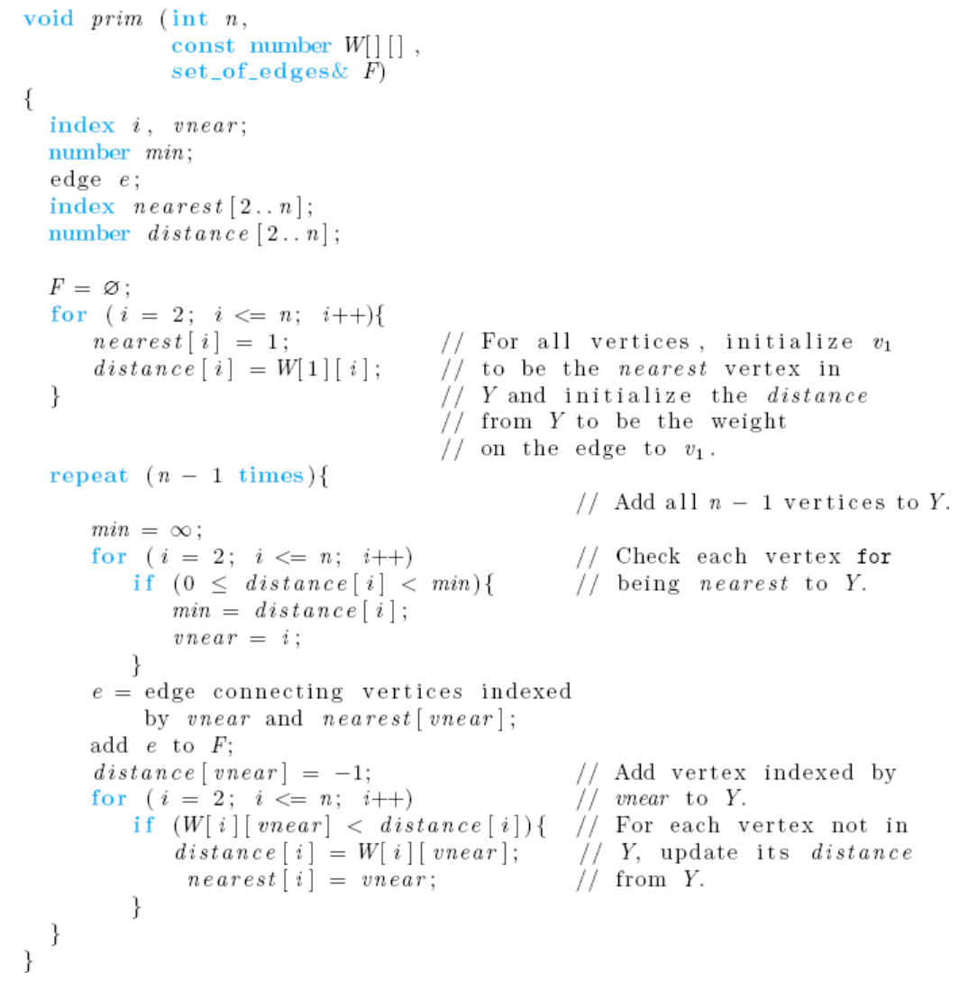
Prim’s Algorithm
Nearest is a one dimensional array that keeps the vertices added to the solution set
Distance is a one dimensional array that keeps track of the current minimum distances of vertices from the vertices that has already been added to the solution set
Notes:
Distance is a one dimensional array that keeps track of the distance of vertices from the vertices that has already been added to the solution set
Nearest is a one dimensional array that keeps the vertices added to the solution set

Slide 19
Every-Case Time Complexity of Prim’s Algorithm
Input Size: n (the number of vertices)
Basic Operation : Two loops with n – 1 iterations inside repeat loop
Repeat loop has n-1 iterations
Time complexity:
T(n) = 2(n – 1)(n – 1) ε θ(n²)

Slide 20
Visualizations
https://www.cs.usfca.edu/~galles/visualization/Prim.html
https://visualgo.net/en/mst

Slide 21
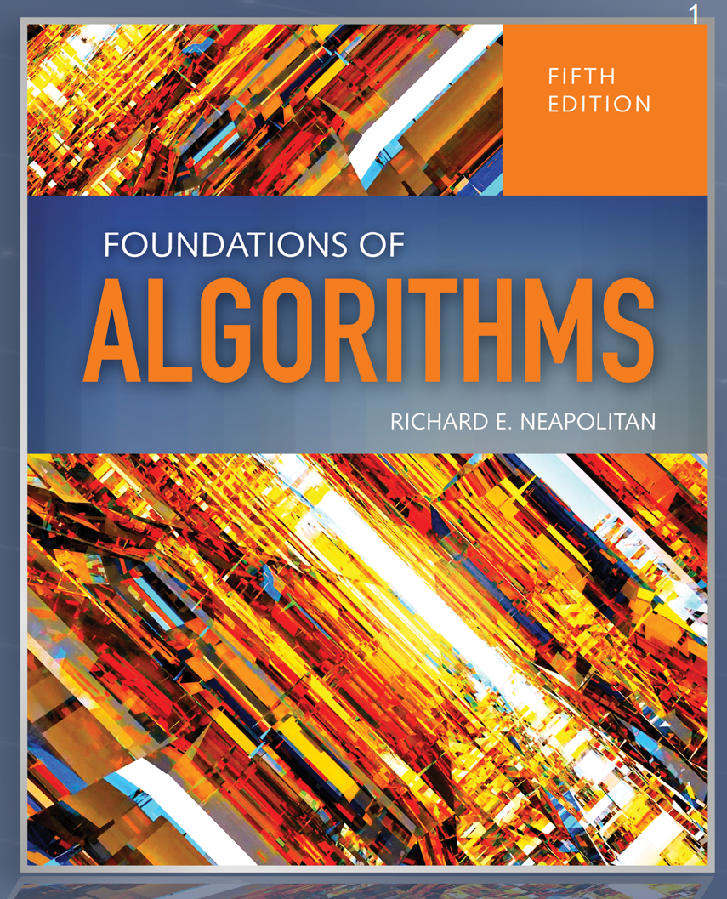

References
Outline
Foundations of Algorithms
by Richard Neapolitan
Algorithm Design Techniques: Recursion, Backtracking, Greedy, Divide and Conquer, and Dynamic Programming
by Narasimha Karumanchi

