Slide 1
Hashing: Introduction

Slide 2


Outline
Applications
Phone Book
International Phone Numbers
Hash Functions
Chaining
Chaining Implementation and Analysis
Hash Tables

Slide 3

Blockchain

Slide 4
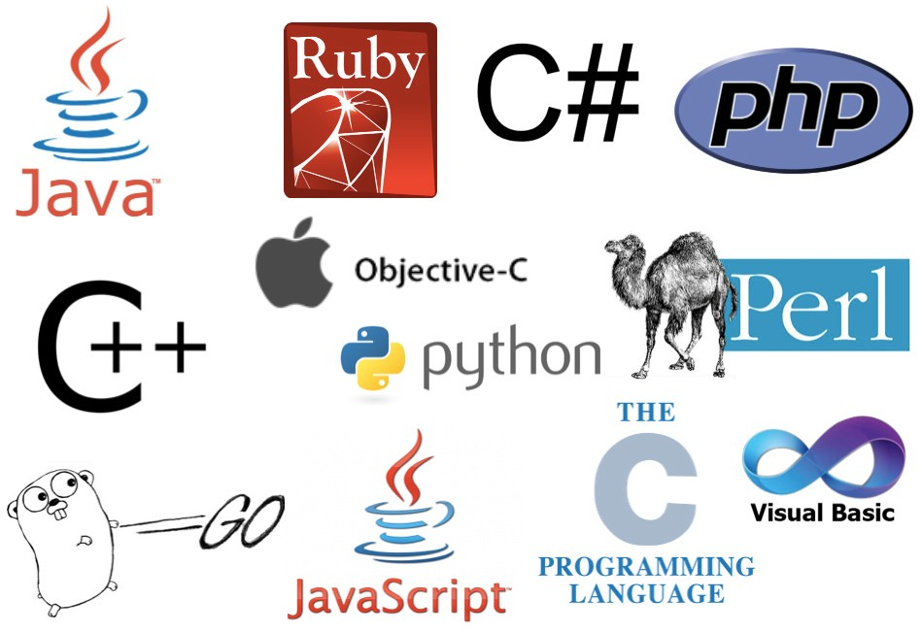
Programming Languages

Slide 5
Programming Languages
dict

Slide 6
Programming Languages
HashMap
dict

Slide 7
Programming Languages
Keywords: for, if, while, int, …

Slide 8
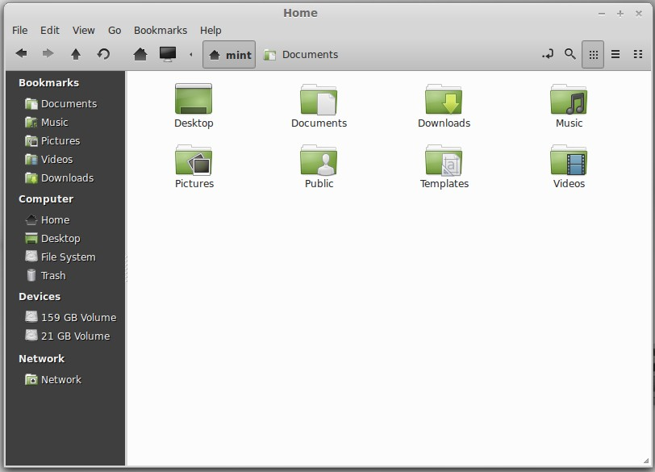
File Systems

Slide 9
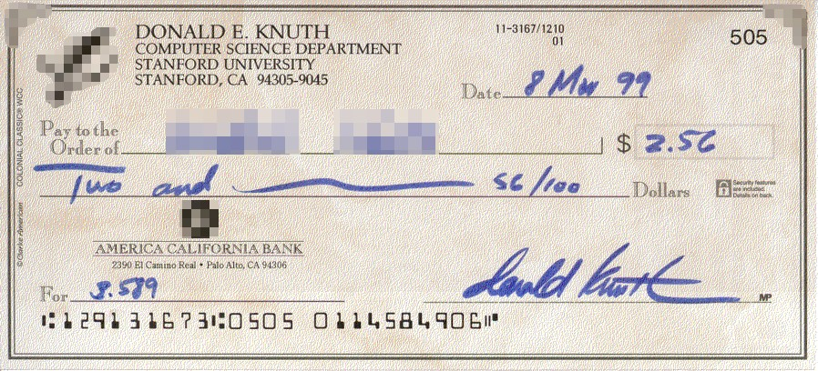
Digital Signature

Slide 10
Digital Signature

Slide 11
Digital Signature

Slide 12
Digital Signature

Slide 13
Outline
Applications
Phone Book
International Phone Numbers
Hash Functions
Chaining
Chaining Implementation and Analysis
Hash Tables

Slide 14
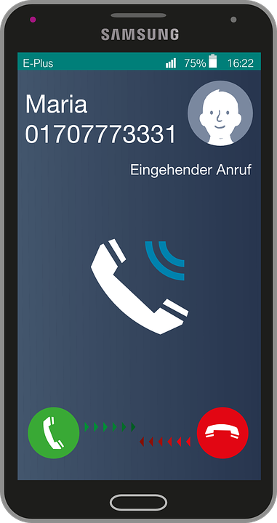
Who’s Calling?

Slide 15
Who’s Calling?

Slide 16
Who’s Calling?

Slide 17
Phone Book
Phone number | Name
01707773331 | Maria
239-17-17 | Sasha
575-75-75 | Helen

Slide 18
Phone to Name
We are going to focus on retrieving name by phone number for now

Slide 19
Local Phone Numbers
Like 123-23-23

Slide 20
Local Phone Numbers
Like 123-23-23
Typically up to 7 digits

Slide 21
Local Phone Numbers
Like 123-23-23
439-59-14
Typically up to 7 digits
Sufficient for 10⁷ = 10 000 000 phone numbers

Slide 22
Convert Phone Number to Integer
Examples
123-23-23 → 1 232 323
049 12 12 → 491 212
5757575 → 5 757 575

Slide 23
Direct Addressing


Phone number | Name
0000000
…
2391717 | Sasha
…
5757575 | Helen
…
9999999





7
10 rows




Slide 24
Direct Addressing
Store phone book as array of size 10⁷ Names are values of the array
To retrieve name by phone number, convert phone number to integer first Use the resulting integer as index in the array of names

Slide 25
GetName(phoneNumber)
index ← ConvertToInt(phoneNumber) return phoneBookArray[index]
SetName(phoneNumber, name)
index ← ConvertToInt(phoneNumber) phoneBookArray[index] ← name

Slide 26
GetName(phoneNumber)
index ← ConvertToInt(phoneNumber) return phoneBookArray[index]
SetName(phoneNumber, name)
index ← ConvertToInt(phoneNumber) phoneBookArray[index] ← name

Slide 27
GetName(phoneNumber)
index ← ConvertToInt(phoneNumber) return phoneBookArray[index]
SetName(phoneNumber, name)
index ← ConvertToInt(phoneNumber) phoneBookArray[index] ← name

Slide 28
GetName(phoneNumber)
index ← ConvertToInt(phoneNumber) return phoneBookArray[index]
SetName(phoneNumber, name)
index ← ConvertToInt(phoneNumber) phoneBookArray[index] ← name

Slide 29
GetName(phoneNumber)
index ← ConvertToInt(phoneNumber) return phoneBookArray[index]
SetName(phoneNumber, name)
index ← ConvertToInt(phoneNumber) phoneBookArray[index] ← name

Slide 30
GetName(phoneNumber)
index ← ConvertToInt(phoneNumber) return phoneBookArray[index]
SetName(phoneNumber, name)
index ← ConvertToInt(phoneNumber) phoneBookArray[index] ← name

Slide 31
Asymptotics
For a phone book with n contacts,
Retrieve name by phone number in O(1)

Slide 32
Asymptotics
For a phone book with n contacts,
Retrieve name by phone number in O(1)
Set name for a phone number in O(1)

Slide 33
Asymptotics
For a phone book with n contacts,
Retrieve name by phone number in O(1) Set name for a phone number in O(1) Memory consumption is O(|U|), where U is the set of all possible phone numbers

Slide 34
Conclusion
Local phone numbers are up to 7 digits long
Can store them in an array of size 10⁷ This scheme is called direct addressing It is the simplest form of hashing

Slide 35
Outline
Applications
Phone Book
International Phone Numbers
Hash Functions
Chaining
Chaining Implementation and Analysis
Hash Tables

Slide 36
International Phone Numbers
Like +1-800-700-00-00

Slide 37
International Phone Numbers
Like +1-800-700-00-00
Can be up to 15 digits:
+594 700 123 233 455

Slide 38
International Phone Numbers
Like +1-800-700-00-00
Can be up to 15 digits:
+594 700 123 233 455
Using direct addressing requires array of size 10¹⁵, which would take 7PB (7 petabytes) to store one phone book (1PB = 1024TB, 1TB = 1024GB)

Slide 39
International Phone Numbers
Like +1-800-700-00-00
Can be up to 15 digits:
+594 700 123 233 455
Using direct addressing requires array of size 10¹⁵, which would take 7PB (7 petabytes) to store one phone book (1PB = 1024TB, 1TB = 1024GB)
Your phone memory is probably at most 256GB, so you would need 28762 phones to store your phone book :)

Slide 40
Idea
Direct addressing requires too much memory

Slide 41
Idea
Direct addressing requires too much memory
Array is huge because it has a cell for every possible phone number

Slide 42
Idea
Direct addressing requires too much memory
Array is huge because it has a cell for every possible phone number
Let’s store only the known phone numbers

Slide 43
Idea
Direct addressing requires too much memory
Array is huge because it has a cell for every possible phone number
Let’s store only the known phone numbers
Put pairs (Phone number, Name) into a doubly-linked list

Slide 44
Idea
14052391717
Sasha
15025757575
Helen
01707773331
Maria

Slide 45
Operations
To add a contact, just insert new pair (Phone number, Name) into the list in O(1)

Slide 46
Operations
To add a contact, just insert new pair (Phone number, Name) into the list in O(1)
To retrieve name by phone number, search through the list...

Slide 47
Operations
To add a contact, just insert new pair (Phone number, Name) into the list in O(1)
To retrieve name by phone number, search through the list...
...in O(n), where n is the total number of contacts

Slide 48
Operations
To add a contact, just insert new pair (Phone number, Name) into the list in O(1)
To retrieve name by phone number, search through the list...
...in O(n), where n is the total number of contacts
Too slow

Slide 49
Idea 2
Retrieving a name by phone number is slow, because we need to look through the whole list

Slide 50
Idea 2
Retrieving a name by phone number is slow, because we need to look through the whole list
Let’s put the pairs (Phone number, Name) in a dynamic array sorted by phone number!

Slide 51
Idea 2
01707773331 | Maria
14052391717 | Sasha
15025757575 | Helen

Slide 52
Operations
Retrieve name by phone number using binary search in O(log n)

Slide 53
Operations
Retrieve name by phone number using binary search in O(log n)
To insert a new contact, find appropriate position in O(log n), then insert in...

Slide 54
Operations
Retrieve name by phone number using binary search in O(log n)
To insert a new contact, find appropriate position in O(log n), then insert in...
...O(n), because we need to first move part of the array 1 position to the right

Slide 55
Operations
Retrieve name by phone number using binary search in O(log n)
To insert a new contact, find appropriate position in O(log n), then insert in...
...O(n), because we need to first move part of the array 1 position to the right Too slow again

Slide 56
Conclusion
International numbers can be up to 15 digits long
Direct addressing requires 7 petabytes of memory
Simple list-based and array-based approaches are too slow
Next— solution using hashing

Slide 57
Outline
Applications
Phone Book
International Phone Numbers
Hash Functions
Chaining
Chaining Implementation and Analysis
Hash Tables

Slide 58
Encoding Phone Numbers
Encode international phone numbers with small numbers

Slide 59
Encoding Phone Numbers
Encode international phone numbers with small numbers
E.g. numbers from 0 to 999

Slide 60
Encoding Phone Numbers
Encode international phone numbers with small numbers
E.g. numbers from 0 to 999
Different codes for the phone numbers in the phone book

Slide 61
Hash Function
Definition
For any set of objects S and any integer
m > 0, a function h : S → {0, 1, . . . , m − 1} is called a hash function.

Slide 62
Hash Function
Definition
For any set of objects S and any integer
m > 0, a function h : S → {0, 1, . . . , m − 1} is called a hash function.
Definition
m is called the cardinality of hash function h.

Slide 63
Desirable Properties
Hash function should be fast to compute

Slide 64
Desirable Properties
Hash function should be fast to compute
Different values for different objects

Slide 65
Desirable Properties
Hash function should be fast to compute
Different values for different objects Direct addressing with O(m) memory

Slide 66
Desirable Properties
Hash function should be fast to compute
Different values for different objects Direct addressing with O(m) memory Want small cardinality m

Slide 67
Desirable Properties
Hash function should be fast to compute
Different values for different objects Direct addressing with O(m) memory Want small cardinality m
Impossible to have all different values if number of objects |S| is more than m (by pigeonhole principle)

Slide 68
Collisions
Definition
When h(o₁) = h(o₂) and o_{1 ≠} o₂, this is a collision.

Slide 69
Desirable Properties
Hash function should be fast to compute

Slide 70
Desirable Properties
Hash function should be fast to compute
Different values for different objects Small probability of collision

Slide 71
Desirable Properties
Hash function should be fast to compute
Different values for different objects Small probability of collision
Small enough cardinality m

Slide 72
Outline
Applications
Phone Book
International Phone Numbers
Hash Functions
Chaining
Chaining Implementation and Analysis
Hash Tables

Slide 73
Map
Store mapping from objects to other objects: Filename → location of the file
Phone number → name Name → phone number

Slide 74
Definition
Map
Map from set S of objects to set V of values is a data structure with methods HasKey(object), Get(object),
Set(object, value), where
object ∈ S, value ∈ V.

Slide 75
Map
Definition
In a Map from S to V, objects from S are usually called keys of the Map. Objects from V are called values of the Map.

Slide 76
Chaining for Phone Book
0
1
2
3
4
5
6
7

Slide 77
Chaining for Phone Book
h(01707773331) = 4
0
1
2
3
4
5
6
7

Slide 78
Chaining for Phone Book
h(01707773331) = 4
0
1
2
3
4
5
6
7
Maria
01707773331

Slide 79
Chaining for Phone Book
h(01707773331) = 4
h(14052391717) = 1
0
1
2
3
4
5
6
7
Maria
01707773331

Slide 80
Chaining for Phone Book
h(01707773331) = 4
h(14052391717) = 1
0
1
2
3
4
5
6
7
Sasha
14052391717
Maria
01707773331

Slide 81
Chaining for Phone Book
h(01707773331) = 4
h(14052391717) = 1
h(15025757575) = 4
0
1
2
3
4
5
6
7
Sasha
14052391717
Maria
01707773331

Slide 82
Chaining for Phone Book
h(01707773331) = 4
h(14052391717) = 1
h(15025757575) = 4
0
1
2
3
4
5
6
7
Sasha
14052391717
Maria
01707773331
Helen
15025757575

Slide 83
Chaining for Phone Book
Select hash function h of cardinality m

Slide 84
Chaining for Phone Book
Select hash function h of cardinality m
Create array Chains of size m

Slide 85
Chaining for Phone Book
Select hash function h of cardinality m
Create array Chains of size m Each element of Chains is a doubly-linked list of pairs
(name, phoneNumber), called chain

Slide 86
Chaining for Phone Book
Select hash function h of cardinality m
Create array Chains of size m Each element of Chains is a doubly-linked list of pairs
(name, phoneNumber), called chain
Pair (name, phoneNumber) goes into chain at position h(ConvertToInt(phoneNumber)) in the array Chains

Slide 87
Chaining for Phone Book
To look up name by phone number, go to the chain corresponding to phone number and look through all pairs

Slide 88
Chaining for Phone Book
To look up name by phone number, go to the chain corresponding to phone number and look through all pairs
To add a contact, create a pair
(name, phoneNumber) and insert it into the corresponding chain

Slide 89
Chaining for Phone Book
To look up name by phone number, go to the chain corresponding to phone number and look through all pairs
To add a contact, create a pair
(name, phoneNumber) and insert it into the corresponding chain
To remove a contact, go to the corresponding chain, find the pair (name, phoneNumber) and remove it from the chain

Slide 90
Outline
Applications
Phone Book
International Phone Numbers
Hash Functions
Chaining
Chaining Implementation and Analysis
Hash Tables

Slide 91
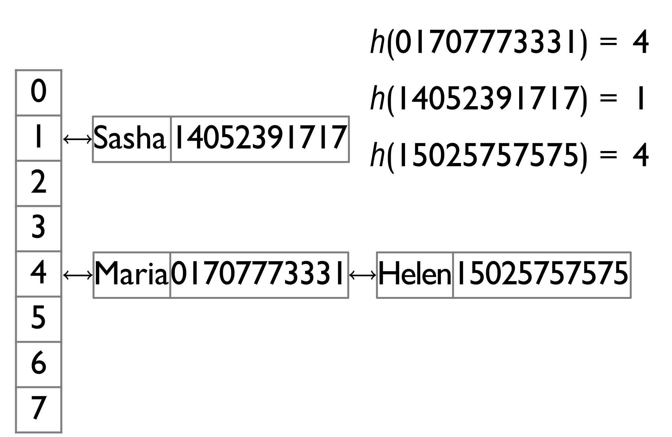
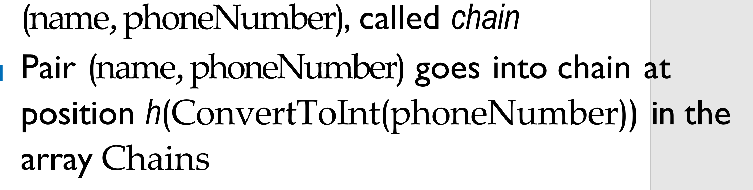
Implementation
Chains — array of chains
Each chain is a list of pairs (object, value)
HasKey(object)//is the phone number there?
chain ← Chains[hash(object)] for (key, value) in chain:
if key == object: return true
return false

Slide 92
Implementation
Chains — array of chains
Each chain is a list of pairs (object, value)
HasKey(object)
chain ← Chains[hash(object)] for (key, value) in chain:
if key == object: return true
return false

Slide 93
Implementation
Chains — array of chains
Each chain is a list of pairs (object, value)
HasKey(object)
chain ← Chains[hash(object)] for (key, value) in chain:
if key == object: return true
return false

Slide 94
Implementation
Chains — array of chains
Each chain is a list of pairs (object, value)
HasKey(object)
chain ← Chains[hash(object)] for (key, value) in chain:
if key == object: return true
return false

Slide 95
Implementation
Chains — array of chains
Each chain is a list of pairs (object, value)
HasKey(object)
chain ← Chains[hash(object)] for (key, value) in chain:
if key == object: return true
return false

Slide 96
Implementation
Chains — array of chains
Each chain is a list of pairs (object, value)
HasKey(object)
chain ← Chains[hash(object)] for (key, value) in chain:
if key == object: return true
return false

Slide 97
Implementation
Get(object)
chain ← Chains[hash(object)] for (key, value) in chain:
if key == object: return value
return N/A

Slide 98
Implementation
Get(object)
chain ← Chains[hash(object)] for (key, value) in chain:
if key == object: return value
return N/A

Slide 99
Implementation
Get(object)
chain ← Chains[hash(object)] for (key, value) in chain:
if key == object: return value
return N/A

Slide 100
Implementation
Get(object)
chain ← Chains[hash(object)] for (key, value) in chain:
if key == object: return value
return N/A

Slide 101
Implementation
Get(object)
chain ← Chains[hash(object)] for (key, value) in chain:
if key == object: return value
return N/A

Slide 102
Implementation
Get(object)
chain ← Chains[hash(object)] for (key, value) in chain:
if key == object: return value
return N/A

Slide 103
Implementation
Set(object, value)
chain ← Chains[hash(object)] for pair in chain:
if pair.key == object: pair.value ← value return
chain.Append((object, value))

Slide 104
Implementation
Set(object, value)
chain ← Chains[hash(object)] for pair in chain:
if pair.key == object: pair.value ← value return
chain.Append((object, value))

Slide 105
Implementation
Set(object, value)
chain ← Chains[hash(object)] for pair in chain:
if pair.key == object: pair.value ← value return
chain.Append((object, value))

Slide 106
Implementation
Set(object, value)
chain ← Chains[hash(object)] for pair in chain:
if pair.key == object: pair.value ← value return
chain.Append((object, value))

Slide 107
Implementation
Set(object, value)
chain ← Chains[hash(object)] for pair in chain:
if pair.key == object: pair.value ← value return
chain.Append((object, value))

Slide 108
Implementation
Set(object, value)
chain ← Chains[hash(object)] for pair in chain:
if pair.key == object: pair.value ← value return
chain.Append((object, value))

Slide 109
Implementation
Set(object, value)
chain ← Chains[hash(object)] for pair in chain:
if pair.key == object: pair.value ← value return
chain.Append((object, value))

Slide 110
Asymptotics
Lemma
Let c be the length of the longest chain in Chains. Then the running time of HasKey, Get, Set is Θ(c + 1).

Slide 111
Asymptotics
Proof
If the chain corresponding to the object is non-empty, but the object is not found in the chain, we will scan all c items — Θ(c) = Θ(c + 1)

Slide 112
Asymptotics
Proof
If the chain corresponding to the object is non-empty, but the object is not found in the chain, we will scan all c items — Θ(c) = Θ(c + 1)
If c = 0, we still need O(1) time, thus the need for “+1”

Slide 113
Asymptotics
Lemma
Let n be the number of different objects currently in the map and m be the cardinality of the hash function. Then the memory consumption for chaining is Θ(n + m).

Slide 114
Asymptotics
Proof
Θ(n) to store n pairs (object, value)

Slide 115
Asymptotics
Proof
Θ(n) to store n pairs (object, value) Θ(m) for array Chains of size m

Slide 116
Outline
Applications
Phone Book
International Phone Numbers
Hash Functions
Chaining
Chaining Implementation and Analysis
Hash Tables

Slide 117
Set
Definition
Set is a data structure with methods Add(object), Remove(object), Find(object).

Slide 118
Set
Examples
Students on campus

Slide 119
Examples
Set
Students on campus
Phone numbers of contacts

Slide 120
Examples
Set
Students on campus
Phone numbers of contacts Keywords in a programming language

Slide 121
Implementing Set
Two ways to implement a set using chaining:
Set is equivalent to map from S to
V = {true}

Slide 122
Implementing Set
Two ways to implement a set using chaining:
Set is equivalent to map from S to
V = {true}
Store just objects instead of pairs
(object, value) in the chains

Slide 123
Implementation
Find(object)
chain ← Chains[hash(object)] for key in chain:
if key == object: return true
return false

Slide 124
Implementation
Find(object)
chain ← Chains[hash(object)] for key in chain:
if key == object: return true
return false

Slide 125
Implementation
Find(object)
chain ← Chains[hash(object)] for key in chain:
if key == object: return true
return false

Slide 126
Implementation
Find(object)
chain ← Chains[hash(object)] for key in chain:
if key == object: return true
return false

Slide 127
Implementation
Find(object)
chain ← Chains[hash(object)] for key in chain:
if key == object: return true
return false

Slide 128
Implementation
Find(object)
chain ← Chains[hash(object)] for key in chain:
if key == object: return true
return false

Slide 129
Implementation
Add(object)
chain ← Chains[hash(object)] for key in chain:
if key == object: return
chain.Append(object)

Slide 130
Implementation
Add(object)
chain ← Chains[hash(object)] for key in chain:
if key == object: return
chain.Append(object)

Slide 131
Implementation
Add(object)
chain ← Chains[hash(object)] for key in chain:
if key == object: return
chain.Append(object)

Slide 132
Implementation
Add(object)
chain ← Chains[hash(object)] for key in chain:
if key == object: return
chain.Append(object)

Slide 133
Implementation
Add(object)
chain ← Chains[hash(object)] for key in chain:
if key == object: return
chain.Append(object)

Slide 134
Implementation
Add(object)
chain ← Chains[hash(object)] for key in chain:
if key == object: return
chain.Append(object)

Slide 135
Implementation
Remove(object)
if not Find(object): return
chain ← Chains[hash(object)] chain.Erase(object)

Slide 136
Implementation
Remove(object)
if not Find(object): return
chain ← Chains[hash(object)] chain.Erase(object)

Slide 137
Implementation
Remove(object)
if not Find(object): return
chain ← Chains[hash(object)] chain.Erase(object)

Slide 138
Implementation
Remove(object)
if not Find(object): return
chain ← Chains[hash(object)] chain.Erase(object)

Slide 139
Implementation
Remove(object)
if not Find(object): return
chain ← Chains[hash(object)] chain.Erase(object)

Slide 140
Hash Table
Definition
An implementation of a Set or a Map using hashing is called a hash table.

Slide 141
Programming Languages
Set:
unordered_set in C++
HashSet in Java
set in Python Map:
unordered_map in C++
HashMap in Java
dict in Python

Slide 142
Conclusion
Chaining is a technique to implement a hash table

Slide 143
Conclusion
Chaining is a technique to implement a hash table
Number of objects n, hash function cardinality m, longest chain length c

Slide 144
Conclusion
Chaining is a technique to implement a hash table
Number of objects n, hash function cardinality m, longest chain length c Memory consumption is Θ(n + m)

Slide 145
Conclusion
Chaining is a technique to implement a hash table
Number of objects n, hash function cardinality m, longest chain length c Memory consumption is Θ(n + m) Operations work in time Θ(c + 1)

Slide 146
Conclusion
Chaining is a technique to implement a hash table
Number of objects n, hash function cardinality m, longest chain length c Memory consumption is Θ(n + m) Operations work in time Θ(c + 1)
How to make both m and c small?

