Slide 1
Camera Rendering

Slide 3
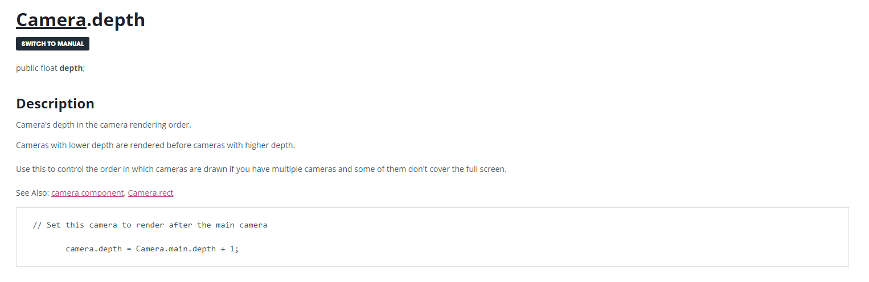
Depth

Slide 4
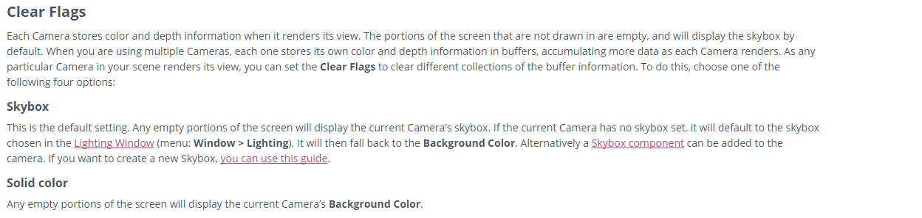
Clear Flag

Slide 5
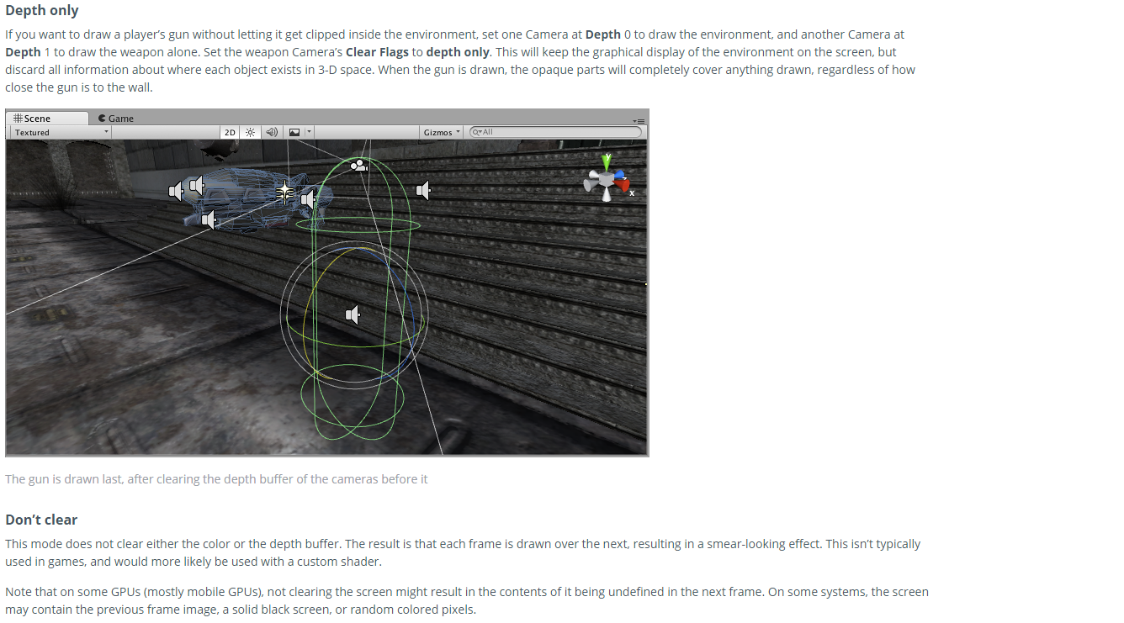

Slide 6
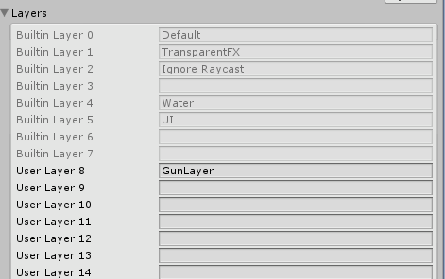

Slide 7
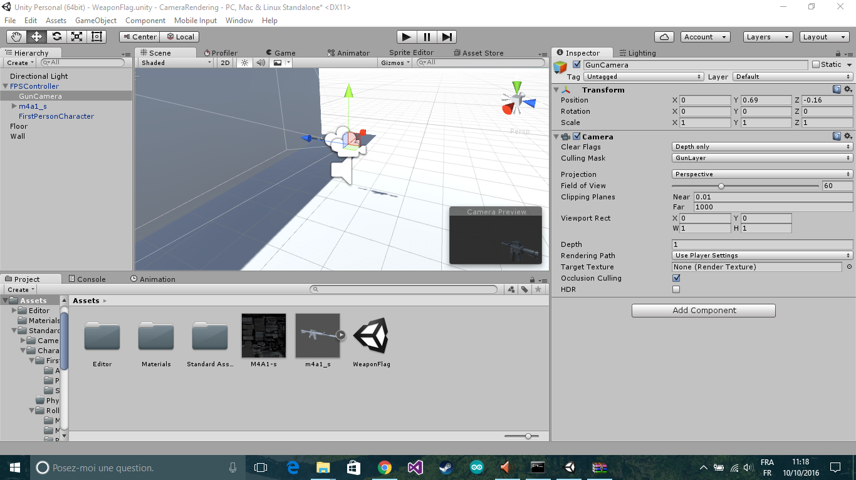

Slide 8


Slide 9
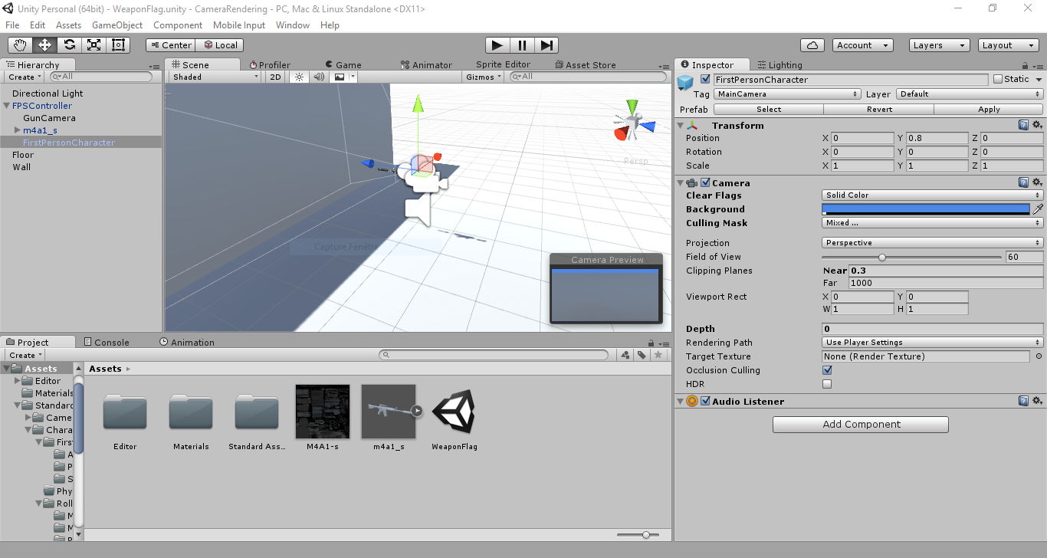

Slide 10


DEMO

Slide 11
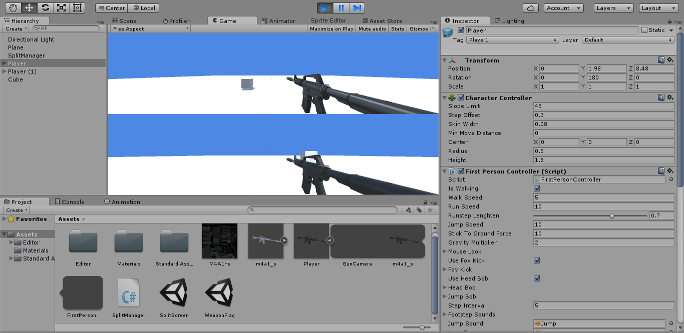
Normalized Viewport Rectangle

Slide 12
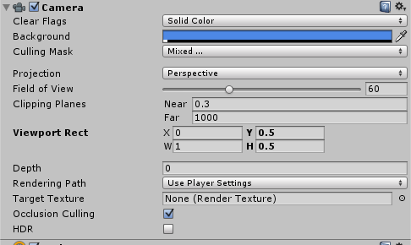

Slide 13

DEMO

Slide 14
Rendering Paths

Slide 15
Deferred Shading

