Slide 1
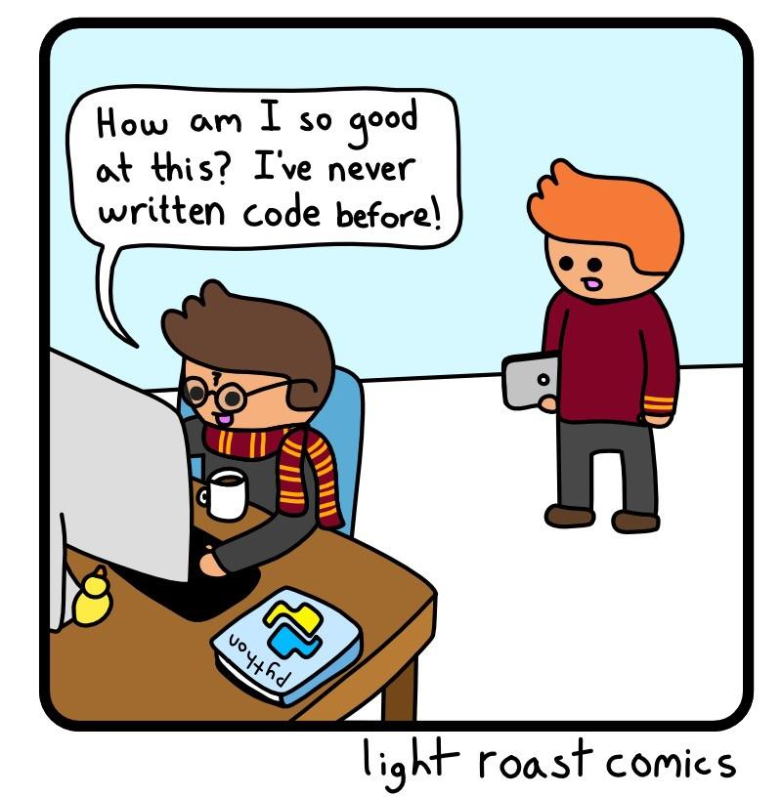
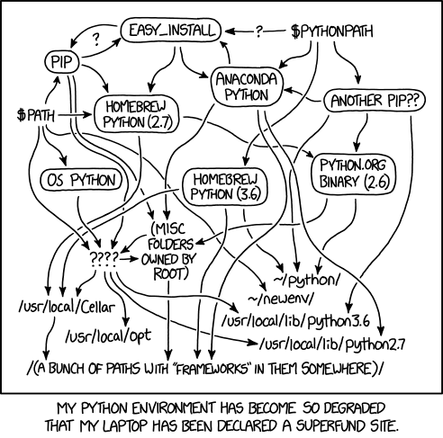
Python Part 4
Spring 2024
PCfB Class 7
March 1, 2024

Slide 2
Check-in

Slide 3
Outline
Stand-alone python scripts
argparse module
Functions
Sets

Slide 4
Stand-alone python scripts

Slide 5
To make a text file a Python script

Slide 6
raw_input()
sys.argv

Slide 7
argparse module

Slide 8
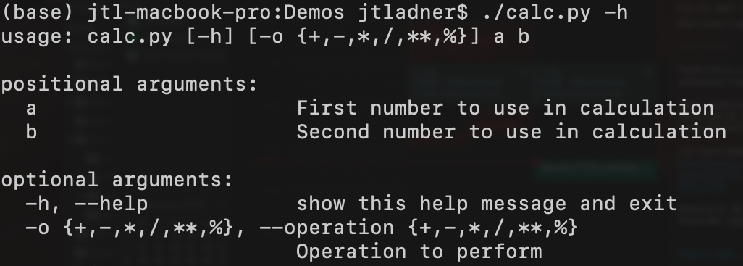
argparse generates help documentation

Slide 10
import argparse
parser = argparse.ArgumentParser()
args = parser.parse_args()

Slide 11
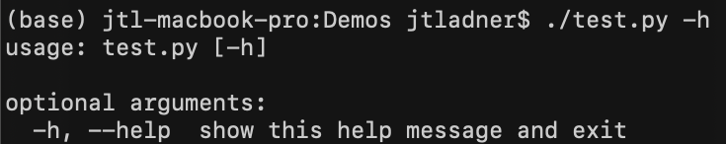

Slide 12
Positional arguments

Slide 13
Optional arguments

Slide 14
parser = argparse.ArgumentParser()
parser.add_argument("num", help="Number of hits to report")
args = parser.parse_args()

Slide 15
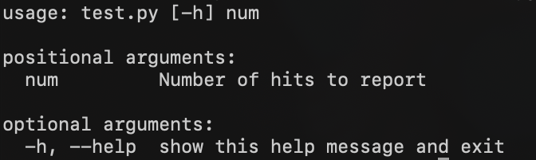

Slide 16
parser = argparse.ArgumentParser()
parser.add_argument("-n", "--num", help="Number of hits to report")
args = parser.parse_args()

Slide 17
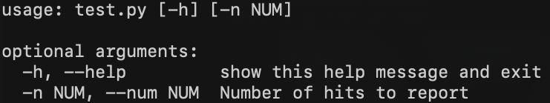

Slide 18
Functions

Slide 19
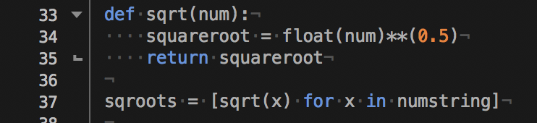

Slide 22
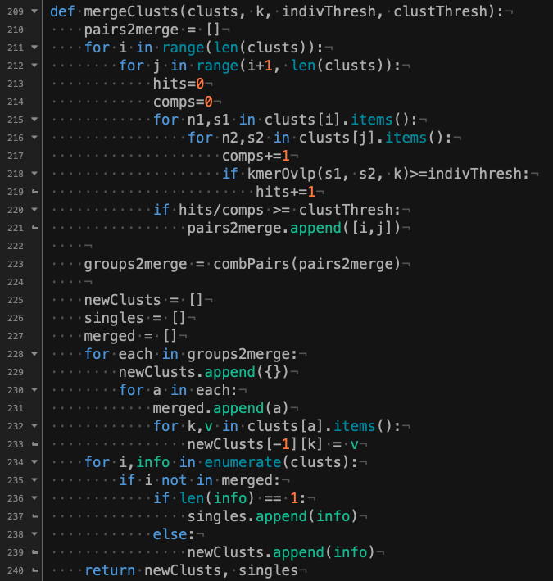

Slide 23
Sets

Slide 24
Sets

Slide 25
Compare collections of items
A.intersection(B)
A.union(B)
A.difference(B)
A.symmetric_difference(B)
A.issubset(B)
A.issuperset(B)

Slide 26





Slide 27


