Slide 1

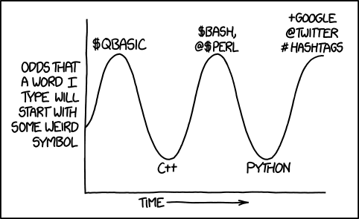
Python Scripting - Part 3
Spring 2024
PCfB Class 6
February 23, 2024

Slide 2
Check-in

Slide 3
Outline
List/dictionary comprehension
Reading from/writing to files
String formatting
Python modules

Slide 4
List/dictionary comprehension

Slide 5
List comprehension

Slide 6
l = [1, 8, 5, 2]

Slide 7
l = [1, 8, 5, 2]

Slide 8
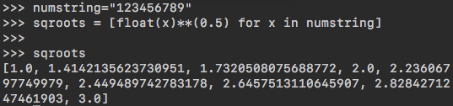
Iterate through a string

Slide 9
l = [1, 8, 5, 2]

Slide 10
l = [1, 8, 5, 2]

Slide 11
Dictionary comprehension

Slide 12
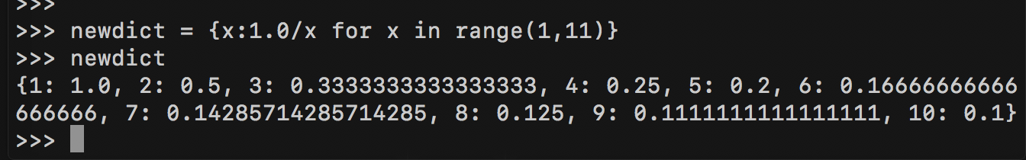

Slide 13
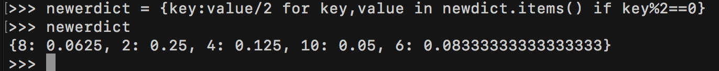

Slide 14
Reading from/writing to files

Slide 15
Reading from/Writing to files
read mode file object
fin = open(filename, ‘r’)
fout = open(filename, ‘w’)
Indicate file mode
write mode file object
fin.close()
fout.close()
Closes the file objects

Slide 16
with statement

Slide 17
Step through file line by line
with open(filename, “r”) as fin:

Slide 18
Write to a file
with open(filename, “w”) as fout:

Slide 19
String formatting

Slide 20
% operator
%s
%d
%f

Slide 21
% operator
a = 5
b = 1.25
c = “Sample1”

Slide 22
%d operator
a = 5
d = 55

Slide 23
%f operator
b = 1.25
e = 5.7812163

Slide 24
f-string formatting
a = 5
b = 1.25
c = “Sample1”

Slide 25
Python modules

Slide 26
Python modules
Python functions that can be imported, as needed for use within your scripts
Standard modules: included with Python installation
3rd party modules: must be installed

Slide 27
Module basics

Slide 28
Method #1: import numpy
Import the entire module and link functions to the module name
Example usage:
numpy.mean([54, 75, 78, 91, 37, 81])
numpy.std([54, 75, 78, 91, 37, 81])

Slide 29
Method #2: import numpy as np
Import the entire module and link functions to a name specified by the user
Example usage:
np.mean([54, 75, 78, 91, 37, 81])
np.std([54, 75, 78, 91, 37, 81])

Slide 30
Method #3: from numpy import mean
Import select functions from a module
Functions exist on their own, NOT linked to module name
Example usage:
mean([54, 75, 78, 91, 37, 81])

Slide 31
Method #4: from numpy import *
Import ALL functions from a module
Functions exist on their own, NOT linked to module name
Example usage:
mean([54, 75, 78, 91, 37, 81])
std([54, 75, 78, 91, 37, 81])

Slide 32
Recommended 3rd party modules
NumPy & SciPy (https://scipy.org/)
Biopython (https://biopython.org/)
Pandas (https://pandas.pydata.org/)
Matplotlib (https://matplotlib.org/)

Slide 33
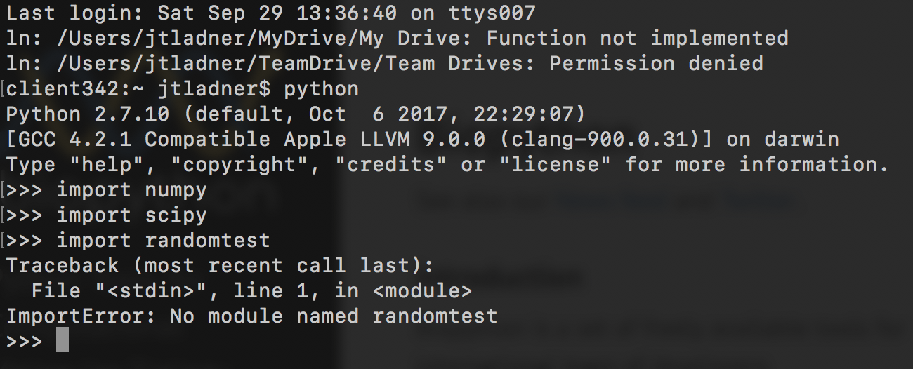
Checking to see if module is installed

