Slide 1
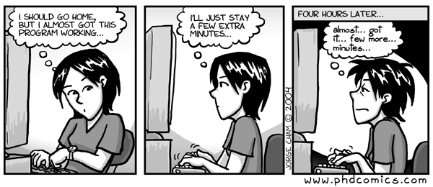
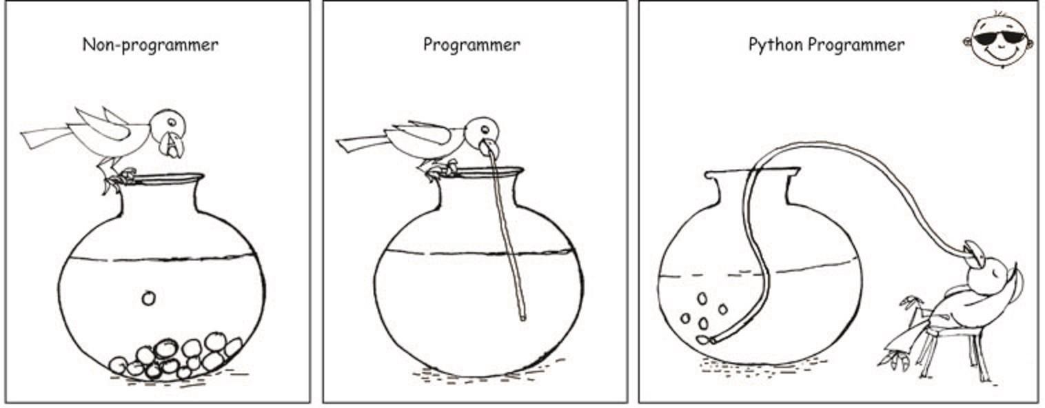
Python Pt2: Decisions & Loops
Spring 2024
PCfB Class 5
February 16, 2023

Slide 2
Check-in

Slide 3
Outline
Lists & strings revisited
Decisions (if, elif, else)
for loops
while loops

Slide 4
Lists & strings revisited

Slide 5
Positive indexing
l = [1, ‘1’, ‘one’, [1,2]]

Slide 6
Negative indexing
l = [1, ‘1’, ‘one’, [1,2]]

Slide 7
List slicing

Slide 8
l = [1, ‘1’, ‘one’, [1,2]]

Slide 9
String indexing & slicing
s = ‘The dog ran.’

Slide 10
split() method

Slide 11
join() method

Slide 12
Decisions

Slide 13
if
elif
else

Slide 14
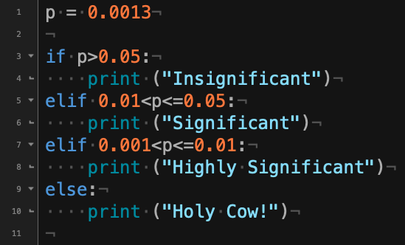

Slide 15
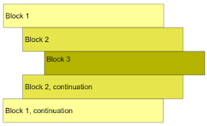
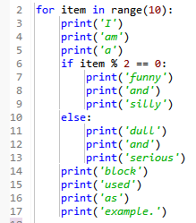
Indentation
White space at the beginning of a line is used to define blocks of code
Can use tabs, spaces or even a combination
Best practice is to choose one and stick with it

Slide 16
Indentation shortcut
Many text editors have shortcuts for quickly indenting blocks of code

Slide 17
Comparison operators (Table 9.1)
x == y
x != y
x > y
x < y
x >= y
x <= y

Slide 18
Logical operators (Table 9.2)
A and B
A or B
not B
(not A) or B
not (A or B)

Slide 19
for loops

Slide 20
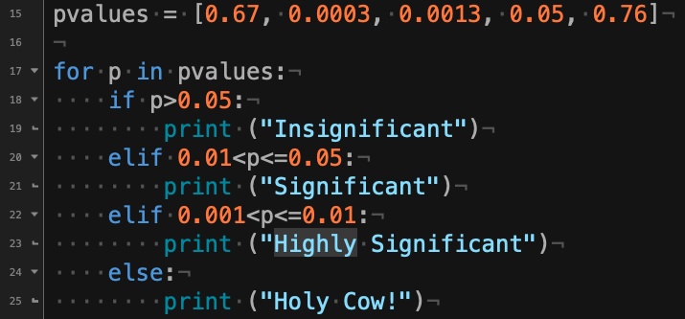
for loops

Slide 21
while loops

Slide 22
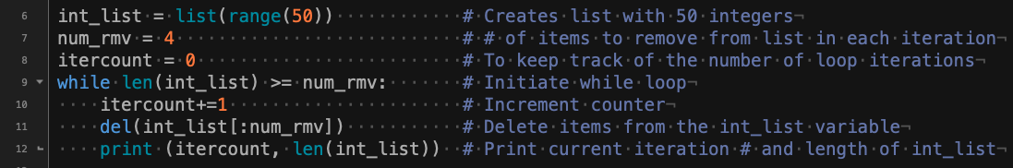

Slide 23
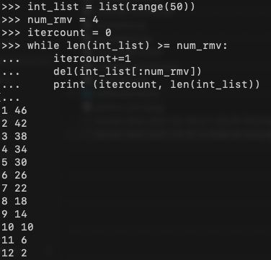
Initiate variables
While loop
Printed results

Slide 24
Control statement within loops
break: internal command to exit loop
continue: end current loop iteration

