Slide 1

Making figures with Python
Spring 2024
PCfB Class 10
March 29, 2024
Dudas et al. 2017, Nature
Notes:
Today we’re going to be returning to Python,
but this will also be a continuation of last week’s graphics-focused class
Because today we’ll be focusing exclusively on using Python scripts to generate scientific figures
Now, to kick things off, I’ve included one of the most impressive figures I’ve ever seen
This is actually not a static figure, but rather a video reconstructing the dynamics of
the entire West African Ebola virus disease outbreak based on a phylogenetic analysis of 1600 Ebola virus genomes
And, believe it or not, this entire figure was generated using Python
Now, clearly, this is more advanced than what we’ll be able to cover in this class
but I think this it’s a nice illustration of the near limitless potential of figure generation with Python
And you don’t need to be a Python expert to start using python to make your figures

Slide 2
Check-in

Slide 3
Outline
Benefits of Python for figures
Intro to Matplotlib module
Notes:
In the lecture portion of this class, I’m going to cover two main topics
My first objective is to convince you all of the advantages of
using Python to generate your scientific figures
Then I’ll walk through some of the basics of how to use the Matplotlib module,
which is the primary plotting module in Python

Slide 4
Why use Python?
Highly customizable
Notes:
In my opinion, there are at least 4 good reasons to generate your figures using Python
The first is that Python allows for a very high level of customization.
Pretty much any element of a plot, from the number and placement of tick marks,
colors, line thickness, etc. can easily be customized using Matplotlib
You can also include annotations on top of your data plot to enhance interpretability
Now, of course, as we learned last week, all of this customization can also be achieved using a vector-based graphics editing tool, like Illustrator or Inkscape
But…

Slide 5
Why use Python?
Highly customizable
Automated, easy to rerun
Notes:
…that brings us to the 2nd good reason to use Python,
which is that all of this customization can be fully automated
I can pretty much guarantee that you will end up regenerating
just about every data figure that you include in a manuscript, at least once
Either because you’ve added new data, you’ve removed data, you’ve found an error in your data, etc.
And if you end up doing all of your customization in one of the GUI programs,
You’ll have to manually redo all of your customization each time you remake that figure
Whereas, if all of your customization is automated with a Python script, remaking your figures becomes painless.

Slide 6
Why use Python?
Highly customizable
Automated, easy to rerun
Integrate into analysis
Notes:
The third reason to use Python for figures is that you can very easily integrate figure generation into your data analysis scripts
And as you become more comfortable with the Python syntax,
It will be much easier and quicker to stick with that syntax for your figure generation
Rather than switching over to another program like R or Matlab to make your figures

Slide 7
Why use Python?
Highly customizable
Automated, easy to rerun
Integrate into analysis
Open science compatible
Notes:
And finally, I really like using Python for my figures because it fits nicely into an open science framework
Not only is Python completely open source, but you can easily share the code you use to generate your figures
which makes your work more transparent for the community
and provides a tool for anyone who may want to generate a similar figure.

Slide 8
Using matplotlib
Notes:
Alright, that’s by spiel for why it’s a good idea to generate your figures using Python
Now let’s talk about how you can actually do this
Although there are multiple graphing modules available for Python,
In this class, we’re going to be using a 3rd party module named matplotlib
This is the primary plotting module for Python, it has a large user base, and
it’s capable of generating a wide variety of plot types
Also, some of the other, high-level plotting modules, like Seaborn, are built on top of matplotlib
And therefore, understanding the syntax of matplotlib will also help with the use of these other modules

Slide 9

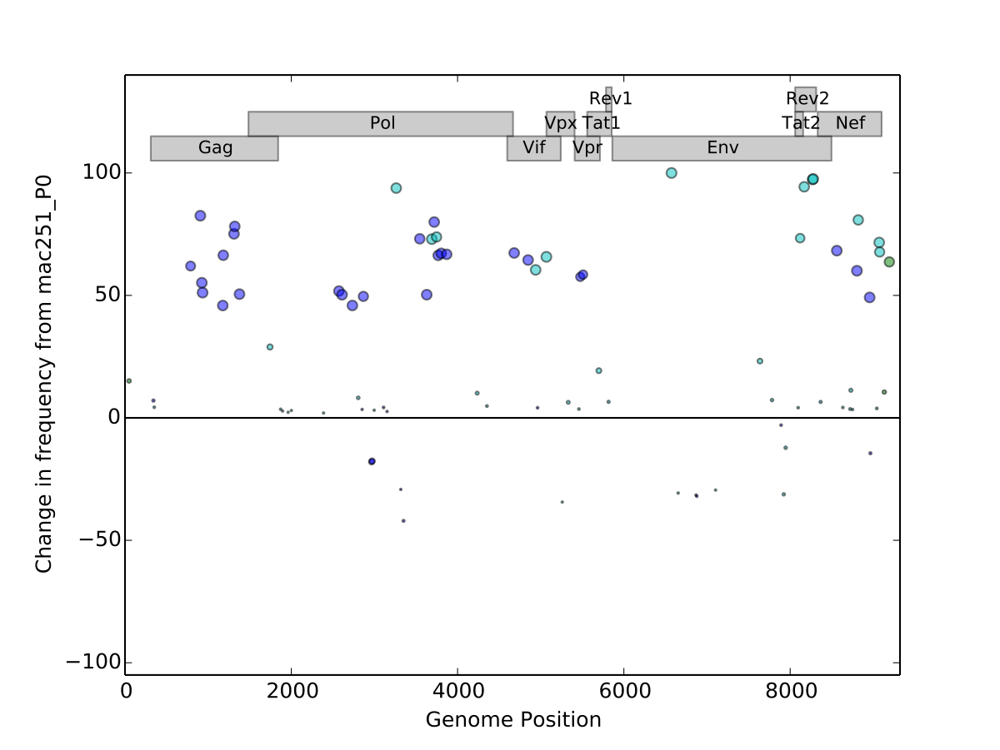
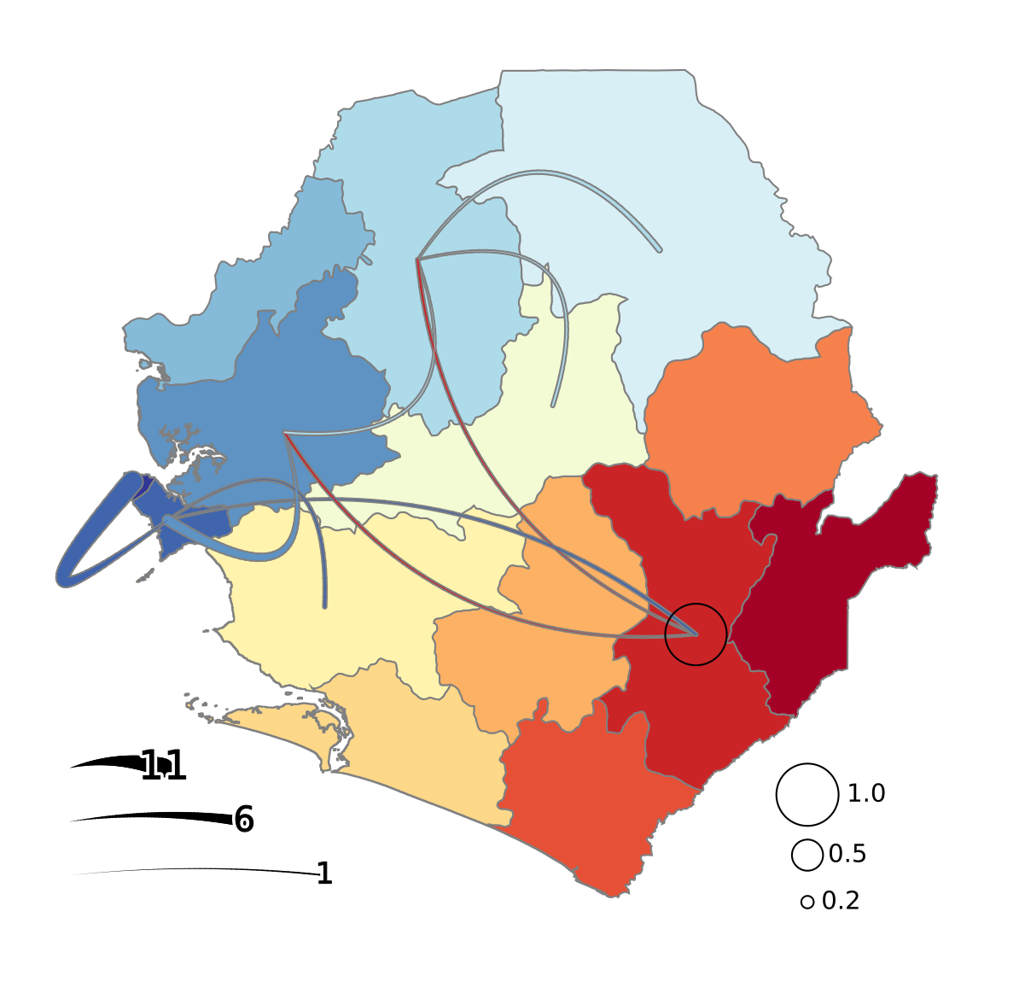
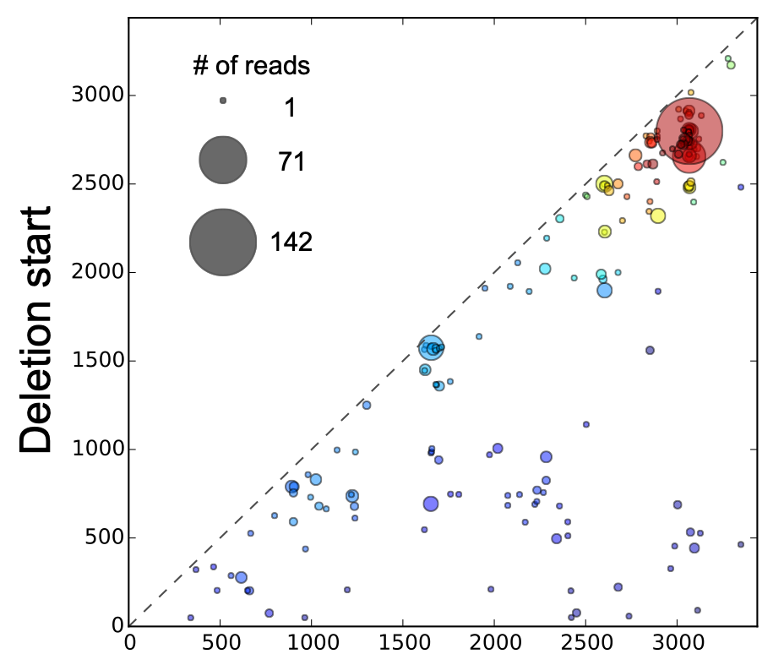
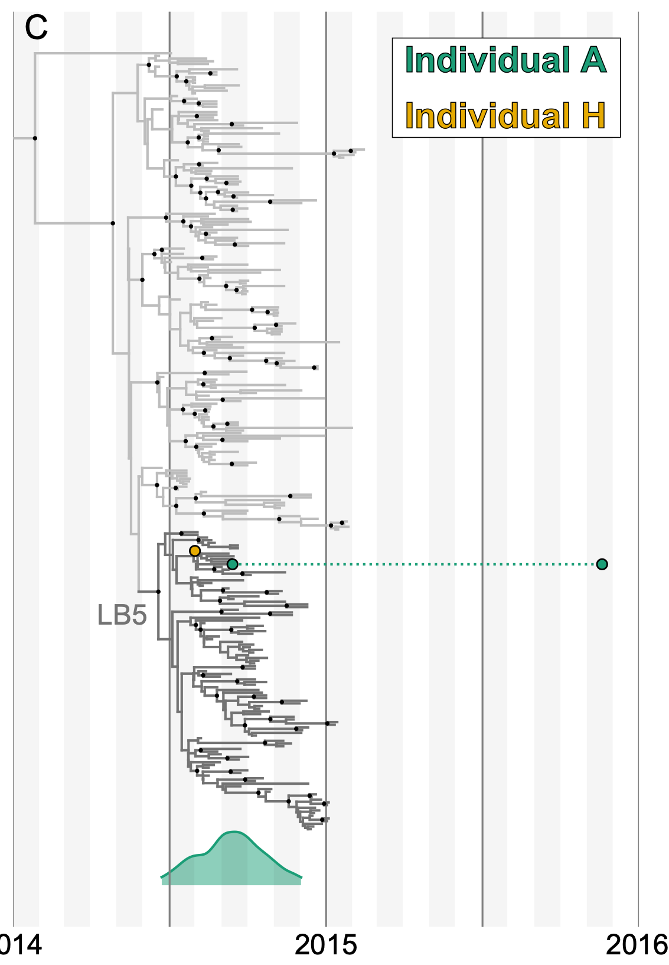
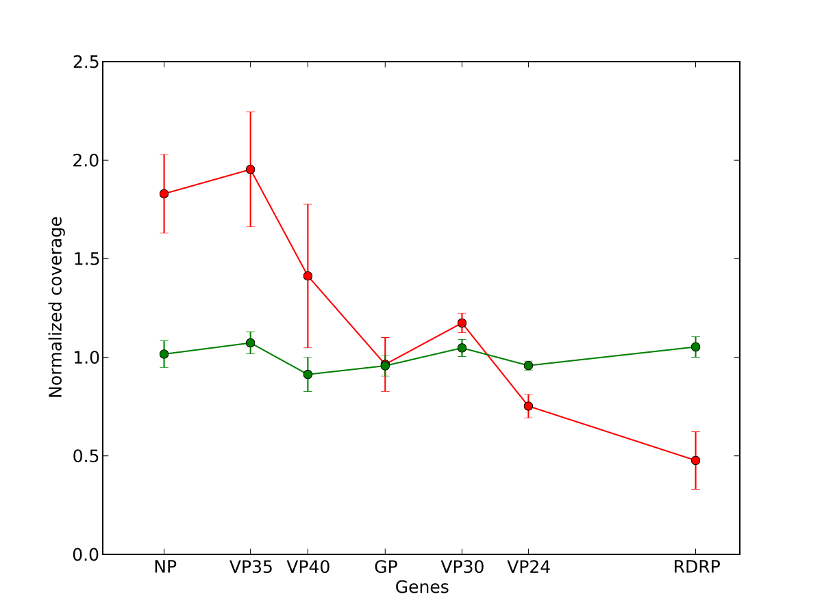
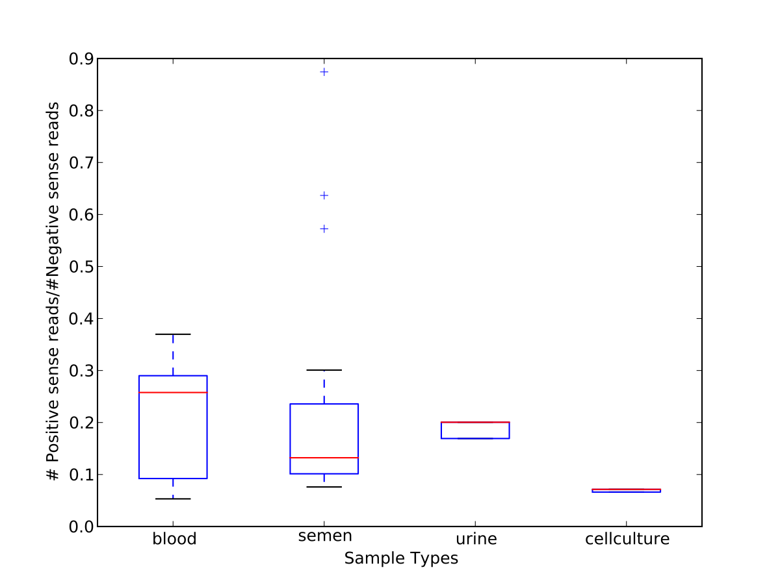
Powerful plotting module
Preloaded in Anaconda installations
Notes:
To help illustrate the flexibility of Matplotlib, I’m showing six different plots that I’ve generated using this module
Some of these, like the line plot and the boxplot are more or less “straight out of the box”
whereas, others like the phylogeny and the map are highly customized.
To start, we’ll be using a Jupyter notebook to work with Matplotlib
And Matplotlib comes pre-installed with the anaconda-version of python
Therefore, in that space, you should be good to go
However, if you want to use this module with a non-anaconda version of python then you’ll likely
need to install it first, as this module is not included in the standard python distribution

Slide 10
import matplotlib.pyplot as plt
Recommended ways to use Matplotlib:
Stand-alone scripts
Jupyter notebook
Notes:
Of course, the first thing you need to do, before you can utilize any module is to import it
Within Matplotlib, you’ll specifically be using the “pyplot” module to generate your figures
And the typical way that this module is imported is using this command…
Or, alternatively, “from matplotlib import pyplot as plt”
Does everyone understand why these two are functionally the same?
Now, you can import and use Matplotlib in all of the different ways that you can use Python,
including via the interactive command line interface
But, I would recommend that you stick to either stand-alone scripts or Jupyter notebooks, for using Matplotlib
Both of these will assure that you have a saved version of the commands that you use to make your figures,
and because you’ll typically have a series of (potentially complicated) commands for each figure you make,
it will be pretty tedious to enter all of these on the command prompt

Slide 11
1. Initialize your figure
fig, ax = plt.subplots()
Notes:
Matplotlib was actually designed to provide similar functionality to MatLab
So, the usage should be familiar to anyone with MatLab experience
But even for those without MatLab experience, the basic structure of a script using Matplotlib is pretty straightforward
The first thing you’ll need to do is include a command that will initialize your figure
and the command that I’m showing here illustrates the basic syntax for initializing a figure with Matplotlib
Specifically, you will initialize your figures using the “subplots” method of the pyplot module
And this will return two objects, which I’ve arbitrarily assigned to the variables “fig” and “ax”

Slide 12
1. Initialize your figure
fig, ax = plt.subplots()
Figure object
Top-level container for plot elements
Can contain multiple Axes objects (i.e. plots)
Notes:
The first object, which I’ve assigned to the variable “fig” is what we call a Figure-type object
Every plot you generate will have an associated Figure object
and this object serves as a top-level container for all of the different elements in your plot
However, you will not actually interact very much with this Figure type object
Instead, most of your commands will act on Axes type objects
And you will always have at least one Axes object associated with your Figure object
And if you generate a figure with multiple panels, you will actually have multiple
Axes objects associated with your Figure object

Slide 13
1. Initialize your figure
fig, ax = plt.subplots()
Axes object
One per graph/plot
Contains most figure elements
Notes:
Now, as you’ve probably guessed, the second object returned by my initialization command,
the one called “ax”, this is an Axes object,
Each panel within your figure will have an associated Axes type object
And these objects contain most of the elements associated with your figure
In fact, most of the methods you’ll use to generate your figure will be called from these Axes objects using dot notation
And, in this example, there’s only one panel, and therefore only one Axes object
Alright, so this is always going to be the first step when building a new plot with matplotlib,
but this command will only generate a blank canvas

Slide 14
2. Add or modify elements to build your custom figure
Notes:
After this, you will need to include a series of commands that will add elements to your plot
or modify existing elements to create your custom figure
So, the next thing I want to do is to walk through some examples of doing this

Slide 15
import matplotlib.pyplot as plt
fig, ax = plt.subplots()
ax.plot([0,5], [0,5])
ax.set_xlabel(‘xlabel’)
ax.set_title(‘Simple Plot’)
Notes:
As an initial example, I’ve included 5 lines of code that, alone, are sufficient for generating a
simple plot using matplotlib
At the top, in green, I’m simply importing pyplot for use in my script
What’s the next line doing, the orange line? (Initialize the figure)
And then after the initialization of the figure, there are then three commands (pink) that modify the figure
And these are generally analogous to the three commands from the previous slide
This first one draws a line on the plot from 0,0 to 5,5
The 2nd adds an x-axis label
And the 3rd adds a title
And, as you can see, in each case I’m calling the relevant methods directly from the Axes type object that I created
and this makes it explicit exactly to which Axes I’m adding these plot objects

Slide 16
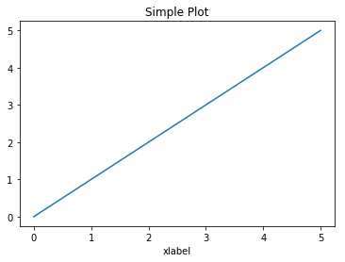
Notes:
And here’s the actual plot that would be generated by these commands
As you can see, it simply contains a single line that starts at 0,0 and ends at 5,5
In this case, we didn’t provide any information about line color or width or style,
So, the line has just been drawn with the default settings
And, in addition, you can see the plot title and x-axis label that we specified
By default, these would not be included
Alright, any questions about the general steps for generating a figure before we move on to cover some additional options and methods?

Slide 17
Options at initialization
fig, ax = plt.subplots()
fig, ax = plt.subplots(figsize=(8,2))
fig, ax = plt.subplots(1,2)
fig, ax = plt.subplots(1,2, figsize=(8,2))
Notes:
Alright, so let’s first talk about a couple options you can include at the time that you’re initializing the figure
At the top here is the command I showed you on the previous slide, and this is the bare bones
version of using the subplots method
As you can see from the empty parentheses, there are no arguments being passed to
the function in this version
The next version of this command includes a single argument called “figsize”.
This argument allows you to set the physical size of the figure you’re generating
In this case, I’m specifying that the figure should be 8 inches wide and 2 inches high
Whereas, the default size, if this argument isn’t provided, is 6.4 inches wide and 4.8 inches high
Another useful thing you can do during initialization is to specify the number of panels,
or distinct axes to include
And you can do this by simply providing two numbers within these parentheses
These correspond to the number of rows, followed by the number of columns
So, in this case, there would be two panels, side by side
Or in other words, 1 row and 2 columns
Importantly, the default for both of these is 1,
So, providing 1, 1 would be equivalent to not specifying any numbers
In both cases, only a single panel would be included
And, of course, we can also combine these two, as shown here at the bottom
In this case though, the figsize refers to the full figure, or the combination of the two panels
Not to the size of the individual panels

Slide 18
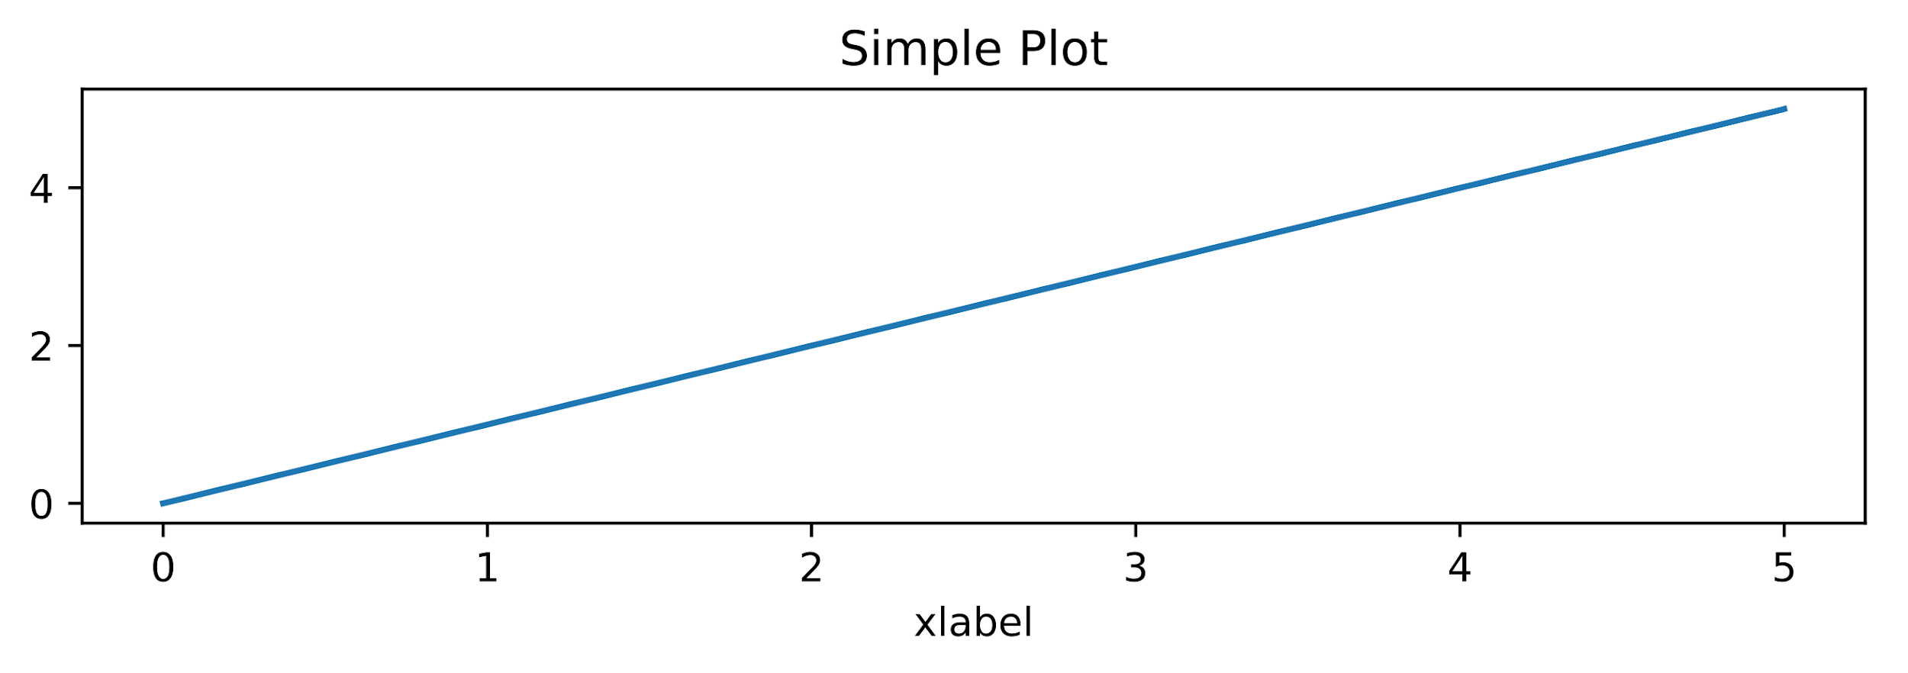
Control figure size
fig, ax = plt.subplots(figsize=(8,2))
ax.plot([0,5], [0,5])
ax.set_xlabel(‘xlabel’)
ax.set_title(‘Simple Plot’)
Notes:
Here, I’m showing how the appearance of the plot we made before would change
with the addition of that figsize argument
In this case, it’s much wider than it is tall

Slide 19
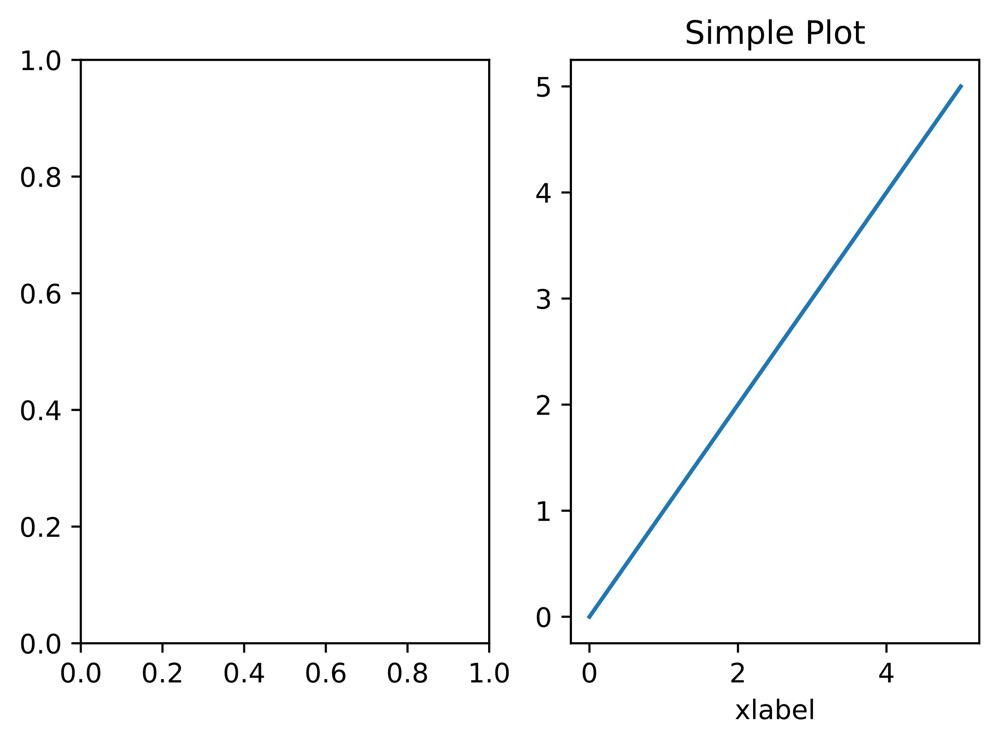
Multiple axes per figure
fig, ax = plt.subplots(1,2)
ax[1].plot([0,5], [0,5])
ax[1].set_xlabel('xlabel')
ax[1].set_title('Simple Plot')
Notes:
And here’s what the figure would look like, when asking for two axes objects
Arranged as 1 row and 2 columns
One important thing to notice here is that because the “ax” variable now contains multiple
AXES type objects, we now need to use indexing to specify which one we want to work with
In this case, I’ve use the index 1 to specify the second subplot
Therefore, the plot on the right contains the blue line and the labels whereas, the plot on the left is currently empty
Alright, this doesn’t cover all possible options at initialization, but these are probably the
two most common
As you get more comfortable with matplotlib, I encourage you to explore the other options
For example, some that I’ve used in the past allow you to link subplots so that they share the same y-axis or x-axis
Alright, now, let’s talk about a few of the other methods that are available for AXES type objects
Remember, it’s by using these methods that you will add elements to your plot
And there are built-in methods for all of the typical plot types

Slide 20
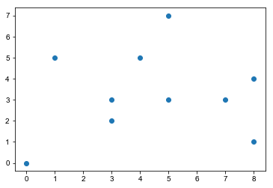
Scatterplot
x = random.choices(range(10), k=10)
y = random.choices(range(10), k=10)
ax.scatter(x, y)
Notes:
For example, if you want to generate a scatter plot, you’ll use the scatter method
And for scatter, there are two required, positional arguments that need to be provided
The 1st is a list or other array-like object containing the x-coordinates of the points
And the 2nd a list (or other array-like object) containing the y-coordinates of the points
So, here for example, is a scatterplot containing 10 points with x and y coordinates that were
chosen randomly from the integers between 0 and 9

Slide 21
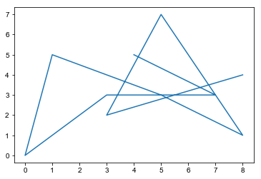
Lineplot
ax.plot(x, y)
Notes:
In the initial example, I already used the method for creating a lineplot
This method is simply called “plot”
And, again, you need to provide two positional arguments to this function
And just like with the scatter method, these arguments must include the x and y coordinates of
the points you want to plot
The only difference is that instead of plotting the individual points
Plot simply draws lines connecting the specified points
Here’s a line plot drawn using the same x and y coordinates as the previous scatterplot
One important thing to recognize about the line plots is that order in your list matters
In this case, the first point from our randomly generated lists was [4,5],
And this was followed by [7,3], [3,3], [0,0] and so on
Because these were randomly generated, the resulting line is kind of crazy looking
In most real world applications, you’ll want to make sure your points are sorted according to at least one of your axes
prior to plotting

Slide 22
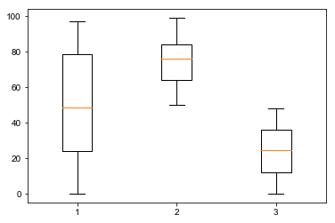
Boxplot
d = [random.choices(range(100), k=100),
random.choices(range(50,100), k=100),
random.choices(range(50), k=100)]
ax.boxplot(d)
Notes:
Another common plot type is the boxplot
In this case, you just need to provide a list of values,
Or, if you want multiple boxes, then provide a list of lists
So, for example, here we’re generating a plot with three boxes
each of which is generated from a list of 100 integers chosen randomly from different ranges:
0 - 99, 50-99, and 0-49
And all I need to do is to provide this single argument (a list containing 3 lists) in order to generate this figure

Slide 23
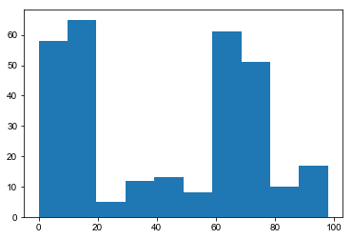
Histogram
o = random.choices(range(20), k=100) +
random.choices(range(100), k=100) +
random.choices(range(60, 75), k=100)
ax.hist(o)
Notes:
You can also use Matplotlib to generate histograms, and this is supported by a method called hist
For the hist method, you’re only required to provide a single argument, which needs to be
A list (or other array-type object) containing your observations
In this case, I randomly generated a list containing 300 integers
However, one common, optional argument you’ll likely want to include is the “bins” argument
By default, only 10 bins are used

Slide 24
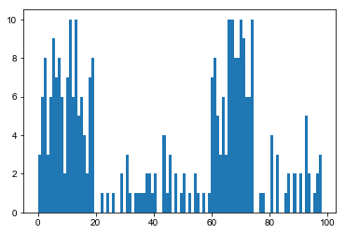
Histogram
o = random.choices(range(20), k=100) +
random.choices(range(100), k=100) +
random.choices(range(60, 75), k=100)
ax.hist(o, bins=100)
Notes:
But we can easily customize the number of bins
Here, for example, is the same dataset I showed on the previous slide,
But now there are 100 bins, instead of 10
Alright, so there are a few of the common methods that you can use to build data plots
But as you can see, the plots that are generated are pretty bare bones
So, let’s talk about a few methods that you can use to further modify the appearance of your plots

Slide 25
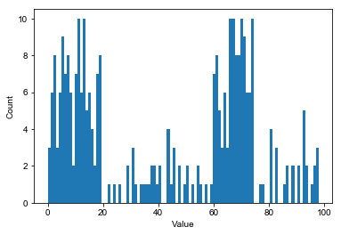
Adding axis labels
ax.set_xlabel("Value")
ax.set_ylabel("Count")
Notes:
For example, you’ll almost always want to add both x- and y-axis labels
And we can do this easily using the “set_xlabel” and “set_ylabel” methods
Here, I’ve added axis labels onto the plot from the previous slide
And I’m only providing the one required argument for each method
However, I find that generally the default labels are too small
So, I always use at least one optional argument with these methods…

Slide 26
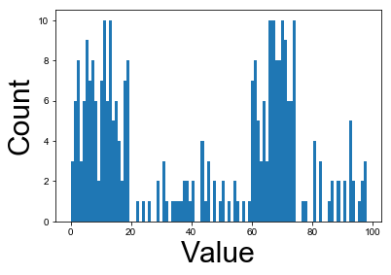
Adding axis labels
ax.set_xlabel("Value", fontsize=30)
ax.set_ylabel("Count", fontsize=30)
Notes:
And that is the argument used to specify the size of the font
Alright, now the axis labels look pretty good,
But the labels at the tick marks are pretty small

Slide 27
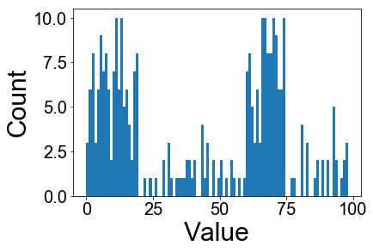
Adding axis labels
ax.tick_params(labelsize=20)
Notes:
Well, you can use the tick_params method to make many different changes to the
tick marks, tick labels and grid lines
Here, I’m changing the major tick mark label size on both axes to 20
Now, the reason that this command is as simple as it is, is because I’m relying on several default settings

Slide 28
Adding axis labels
ax.tick_params(axis=‘both’, which=‘major’, labelsize=20)
Notes:
Here, I’m doing exactly the same thing, but now I’m explicitly
defining all of the relevant parameters, instead of implicitly relying on the default settings
And, I find that it’s often useful to be explicit, because you may want to reuse this code in the future
But maybe then you won’t want to use all the defaults
For example, you might NOT want to manipulate both axes in the same way
Well, no problem, it’s easy to just modify “both” to be “y” or “x”
Because the optional argument is already present
Whereas, if that argument wasn’t present, I would either have to remember the name of the argument, or look it up
And, given that I’m probably going to remember it wrong, this is likely going to slow me down

Slide 29
Axes object methods
['acorr', 'add_artist', 'add_callback', 'add_collection', 'add_container', 'add_line', 'add_patch', 'add_table', 'aname', 'annotate', 'apply_aspect', 'arrow', 'artists', 'autoscale', 'autoscale_view', 'axes', 'axesPatch', 'axhline', 'axhspan', 'axis', 'axison', 'axvline', 'axvspan', 'bar', 'barbs', 'barh', 'bbox', 'boxplot', 'broken_barh', 'callbacks', 'can_pan', 'can_zoom', 'change_geometry', 'cla', 'clabel', 'clear', 'clipbox', 'cohere', 'colNum', 'collections', 'containers', 'contains', 'contains_point', 'contour', 'contourf', 'convert_xunits', 'convert_yunits', 'csd', 'dataLim', 'drag_pan', 'draw', 'draw_artist', 'end_pan', 'errorbar', 'eventplot', 'eventson', 'figbox', 'figure', 'fill', 'fill_between', 'fill_betweenx', 'findobj', 'fmt_xdata', 'fmt_ydata', 'format_coord', 'format_xdata', 'format_ydata', 'get_adjustable', 'get_agg_filter', 'get_alpha', 'get_anchor', 'get_animated', 'get_aspect', 'get_autoscale_on', 'get_autoscalex_on', 'get_autoscaley_on', 'get_axes', 'get_axes_locator', 'get_axis_bgcolor', 'get_axisbelow', 'get_children', 'get_clip_box', 'get_clip_on', 'get_clip_path', 'get_contains', 'get_cursor_props', 'get_data_ratio', 'get_data_ratio_log', 'get_default_bbox_extra_artists', 'get_figure', 'get_frame_on', 'get_geometry', 'get_gid', 'get_images', 'get_label', 'get_legend', 'get_legend_handles_labels', 'get_lines', 'get_navigate', 'get_navigate_mode', 'get_path_effects', 'get_picker', 'get_position', 'get_rasterization_zorder', 'get_rasterized', 'get_renderer_cache', 'get_shared_x_axes', 'get_shared_y_axes', 'get_sketch_params', 'get_snap', 'get_subplotspec', 'get_tightbbox', 'get_title', 'get_transform', 'get_transformed_clip_path_and_affine', 'get_url', 'get_visible', 'get_window_extent', 'get_xaxis', 'get_xaxis_text1_transform', 'get_xaxis_text2_transform', 'get_xaxis_transform', 'get_xbound', 'get_xgridlines', 'get_xlabel', 'get_xlim', 'get_xmajorticklabels', 'get_xminorticklabels', 'get_xscale', 'get_xticklabels', 'get_xticklines', 'get_xticks', 'get_yaxis', 'get_yaxis_text1_transform', 'get_yaxis_text2_transform', 'get_yaxis_transform', 'get_ybound', 'get_ygridlines', 'get_ylabel', 'get_ylim', 'get_ymajorticklabels', 'get_yminorticklabels', 'get_yscale', 'get_yticklabels', 'get_yticklines', 'get_yticks', 'get_zorder', 'grid', 'has_data', 'have_units', 'hexbin', 'hist', 'hist2d', 'hitlist', 'hlines', 'hold', 'ignore_existing_data_limits', 'images', 'imshow', 'in_axes', 'invert_xaxis', 'invert_yaxis', 'is_figure_set', 'is_first_col', 'is_first_row', 'is_last_col', 'is_last_row', 'is_transform_set', 'ishold', 'label_outer', 'legend', 'legend_', 'lines', 'locator_params', 'loglog', 'margins', 'matshow', 'minorticks_off', 'minorticks_on', 'name', 'numCols', 'numRows', 'patch', 'patches', 'pchanged', 'pcolor', 'pcolorfast', 'pcolormesh', 'pick', 'pickable', 'pie', 'plot', 'plot_date', 'properties', 'psd', 'quiver', 'quiverkey', 'redraw_in_frame', 'relim', 'remove', 'remove_callback', 'reset_position', 'rowNum', 'scatter', 'semilogx', 'semilogy', 'set', 'set_adjustable', 'set_agg_filter', 'set_alpha', 'set_anchor', 'set_animated', 'set_aspect', 'set_autoscale_on', 'set_autoscalex_on', 'set_autoscaley_on', 'set_axes', 'set_axes_locator', 'set_axis_bgcolor', 'set_axis_off', 'set_axis_on', 'set_axisbelow', 'set_clip_box', 'set_clip_on', 'set_clip_path', 'set_color_cycle', 'set_contains', 'set_cursor_props', 'set_figure', 'set_frame_on', 'set_gid', 'set_label', 'set_lod', 'set_navigate', 'set_navigate_mode', 'set_path_effects', 'set_picker', 'set_position', 'set_rasterization_zorder', 'set_rasterized', 'set_sketch_params', 'set_snap', 'set_subplotspec', 'set_title', 'set_transform', 'set_url', 'set_visible', 'set_xbound', 'set_xlabel', 'set_xlim', 'set_xmargin', 'set_xscale', 'set_xticklabels', 'set_xticks', 'set_ybound', 'set_ylabel', 'set_ylim', 'set_ymargin', 'set_yscale', 'set_yticklabels', 'set_yticks', 'set_zorder', 'specgram', 'spines', 'spy', 'stackplot', 'start_pan', 'stem', 'step', 'streamplot', 'table', 'tables', 'text', 'texts', 'tick_params', 'ticklabel_format', 'title', 'titleOffsetTrans', 'transAxes', 'transData', 'transLimits', 'transScale', 'tricontour', 'tricontourf', 'tripcolor', 'triplot', 'twinx', 'twiny', 'update', 'update_datalim', 'update_datalim_bounds', 'update_datalim_numerix', 'update_from', 'update_params', 'viewLim', 'vlines', 'xaxis', 'xaxis_date', 'xaxis_inverted', 'xcorr', 'yaxis', 'yaxis_date', 'yaxis_inverted', 'zorder']
Notes:
Alright, so we’ve discussed several different methods you can use to modify a plot in Matplotlib
but we’ve barely scratched the surface of what this module is capable of
And to illustrate this, I’m showing a list of all the built-in methods for an Axes type object
And unlike the methods associated with lists or strings, none of these are magic methods
These are all designed to be called directly by the user
Now, I don’t expect you to be able to actually read these…
I just wanted to use this as an illustration of the great power of this module
Also, these are only the methods themselves,
This representation doesn’t tell you anything about all of the different options that are available for each of these methods
And it’s really the combination of all of these different methods
And all of the different options within methods, that allows for an incredible level of customization
In your assignment today, you’ll be introduced to a few more methods
And some additional options
But the main focus today is getting comfortable with the basics of figure generation with Matplotlib
Whereas, next week we’re going to be digging further into these different options to generate highly customized figures

Slide 30
Plots occur inline with code in jupyter notebook
Notes:
Now, of course, one of the critical things you’ll want to do, after building your plot,
is to actually view the plot you’ve generated
There are generally two ways that I utilize matplotlib
And One of them is within a jupyter notebook
Well, one of the really great things about working in a jupyter notebook
Is that your figures will be displayed inline with your code,
just like all of your print statements and error messages
What I’ve found is that, by default, this inline figure generation has been turned on in my jupyter notebooks,
But this will not necessarily be true in all cases

Slide 31

To test if inline display is default
Notes:
To test whether in line figure display is also the default on your system,
You can import pyplot, as usual and then call the built-in method “get_backend()”
If the the result looks like this, ending in “.backend_inline”
Then you’re good to go
If it doesn’t, then all you need to do is …

Slide 32
Add as first line of notebook to activate inline display
%matplotlib inline
Notes:
add this line at the very beginning of your notebook to activate inline figure generation

Slide 33
Saving your plots
fig.savefig(‘name.pdf’)
Notes:
Now, of course, seeing your plot inline is great for when you’re working on building your plot
But once you have something you like, you’ll want to actually save the plot
And, although there are ways to get pop up windows to display your plot, when you’re
using matplotlib within a stand alone script
Whether or not this will work, is variable on different systems
And if you’re logging into a remote terminal, like when you’re suing monsoon, it definitely won’t work
Therefore, when I run matplotlib from a stand alone script, I generally always save my figures to
files and then just open the files to view the figures
For actually saving your figures to a file, you’ll utilize the “savefig” method
But note that while most of the manipulations have involved axes object methods,
This method is called from the Figure type object, which we assigned to the variable “fig”
One cool thing about this method is that it can actually infer the the format in which you want to save the file
directly from the file extension of the provided output name
This is one of the reasons that it’s really important to know your file extensions
Here, I’m showing a barebones version of a savefig command,
where only the file name is provided
And since the provided filename ends in .pdf,
the resulting file will be vector-based, in the pdf format
And one of the reasons I really like that the output format can be specified in this way
Is that it means I can write scripts that allow the user to specify the output name
And therefore, the user is also able to intuitively and easily modify the type of figure generated
meaning Vector-based or pixel-based, just by modifying the requested file name

Slide 34
Saving your plots
fig.savefig(‘name.pdf’,
bbox_inches=‘tight’)
Notes:
Now, one option that I always recommend that you use when saving your figures is the, somewhat crytpic,
bbox_inches=‘tight’ setting
This will remove extraneous white space from the borders of the figure
And will generally make sure that all of your added components fit within the canvas
So, nothing gets cutoff because it’s outside of the borders of your plot

Slide 35
Saving your plots
fig.savefig(‘name.png’, bbox_inches=‘tight’, dpi=300)
Notes:
Additionally, if you’re saving your figure in a pixel-based format, like png
then you’ll want to specify the number of dots (or pixels) per inch
Which is specified using the “dpi” optional argument
And even though it’s not needed or used, you can even include this option when generating vector-based graphics,
Which means that you can just keep the dpi argument in your standard savefig command
and it will work fine for saving both vector and pixel graphics.
??? Any questions ???

Slide 36
Approach used in this class = “Object-oriented”
Notes:
Alright, the final thing I want to do is to point out that the approach I’ve been using for interacting with
Matplotlib is called “Object-oriented”
With an object oriented approach, you will always explicitly initialize your figure, and in doing so,
you’ll create your figure and axes type objects,
And you’ll call all of the methods for building your figures directly from these objects
Now, the reason I’m bringing this up is because this isn’t the only way that you can build figures with Matplotlib,
although it is the way that I recommend

Slide 37
State-machine interface
import matplotlib.pyplot as plt
plt.plot([0,5], [0,5])
plt.xlabel(‘xlabel’)
plt.title(‘Simple Plot’)
Notes:
The other approach is called the “State-machine interface”, and I just wanted to briefly mention it here because
you may run across examples online that utilize this other approach
With this approach, all of the methods used to generate your plot are called directly from the Pyplot module (green)
Remember that we import the pyplot module as “plt”
That’s shown here at the top
With these commands, I’ve recreated the very first example plot I showed today by
first drawing a line on the plot from 0,0 to 5,5
Then adding an x-axis label
And, finally, adding a title
However, one thing I don’t have here is a command to initialize the figure
Well, this is one of the things I don’t like about this approach,
It implicitly relies on pyplot to automatically create the necessary Figure and Axes objects to achieve the desired plot
And instead of explicitly interacting with those objects, the user instead interacts directly with the pyplot module
Personally, I find this approach to be a very confusing way to learn to use matplotlib
And it’s also limited in its capabilities,
Whereas, the object-oriented approach is going to give you more room to grow and
create highly customized figures
So, I want you to be aware of the state machine interface, but I highly recommend that you stick to the
object-oriented approach in your code

