Slide 1
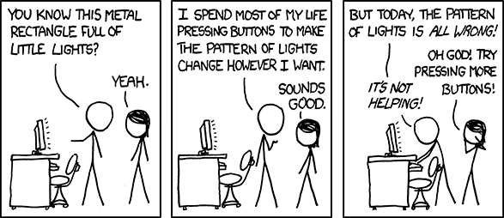
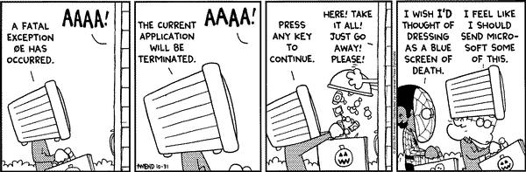
Python Part 5
Spring 2024
PCfB Class 8
March 8, 2024

Slide 2
Check in

Slide 3
Outline
pandas module
Types of errors
Debugging tools/tips

Slide 4
pandas module

Slide 5
Series

Slide 6
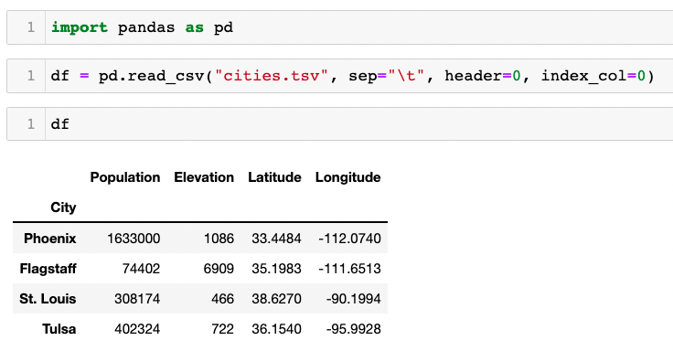
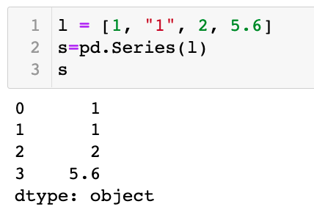

Slide 7
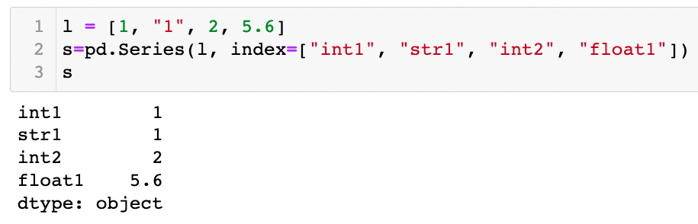

Slide 8
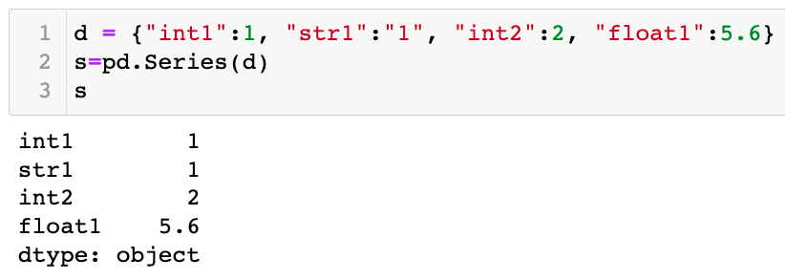

Slide 9
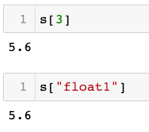
Accessing items in Series

Slide 10
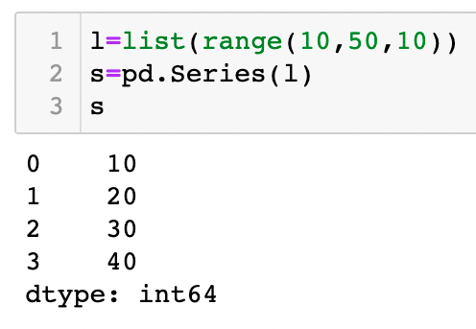

Slide 11
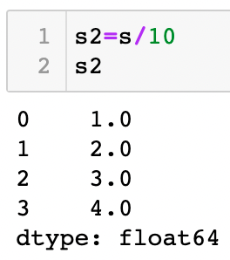
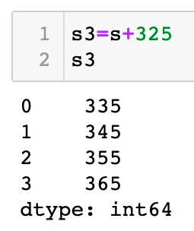

Slide 12
Dataframe

Slide 13
Convert file to dataframe

Slide 14
Optional arguments
sep
header
names
index_col

Slide 15
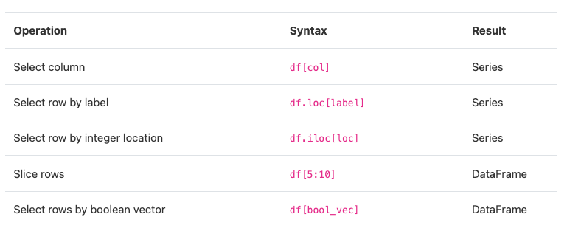
Accessing data

Slide 16
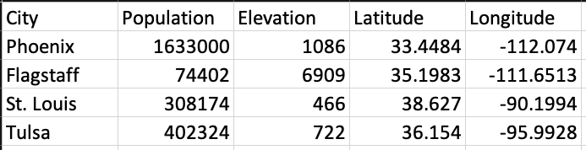
Example dataset
“cities.tsv”

Slide 18
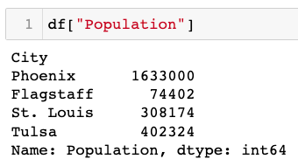
Access a single column

Slide 19
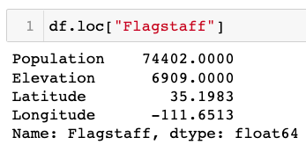
Access a single row - By name

Slide 20
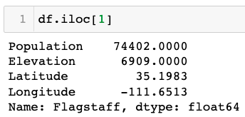
Access a single row - By position

Slide 21
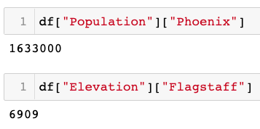
Access specific item

Slide 22
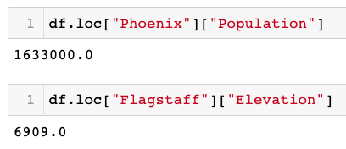
Access specific item

Slide 23
Pandas can be very inefficient!

Slide 24
Pandas demo

Slide 25
Types of errors

Slide 26
Syntax Errors
Detected before program is run
Part of your code is not understood by the interpreter

Slide 27
File "./rev_comp_v1.py", line 10
print (revseq.translate(trantab))
^
SyntaxError: invalid syntax

Slide 28
Runtime Errors (aka, Exceptions)
Occur when program is executed
29 standard exception types (https://www.tutorialspoint.com/python/standard_exceptions.htm)
Format = Traceback

Slide 29
Traceback (most recent call last):
File "./rev_comp_v3.py", line 19, in <module>
print_rev_comp(seq)
File "./rev_comp_v3.py", line 10, in print_rev_comp
print (revseq.translate(trantab))
AttributeError: 'builtin_function_or_method' object has no attribute 'translate'

Slide 30
Tip #1: Look up!
Problem not necessarily on the line where the error was detected
Could be on a preceding line

Slide 31
Tool #1: print() function
Prior to the error to check the status of important variables
Within loops to check whether conditions have been met

Slide 32
Tool #2: Comments
Temporarily remove sections of code to isolate problem
Use # to comment out a single line
Use ‘‘‘ ’’’ to comment out multiple lines

Slide 33
Tip #2: Interactive interpreter
Don’t forget about the command line interface
Easy way to test commands

Slide 34
Executing script in working directory
./fasta2phy.py -f lassa_seqs.fasta

Slide 35



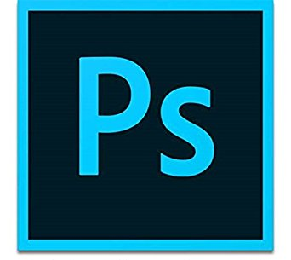
Please install:
or
Adobe Illustrator
Inkscape
And:
or
Adobe Photoshop
GIMP

