Slide 1
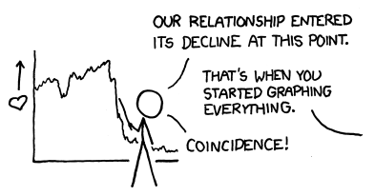
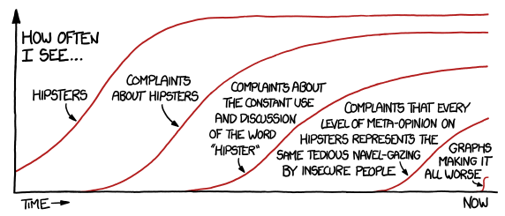
More Python figures
Spring 2024
Week 11
April 5, 2024

Slide 2
Check-in

Slide 3
Work/troubleshoot days
Start with roundtable
Independent work/discussion

Slide 4
Project presentations
~10-12 min presentation
~5 min Q & A

Slide 5
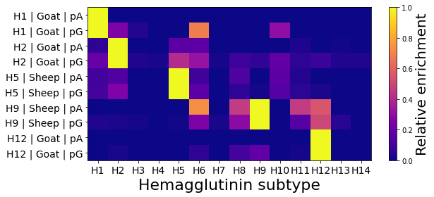
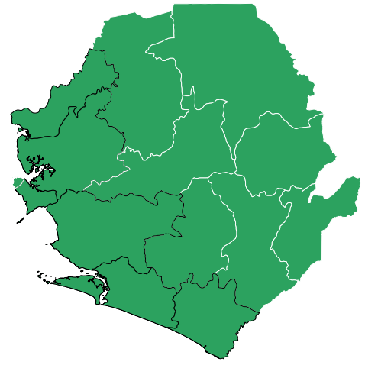
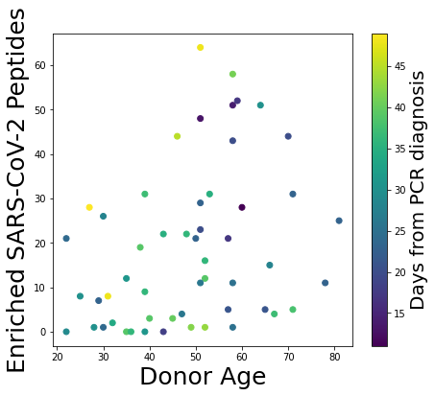
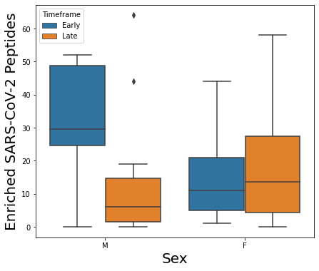
More plots!

