Slide 1

Making figures with Python
Spring 2024
PCfB Class 10
March 29, 2024
Dudas et al. 2017, Nature

Slide 2
Check-in

Slide 3
Outline
Benefits of Python for figures
Intro to Matplotlib module

Slide 4
Why use Python?
Highly customizable

Slide 5
Why use Python?
Highly customizable
Automated, easy to rerun

Slide 6
Why use Python?
Highly customizable
Automated, easy to rerun
Integrate into analysis

Slide 7
Why use Python?
Highly customizable
Automated, easy to rerun
Integrate into analysis
Open science compatible

Slide 8
Using matplotlib

Slide 9

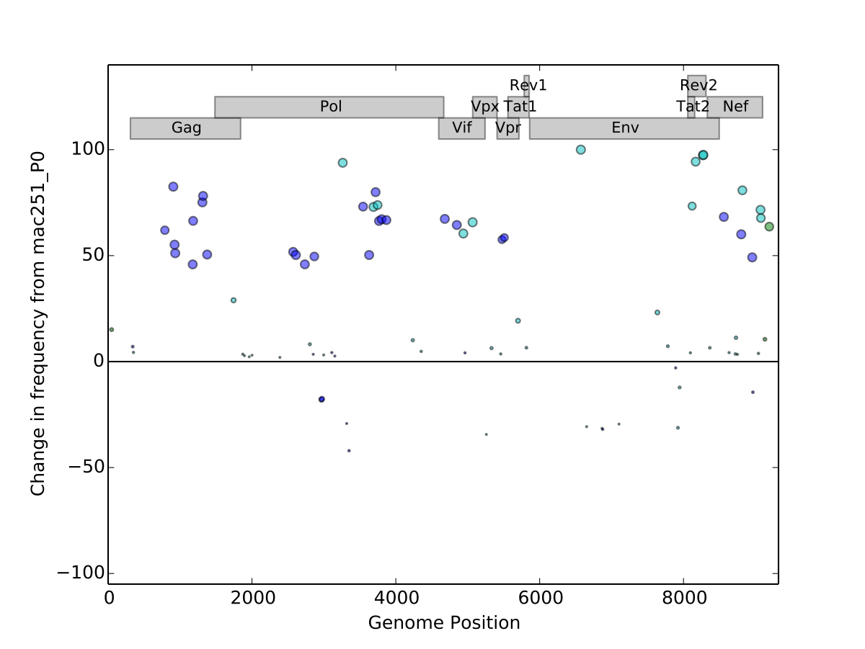
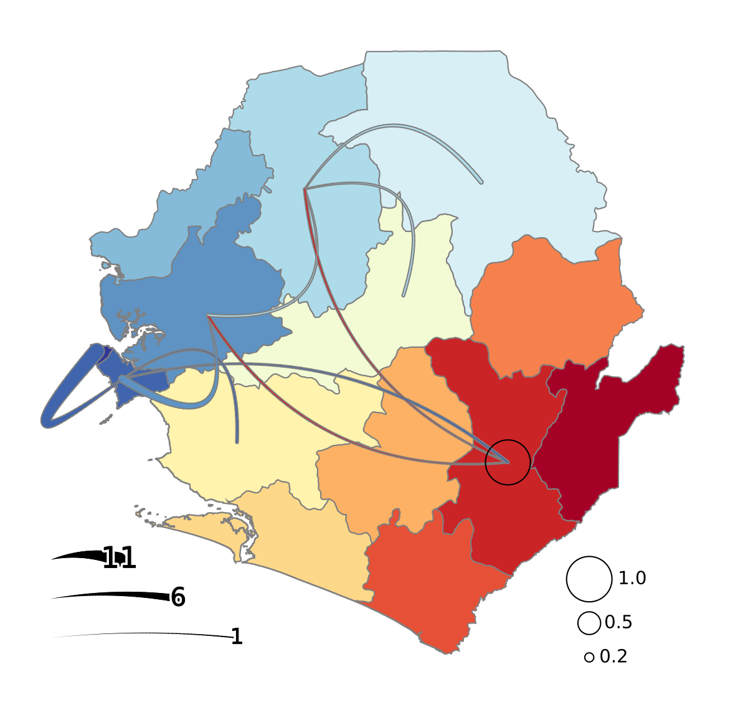
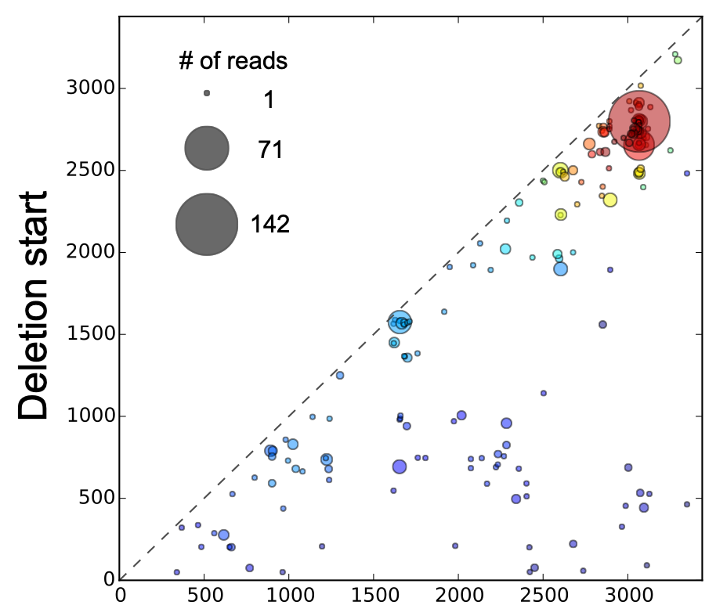
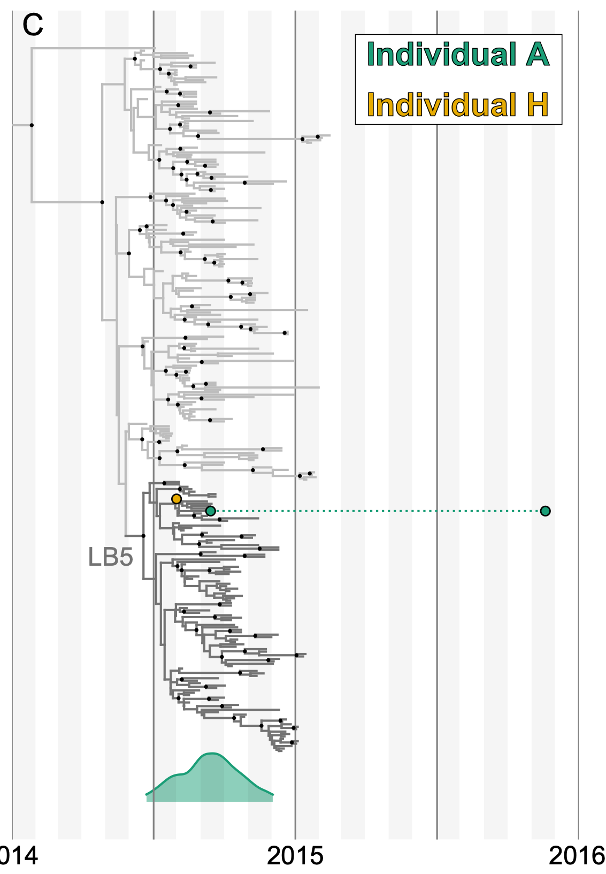
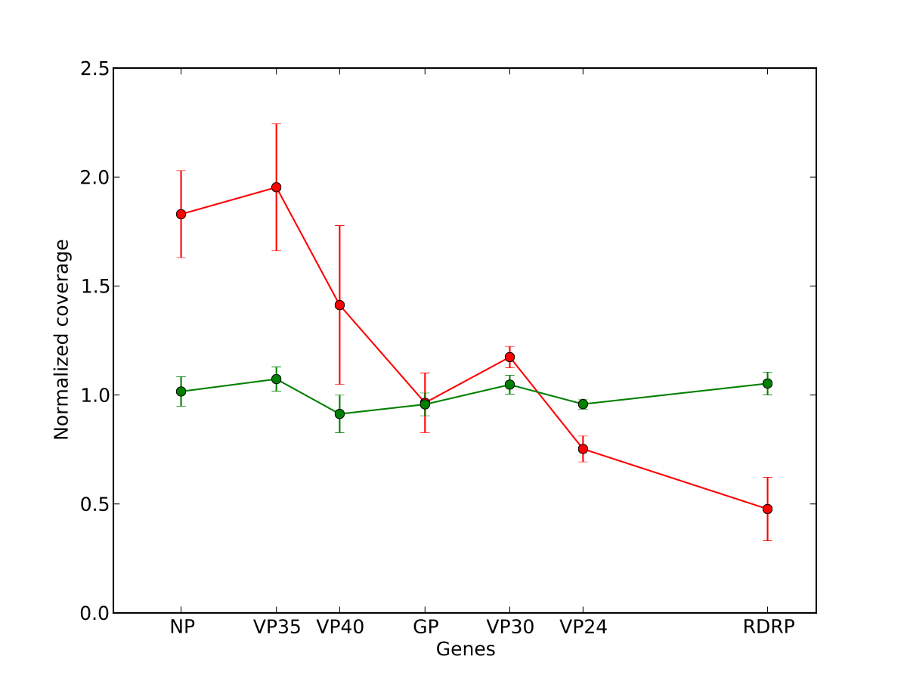
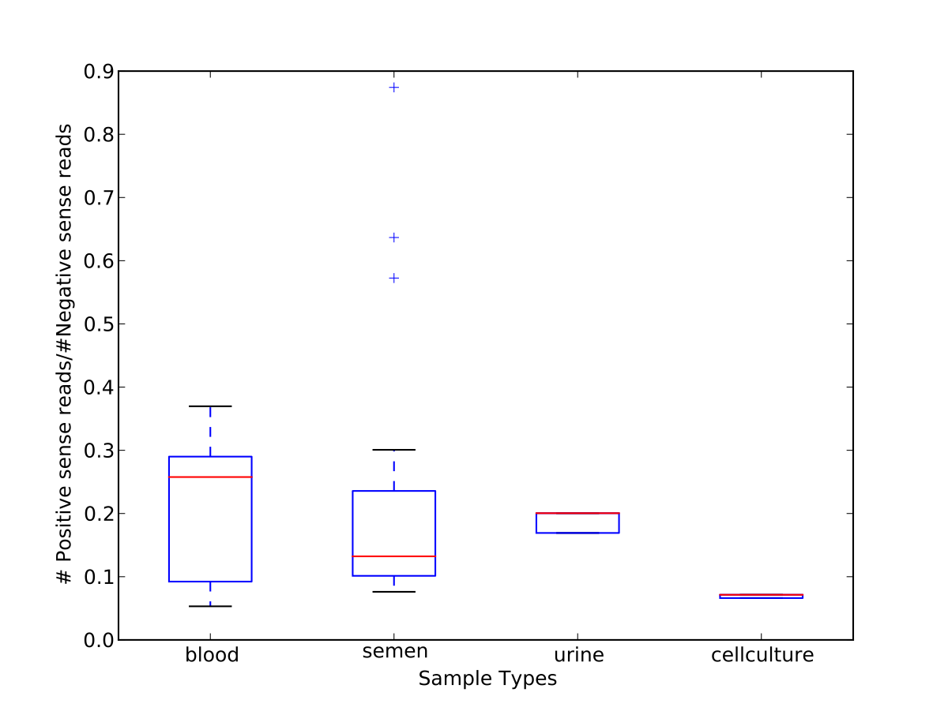
Powerful plotting module
Preloaded in Anaconda installations

Slide 10
import matplotlib.pyplot as plt
Recommended ways to use Matplotlib:
Stand-alone scripts
Jupyter notebook

Slide 11
1. Initialize your figure
fig, ax = plt.subplots()

Slide 12
1. Initialize your figure
fig, ax = plt.subplots()
Figure object
Top-level container for plot elements
Can contain multiple Axes objects (i.e. plots)

Slide 13
1. Initialize your figure
fig, ax = plt.subplots()
Axes object
One per graph/plot
Contains most figure elements

Slide 14
2. Add or modify elements to build your custom figure

Slide 15
import matplotlib.pyplot as plt
fig, ax = plt.subplots()
ax.plot([0,5], [0,5])
ax.set_xlabel(‘xlabel’)
ax.set_title(‘Simple Plot’)

Slide 16
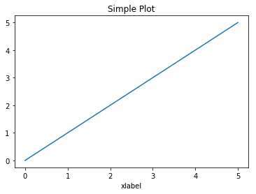

Slide 17
Options at initialization
fig, ax = plt.subplots()
fig, ax = plt.subplots(figsize=(8,2))
fig, ax = plt.subplots(1,2)
fig, ax = plt.subplots(1,2, figsize=(8,2))

Slide 18
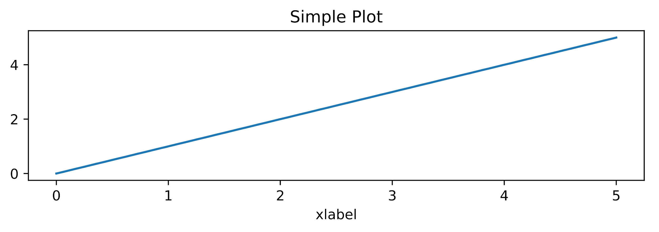
Control figure size
fig, ax = plt.subplots(figsize=(8,2))
ax.plot([0,5], [0,5])
ax.set_xlabel(‘xlabel’)
ax.set_title(‘Simple Plot’)

Slide 19
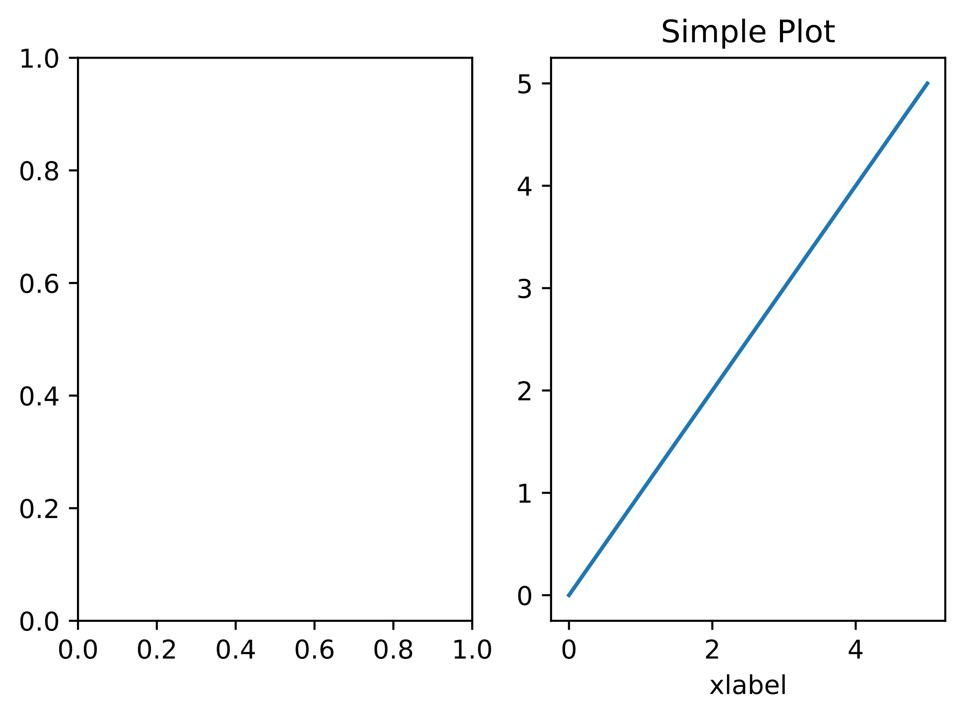
Multiple axes per figure
fig, ax = plt.subplots(1,2)
ax[1].plot([0,5], [0,5])
ax[1].set_xlabel('xlabel')
ax[1].set_title('Simple Plot')

Slide 20
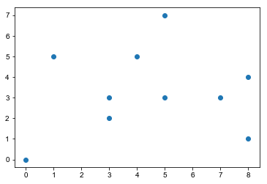
Scatterplot
x = random.choices(range(10), k=10)
y = random.choices(range(10), k=10)
ax.scatter(x, y)

Slide 21
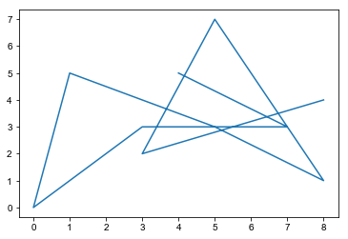
Lineplot
ax.plot(x, y)

Slide 22
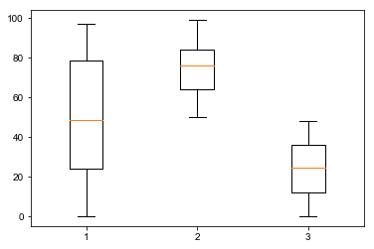
Boxplot
d = [random.choices(range(100), k=100),
random.choices(range(50,100), k=100),
random.choices(range(50), k=100)]
ax.boxplot(d)

Slide 23
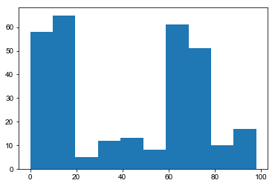
Histogram
o = random.choices(range(20), k=100) +
random.choices(range(100), k=100) +
random.choices(range(60, 75), k=100)
ax.hist(o)

Slide 24
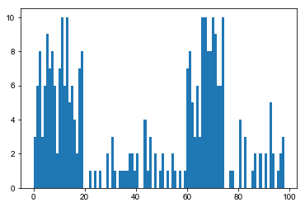
Histogram
o = random.choices(range(20), k=100) +
random.choices(range(100), k=100) +
random.choices(range(60, 75), k=100)
ax.hist(o, bins=100)

Slide 25
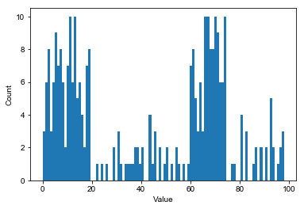
Adding axis labels
ax.set_xlabel("Value")
ax.set_ylabel("Count")

Slide 26
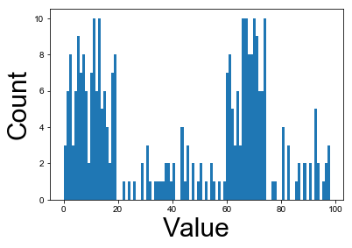
Adding axis labels
ax.set_xlabel("Value", fontsize=30)
ax.set_ylabel("Count", fontsize=30)

Slide 27
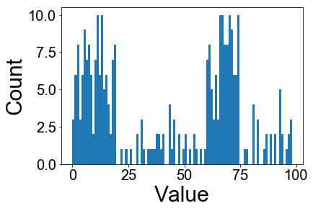
Adding axis labels
ax.tick_params(labelsize=20)

Slide 28
Adding axis labels
ax.tick_params(axis=‘both’, which=‘major’, labelsize=20)

Slide 29
Axes object methods
['acorr', 'add_artist', 'add_callback', 'add_collection', 'add_container', 'add_line', 'add_patch', 'add_table', 'aname', 'annotate', 'apply_aspect', 'arrow', 'artists', 'autoscale', 'autoscale_view', 'axes', 'axesPatch', 'axhline', 'axhspan', 'axis', 'axison', 'axvline', 'axvspan', 'bar', 'barbs', 'barh', 'bbox', 'boxplot', 'broken_barh', 'callbacks', 'can_pan', 'can_zoom', 'change_geometry', 'cla', 'clabel', 'clear', 'clipbox', 'cohere', 'colNum', 'collections', 'containers', 'contains', 'contains_point', 'contour', 'contourf', 'convert_xunits', 'convert_yunits', 'csd', 'dataLim', 'drag_pan', 'draw', 'draw_artist', 'end_pan', 'errorbar', 'eventplot', 'eventson', 'figbox', 'figure', 'fill', 'fill_between', 'fill_betweenx', 'findobj', 'fmt_xdata', 'fmt_ydata', 'format_coord', 'format_xdata', 'format_ydata', 'get_adjustable', 'get_agg_filter', 'get_alpha', 'get_anchor', 'get_animated', 'get_aspect', 'get_autoscale_on', 'get_autoscalex_on', 'get_autoscaley_on', 'get_axes', 'get_axes_locator', 'get_axis_bgcolor', 'get_axisbelow', 'get_children', 'get_clip_box', 'get_clip_on', 'get_clip_path', 'get_contains', 'get_cursor_props', 'get_data_ratio', 'get_data_ratio_log', 'get_default_bbox_extra_artists', 'get_figure', 'get_frame_on', 'get_geometry', 'get_gid', 'get_images', 'get_label', 'get_legend', 'get_legend_handles_labels', 'get_lines', 'get_navigate', 'get_navigate_mode', 'get_path_effects', 'get_picker', 'get_position', 'get_rasterization_zorder', 'get_rasterized', 'get_renderer_cache', 'get_shared_x_axes', 'get_shared_y_axes', 'get_sketch_params', 'get_snap', 'get_subplotspec', 'get_tightbbox', 'get_title', 'get_transform', 'get_transformed_clip_path_and_affine', 'get_url', 'get_visible', 'get_window_extent', 'get_xaxis', 'get_xaxis_text1_transform', 'get_xaxis_text2_transform', 'get_xaxis_transform', 'get_xbound', 'get_xgridlines', 'get_xlabel', 'get_xlim', 'get_xmajorticklabels', 'get_xminorticklabels', 'get_xscale', 'get_xticklabels', 'get_xticklines', 'get_xticks', 'get_yaxis', 'get_yaxis_text1_transform', 'get_yaxis_text2_transform', 'get_yaxis_transform', 'get_ybound', 'get_ygridlines', 'get_ylabel', 'get_ylim', 'get_ymajorticklabels', 'get_yminorticklabels', 'get_yscale', 'get_yticklabels', 'get_yticklines', 'get_yticks', 'get_zorder', 'grid', 'has_data', 'have_units', 'hexbin', 'hist', 'hist2d', 'hitlist', 'hlines', 'hold', 'ignore_existing_data_limits', 'images', 'imshow', 'in_axes', 'invert_xaxis', 'invert_yaxis', 'is_figure_set', 'is_first_col', 'is_first_row', 'is_last_col', 'is_last_row', 'is_transform_set', 'ishold', 'label_outer', 'legend', 'legend_', 'lines', 'locator_params', 'loglog', 'margins', 'matshow', 'minorticks_off', 'minorticks_on', 'name', 'numCols', 'numRows', 'patch', 'patches', 'pchanged', 'pcolor', 'pcolorfast', 'pcolormesh', 'pick', 'pickable', 'pie', 'plot', 'plot_date', 'properties', 'psd', 'quiver', 'quiverkey', 'redraw_in_frame', 'relim', 'remove', 'remove_callback', 'reset_position', 'rowNum', 'scatter', 'semilogx', 'semilogy', 'set', 'set_adjustable', 'set_agg_filter', 'set_alpha', 'set_anchor', 'set_animated', 'set_aspect', 'set_autoscale_on', 'set_autoscalex_on', 'set_autoscaley_on', 'set_axes', 'set_axes_locator', 'set_axis_bgcolor', 'set_axis_off', 'set_axis_on', 'set_axisbelow', 'set_clip_box', 'set_clip_on', 'set_clip_path', 'set_color_cycle', 'set_contains', 'set_cursor_props', 'set_figure', 'set_frame_on', 'set_gid', 'set_label', 'set_lod', 'set_navigate', 'set_navigate_mode', 'set_path_effects', 'set_picker', 'set_position', 'set_rasterization_zorder', 'set_rasterized', 'set_sketch_params', 'set_snap', 'set_subplotspec', 'set_title', 'set_transform', 'set_url', 'set_visible', 'set_xbound', 'set_xlabel', 'set_xlim', 'set_xmargin', 'set_xscale', 'set_xticklabels', 'set_xticks', 'set_ybound', 'set_ylabel', 'set_ylim', 'set_ymargin', 'set_yscale', 'set_yticklabels', 'set_yticks', 'set_zorder', 'specgram', 'spines', 'spy', 'stackplot', 'start_pan', 'stem', 'step', 'streamplot', 'table', 'tables', 'text', 'texts', 'tick_params', 'ticklabel_format', 'title', 'titleOffsetTrans', 'transAxes', 'transData', 'transLimits', 'transScale', 'tricontour', 'tricontourf', 'tripcolor', 'triplot', 'twinx', 'twiny', 'update', 'update_datalim', 'update_datalim_bounds', 'update_datalim_numerix', 'update_from', 'update_params', 'viewLim', 'vlines', 'xaxis', 'xaxis_date', 'xaxis_inverted', 'xcorr', 'yaxis', 'yaxis_date', 'yaxis_inverted', 'zorder']

Slide 30
Plots occur inline with code in jupyter notebook

Slide 31

To test if inline display is default

Slide 32
Add as first line of notebook to activate inline display
%matplotlib inline

Slide 33
Saving your plots
fig.savefig(‘name.pdf’)

Slide 34
Saving your plots
fig.savefig(‘name.pdf’,
bbox_inches=‘tight’)

Slide 35
Saving your plots
fig.savefig(‘name.png’, bbox_inches=‘tight’, dpi=300)

Slide 36
Approach used in this class = “Object-oriented”

Slide 37
State-machine interface
import matplotlib.pyplot as plt
plt.plot([0,5], [0,5])
plt.xlabel(‘xlabel’)
plt.title(‘Simple Plot’)

