Slide 1
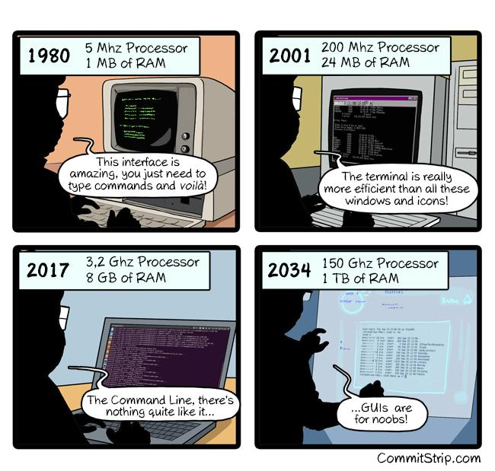
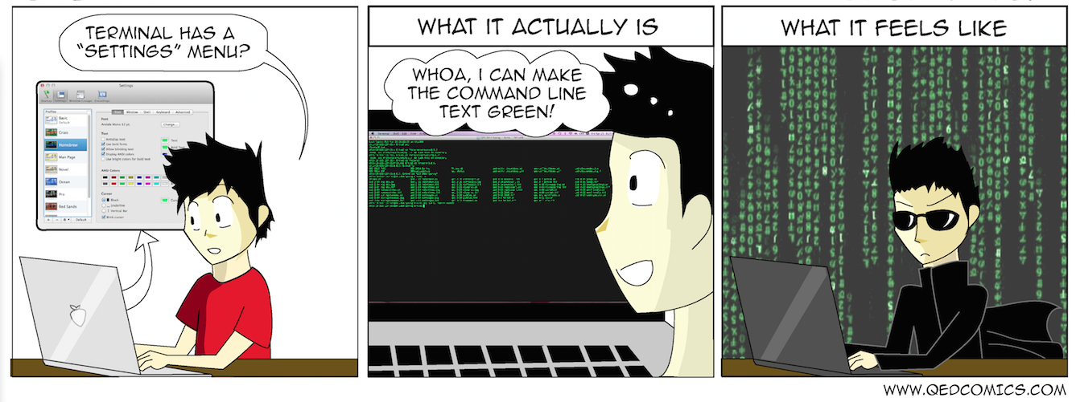
Interacting with the Shell
Spring 2024
PCfB Class 2
January 26, 2024

Slide 2
Check in

Slide 3
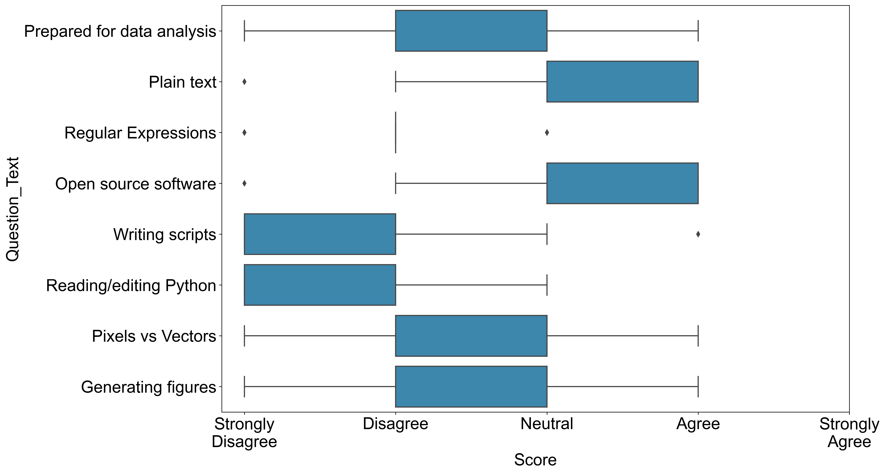
Pre-course Assessment

Slide 4
Office Hours
Three options most weeks
In person or via Zoom
Monday 4 – 5 pm
Tuesday 1 – 2 pm
Thursday 11 am – 12 pm

Slide 5
Outline
Intro to Unix shell
Configuration files
Useful commands
Assignment

Slide 6
Intro to unix shell

Slide 7
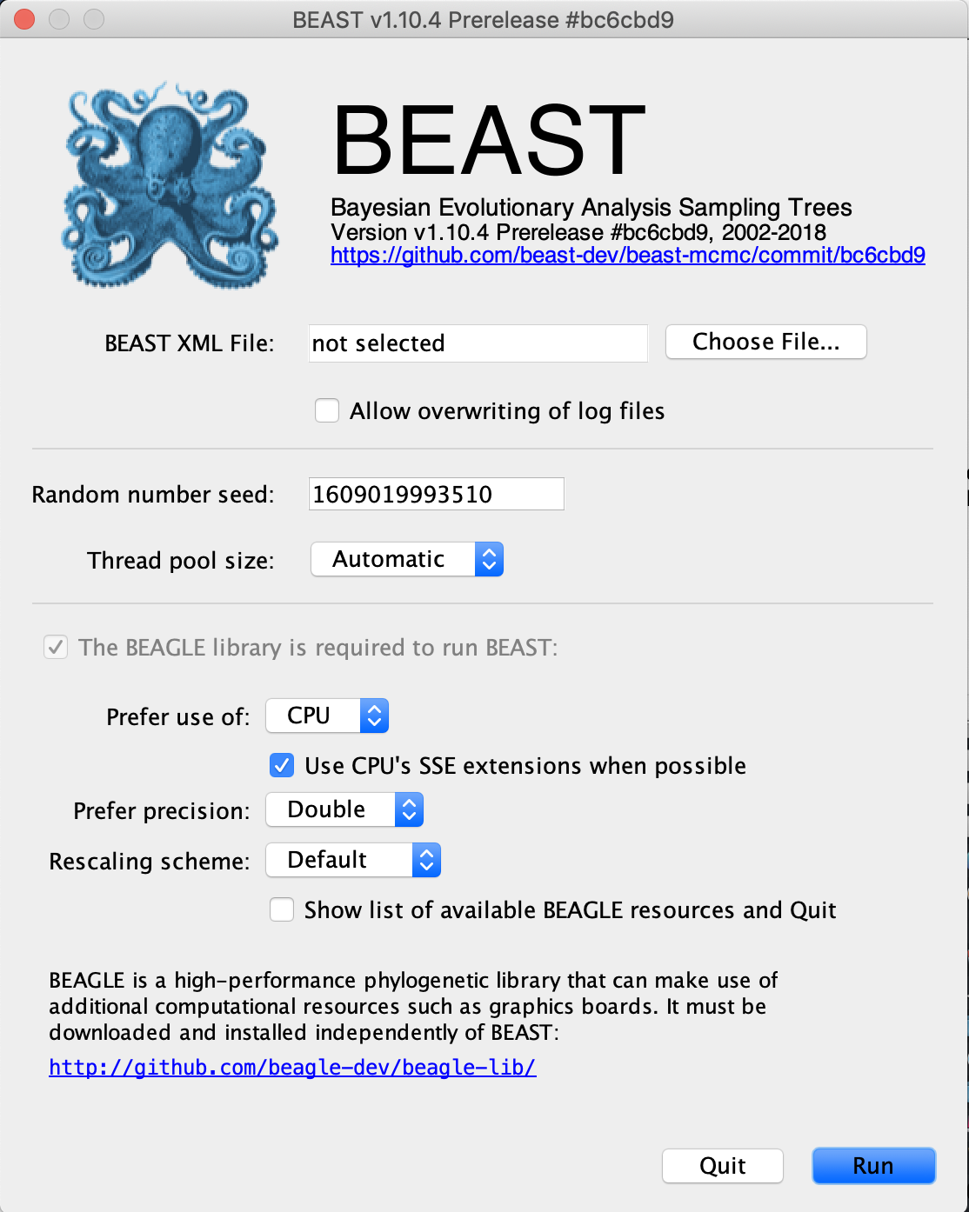
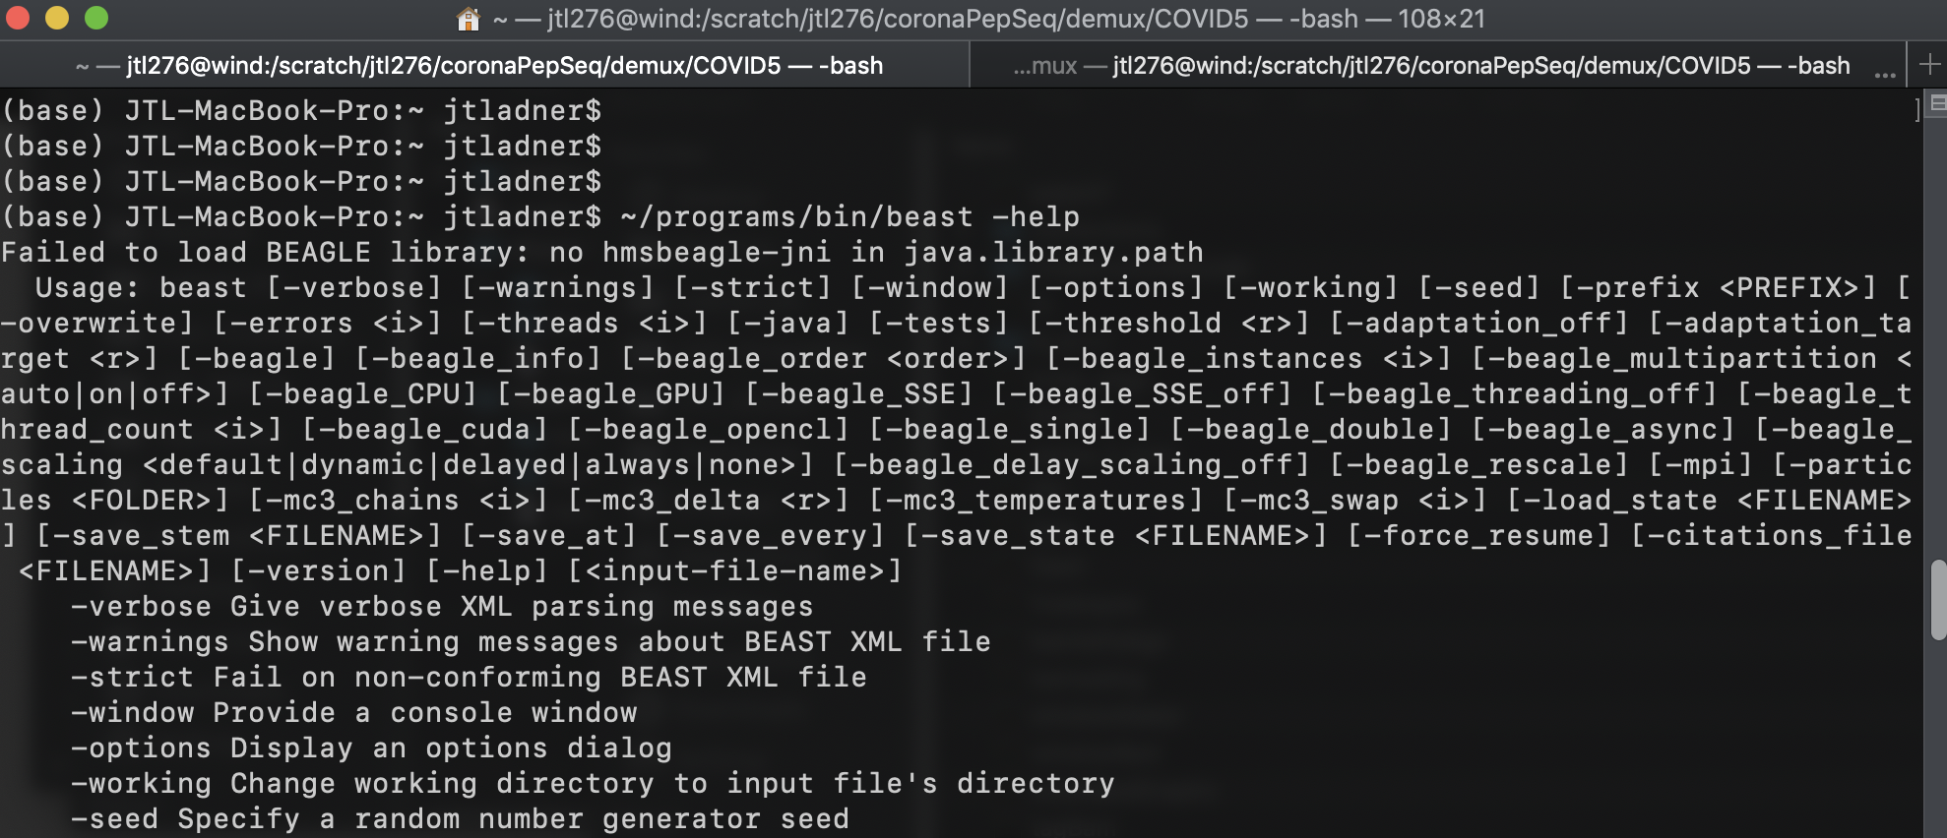
GUI vs. Command line
Graphical user interface
Command line/Terminal

Slide 8
Unix Shell
Command-line interpreter
A programming language
Commands can be entered by a user or read from a file

Slide 9
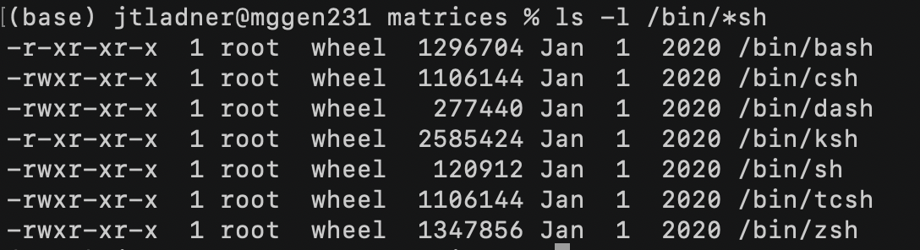
Available shells on my computer

Slide 10

Be careful!
The shell will not ask for confirmation before permanently deleting files from your computer
Deleted files are NOT moved to the trash
No Undo (ctrl-z)

Slide 11
Filesystem structure

Slide 12
/
root
Users
Volumes
Library
bin
Guest
lryle
zsh
mkdir
programs
.zshrc
directory
Working Directory
file

Slide 13
Types of paths
Absolute – always begins at root
Relative – starts at working directory

Slide 14
/
Users
Volumes
Library
bin
Guest
lryle
zsh
mkdir
programs
.zshrc
/Users/lryle/.zshrc

Slide 15
/
Users
Volumes
Library
bin
Guest
lryle
zsh
mkdir
programs
.zshrc
/Users/lryle/.zshrc
/lryle/.zshrc
/.zshrc

Slide 16
/
Users
Volumes
Library
bin
Guest
lryle
zsh
mkdir
programs
.zshrc
/.zshrc
(..) move backwards
../../../bin/mkdir

Slide 17
/
Users
Volumes
Library
bin
Guest
lryle
zsh
mkdir
programs
.zshrc
Absolute path to home directory

Slide 18
Configuration files

Slide 19
Bash:
Zsh:
.bash_profile* (Mac)
.bashrc*
.zshrc

Slide 20
Practically speaking…
For Mac OSX:
You only need .bash_profile or .zshrc
Terminal.app runs login shell for each new window, by default
For Linux:
Use .bashrc for most settings
Execute .bashrc within .bash_profile (instructions on GitHub)

Slide 21

set -o noclobber
Protects you from accidentally overwriting files that already exist

Slide 22
Subtle change to behavior of up and down arrow keys
Still scroll through command history…
but now if you start typing a command, you will only scroll through commands that match what you have started typing

Slide 23
Bash:
bind '"\e[A": history-search-backward'
bind '"\e[B": history-search-forward'
Zsh:
bindkey '\eOA' history-beginning-search-backward
bindkey '\e[A' history-beginning-search-backward
bindkey '\eOB' history-beginning-search-forward
bindkey '\e[B' history-beginning-search-forward

Slide 24
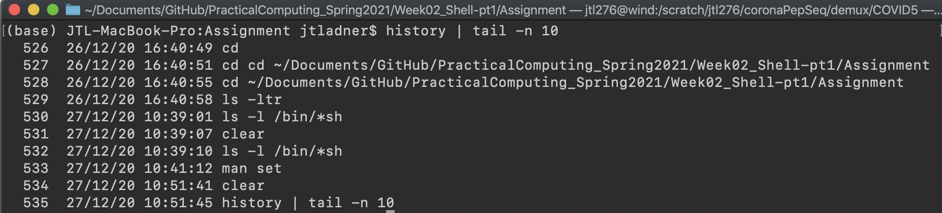
HISTTIMEFORMAT="%d/%m/%y %T "
Add time stamp to each command from history

Slide 25
fc -li
Alternative to history for zsh

Slide 26
source command
Changes to your .bash_profile/.bashrc/.zshrc will not automatically take effect within your current session
2 options:
Open a new terminal window
source ~/.bashrc

Slide 27
Configuration demo

Slide 28
Useful commands

Slide 29
Getting around
pwd
ls
cd
Print working directory
List –l long, –t time, –a all, –s size, –r reverse
Change directory

Slide 30
Create/modify/delete files
cp
mv
rm
Copy directories: -R
Move file or directory (rename)
Remove

Slide 31
Create/delete directories
mkdir
rmdir
Make directory
Remove directory

Slide 32
history
Print command history to screen
Fc –li | tail –n # >>! commands.txt
history | tail –n # >> commands.txt

Slide 33
Commands covered in reading
Getting around
Creating/deleting files
Other
cd
pwd
cp
mv
rm
mkdir
rmdir
grep
cat
curl
man (-k)
history
ls
View/edit text
less
nano/pico
Data flow
>
>>
|
Questions?

Slide 34
Other useful commands

Slide 35
Extracting parts of files
head
tail
Grab lines from beginning of file
Grab lines from end of file

Slide 36
Quantify file contents
wc
grep -c
Word count
wc -1 = line count
Pattern filename(s)
# of lines with pattern

Slide 37
rename
Batch rename files
Foil1.txt
Foil2.txt
Foil3.txt
Rename –s foil file *txt

Slide 38
Keyboard shortcuts
ctrl-a
ctrl-e
ctrl-u
ctrl-k
Move cursor to start of command
end of command
Delete everything to left
to right

Slide 39
Terminal demos

