Slide 1

NG-Template

Slide 2
With <ng-template>, you can define template content that is only being rendered by Angular when you, whether directly or indirectly, specifically instruct it to do so, allowing you to have full control over how and when the content is displayed.
Note that if you wrap content inside an <ng-template> without instructing Angular to render it, such content will not appear on a page. For example, see the following HTML code, when handling it Angular won't render the middle "Hip!" in the phrase "Hip! Hip! Hooray!" because of the surrounding <ng-template>
<p>Hip!</p>
<ng-template>
<p>Hip!</p>
</ng-template>
<p>Hooray!</p>

Slide 3
Usage notes
Structural Directives
One of the main uses for <ng-template> is to hold template content that will be used by Structural directives. Those directives can add and remove copies of the template content based on their own logic.
When using the structural directive shorthand, Angular creates an <ng-template> element behind the scenes.
TemplateRef
<ng-template> elements are represented as instances of the TemplateRef class.
To add copies of the template to the DOM, pass this object to the ViewContainerRef method createEmbeddedView()

Slide 4
What is ng-template used for?
Now, this might seem pointless to you - why use a tag when its contents don't render?
However, note that ng-template is always used along with structural derivatives such as ngIf, nfFor, and ngSwitch.
It is used for grouping content that is not rendered, but that can be used in other parts of your code.
These directives are very common in Angular, and are present almost everywhere either implicitly or explicitly. However, note that it is not possible to use the same element along with two structural directives.
You can use a combination of these directives together to build dynamic and customisable components, and completely change the design of a component based on input templates.

Slide 5
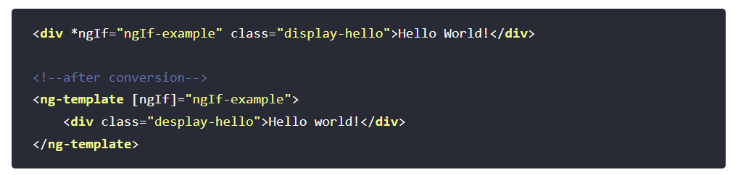
How to use the ng-template?
You can use the ng-template alongside standard and custom structural derivatives. Let us see how, with examples.
Using ng-template with *ngIf

Slide 6
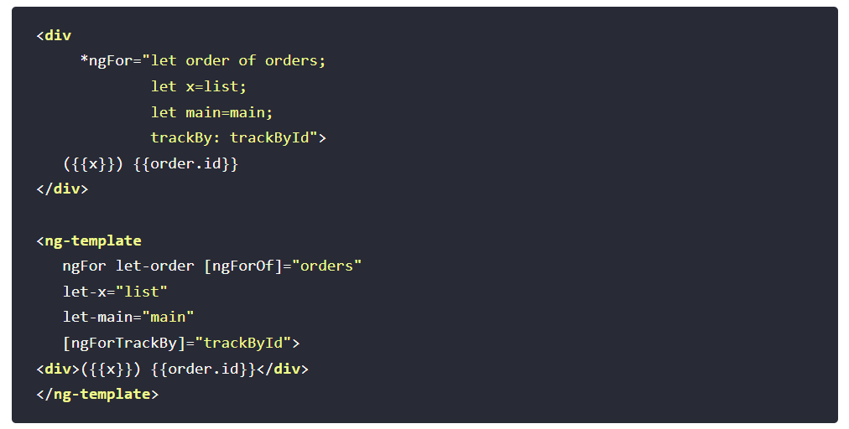
Using ng-template with *ngFor

Slide 7
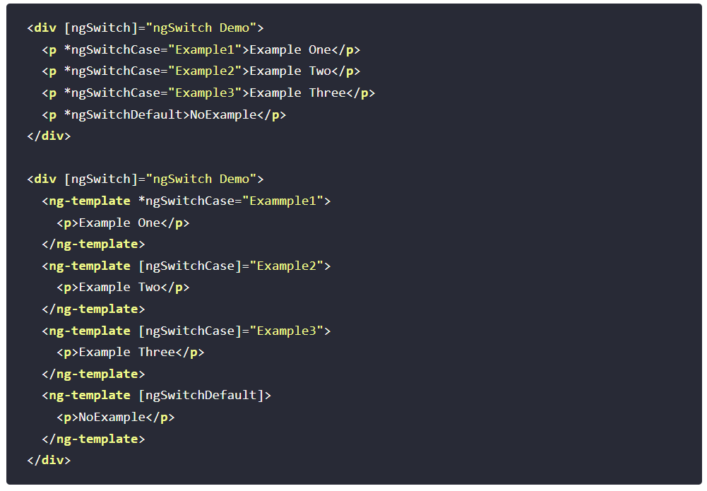
Using ng-template with ngSwitch

