Slide 1
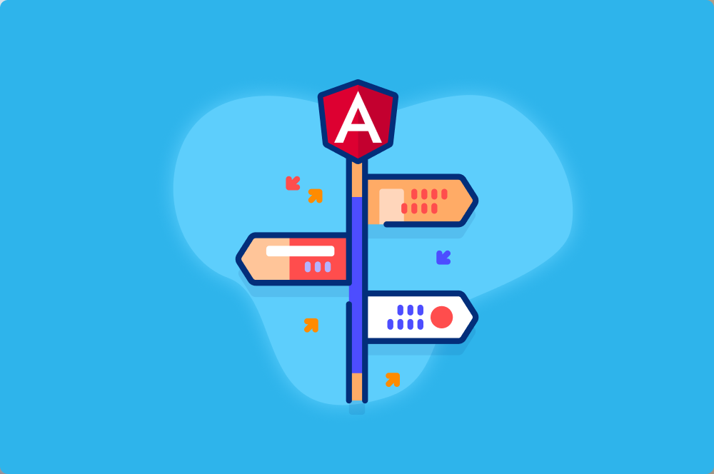
Routing

Slide 2
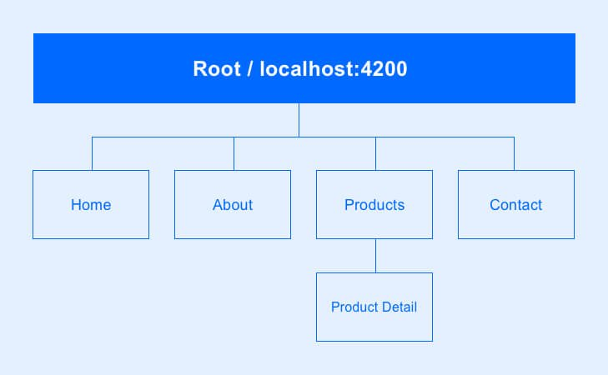

Slide 3
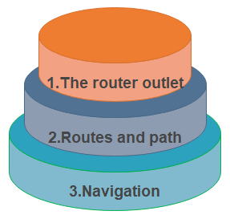
Routing
The angular Router is the main part of Angular platform. It allows developers to build single-page applications with multiple views and allow navigation between views.
The Router-outlet
The router-outlet is a directive that’s available from the @angular/router package and is used by the router to mark where in a template, a matched component should be inserted.
<router-outlet></router-outlet>

Slide 4
Routes And Paths
The path mention to the part of the URL that determines a unique view that can be displayed, and refer to the Angular component that needs to be associated with a path.
{path:’contacts’, component: ContactListComponent}

Slide 5
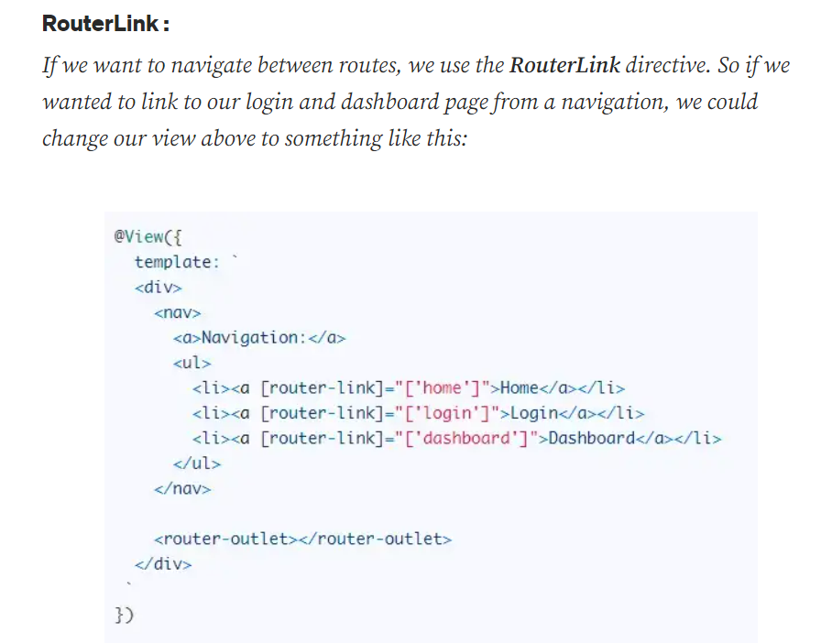

Slide 6
