Slide 1

Service Workers
With code example

Slide 2
What is service worker?
A service worker is a script that your browser runs in the background, separate from a web page, opening the door to features that don’t need a web page or user interaction.
It is responsible for caching the application's assets, including the HTML, CSS, and JavaScript files, as well as any data that the application needs to function.
By caching these files, the service worker enables the application to load faster, even when the user is offline or has a slow network connection. It also allows the application to work even when the user is offline, by serving up cached content.
Adding a service worker to an Angular application is one of the steps for turning an application into a Progressive Web App (also known as a PWA)

Slide 3
Use cases of service worker
Background Sync
Push Notifications:
Offline Forms <---- this one we are going to write code for in this tutorial
Load Balancing:
Custom APIs:
Analytics: Service workers can be used to collect analytics data
Geolocation: Service workers can be used to collect geolocation data from a user's device and send it to a server.

Slide 4
How to install & setup service worker in Angular
We can now scaffold an Angular application and add it Angular Service Worker support
ng new angular-pwa-app — service-worker
We can also add the Angular Service Worker to an existing application using the following command:
ng add @angular/pwa — project <name of project as in angular.json>
Write your own custom a worker script
Run it using any http-server because ng serve does not work with service workers, you must use a separate HTTP server to test your project locally.
E.g. http-server -p 8080 -c-1 dist/<project-name>
Verify it in browser

Slide 5
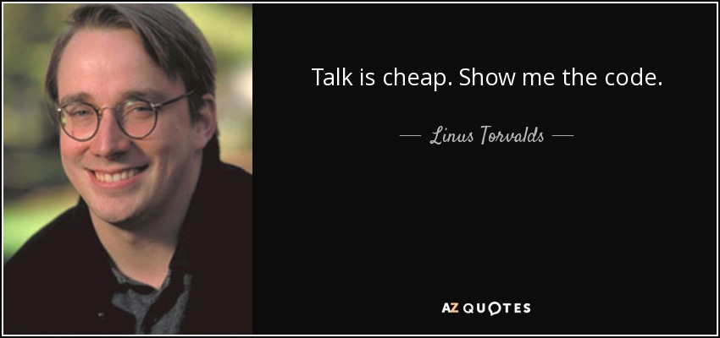
Let's code it now!

