Slide 1
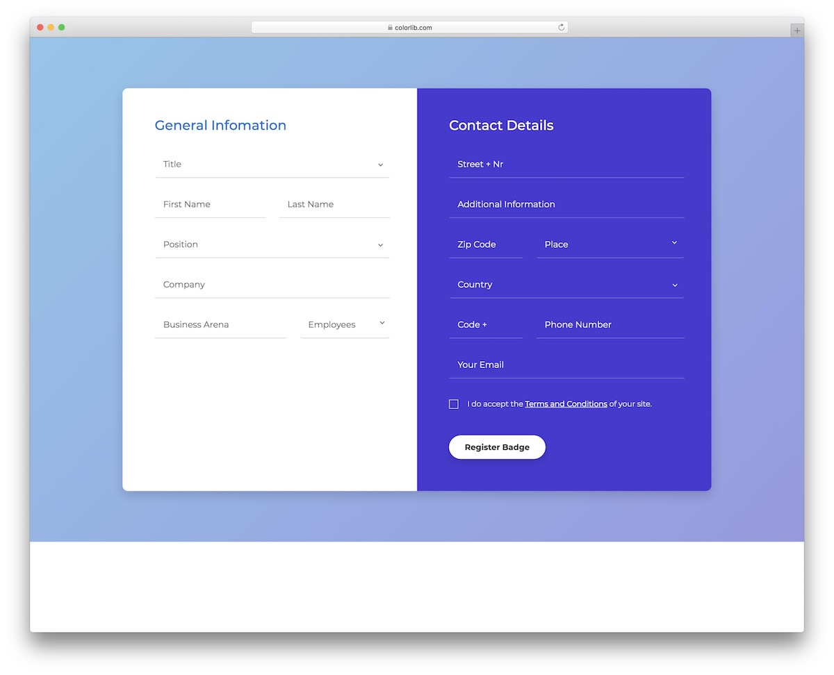

Angular Forms
with
Example

Slide 2

What is Form?
Forms in general in web development are ways to send data to SERVER (backend).
Real world analogy of form could be account opening registration information you fill in bank, slip you fill in order to remove cash from bank (in old days off course ☺)

Slide 3

The purpose of forms is to gather input from user and then pass it in system.
It is logical grouped model of related fields, fields represent each information about the user e.g. their name, date of birth, contact details & so on.

Slide 4
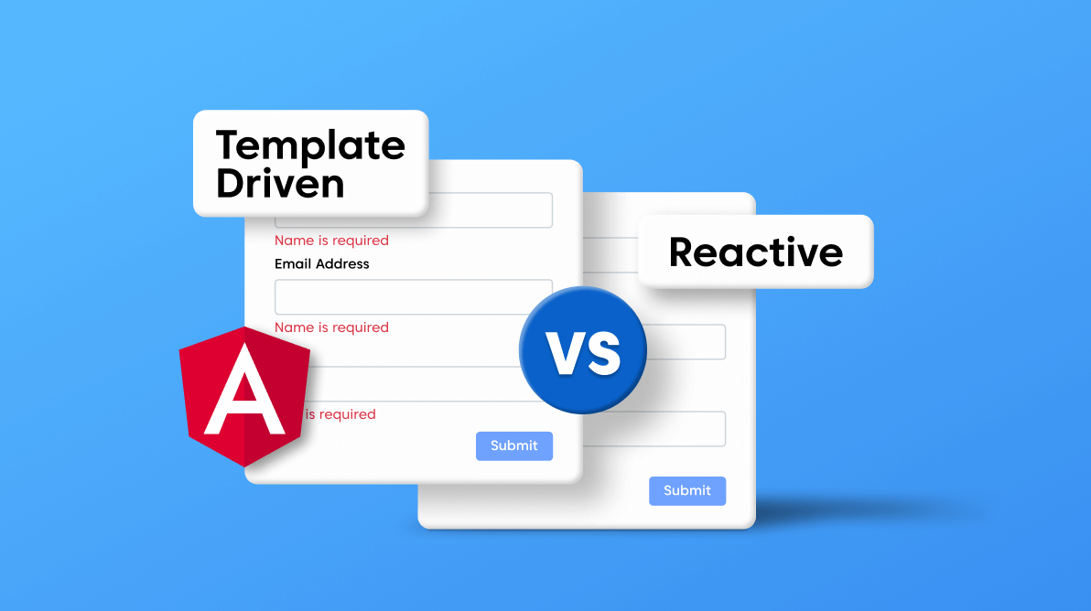
Forms in Angular
Template Driven
Reactive Form

Slide 5
Reactive Forms
Reactive Forms is a powerful feature of Angular that allows developers to build complex and dynamic forms in a reactive and declarative way.
Reactive Forms in Angular is a way of building forms that are based on reactive programming principles.
Reactive Forms rely on Observables to capture and manage user input and changes to form controls.
With Reactive Forms, developers can define the form controls, their validators, and their default values in the component class.
This allows developers to have complete control over the form's behaviour and validation rules.

Slide 6
Reactive Forms benefits
Better performance: Reactive Forms provide better performance by reducing the number of DOM updates that are required when the user interacts with the form.
Complex forms: Reactive Forms are ideal for building complex forms that require dynamic behaviour, such as conditional fields, form arrays, and form groups.
Testing: Reactive Forms make it easier to test forms since you can create and manipulate form controls programmatically.

Slide 7
Technical building blocks
To use Reactive Forms in Angular, you need to import the ReactiveFormsModule in your module and then create a FormGroup object in your component class. The FormGroup object contains all the form controls and their values, which can be accessed and manipulated using the FormGroup API.
Overall, Reactive Forms is a powerful feature of Angular that makes it easier to build dynamic and complex forms with less code and better perform

