Slide 1
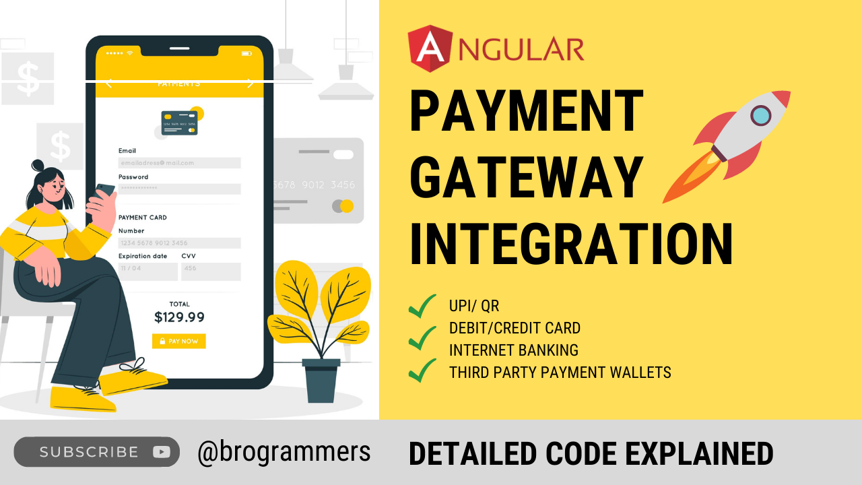

Slide 2
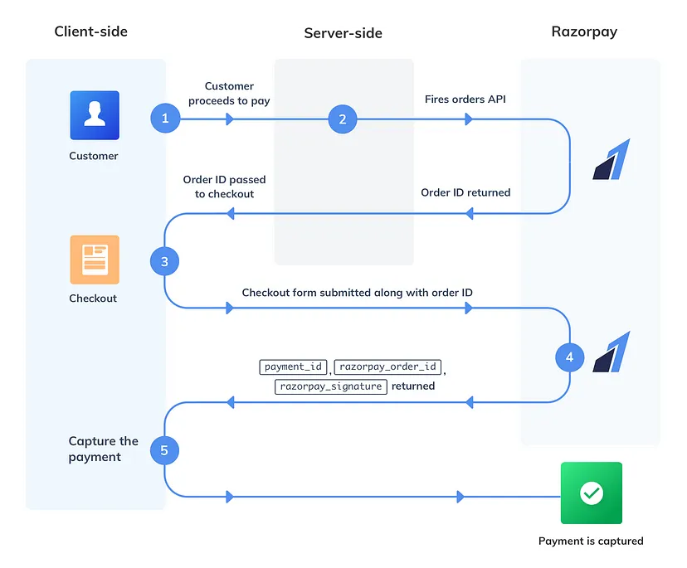

Slide 3
Pre-requites
Node JS (Backend)
Angular (Frontend)
Payment Gateway Account- I'm using Razorpay here

Slide 4
Steps-
Create Angular's shopping site.
Call post:/createOrder at backend when user clicks on buy now
Navigate to checkout page where order_id from above is used to initiate payment.
Get Payment response and save at backend, also backend can verify payment is valid or not and make status captured.

