Slide 1
EduERP
An Integrated Microservices ERP System for Educational Institutions
Academic | Marketing & Finance | Administration & Human Resources
Project presentation - 25 September 2026
Presented by: ____________________ Supervisor: ____________________
Notes:
Greet the panel and introduce the project: a working ERP for an educational institution, built with microservices.

Slide 2
Presentation outline
1. Background and problem
2. Objectives
3. What EduERP is: users and modules
4. How it works: a student's journey
5. Architecture and deployment
6. Requirements
7. Design models: use cases, classes, ERD, sequences
8. Implementation, security and testing
9. Demonstration
10. Limitations, future work and conclusion
2
Notes:
Read the outline quickly; the talk follows a normal project structure.

Slide 3
Background and problem
Educational institutions run several kinds of activity at the same time.
EduERP was developed as an academic project to show how these areas can be combined in a single, secure, modern system built with the architecture that large organisations use today: independent services that own their data and talk to each other through well-defined interfaces.
Separate tools for academics, finance and HR lead to duplicated data entry and delays. A student who enrolls in a course must then be billed manually.
Staff need different levels of access. A student must not see payroll screens and a clerk must not be able to create administrators, so access control must be built in.
A single large application is hard to change: a fault or a change in the payroll code should not stop enrollment. The institution needs parts that can be developed, tested and deployed separately.
Financial actions such as payments must be consistent: a payment must never be recorded without the matching invoice update and receipt.
3
Notes:
Explain why one integrated system helps: no re-entering data, controlled access, parts that can change independently, consistent payments.

Slide 4
Project objectives
Provide one integrated platform for academic, marketing and finance, and administration and HR operations.
Apply a microservices architecture: separate services, one database per service, one public entry point (API Gateway).
Secure the system with JWT authentication, refresh-token rotation, account lockout and role-based authorization.
Automate tuition billing: enrolling a student must trigger invoice creation in the Finance Service through a message broker, without manual work.
Support simulated mobile-money payments (MTN MoMo and Orange Money) with receipts.
Support HR processes: employee records, recruitment, payroll calculation, QR-code attendance, leave requests, performance reviews and asset tracking.
Make the system easy to run and verify: one-command container deployment, automated tests and a continuous-integration pipeline.
4
Notes:
Each objective is met by a specific part of the system; we will see them in the following slides.

Slide 5
What is EduERP?
A web application that runs academic, financial and HR work of an institution in one place
Users log in and see a menu that depends on their role
Three business services + one gateway: Academic, Marketing & Finance, Administration & HR
Each service owns its own PostgreSQL database
Enrollment automatically creates a tuition invoice through a message broker (RabbitMQ)
Runs in 9 Docker containers with one command
5
Notes:
This is the one-slide answer to "what is your system about".

Slide 6
Users and roles
Role | What the role does | Web menu
Student | Registers an account, enrolls in courses, views own courses, grades, GPA and attendance, sees at-risk status, views invoices, pays tuition by simulated mobile money, submits grade appeals. | Menu: My Dashboard, My Courses, My Invoices & Payments, Grade Appeals
Staff | Runs day-to-day academic operations (students, courses, grades, attendance, exams, appeals), scans QR attendance and handles leave requests in the web interface. | Menu: 7 entries
Admin | Academic functions like staff, plus finance (invoices, expenses, reports) and HR (employees, recruitment, payroll, leave) screens, deletions and deactivations, payroll-rate updates and creation of staff accounts. | Menu: 12 entries
Super Admin | All admin screens, plus QR attendance, marketing campaigns, asset management, creation of admin and super-admin accounts and a service-health view. | Menu: 15 entries
6
Notes:
Four roles stored with the account and carried in the login token.

Slide 7
Academic module (Academic Service)
Student records: staff create and update students (student number, name, e-mail, programme, level, status) and admins can deactivate them. A student who registers online gets a profile automatically.
Courses: each course has a code, title, credits and a capacity. A course can have prerequisite courses.
Enrollment: a student can enroll only if the prerequisites are passed, the course is not full and the student is not already enrolled. A successful enrollment publishes an event to the Finance Service. Students can also drop a course.
Grades: staff enter a score from 0 to 100; the system assigns the letter grade (A from 90, B from 80, C from 70, D from 60, E from 50, F below) and marks 50 and above as passing. A credit-weighted GPA is calculated.
Attendance: staff record present, absent or late for each student, course and date; the attendance percentage is calculated.
At-risk detection: a student is flagged when attendance is below 75% or when two failing grades occur in a row.
Examinations: staff schedule exams; the system refuses a room that is already booked for an overlapping time.
Grade appeals: a student can appeal one of their own grades; staff approve or reject each appeal once.
7
Notes:
The Academic Service manages the academic life of the institution and also hosts the login system, because every user is a member of the institution.

Slide 8
Marketing & Finance module (Finance Service)
Automatic invoicing: when the Academic Service announces a new enrollment, the Finance Service creates an invoice numbered INV-year-number. The amount is the course credits multiplied by a per-credit rate (15,000 FCFA by default) and it is due in 30 days.
Payments: a student pays an invoice through a simulated MTN MoMo or Orange Money charge. Partial payments are allowed; an amount larger than the balance is refused. The invoice status becomes partially paid or paid.
Receipts: every successful payment produces a numbered receipt (RCT-year-number).
Overdue invoices: staff can mark unpaid invoices past their due date as overdue.
Expenses: staff record, edit and delete institutional expenses by category.
Reports: daily and monthly income and expense summaries, outstanding fees and an expense report, all in FCFA.
Marketing campaigns: staff record a campaign with dates and budget and update its leads, conversions and revenue; the system calculates the conversion rate and the return on investment (ROI).
8
Notes:
The Finance Service handles money coming in and going out, and also the marketing campaigns of the institution.

Slide 9
Administration & HR module (HR Service)
Employees: records with department, position, salary and status. Each employee receives a unique QR token.
Recruitment: candidates are tracked through the stages applied, interview, selected and rejected.
Payroll: for a chosen employee and month the system computes gross pay (basic salary plus allowances), the CNPS and PAYE deductions from configurable rates, and the net pay. Admins can change the rates.
QR attendance: scanning an employee's QR token records a check-in, once per employee per day.
Leave: requests are submitted and then approved or rejected by staff.
Performance reviews: a score from 0 to 10 with comments can be recorded for an employee.
Assets: equipment is recorded with category, value and status, and can be assigned to an employee.
Dashboard: a summary of active employees, check-ins today, pending leave, average performance and number of assets.
9
Notes:
The HR Service manages the people who work for the institution and the equipment they use.

Slide 10
Authentication and administration
Registration: anyone can register, but a public registration always creates a student account. Staff-level accounts can only be created by a logged-in admin (staff accounts) or super admin (any role).
Login: passwords are checked against a bcrypt hash. After five wrong attempts the account is locked for 15 minutes. The system returns a 15-minute access token and a 7-day refresh token.
Token refresh and logout: refresh tokens are stored only as hashes, are replaced each time they are used, and are revoked on logout.
Authorization: the API Gateway and every service each verify the token and check the user's role on every protected route.
Service health: the super admin can see whether the three services are running.
10
Notes:
Login and access control are provided by the Academic Service and enforced everywhere.

Slide 11
Scenario 1: from enrollment to receipt
A new student registers on the web page and logs in.
The student opens My Courses and enrolls in a course. The Academic Service checks prerequisites and capacity and saves the enrollment.
The Academic Service publishes a STUDENT_ENROLLED event to RabbitMQ and immediately confirms the enrollment to the student.
The Finance Service receives the event and creates a tuition invoice (credits x 15,000 FCFA) without any human action.
The student opens My Invoices & Payments, chooses MTN MoMo or Orange Money, enters a phone number and pays. The invoice is updated and a receipt is issued.
11
Notes:
Walk through the steps as a demonstration story.

Slide 12
Scenario 2: teaching staff and grades
Staff record attendance for a class and enter grades for enrolled students.
The system calculates letter grades and GPA and flags students who fall below 75% attendance or fail twice in a row.
A student who disagrees with a grade submits an appeal; staff approve or reject it.
12
Notes:
Walk through the steps as a demonstration story.

Slide 13
Scenario 3: HR and payroll
An admin registers an employee; the system generates a QR token.
Each day the employee is checked in by scanning the QR token.
At month end an admin runs payroll for the employee and the system stores gross pay, CNPS, PAYE and net pay for that month.
13
Notes:
Walk through the steps as a demonstration story.

Slide 14
System architecture
Microservices: small services, one business area each, one database each
One public entry point: the API Gateway (/api/v1) checks the token, limits requests and routes to the right service
Synchronous: normal HTTP requests for almost every screen
Asynchronous: RabbitMQ carries the enrollment event so billing never blocks enrollment
Identity is issued by the Academic Service; Finance and HR verify the token themselves
14
Notes:
Explain the difference between synchronous and asynchronous communication in plain words.

Slide 15
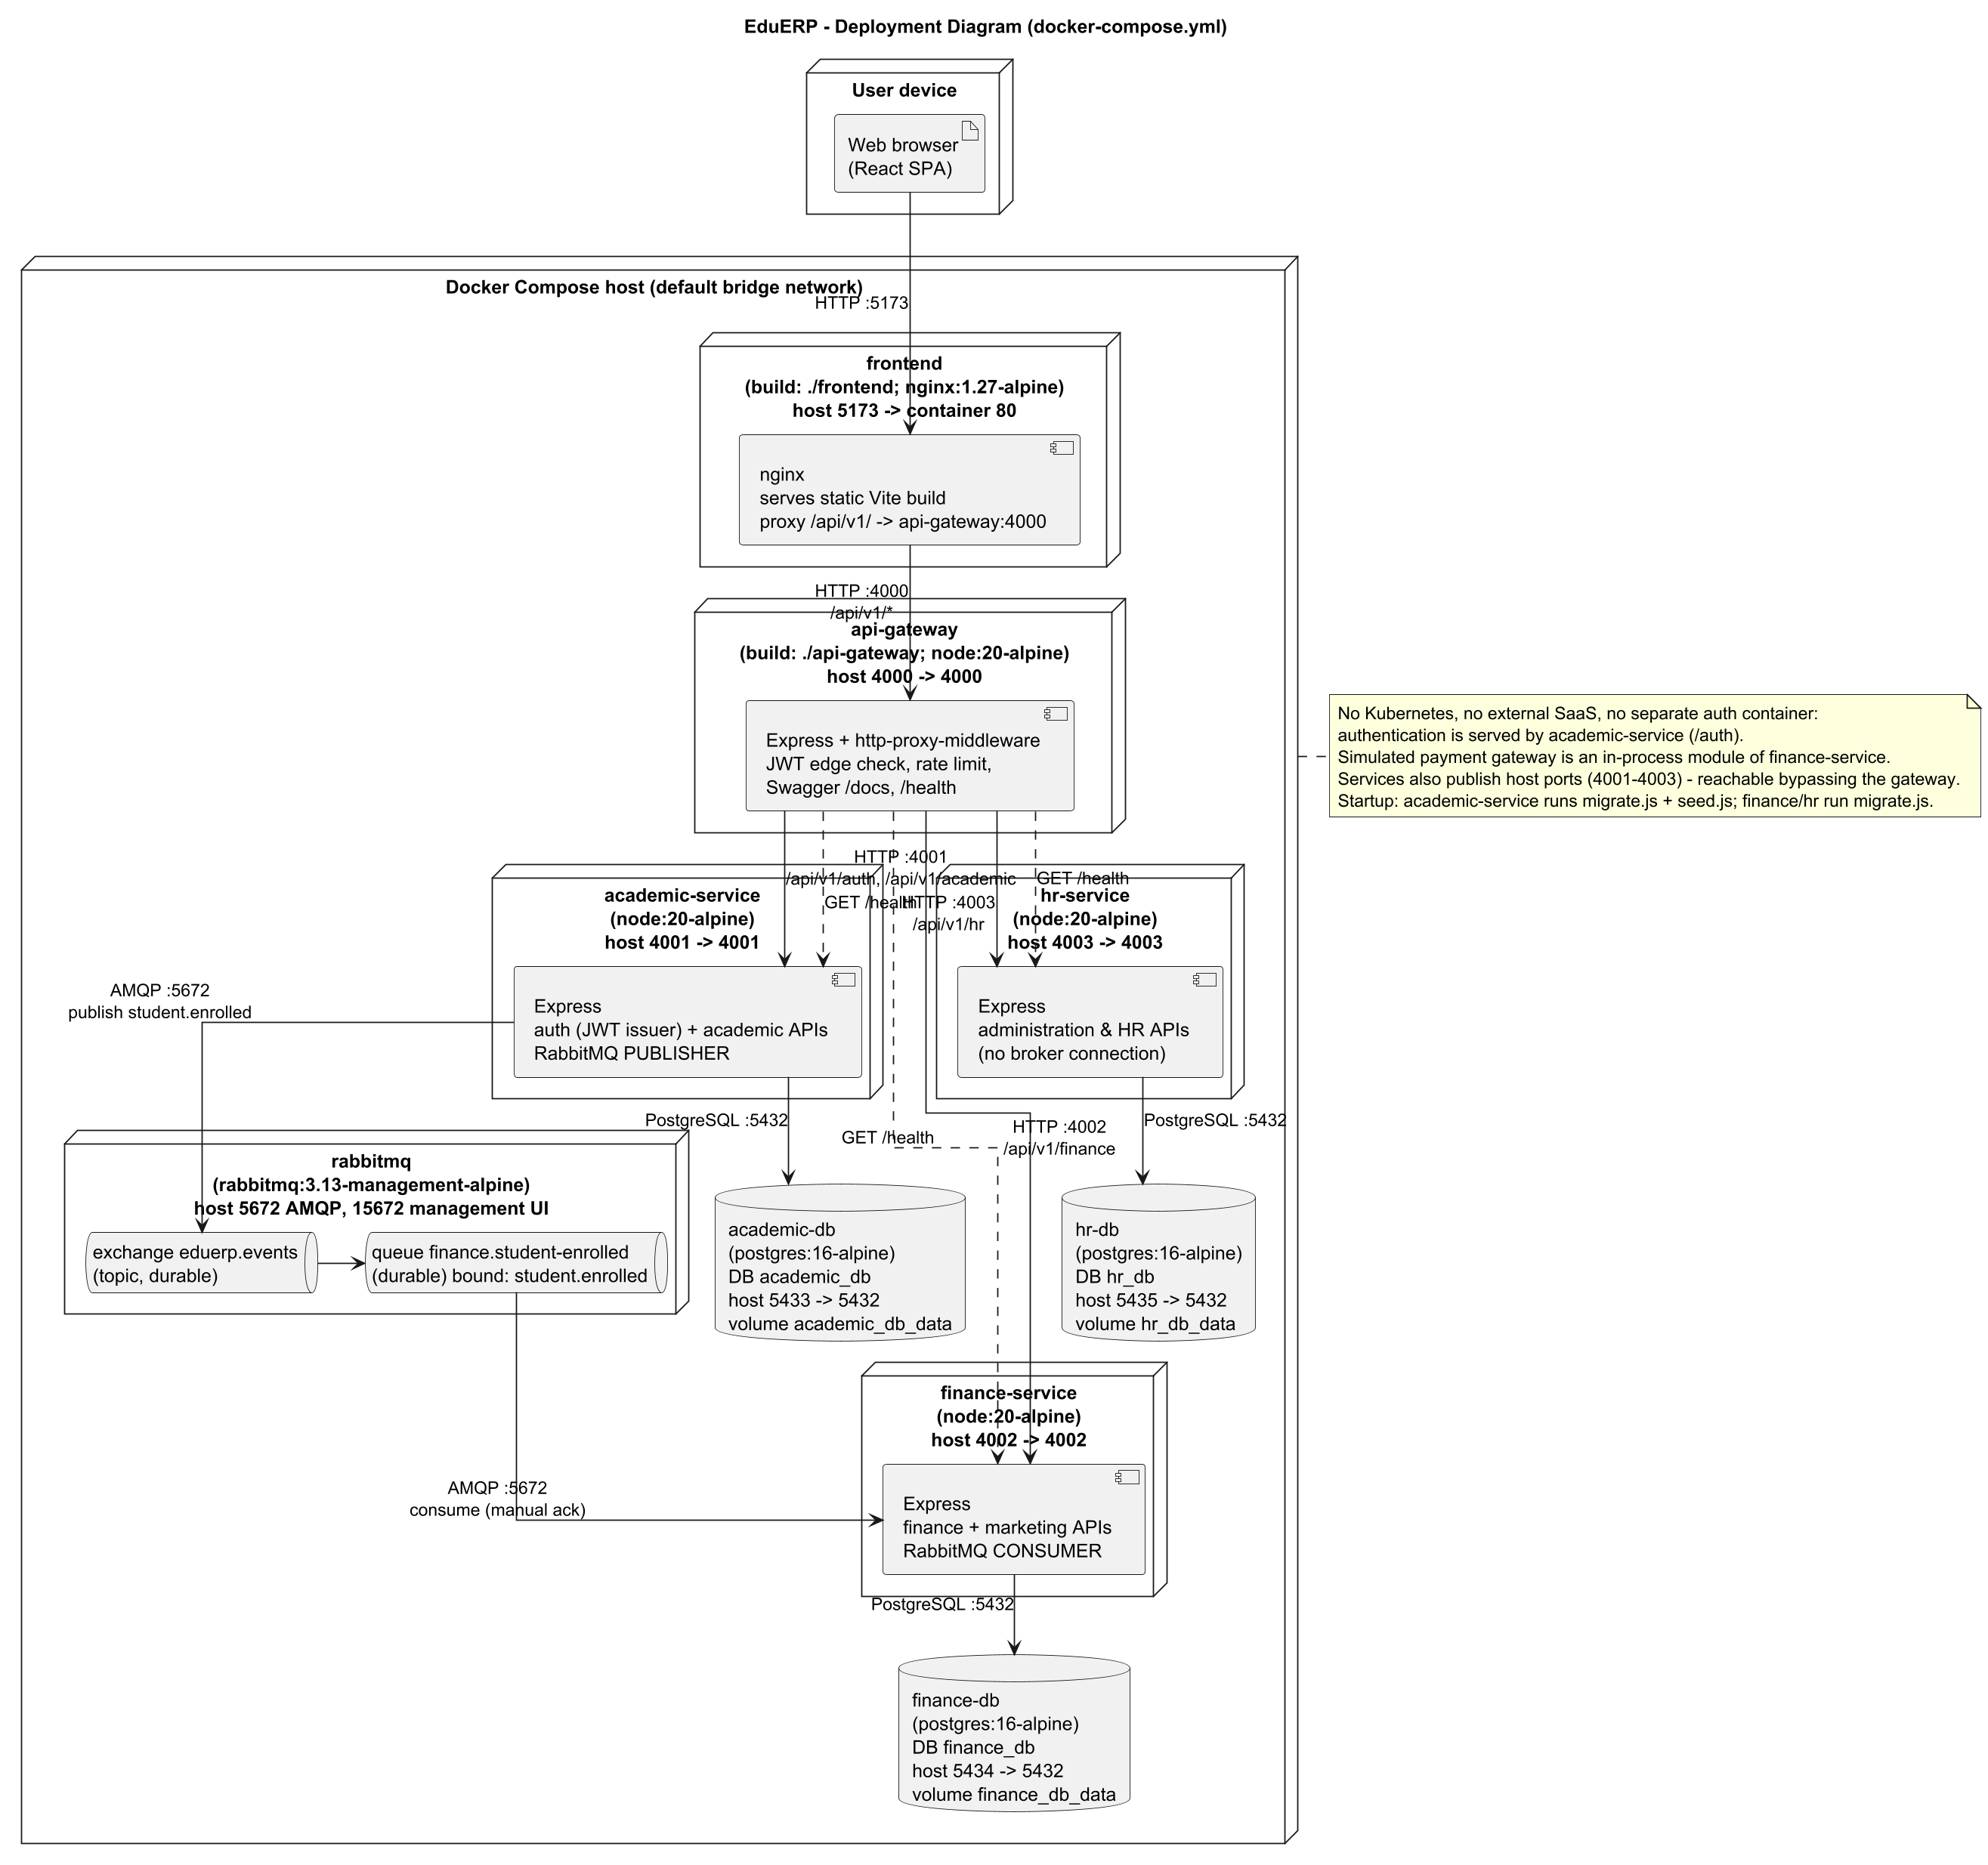
Deployment Diagram - Docker Compose
Nine containers on one Compose network: nginx frontend, gateway, three services, RabbitMQ and three PostgreSQL databases, with ports, protocols and communication direction.
15
Notes:
Nine containers on one Compose network. Point out the gateway on 4000, the three services on 4001-4003, three databases, and RabbitMQ. Academic publishes, Finance consumes, HR has no broker.

Slide 16
Technology stack
Layer | Technologies used
Backend | Node.js 20 (Alpine), Express 4, pg (raw SQL), amqplib, jsonwebtoken, bcryptjs, helmet, express-rate-limit, express-validator, swagger-ui-express
Gateway | Express + http-proxy-middleware, JWT edge verification, rate limiting
Frontend | React 18, Vite 5, react-router 6, axios, served by nginx 1.27
Data | PostgreSQL 16 (three instances), RabbitMQ 3.13 (topic exchange)
Delivery | Docker, Docker Compose, GitHub Actions CI, Jest + Supertest
16
Notes:
Everything listed appears in package.json files, Dockerfiles or docker-compose.yml.

Slide 17
Requirements at a glance
Group | Functional requirements | IDs
Authentication / Authorization | 13 | FR-001 to FR-013
Academic Service | 19 | FR-014 to FR-032
Marketing & Finance Service | 9 | FR-033 to FR-041
Administration & HR Service | 12 | FR-042 to FR-053
Inter-service communication and Web front-end | 7 | FR-054 to FR-060
Non-functional (security, integrity, reliability, observability...) | 21 | NFR-001 to NFR-021
17
Notes:
Every requirement has an ID and cites the code that implements it; the full tables are in the report.

Slide 18
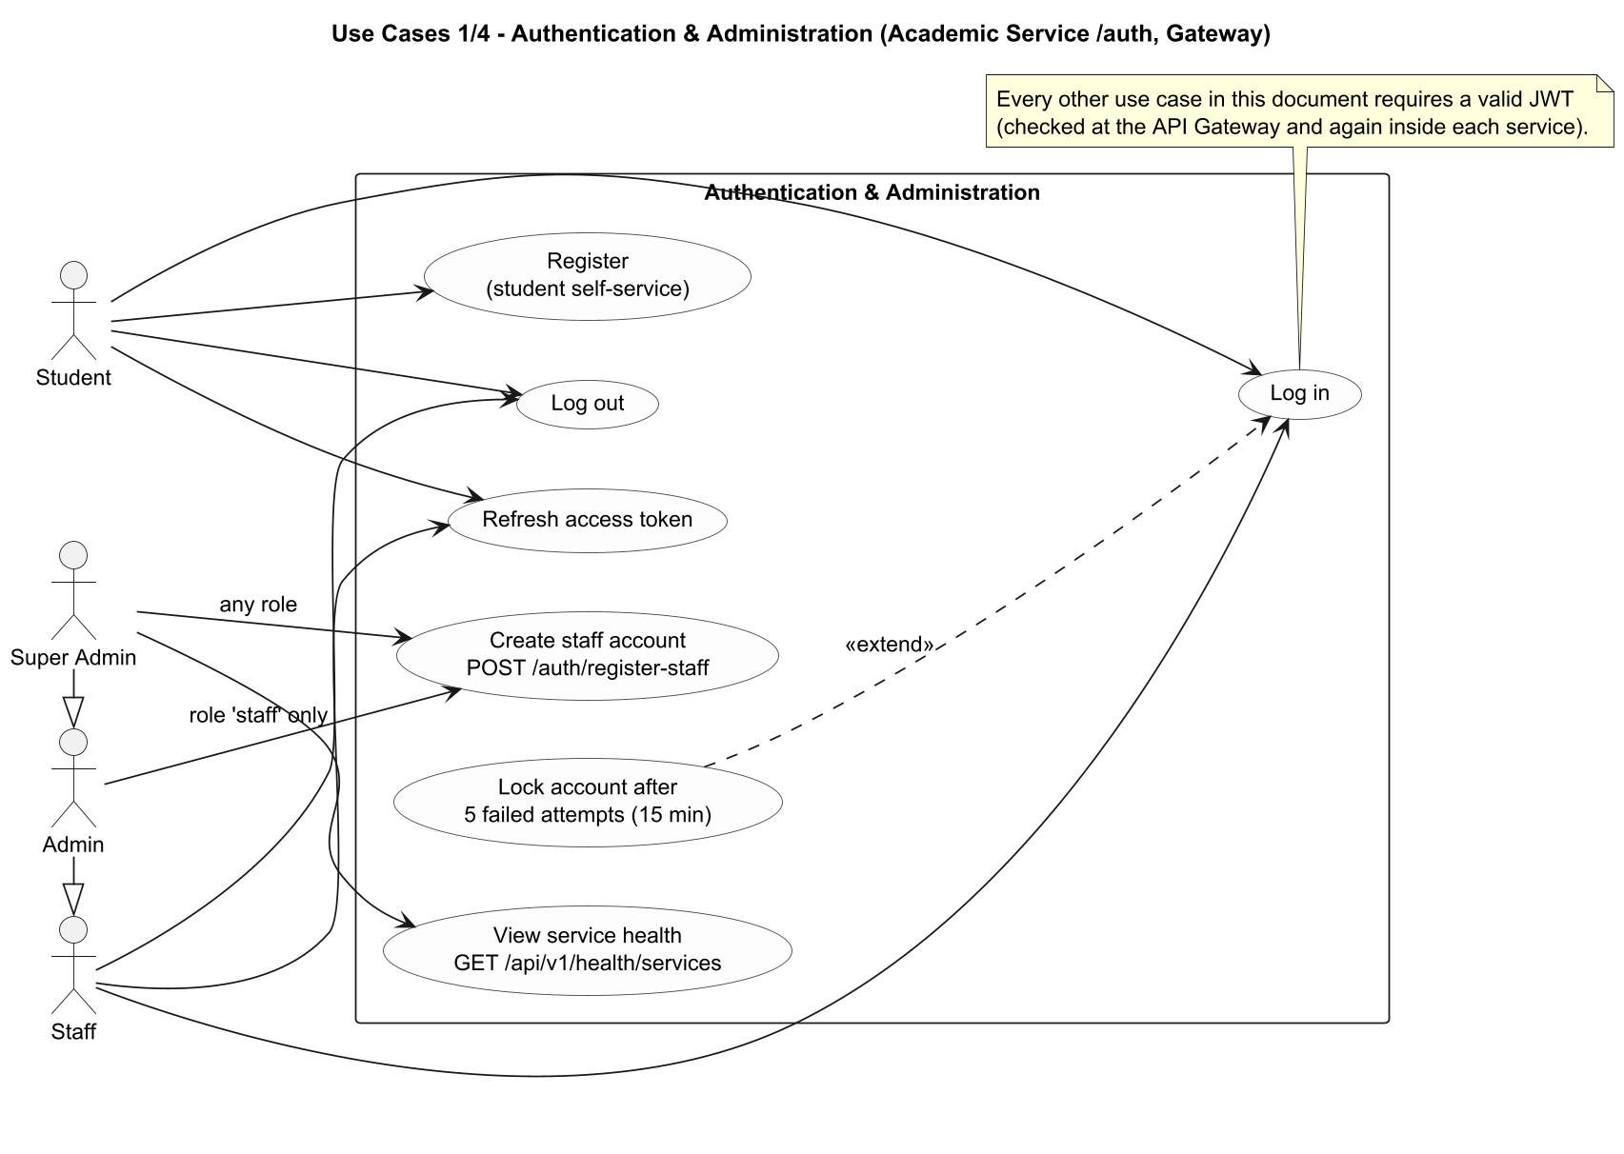
Use-Case Diagram 1/4 - Authentication & Administration
Actors are the four real roles (student, staff, admin, super_admin). Generalization admin > staff and super_admin > admin reflects the API role lists. "Lock account" extends "Log in" (5 failed attempts).
18
Notes:
Actors are the four real roles (student, staff, admin, super_admin). Generalization admin > staff and super_admin > admin reflects the API role lists. "Lock account" extends "Log in" (5 failed attempts). Implementation: authRoutes.js, authController.js, healthRoutes.js. Admin may create staff only; super_admin may create any staff-level role.

Slide 19
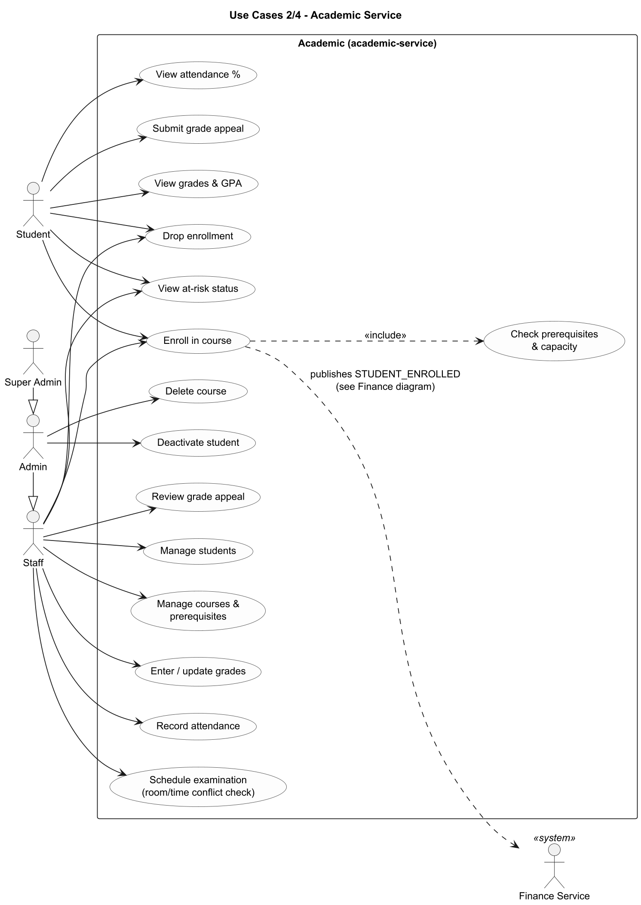
Use-Case Diagram 2/4 - Academic Service
Enrolling includes the prerequisite/capacity check and triggers the STUDENT_ENROLLED event consumed by the Finance Service.
19
Notes:
Enrolling includes the prerequisite/capacity check and triggers the STUDENT_ENROLLED event consumed by the Finance Service. Implementation: Routes under /academic (students, courses, enrollments, grades, attendance, exams, appeals). Delete course and deactivate student are admin-only.

Slide 20
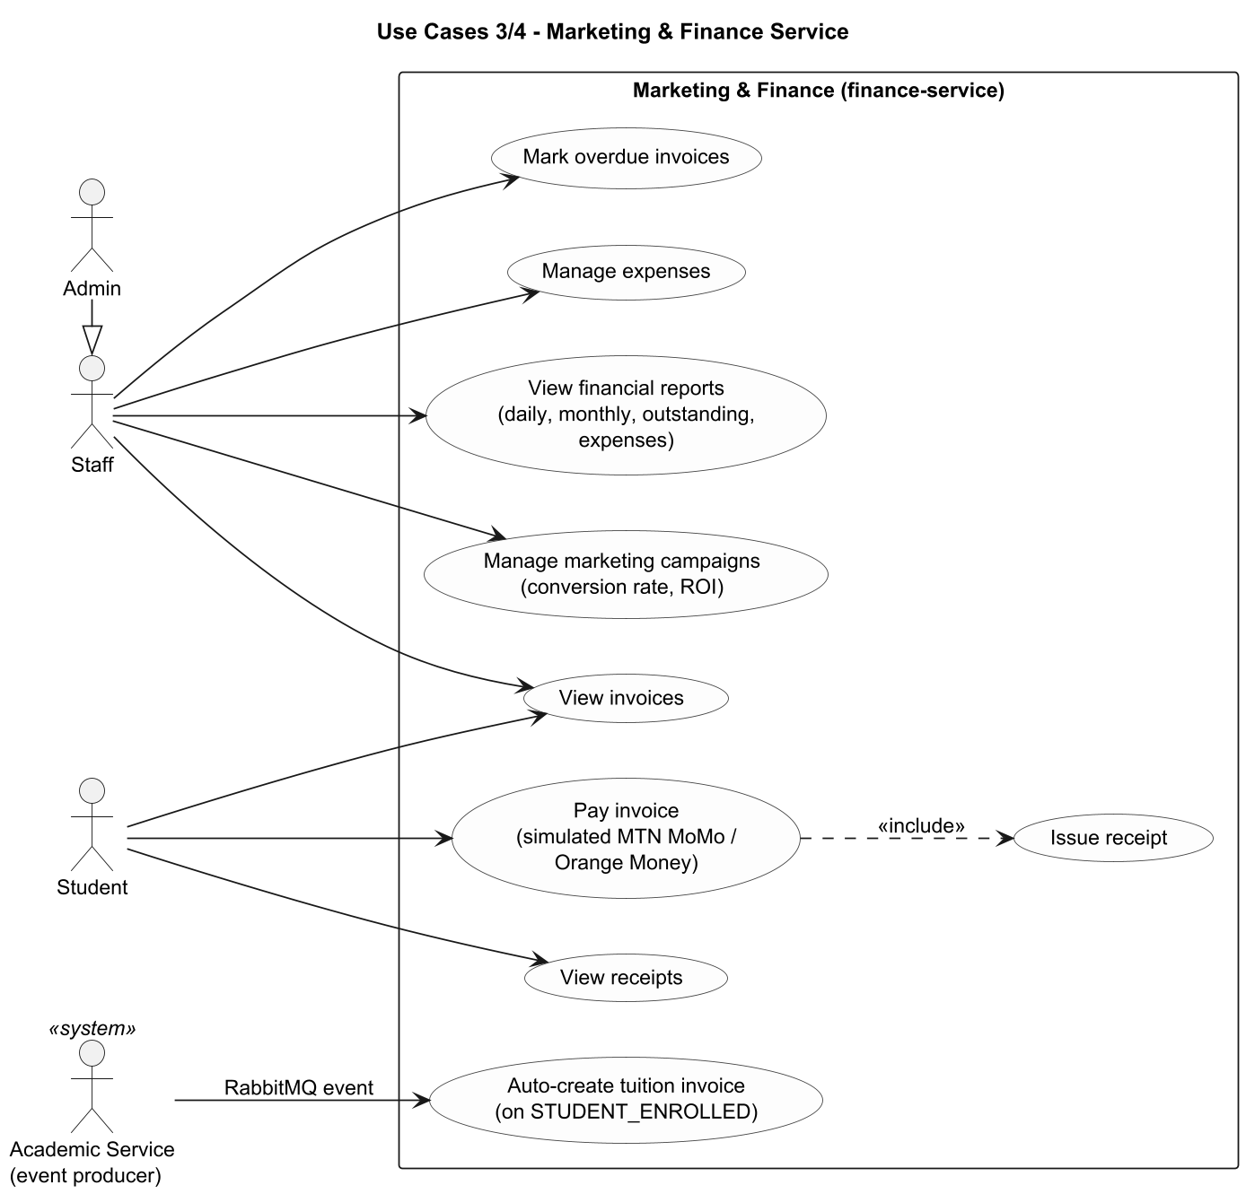
Use-Case Diagram 3/4 - Marketing & Finance Service
The invoice is created by the Finance Service itself from a RabbitMQ event; paying an invoice includes issuing a receipt.
20
Notes:
The invoice is created by the Finance Service itself from a RabbitMQ event; paying an invoice includes issuing a receipt. Implementation: invoiceService.js, paymentController.js, expense/report/campaign controllers. Marketing = campaigns only.

Slide 21
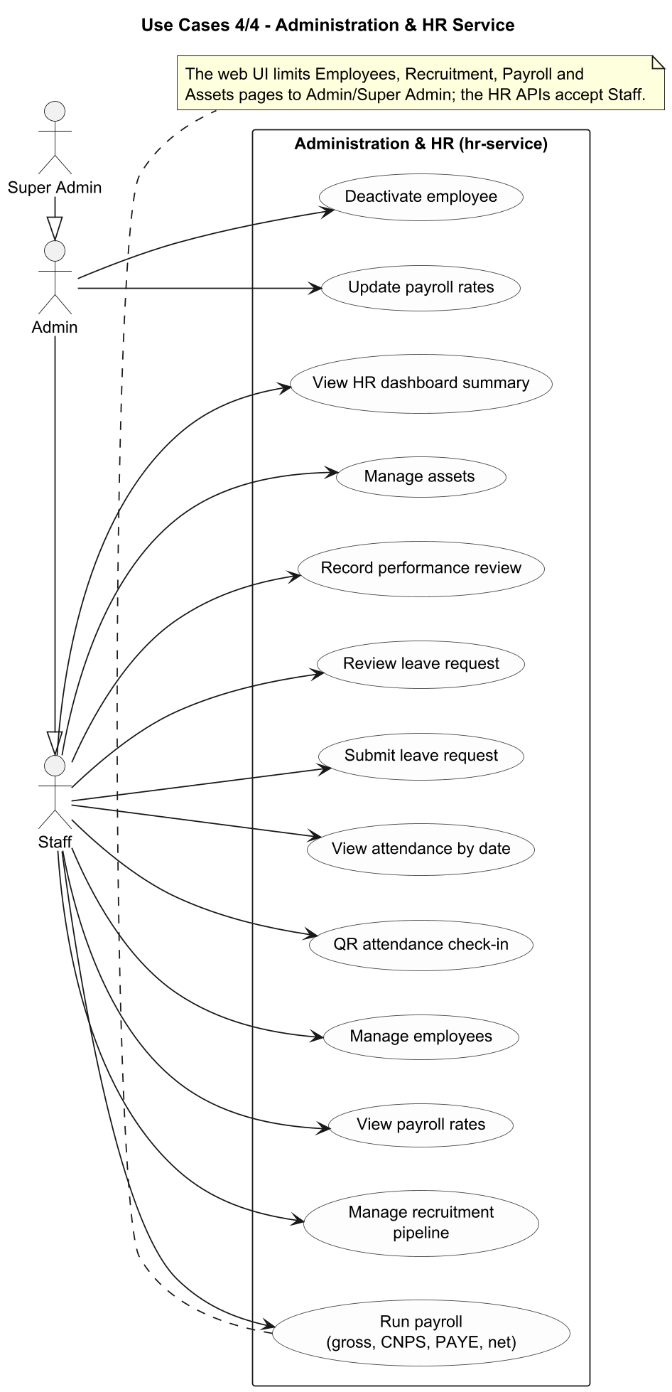
Use-Case Diagram 4/4 - Administration & HR Service
All HR functions are available to staff-level roles at API level; updating payroll rates and deactivating employees are admin-only.
21
Notes:
All HR functions are available to staff-level roles at API level; updating payroll rates and deactivating employees are admin-only. Implementation: Routes under /hr. The web UI restricts several pages to admin/super_admin.

Slide 22
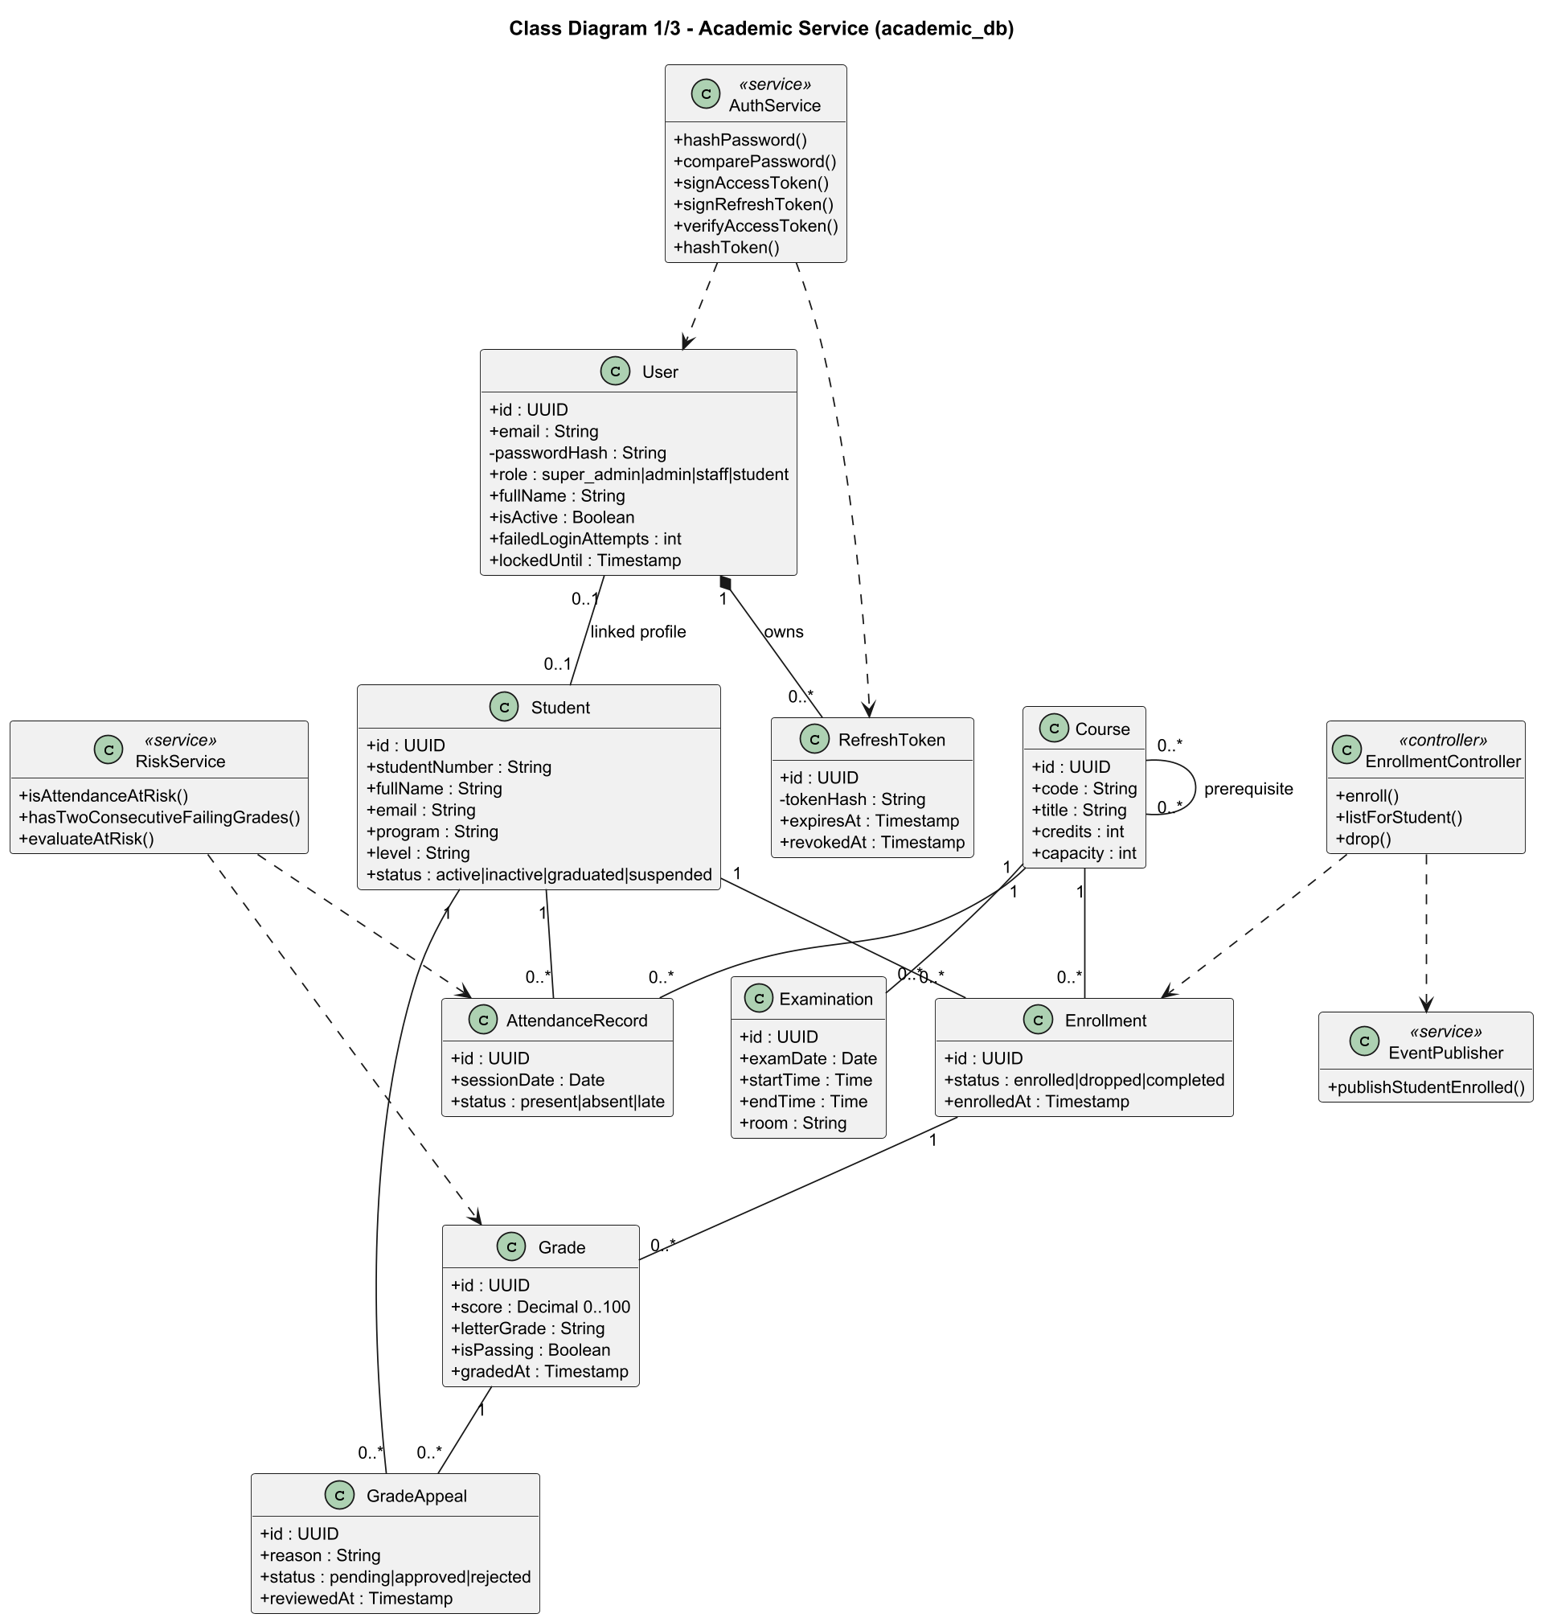
Class Diagram 1/3 - Academic Service
Domain classes mirror the academic_db tables; service and controller classes show the main application logic (authentication, at-risk evaluation, enrollment and event publishing).
22
Notes:
Domain classes mirror the academic_db tables; service and controller classes show the main application logic (authentication, at-risk evaluation, enrollment and event publishing). Implementation: schema.sql (academic), authService.js, riskService.js, enrollmentController.js, eventPublisher.js. Composition User-RefreshToken reflects ON DELETE CASCADE.

Slide 23
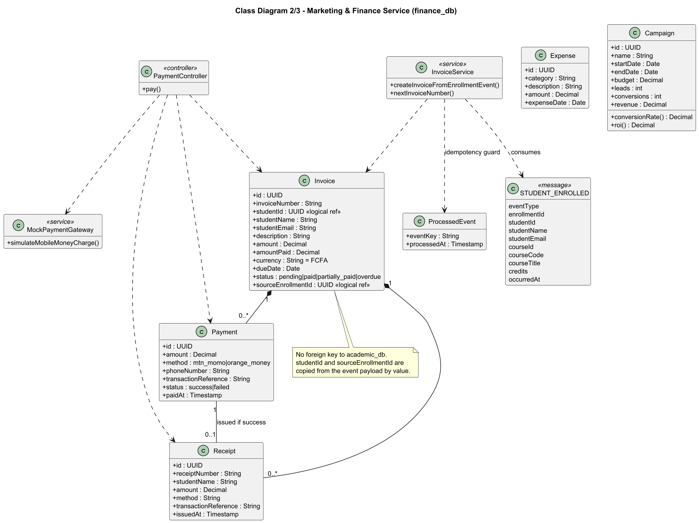
Class Diagram 2/3 - Marketing & Finance Service
Invoice aggregates payments and receipts. studentId and sourceEnrollmentId are logical references to academic data, copied from the event.
23
Notes:
Invoice aggregates payments and receipts. studentId and sourceEnrollmentId are logical references to academic data, copied from the event. Implementation: schema.sql (finance), invoiceService.js, paymentController.js, mockPaymentGateway.js, campaignController.js (conversionRate and roi are derived).

Slide 24
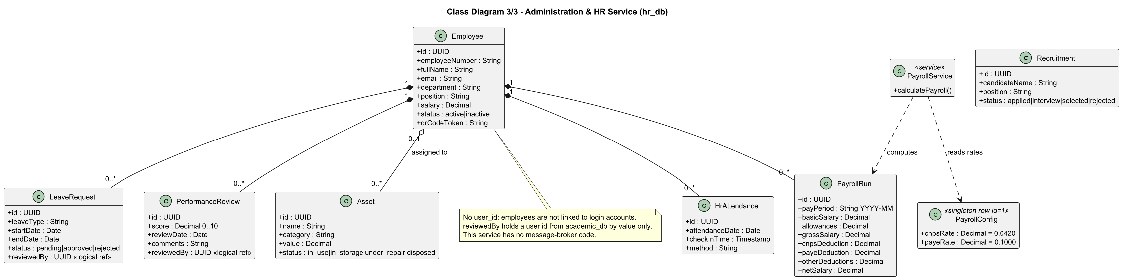
Class Diagram 3/3 - Administration & HR Service
Employee is the aggregate root for payroll runs, attendance, leave and performance reviews; assets may be assigned to an employee.
24
Notes:
Employee is the aggregate root for payroll runs, attendance, leave and performance reviews; assets may be assigned to an employee. Implementation: schema.sql (hr), payrollService.js. PayrollConfig is a singleton row read during payroll calculation.

Slide 25
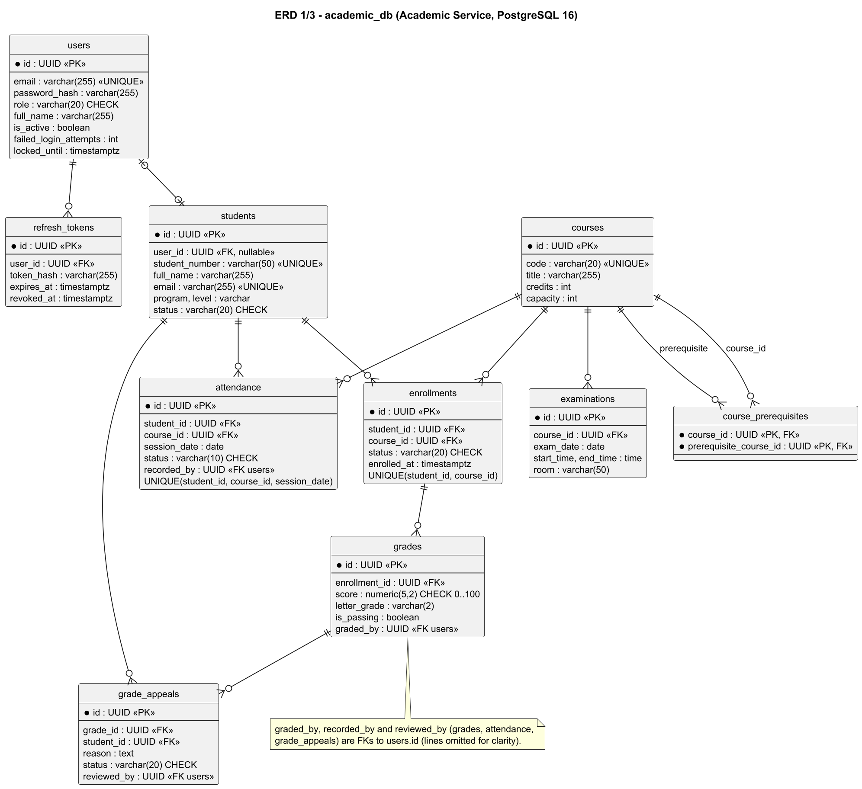
ERD 1/3 - academic_db (Academic Service)
Ten tables including the identity tables (users, refresh_tokens). Audit columns graded_by, recorded_by and reviewed_by reference users.
25
Notes:
Ten tables including the identity tables (users, refresh_tokens). Audit columns graded_by, recorded_by and reviewed_by reference users. Implementation: services/academic-service/src/db/schema.sql.

Slide 26
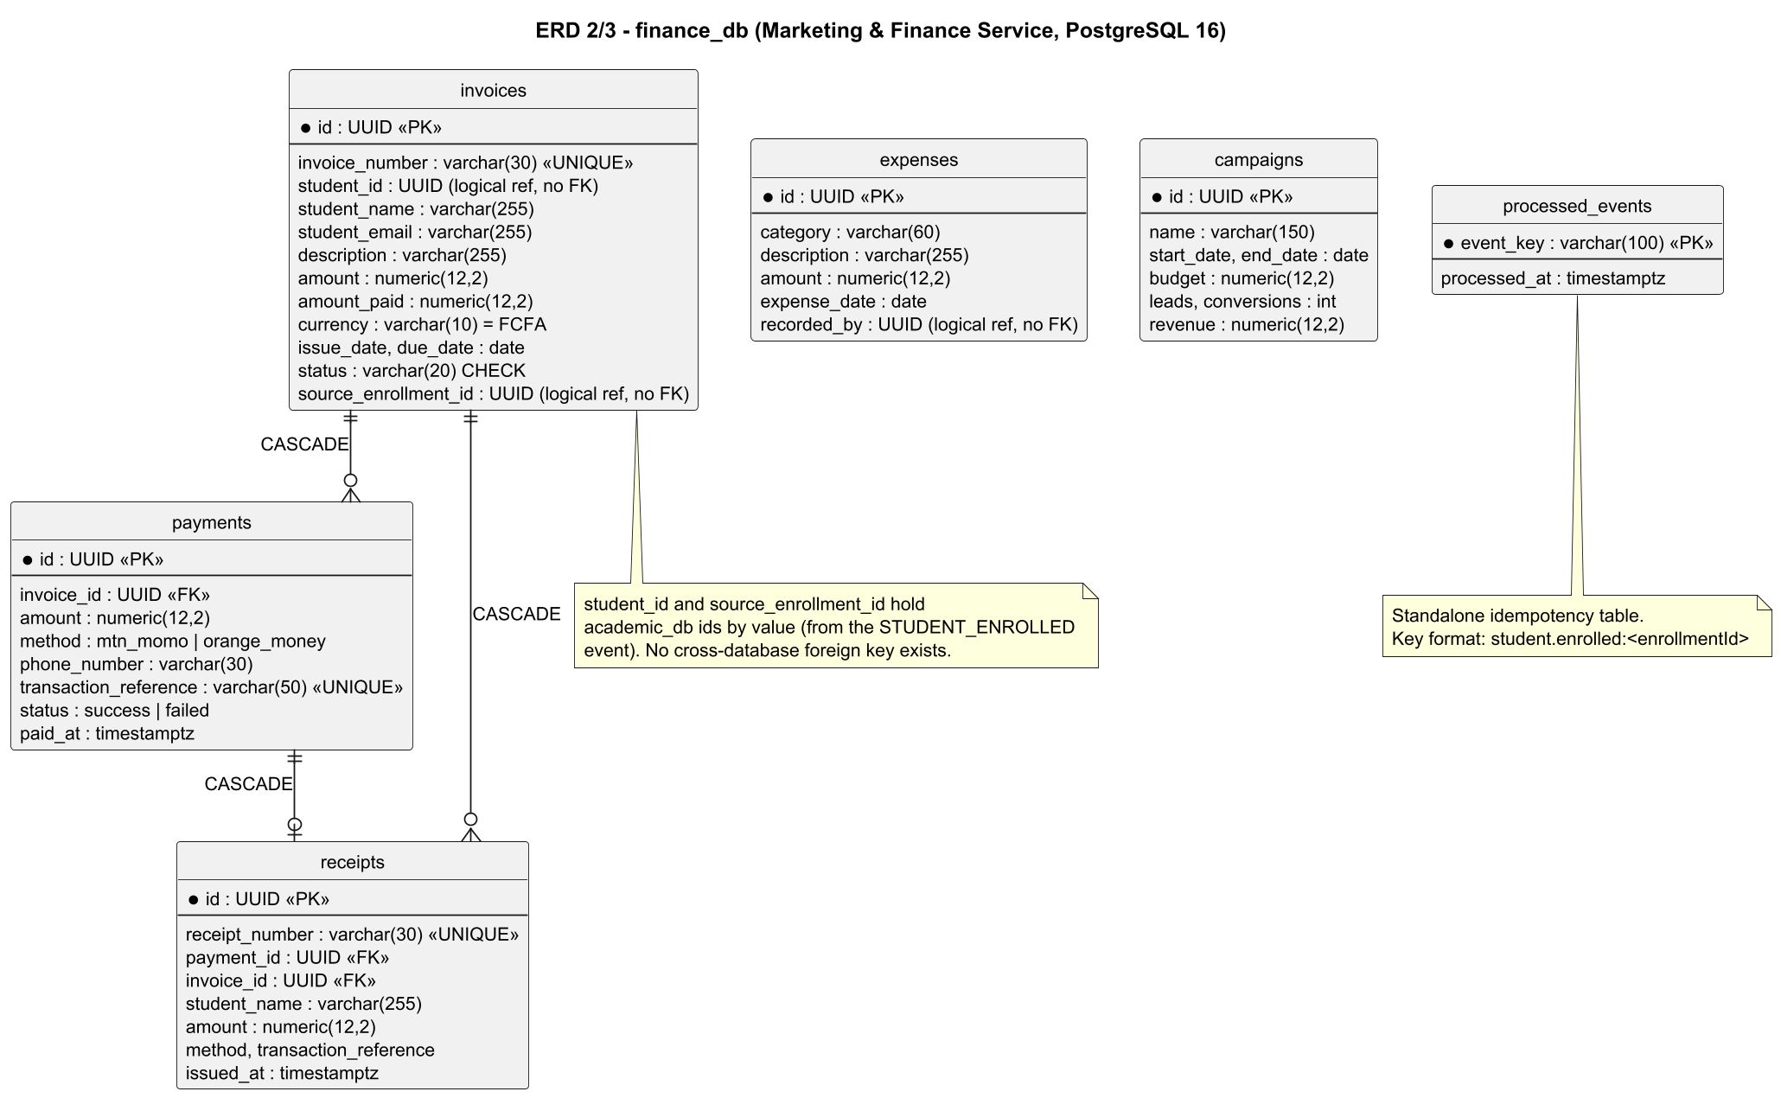
ERD 2/3 - finance_db (Marketing & Finance Service)
Invoices, payments, receipts, expenses, campaigns and the processed_events idempotency table. No foreign key leaves this database.
26
Notes:
Invoices, payments, receipts, expenses, campaigns and the processed_events idempotency table. No foreign key leaves this database. Implementation: services/finance-service/src/db/schema.sql.

Slide 27
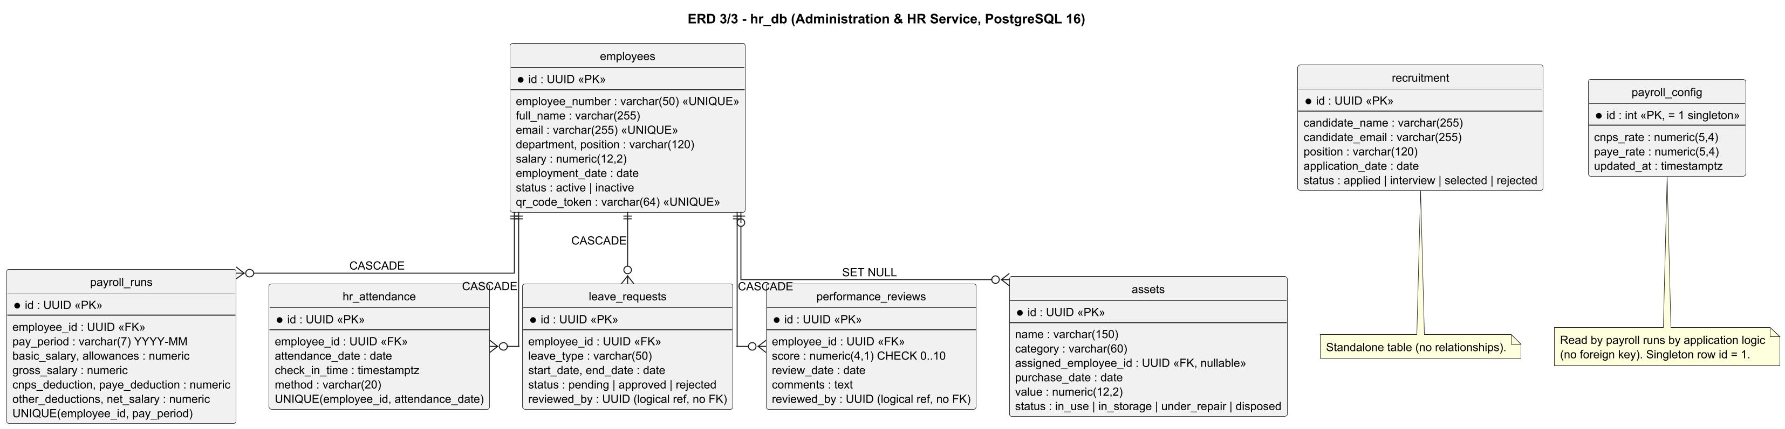
ERD 3/3 - hr_db (Administration & HR Service)
Employees and their payroll runs, attendance, leave and performance reviews; assets optionally assigned to an employee; payroll_config singleton; recruitment standalone.
27
Notes:
Employees and their payroll runs, attendance, leave and performance reviews; assets optionally assigned to an employee; payroll_config singleton; recruitment standalone. Implementation: services/hr-service/src/db/schema.sql.

Slide 28
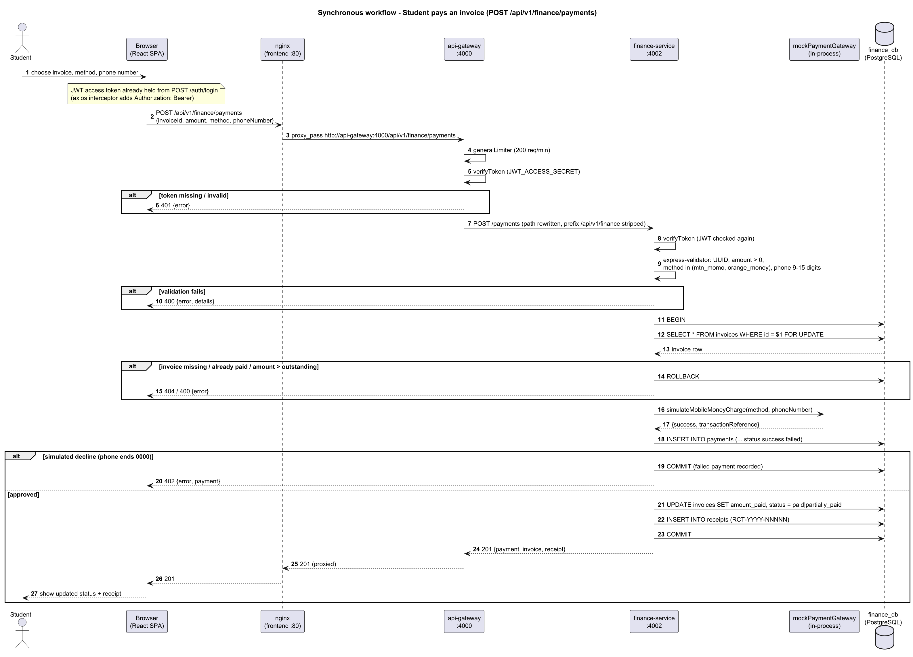
Sequence Diagram - Synchronous workflow: paying an invoice
Browser to nginx to API Gateway to finance-service to finance_db and back, with JWT verification at the gateway and in the service, validation, a row-locked transaction and the simulated payment gateway.
28
Notes:
Synchronous example: paying an invoice. Follow the arrows from the browser to nginx, gateway, finance service and database. Note the double token check and the database transaction.

Slide 29
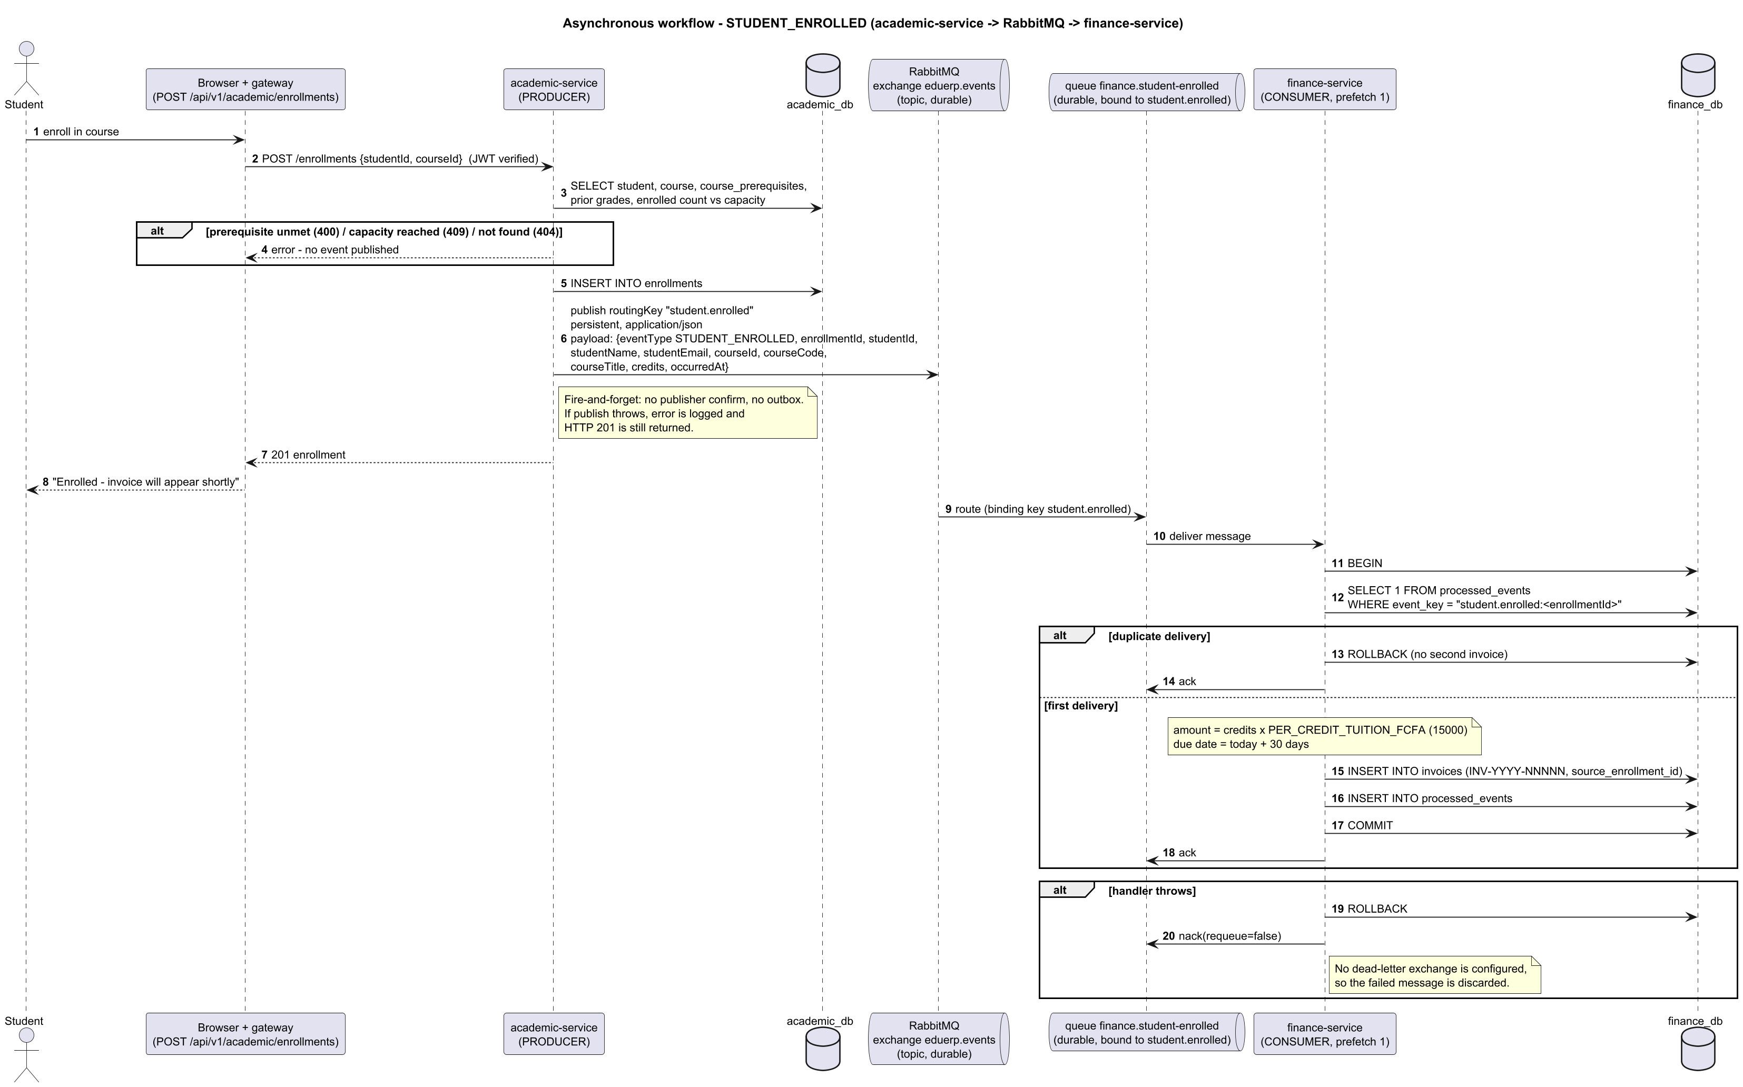
Sequence Diagram - Asynchronous workflow: STUDENT_ENROLLED
academic-service publishes to exchange eduerp.events with key student.enrolled; queue finance.student-enrolled delivers it to finance-service, which creates the invoice idempotently and acks. Failures are nacked without requeue.
29
Notes:
Asynchronous example: enrollment publishes STUDENT_ENROLLED; the Finance Service consumes it from queue finance.student-enrolled and creates the invoice once (idempotent).

Slide 30
Security measures
Passwords hashed with bcrypt (12 rounds); never stored or logged in plain text.
Short-lived access tokens (15 minutes); refresh tokens stored as SHA-256 hashes, rotated on use and revoked on logout.
Account lockout after 5 failed logins for 15 minutes; the same message is returned for unknown e-mail and wrong password.
Role-based authorization on every protected route, at the gateway and again in each service.
Rate limiting: 200 requests per minute at the gateway, 20 login attempts per 15 minutes, 300 per minute in each service.
Security headers (helmet), CORS restricted to the front-end address, input validation with express-validator, parameterized SQL queries, request size limit of 1 MB.
Database integrity: foreign keys, unique and check constraints; payments applied in one locked transaction.
30
Notes:
Highlight bcrypt, lockout, token rotation and defence in depth (gateway plus service checks).

Slide 31
Testing and quality
Automated tests use Jest and Supertest, with the database and RabbitMQ replaced by mocks so they run anywhere.
Result on 25 September 2026: 44 tests pass - API Gateway 5, Academic Service 19, Finance Service 10, HR Service 10.
Covered: registration and password rules, password hashing and tokens, enrollment with event publishing and capacity, at-risk rules, invoice creation and idempotency, simulated payments and receipts, campaign metrics, payroll calculation, leave workflow, QR attendance and gateway authentication.
A GitHub Actions pipeline runs all backend tests, builds the front end and builds every Docker image on each push and pull request.
Screens and the remaining endpoints were checked manually; they have no automated tests.
31
Notes:
Say clearly that 44 automated tests pass and that screens were checked manually.

Slide 32
Demonstration
Install Docker Desktop, copy .env.example to .env (optional; safe development defaults are built in).
From the project folder run: docker compose up --build
Open the web application at http://localhost:5173
API documentation (Swagger) is at http://localhost:4000/docs; the RabbitMQ management page is at http://localhost:15672.
Development accounts (one per role) are created automatically: superadmin@eduerp.test, admin@eduerp.test, staff@eduerp.test, student@eduerp.test. Their password is set in services/academic-service/src/db/seed.js and is for development only.
32
Notes:
Optional live demo: log in as student, enroll, then show the invoice appearing.

Slide 33
Limitations and future work
Current limitations
Future work
Payments are simulated: a phone number ending in 0000 is declined, every other valid number succeeds. No real telecom API is called.
Tuition is a flat rate per credit; a real fee schedule per programme is not modelled.
Payroll rates (CNPS 4.20%, PAYE 10.00%) are configurable placeholders, not verified legal rates.
Enrollment events are sent fire-and-forget: if RabbitMQ is down at that moment, the enrollment succeeds but the invoice is not created later (no outbox).
A message that fails in the Finance Service is discarded; there is no dead-letter queue. The queue is created by the Finance Service, so events sent before it first starts are lost.
Ownership is not checked on several student-facing endpoints, and HR payroll, leave and performance lookups are open to any logged-in user.
Connect a real mobile-money provider and add payment webhooks.
Add a transactional outbox and a dead-letter queue so no event can be lost.
Enforce ownership rules so students see only their own data and HR employee data is limited to HR roles.
Add PDF transcripts, receipts and reports, and e-mail or SMS notifications.
Link employees to login accounts and add a screen for performance reviews.
Add HTTPS, service replication, monitoring dashboards and performance tests.
33
Notes:
Be open about the limits: these are documented in the report.

Slide 34
Conclusion
One system covers academic, finance/marketing and HR work
Independent services with their own databases, behind one secured gateway
Enrollment triggers billing automatically through RabbitMQ
Role-based security and 44 passing automated tests
Documentation checked against the source code; limits stated openly
34
Notes:
Summarise and invite questions.

Slide 35
Thank you
Questions?

