Slide 1
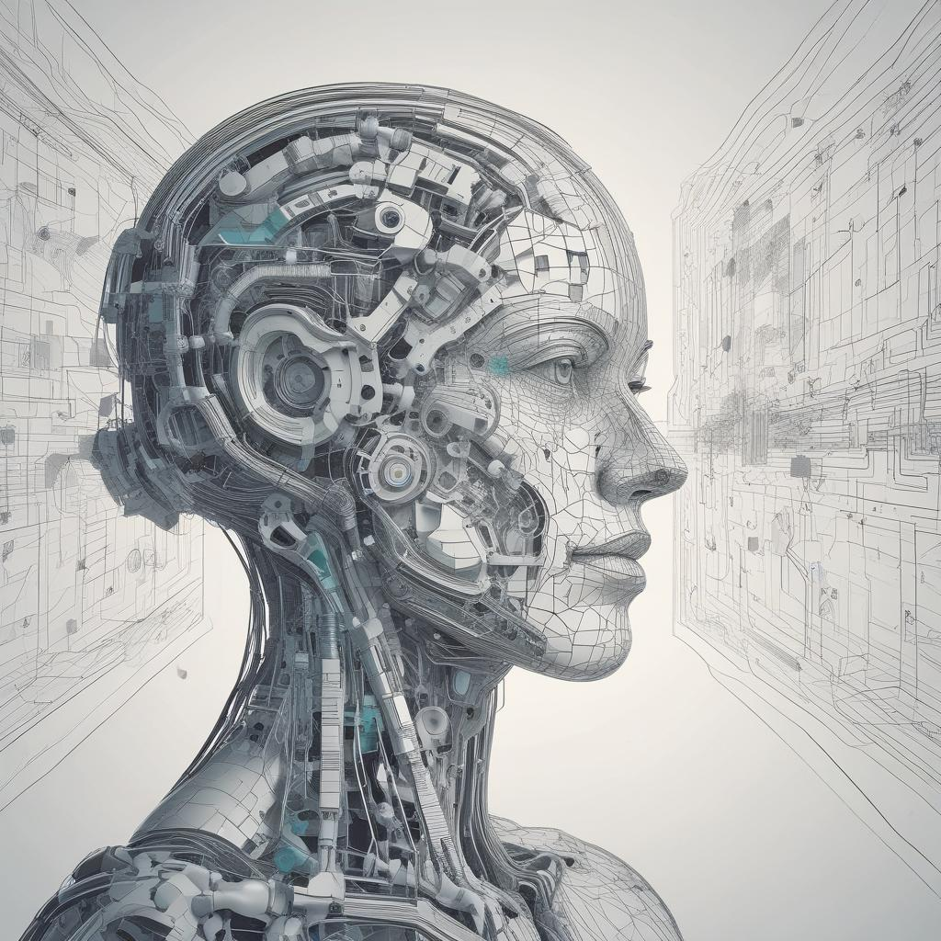

LearnLab AI
By Rodrigo Coloma Gutierrez

Slide 2
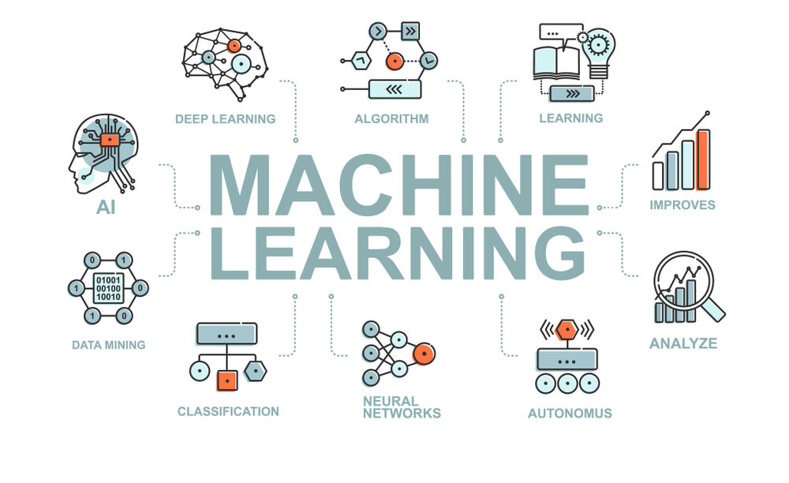
Problem
Creating the right Machine Learning model
takes time and coding skills
Sub-problem #1
A machine learning pipeline requires multiple iterations over every step of the process to find the right combination to maximize the model performance.
Sub-problem #2
It is hard to keep track of all the modifications of the pipeline when creating a model
Sub-problem #3
Model creators tend to use Generative AI tools but without integration with their data
1

Slide 3
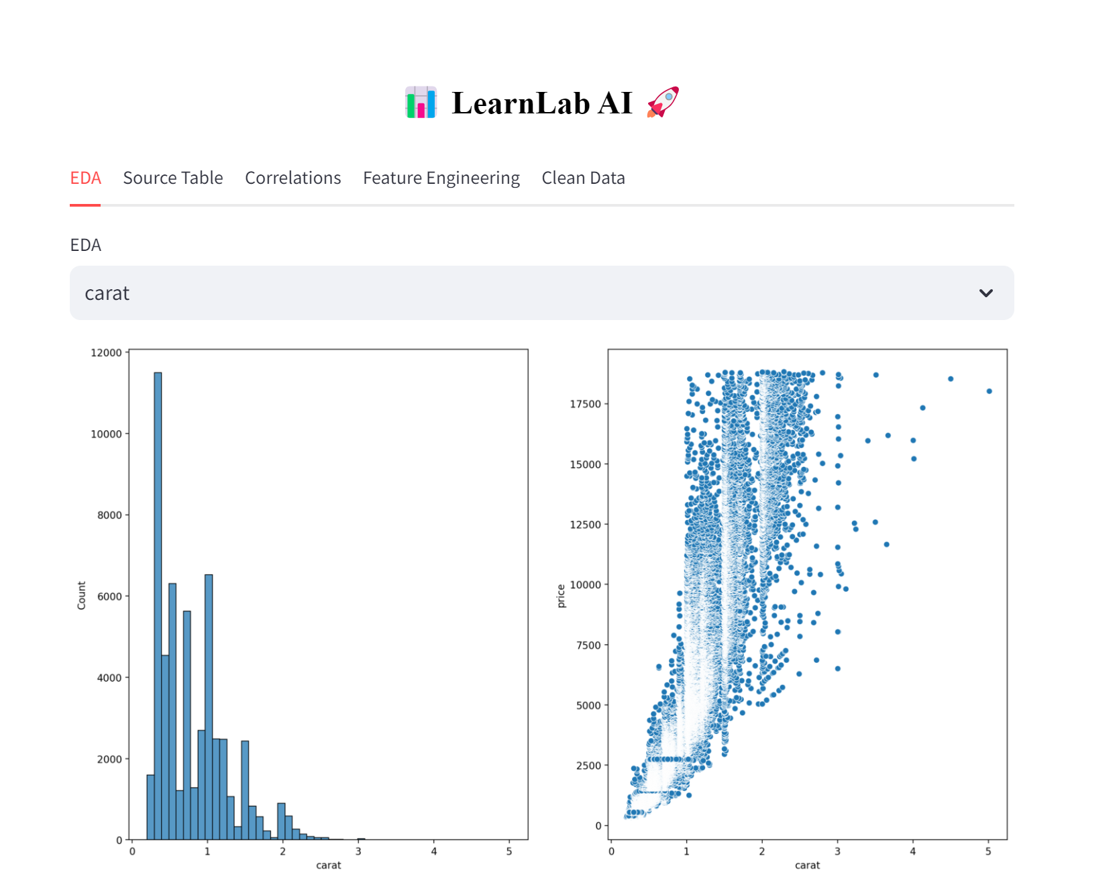
Our Solution
Public
http://localhost:8501/
Localhost
http://localhost:8501/

Slide 4








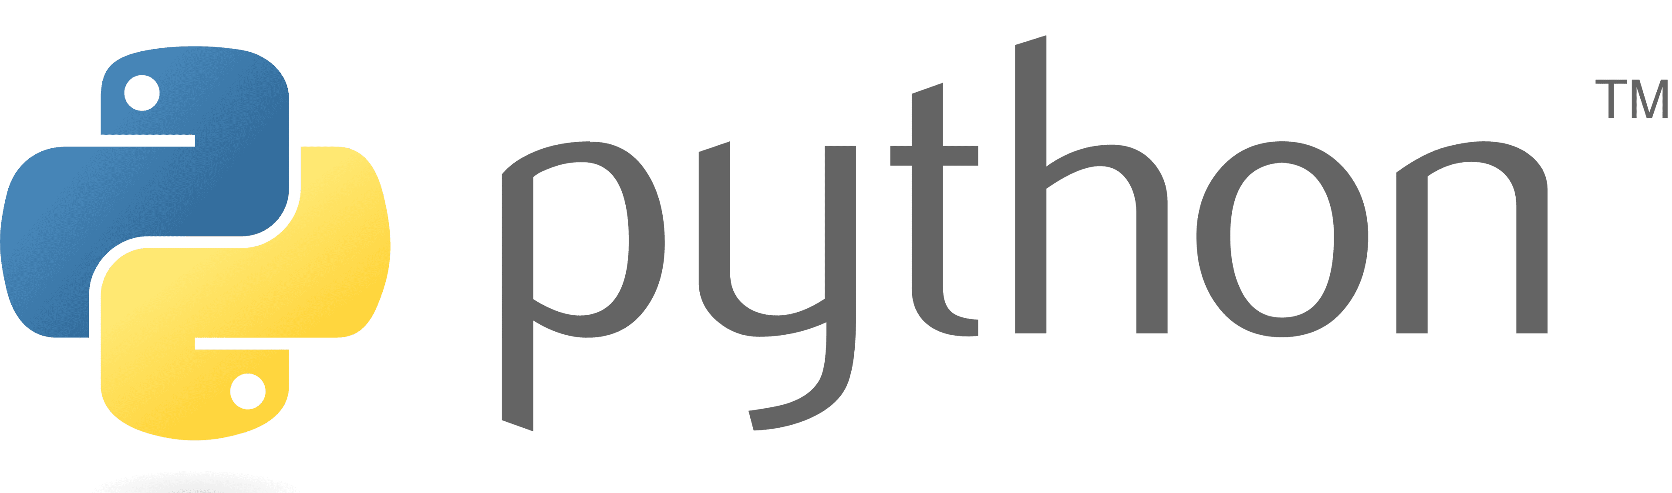


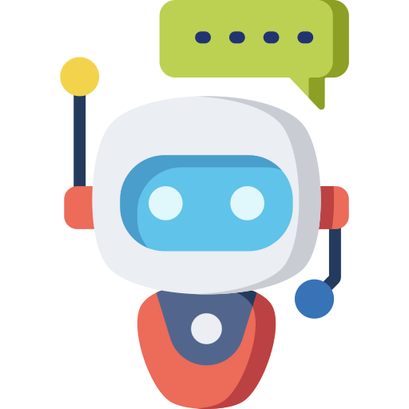

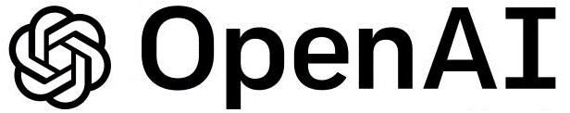
Architecture
Data Input
Data Output
REPOSITORY
Data
Sharing
USER & PROJECTS
MANAGEMENT LAYER
Users
Projects
Models
ML LEARNING PIPELINE
CHATBOT
Data
Sharing
Raw Data
Processed Data
Data Ingestion
EDA & Prepprocessing
Model Selection
Model
Testing
API Integration

