Slide 1
Relatório Rodrigo Campello
Exercícios pyroot

Slide 2
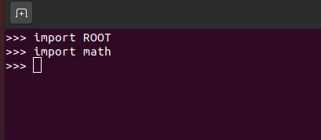
Preparando o ambiente
Para a realização dos exercícios é necessário importar as bibliotecas do root e math para o python.

Slide 3
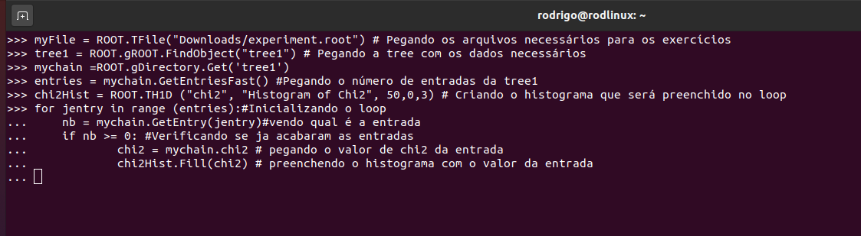
Exercício 1
”Revise the script to draw the chi2 histogram with error bars”

Slide 4
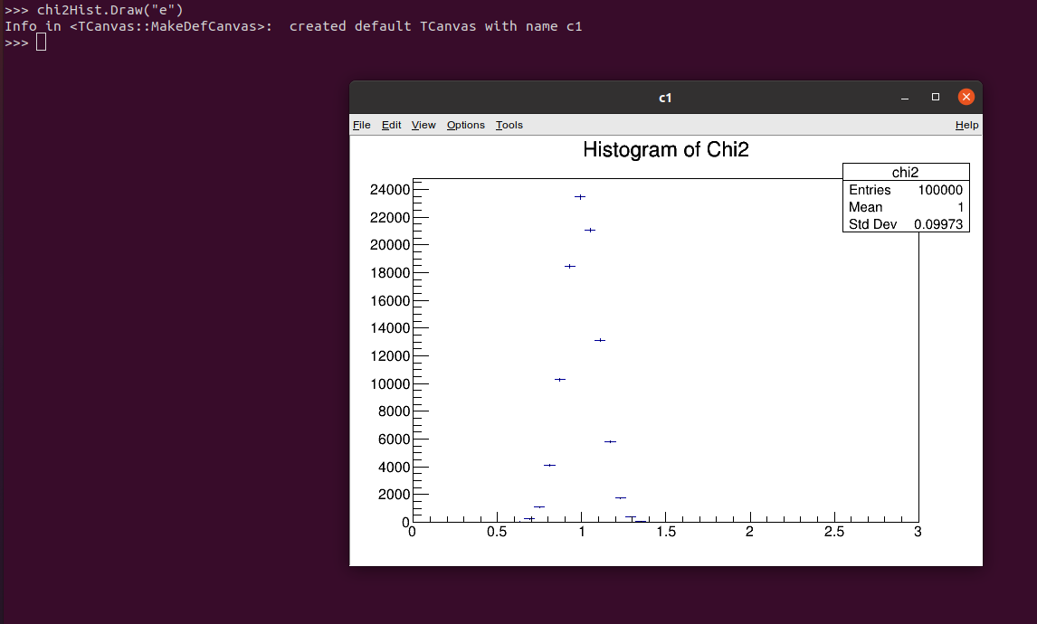

Slide 5
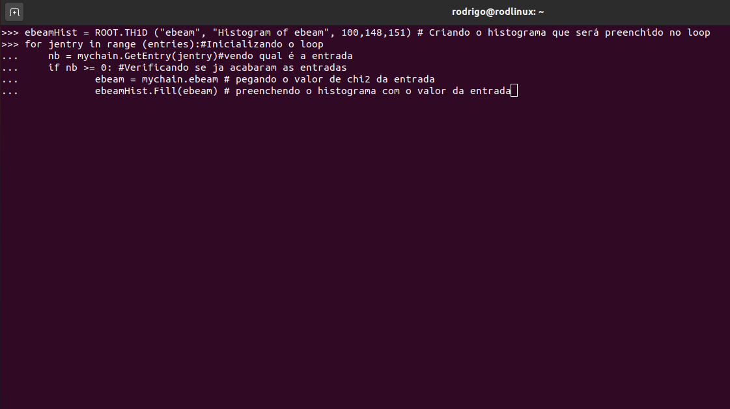
Exercício 2
”Revise the scrip to create, fille and display an additional histogram of the variable ebeam(with error bars and axis labels).”

Slide 6
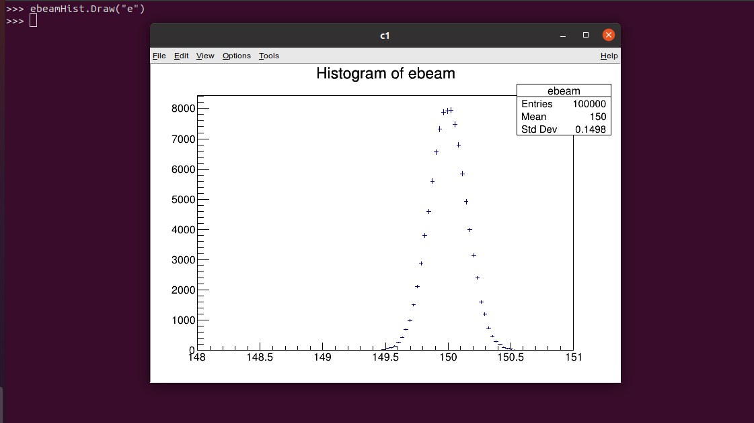

Slide 7
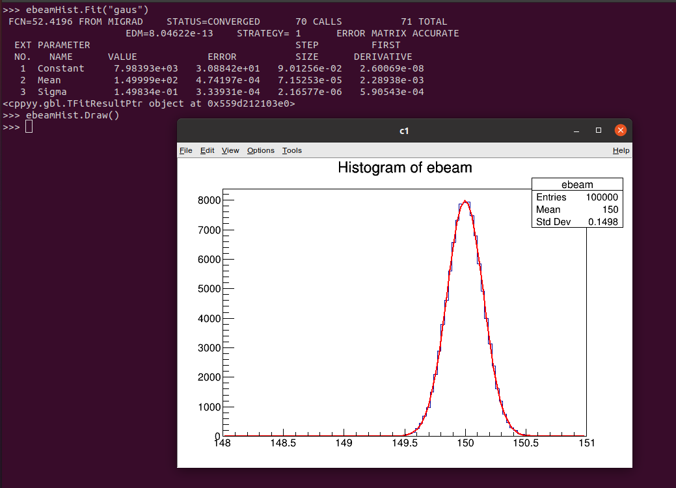
Exercício 3
”Fit the ebeamhistogram to a gaussian distribution.”

Slide 8
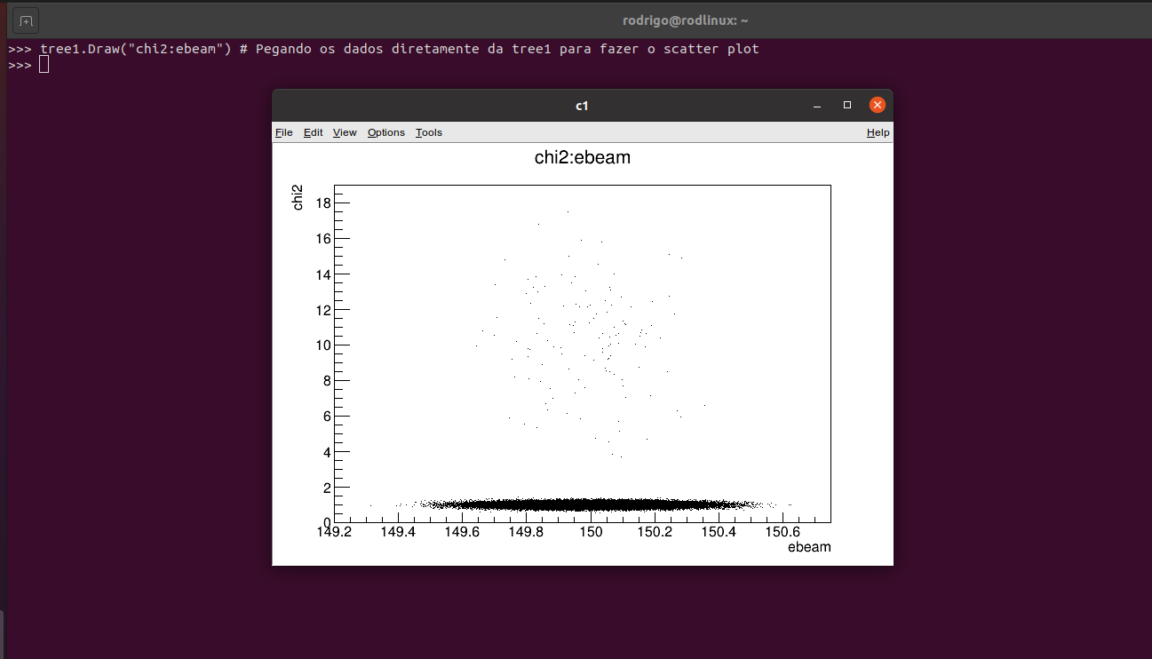
Exercício 4
”Revise the script to draw the chi2 histogram with error bars”

Slide 9
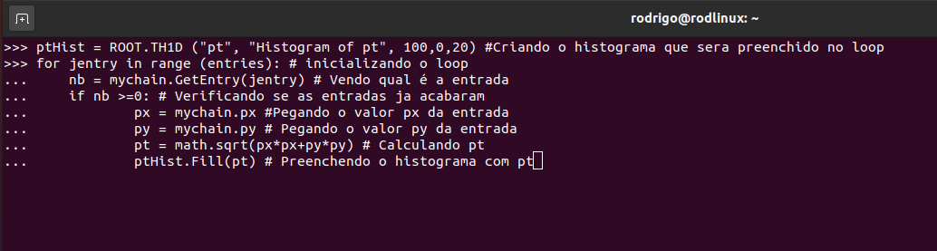
Exercício 5
”Calculate pt in an analysis macro and make a histogram of the variable. Tip: pt = sqrt(px*px + py*py)

Slide 10
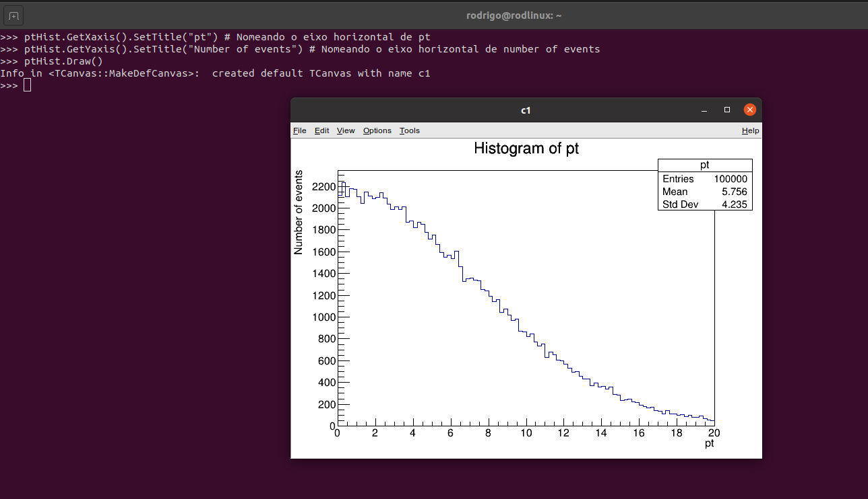

Slide 11
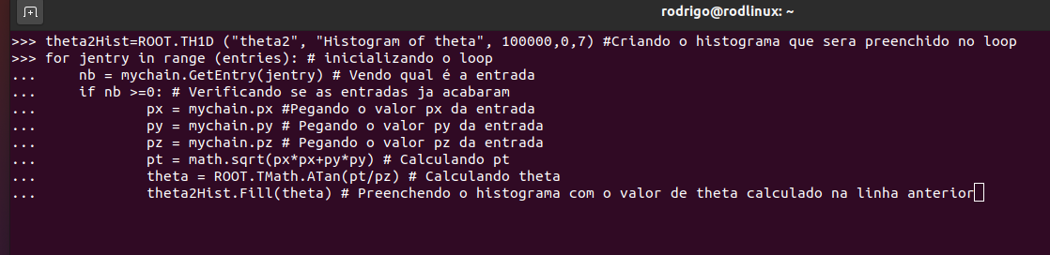
Exercício 6
”Include a histogram of the quantity theta, or the angle that the beam makes with the z-axis.Tip: use this math function ROOT.TMath.ATan(y/x).”

Slide 12
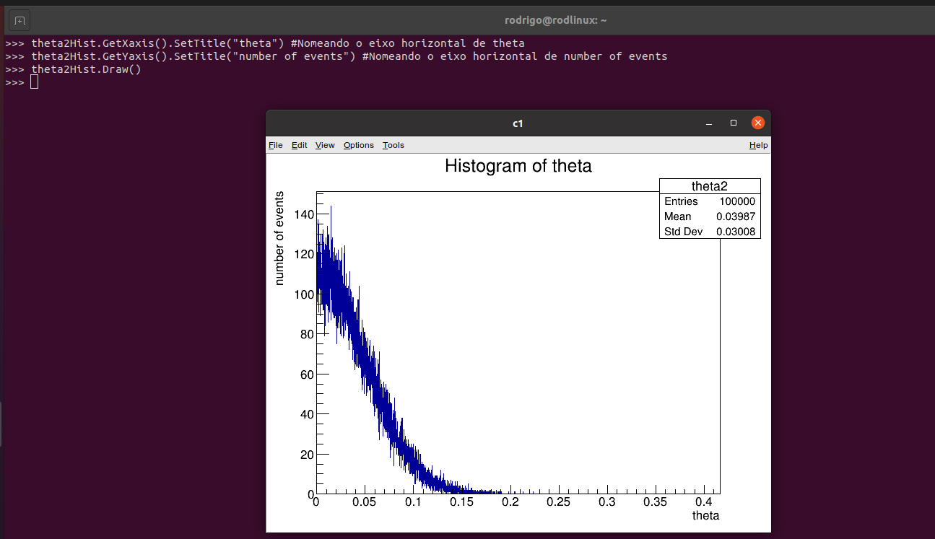

Slide 13
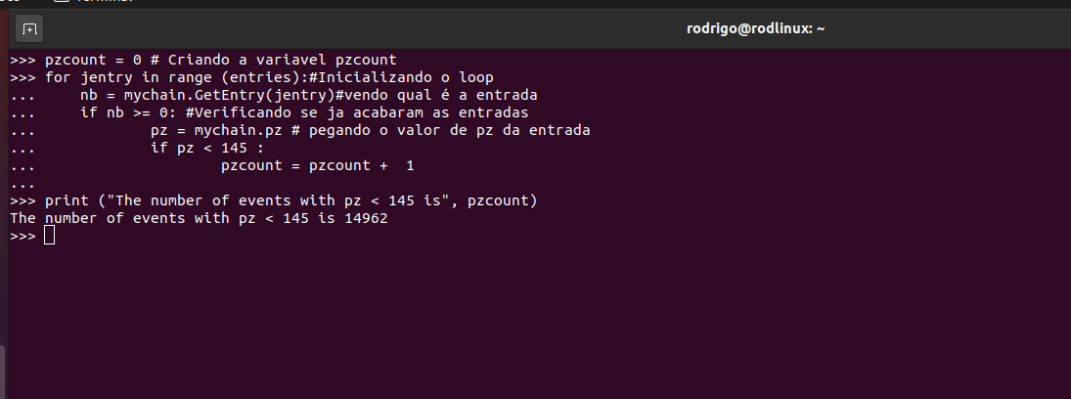
Exercício 7
”Apply a cut in your analysis macro. Your gooal is to count the number of events for which pz is less than 145 geV, and then display the value. Tip: include the following statement in your wrap-up section: print "The number of events with pz < 145 is", pzCount.”

