Slide 1



Implementation of a Ticketing system for the ANSR SINCRO network
Licenciatura em Engenharia Informática e Multimédia
Unidade Curricular Projeto
48633 Rodrigo Costa | 48961 Rodrigo Bugalhão
Oriented by: Tiago M Dias; Carlos Gonçalves;
PRJ#16 | 20/05/2024

Slide 2

Agenda
Basics
Motivation
Functionality
Studying osTicket
Implementation
Dynamic implementation
Installing the plugin
Timeline

Slide 3


Basics
osTicket
SINCRO (Sistema Nacional de Controlo de Velocidade)
ANSR (Autoridade Nacional de Segurança Rodoviária)

Slide 4


Motivation
To create a structured way of reporting problems with radars (and its components) to ANSR, in the form of a plugin for osTicket.
Prj15: osTicket-API – Desenvolvimento de uma API REST para o software osTicket

Slide 5


Functionality
Create support tickets designed for radar characteristics
manually
plugin
Automatically
osTicket
via API of PRJ#15

Slide 6

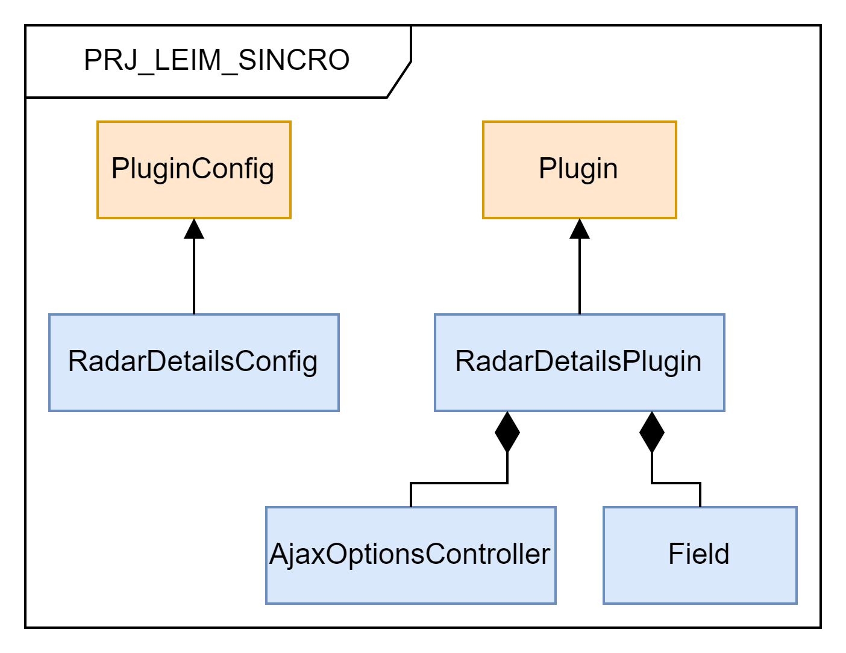
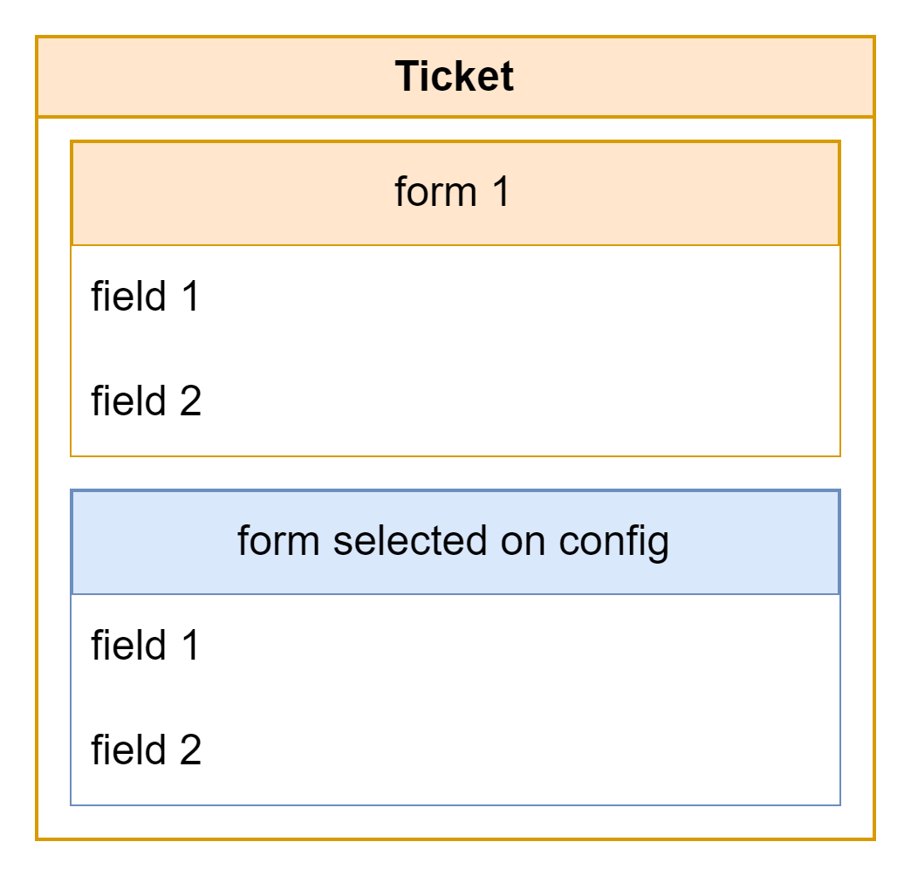
Studying osTicket

Slide 7
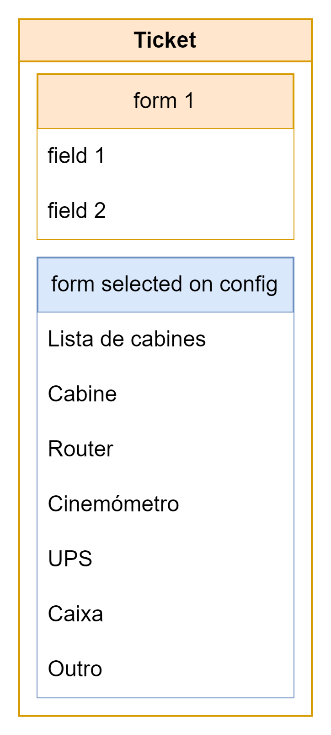

Implementation
Cabine
Router
Cinemómetro
UPS
Caixa
Outro
Lista de cabines

Slide 8


Dynamic implementation
Pros
Cons
More appealing user interface
Better user experience
Easier to find desired radar
No need to write components specifications
Alteration of osTicket source files
Dependent on osTicket version
More computationally demanding

Slide 9
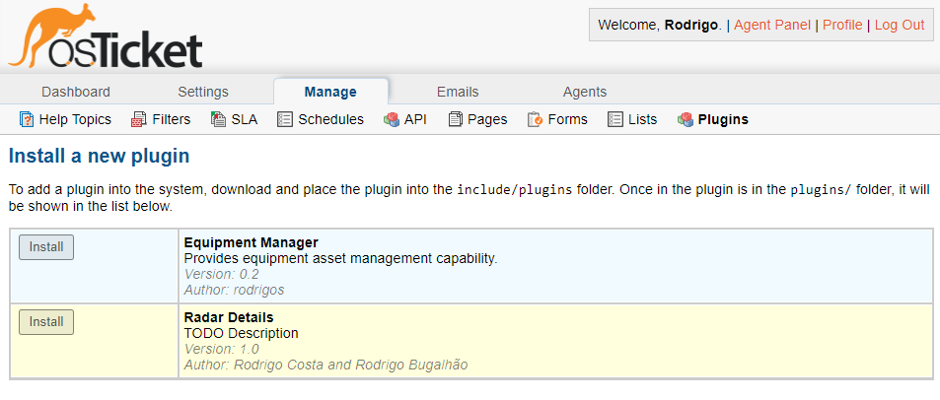

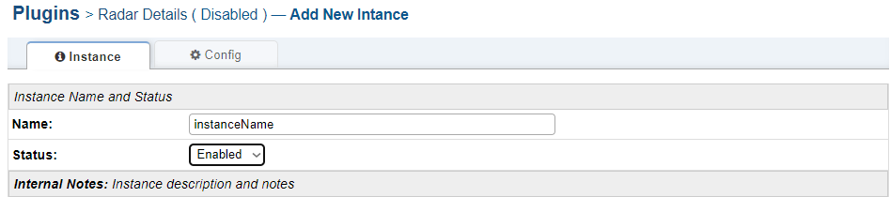
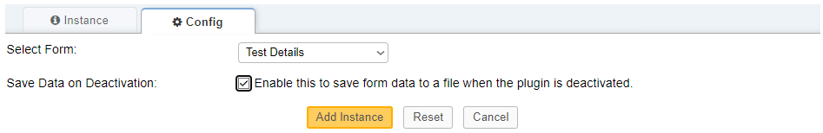
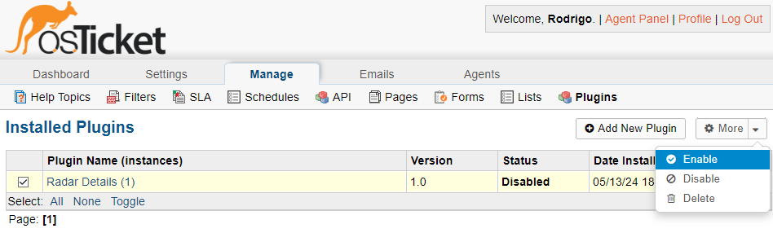

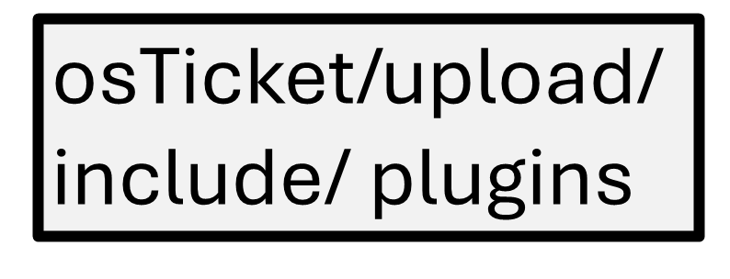
Installing the plugin
open osTicket
move to

Slide 10
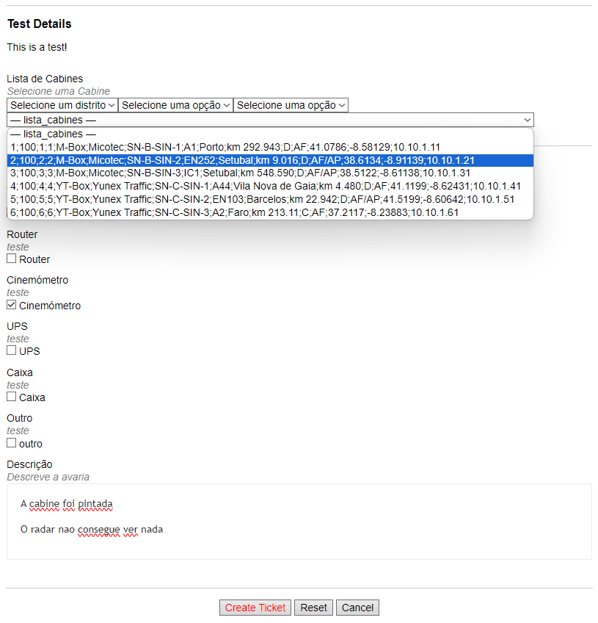
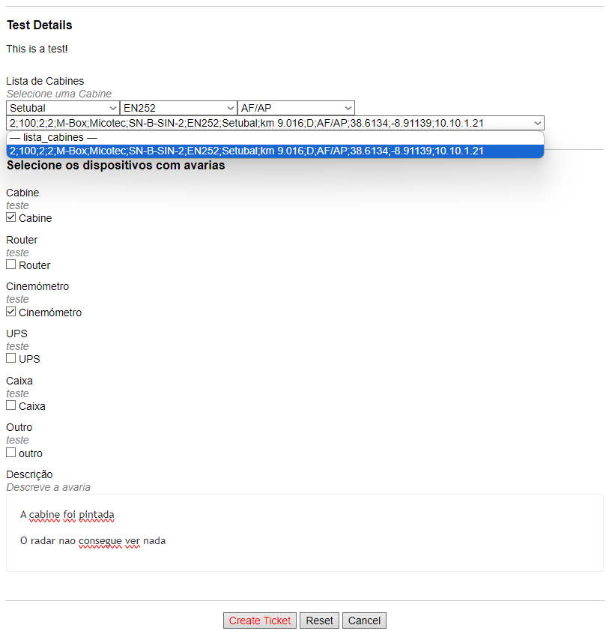

Slide 11
Timeline
Study osTicket
Create a plugin
Add backup functionality
Add dynamic fields
Resolve minor bugs
Write report
Improve user experience
FEIM
Final
presentation
Completed
To do
June
May

