Slide 1


Hi Mate! How’s-it-goin?
Rodrigo Sa

Slide 2
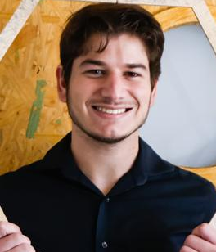
Who am I?
I am a 22 years easy going guy who loves interacting with people and researching the latest innovations, specially in the technology department. I am passionate, hardworking and extremely driven.

Slide 3

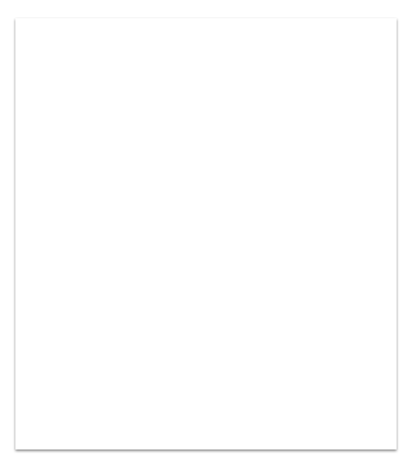
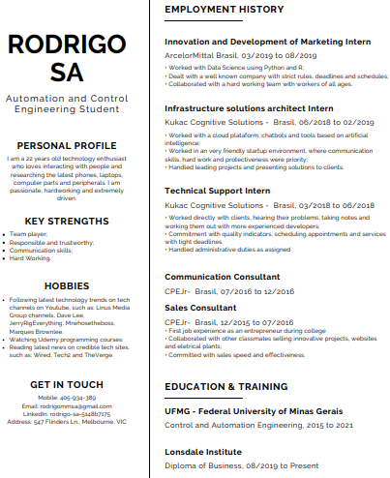
We could read my resume but it would be boring...
Just don’t forget to put it on the fridge, so you can contact me later : )

Slide 4
My key strengths you ask?
Creativity
Hard worker
Team Player
Notes:
In my resume, I also state:
Responsible and trustworthy;
Communication skills.

Slide 5
What I’ve been up to?
So, employment-wise:
Worked in an IT startup;
Worked in a college students only company;
And worked as an intern in a huge international company.
Notes:
Only the first two are interesting for this job actually, but just stating that I’ve been busy

Slide 6
What I’ve been up to?
Academically-wise:
Graduating in Control and Automation Engineering in UFMG (Federal University of Minas Gerais);
Taking Diploma of Business in Lonsdale Institute.
Notes:
Trust me, I’m an engineer … in a few years!

Slide 7
Back to work experiences.
I’ve worked for 1 year in the Kukac startup, 4 of those as support. This job gave me a huge experience talking to customers, along with trying my best to acknowledge their problems and solve them.

Slide 8

Back to work experiences.
Earlier than that, on my first year of college, I’ve got in a company called CPE, which was for students only. There, I’ve worked in sales and later in Marketing.

Slide 9
What did you do there?
I’ve worked really hard to get customers to give a chance to a voluntary company runned by students to sell them something...
In sales we had to work extra hard to achieve our goals and keep the customer to invest in other projects.
Finally, in market I was responsible for the company instagram and Email Marketing
…
Here a few examples:

Slide 10
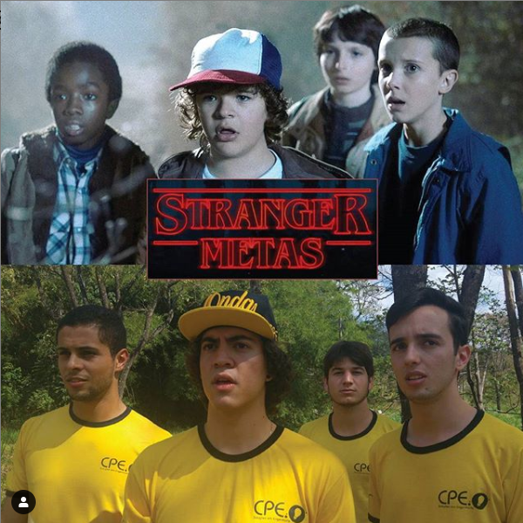
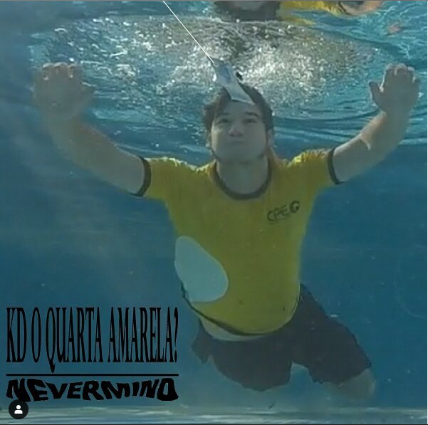
Stranger Goals - Stranger Things
Try to guess it ...

Slide 11
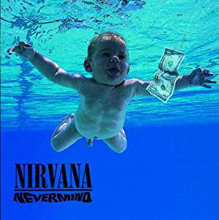
That’s what I call commitment to the job!

Slide 12
Now, How can I help you?
I’ve really enjoyed your instagram page and the job description. So much energy, commitment and genuine desire to help.
I would love to be a part of this team!
Thank you for your time : )

