Slide 1
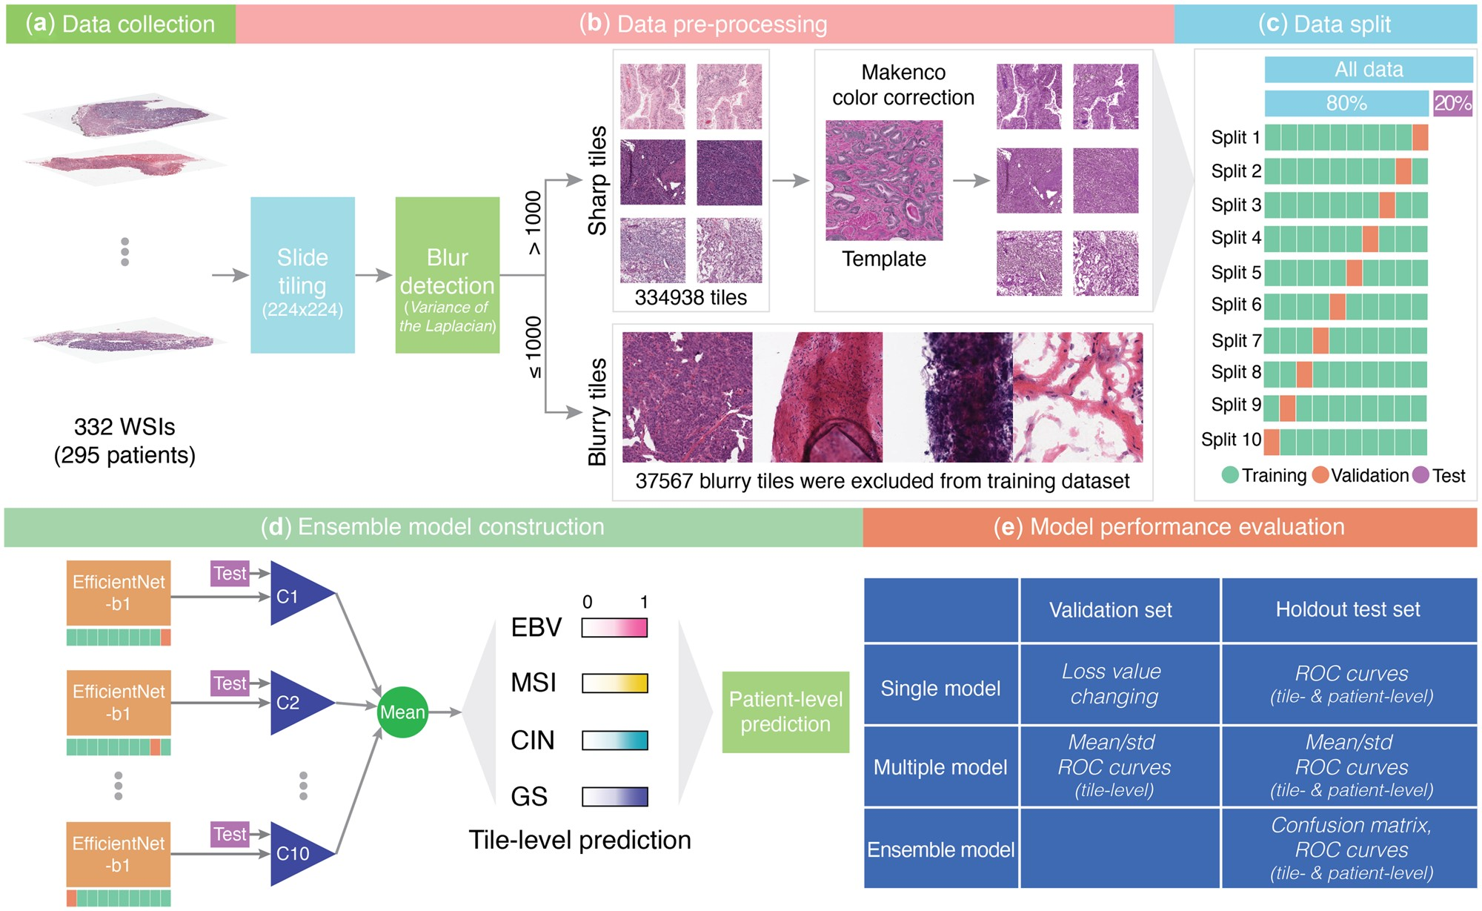

Fig. 1. The workflow. (a) Data collection: Data from the TCGA database (including 332 WSIs representing 295 ...
Notes:
Fig. 1. The workflow. (a) Data collection: Data from the TCGA database (including 332 WSIs representing 295 patients). (b) Data pre-processing: three pre-processing steps are performed, including slide tiling, blur detection and color correction. (c) Data split: This is conducted at the patient-level. Note that the tiles from one WSI are only aggregated into one subset: training, validation or test subset. (d) Ensemble model construction: Ten child models (labeled C1–C10) based on EfficientNet-b1 are included in the ensemble learning framework. As shown in the figure, the mean value of outputs of 10 models is used for the final prediction. (e) Model performance evaluation: as can be seen from the table, the performance of the constructed models is assessed based on the corresponding benchmark datasets and the models (single, multiple or ensemble model). Abbreviations: the four major molecular subtypes: EBV-infected, MSI, GS and CIN. Receiver-operating characteristic (ROC)
Unless provided in the caption above, the following copyright applies to the content of this slide: © The Author(s) 2022. Published by Oxford University Press. All rights reserved. For permissions, please e-mail: journals.permissions@oup.comThis article is published and distributed under the terms of the Oxford University Press, Standard Journals Publication Model (https://academic.oup.com/journals/pages/open_access/funder_policies/chorus/standard_publication_model)

