Slide 1
"Touhou: Darkness of the Void"
Rodrigo Toledo Castillo

Slide 2
Agenda:
Introduction to the Game
What Makes It Unique
Key Gimmicks and Gameplay Features
Visual Showcase (Images & Gameplay Video)

Slide 3
Introduction to the Game
What is it?
A fan game inspired by the iconic Touhou Project series.
A bullet hell (danmaku) game with unique mechanics and aesthetics.
Story Premise
We follow the story of Shiro our main protagonist and her problem when she suddenly wakes up in Gensokyo having no memories other than her name.
She and the player then realize she is also blind, but she can grasp the shape of things.

Slide 4
What Makes It Unique
Monochrome Aesthetics: A world entirely in shades of black and white, creating a distinct visual identity.
Innovative Gameplay Mechanics: Introducing parry and bullet return, a first in the series.
Dynamic Color-Switching: Players toggle between light and dark modes to survive and strategize.
Key Differentiators:
Monochrome Aesthetics: A world entirely in shades of black and white, creating a distinct visual identity.
Innovative Gameplay Mechanics: Introducing parry and bullet return.
Dynamic Color-Switching: Players toggle between light and dark modes to survive and strategize.

Slide 5
Key Gimmicks and Gameplay Features
Basic Mechanics:
The basic mechanics of the games such as: Spell Cards, Graze, Score Points and so on.
Monochrome Aesthetics:
"Art meets function" — visuals are part of the challenge and appeal.
Parry and Return:
Mechanic: Parry colored bullets to reflect them back at enemies.
Color-Switching:
Mechanic: Switch between "dark" and "light" modes.
Example: Dark mode utilizes white bullets and vice versa allowing to dodge said bullets.

Slide 6
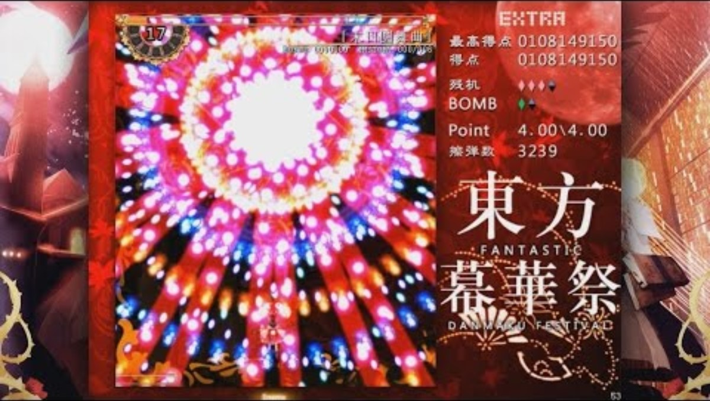

Slide 7
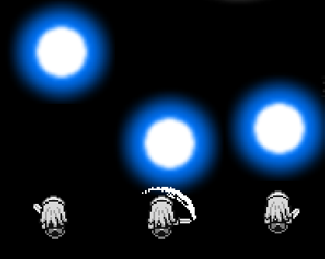


PARRY

Slide 8
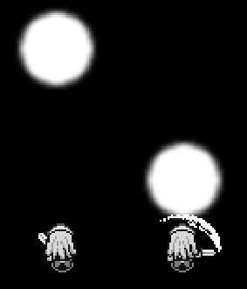





Wrong PARRY

Slide 9



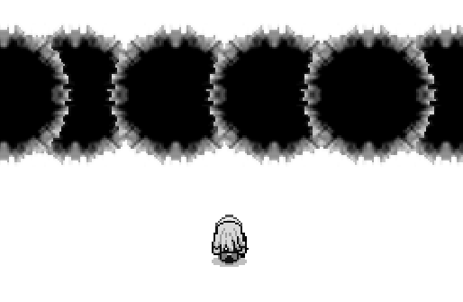


Slide 10

Thank you
Reference: CreepyNinja_. (2018, July 1). THE HARDEST EXTRA BOSS EVER!! - 2nd Try! | TouHou FDF Extra [Reimu] [Video]. YouTube. https://www.youtube.com/watch?v=9thY_FjQTvs

