Slide 1
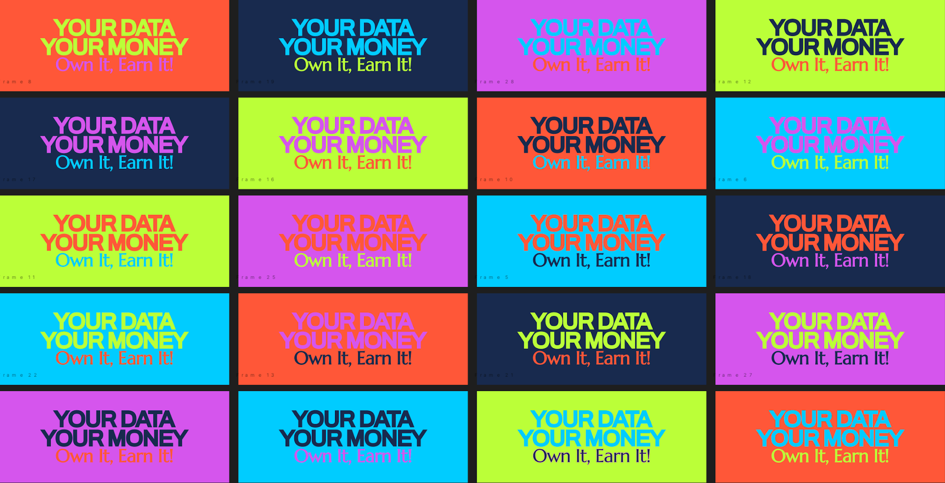

Slide 2
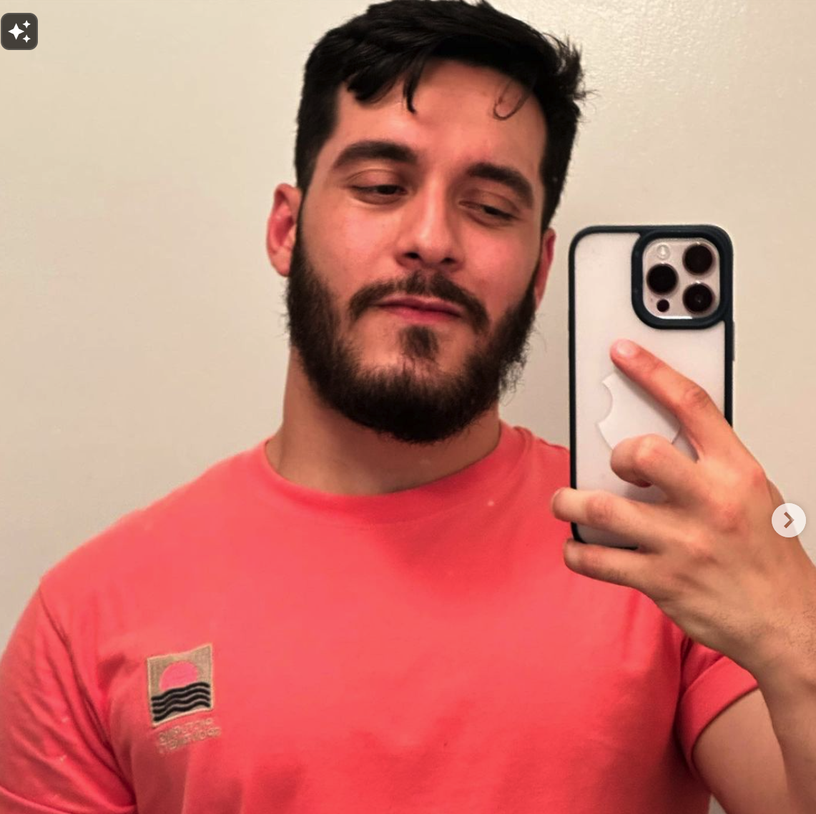


MEET OUR TEAM
RODRIGO
ISABELLE
HTET

Slide 3

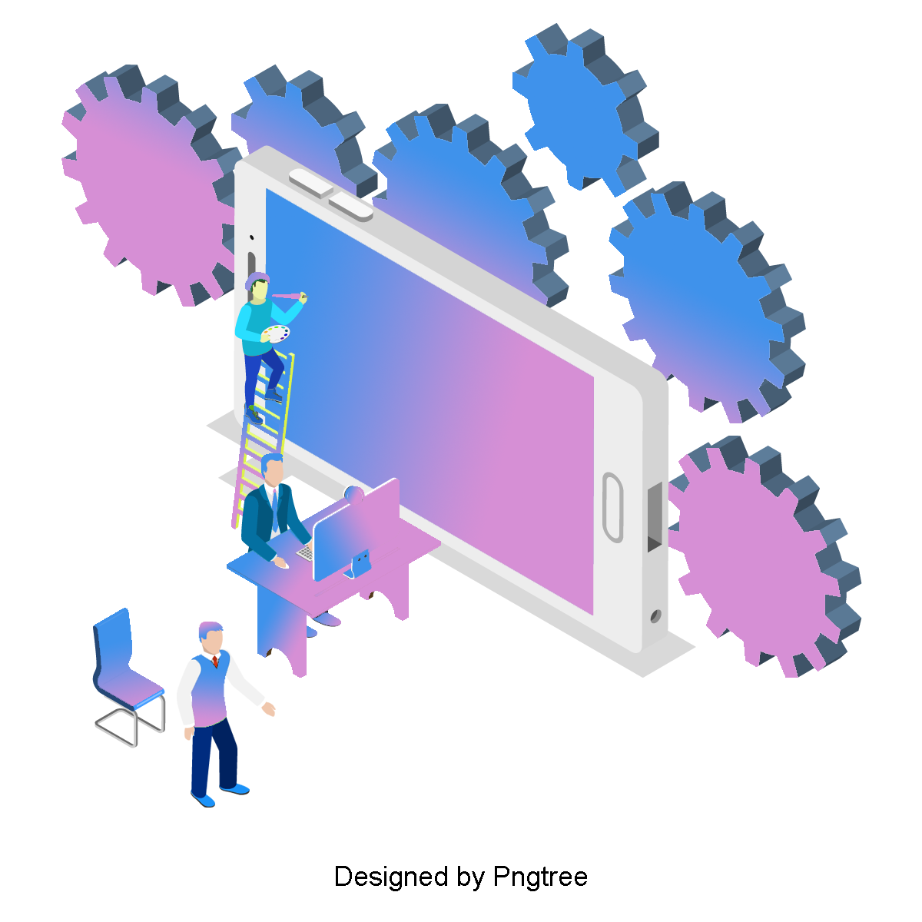

SOCIAL CAUSE
Our campaign highlights the often-overlooked value of personal data, which people create and share daily, while tech companies profit significantly without offering fair compensation. We aim to equip Gen Z with the knowledge to understand the financial worth of their data and empower them to advocate for fair compensation. By promoting transparency and giving young people more control, we seek to shift the digital economy so individuals can benefit from the value they create.

Slide 4
Conscious of social issues - especially digital privacy
Gen Z, tech-savvy digital natives
Aware of digital privacy issues may not fully understand how their data is monetized
Value transparency, social justice, and individual empowerment
More receptive to campaigns around fairness and autonomy.
Inclined to engage since campaign helps understand the value of their data
TARGET AUDIENCE
Gen Z
Age: 18-25 years old
Location: Primarily urban areas, with a (strong) presence on social media platforms like Instagram, TikTok, and YouTube
Behavior: Heavy users of mobile apps and social media. Engage with viral and meme-driven content. Likely to participate in social causes, especially those linked to digital rights.
Income: Low Income / Average / 0 - 70k

Slide 5

Sophia Lee
19 Los Angeles, CA
OCCUPATION: Part-Time Barista / Photography Student
SALARY: $15K
LEVEL OF EDUCATION: Associate Degree in Progress (Photography)
STATUS In a Relationship
SEXUAL ORIENTATION: Straight
RELIGION: Spiritual (Meditation & Wellness)
ETHNICITY: American
Needs clear, straightforward information about what personal data is and how companies profit from it.
Wants to feel empowered to make safer choices online without it feeling complicated or time-consuming.
Seeks a better understanding of how to protect himself online without needing technical knowledge or major lifestyle changes.
Interested in how he can learn to control his personal data and help others

Slide 6

Alex Martinez
24 Chicago, IL
OCCUPATION: Mechanic / Warehouse Worker
SALARY: $30K
LEVEL OF EDUCATION: High School Diploma
STATUS: Single
SEXUAL ORIENTATION: Straight
RELIGION: Christian
ETHNICITY: Hispanic-American
Wants to understand how companies are using her personal data.
Desires to protect her data and avoid feeling exploited by big tech.
Seeks simple ways to secure her online presence without drastic changes to her social media habits.
Wants to educate herself and her peers about privacy rights, but in a casual, approachable way.

Slide 7
Call To Action
Visit our microsite
Participate in street interviews
Follow and engage with our Instagram page
Spread the campaign using viral content (participating #hashtag Instagram post)
Participated in the two actions we are planning: Social Media Blackout + Email Flood to Big Tech Companies

Slide 8
Communication Strategy
Core Message
“Your personal data is valuable, and
it’s time for you to demand fair compensation”
Why it is Important
⚖️
Highlights the unfair profit Big Tech makes from personal data
💡
Helps Gen Z understand the monetary value of their personal data
✊
Empowers Gen Z they have control over their data

Slide 9
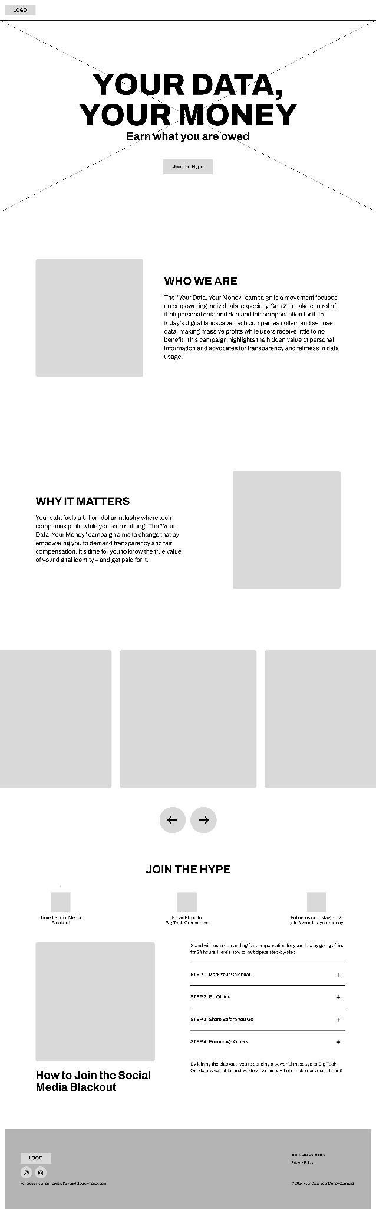
Method 1
Microsite
Instagram Posts

Slide 10
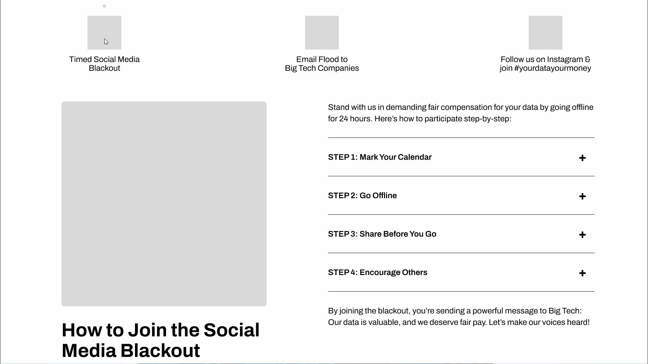
Method 1
Microsite

Slide 11
Hashtags#
Microsite

Slide 12

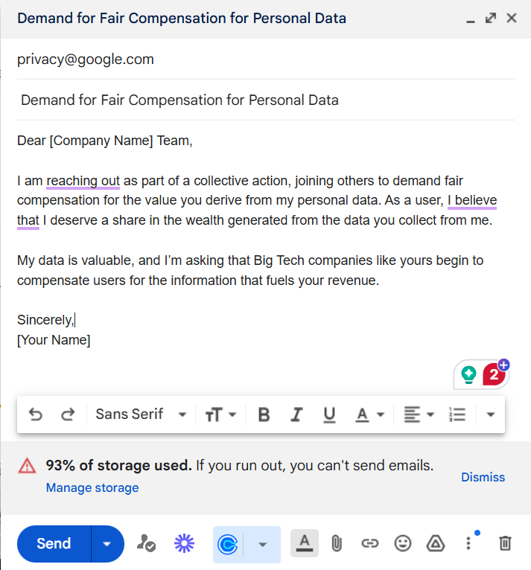

Method 2
Email Flood to Big Tech Companies
Join the Email Flood 🌊 Let’s stand together for fair compensation! Starting January, send an email every Monday to Big Tech. 📧 It’s time they recognize the value of our data. 💸 Set your reminders, spread the word, and let’s make an impact! #YourDataYourMoney 💪
#YourDataYourMoney #DataRights #DigitalEmpowerment #FairCompensation #TakeBackYourData

Slide 13

Method 3
Street Interview (Instagram Reels)
VIDEO 1:
Title: Big Tech’s Dirty Secret: Who Really Owns Your Info? 😳 Privacy Check Starts Here!
Description: Ever wonder who actually owns the data you share online? 📲 In this video, we hit the streets to uncover just how much info big tech companies have on you—and what your privacy actually means. Spoiler: It’s bigger than you think! From your favorite apps to everyday searches, this eye-opening interview will make you question just how much control you really have over your personal info. 💥 Ready to take back the power? Tune in and see how YOU can flip the script on data privacy! 🚀✨ #DataPower #TakeBackControl #PrivacyAwareness
Tags:
#DataPrivacy #BigTech #OwnYourData #GenZPrivacy #DigitalRights #DataOwnership #OnlinePrivacy #SocialMediaAwareness #TakeControl #StreetInterview #PrivacyCheck #DigitalAwareness

Slide 14
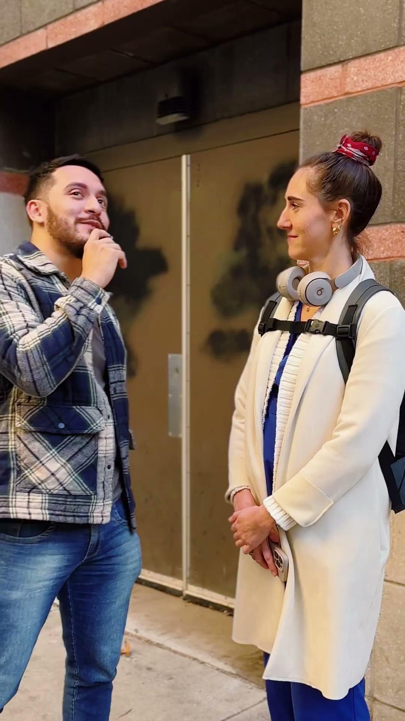
Method 3
Street Interview (Instagram Reels)
VIDEO 2:
Title: Who’s Cashing In on Your Data? 💸 Street Reactions Will Shock You!
Description:
Ever wonder how much your personal data is worth? We hit the streets to ask real people how they think big companies are using their data. Their answers range from hilarious to downright eye-opening! 👀 Get ready to rethink how you manage your info online and take back control of what’s yours. Spoiler alert: It’s worth more than you think! 💼 #GetPaidForYourData
Tags:
#DataValue #StreetInterview #DigitalPrivacy #GenZEmpowerment #PrivacyMatters #BigTechProfits #TakeControl #YourDataYourMoney #DataAwareness #DataRights #EmpowerGenZ

Slide 15

Method 4
Social Media Blackout
INSTAGRAM POSTS TO BE SHARED ON SUPPORTEDS STORIES:
🕶️ Blackout Alert 🕶️
Who profits from your data? Not you.
Let’s stand together for our data rights. Share this post and let Big Companies know it’s time to get paid.
💸 Your Data. Your Money. 💸
Join the Cause.
📢 Call-to-Action:
Share to your story and make your silence heard!
👉 Head over to the Linktree in our Instagram bio to download the photo!
Hashtags:
#YourDataYourMoney #DataRights #GenZPower #DigitalBlackout #OwnYourData #DemandCompensation #TechTransparency #TakeBackYourData #DataPrivacy

Slide 16






INSTAGRAM POST DESIGN STYLE - SKETCHES
Title: Every form you fill could be filling your pocket.
Description: 🖊️ Every form you fill could be filling your pocket! 🤑 While you're sharing your personal data, Big Companies are cashing in—time to flip the script. 💸
Next time you enter your email, ask yourself: Why aren't I getting paid for this? 🤔 Join the movement to reclaim the value of your data. Let’s get what’s ours! 📲💥
#YourDataYourMoney #GetPaidForYourInfo #TakeBackYourData #DataRights #GenZRevolution #OwnYourData #DigitalEmpowerment #TechTransparency #EveryFormCounts

Slide 17





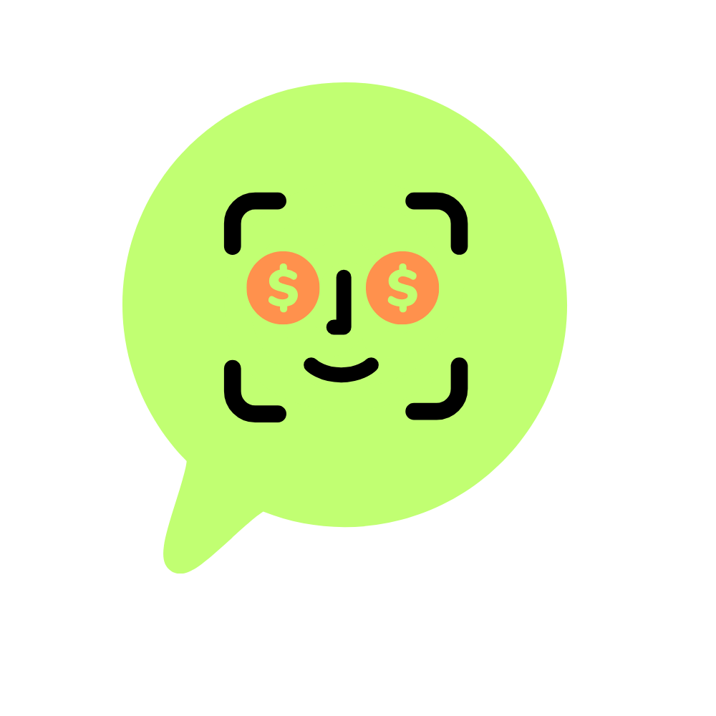

Media
Logo sketches
PAY ME FOR MY DATA NOW!
Our campaign differs from other privacy or data protection initiatives by emphasizing humor, virality, and empowerment instead of fear or distrust of technology. While other campaigns may focus on the negative aspects of data privacy, we’re encouraging individuals to flip the script and profit from their data instead. - using it is inevitable so let’s change rules.
Primary: ARCHIVO
Secondary: MARCELLUS

Slide 18
Perception and Tone
Bold – Encouraging individuals to take a stand
Fun – Using lightheartedness to engage and educate
Empowering – Making people feel they can take control of their data
Relatable – Speaking directly to Gen Z in a tone they understand and appreciate
Provocative – Encouraging them to question the current digital landscape and their role in it.

Slide 19

Thank you for your attention
Any feedback?

