Slide 1
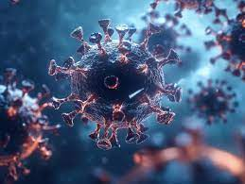
Bayesian Epidemic Modeling
Estimating Infection (β) and Recovery (γ) Rates for Outbreak Control
Rodrigue Irampa
Notes:
NOTE: Want a different image on this slide? Select the picture and delete it. Now click the Pictures icon in the placeholder to insert your own image.

Slide 2

Overview of the Project
Why Bayesian SIR Modeling?
Objective:
Estimate key parameters (β, γ) to predict disease spread.
Incorporate prior knowledge (e.g., past outbreaks) with real-time data.
Key Components:
SIR Model: Tracks Susceptible (S), Infected (I), Recovered (R) populations.
Bayesian Methods: Update beliefs about β and γ using data.
Policy Tools: Quantify uncertainty to guide lockdowns/vaccination.

Slide 3
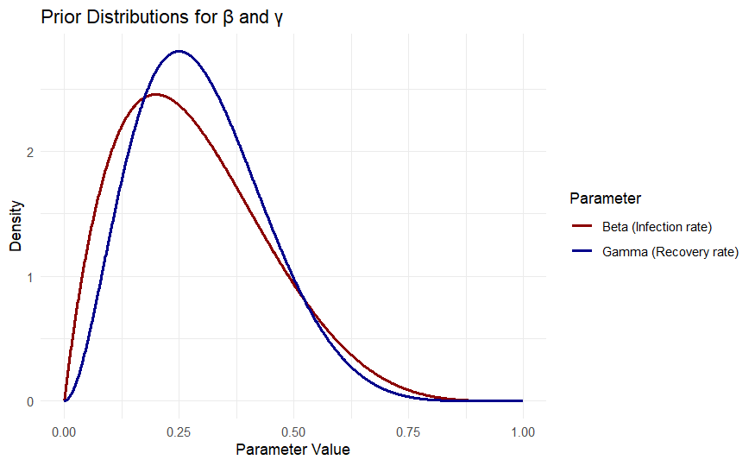
Beta Distribution for Priors
Setting Initial Beliefs: Beta Distributions Infection Rate (β):
Prior: Beta(2,5) → Mean = 2/(2+5) ≈ 0.285.
Interpretation: "We initially assume a 28.5% transmission risk per contact."
Recovery Rate (γ):
Prior: Beta(3,7) → Mean = 0.3.
Interpretation: "Average recovery time = 1/0.3 ≈ 3.3 days."

Slide 4

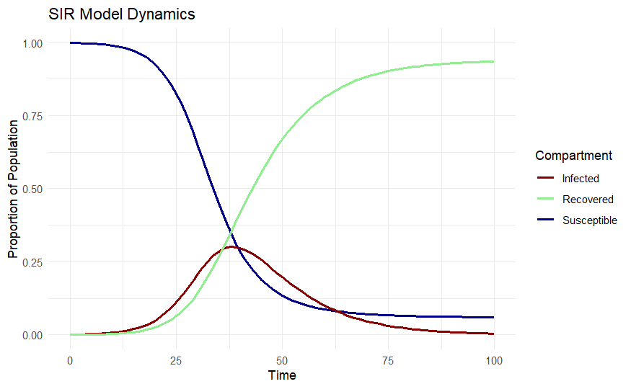
SIR Model: "How Diseases Spread"
S: Susceptible, I: Infected, R: Recovered.
N: Total population.
Simulation Steps:
Initialize: S=999, I=1, R=0, β=0.3, γ=0.1.
Solve ODEs numerically (e.g., using deSolve in R).
Peak infections occur when β > γ(R₀ = β/γ > 1; outbreak grows).

Slide 5
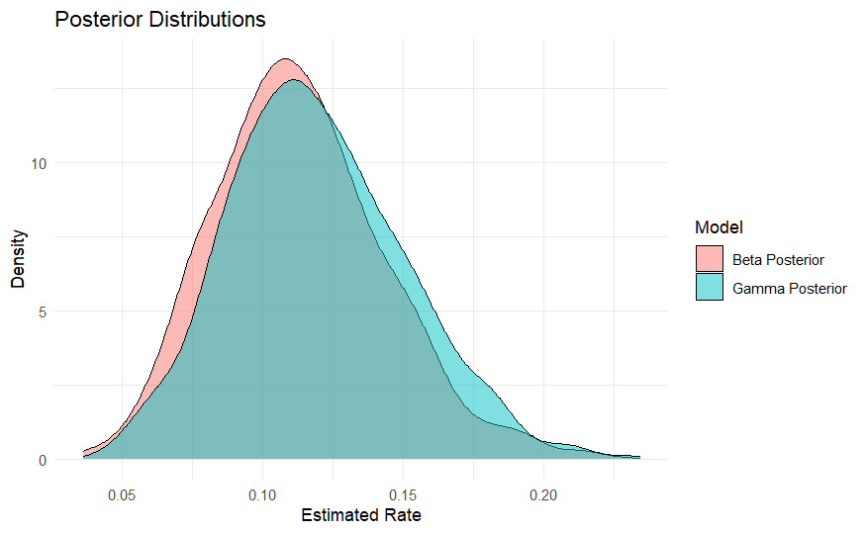
Bayesian Updating of Parameters
Updating Beliefs with New Data
Scenario: 10 cases observed in 100 tests (10% positivity rate).
Priors:
β ~ Beta(2,5) (Mean = 0.285)
γ ~ Beta(3,7) (Mean = 0.3)
Posteriors:
β ~ Beta(2 + 10, 5 + 90) = Beta(12,95) → Mean = 0.112
γ ~ Beta(3 + 10, 7 + 90) = Beta(13,97) → Mean = 0.119
Interpretation:
Lower β posterior (0.112 vs. 0.285): Data suggests slower spread than initially assumed.
γ remains stable (~0.12 recovery rate).

Slide 6
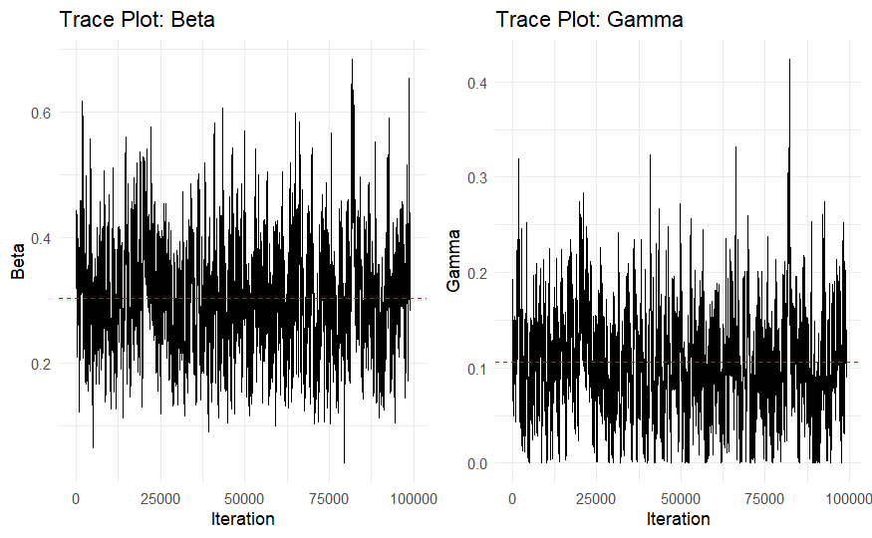
MH Sampler
Why Metropolis-Hastings? Comparing Sampling Methods
Acceptance Rate: 53.7% (ideal range: 20–60%).
Efficiency: MH explores β/γ space in 100,000 iterations (vs. Gibbs failing for non-conjugate SIR model).
Method | Pros | Cons | Why MH wins
Direct MC | Simple to implement | Inefficient for high-dimensional spaces. | MH adapts to complex posteriors (eg, SIR ODEs)
Gibbs Sampling | Fast for conjugate | Requires conditional distributions (often unknown for β/γ in SIR | MH works with any prior/likelihood
MH Sampling | Flexible, no conjugacy needed | Turning required (step size) | Acceptance rate: 53.7% (optimal for our work)

Slide 7
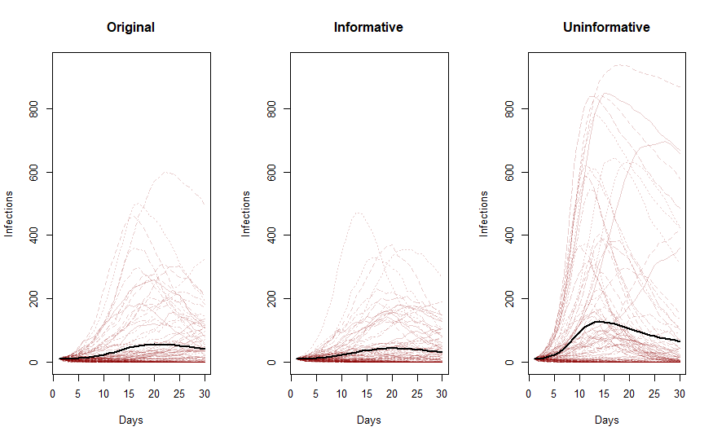
Model Sensitivity
How Priors Impact β and γ Estimates Three Prior Scenarios:
Original:
β ~ Beta(2,5) → Mean = 0.285
γ ~ Beta(3,7) → Mean = 0.3
Use Case: Baseline for novel outbreaks.
Informative:
β ~ Beta(4,10) → Mean = 0.286
γ ~ Beta(6,14) → Mean = 0.3
Use Case: Stronger data (e.g., historical flu).
Uninformative:
β ~ Beta(1,1) → Uniform(0,1)
γ ~ Beta(1,1) → Uniform(0,1)
Use Case: No prior knowledge (rare).
Original and informative priors yield similar means but different uncertainties (informative has narrower posteriors).
Uninformative priors lead to slow convergence (wide posteriors).

Slide 8
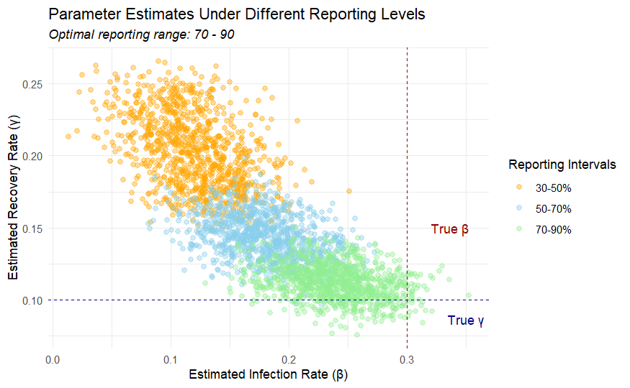
Under-Reporting
The Danger of Missing Data
30-50% Reporting:
β underestimated.
γ overestimated.
Risk: False sense of security, delayed action.
70-90% Reporting:
True β=0.3, γ=0.1.
Under-reporting shifts policies toward inaction.

Slide 9
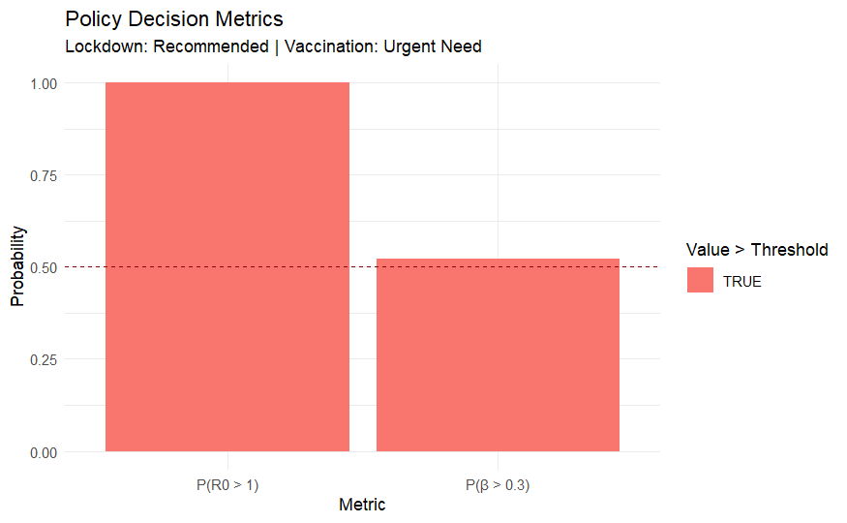
Policy Rules
From Posteriors to Public Health Decisions 1. Lockdown Threshold:
Rule: P(β > 0.3) > 50% → Recommended
For our case we have P(β > 0.3) = 60% , lockdown is advised.
Vaccination Threshold:
Rule: P(R₀ > 1) > 70% → Urgent Need
R₀ = β/γ; if P(R₀ > 1) = 75%, accelerate vaccines.
Uncertainty Matters:
Wider Posteriors: Require more cautious policies (e.g., prepare for worst-case β).
Narrow Posteriors: Confident actions (e.g., targeted interventions).

Slide 10
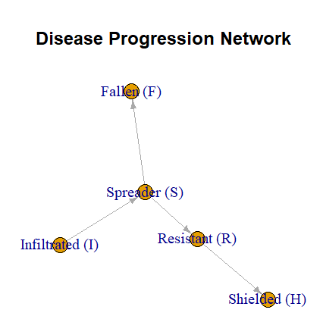
Bayesian ABM
Agent-Based Modeling: Capturing Real-World Complexity
Why ABM?
Heterogeneity: Agents have unique interactions (home/work/school/public).
Bayesian Learning: Updates β, γ as data arrives
Key Parameters
States: Shielded, Resistant, Spreader, Infiltrated, and Fallen
Transitions:
I → H: 30% (per transitionMatrix[3,4] = 0.3).
I → R: γ ~ Beta(3,7) (updated dynamically).

Slide 11
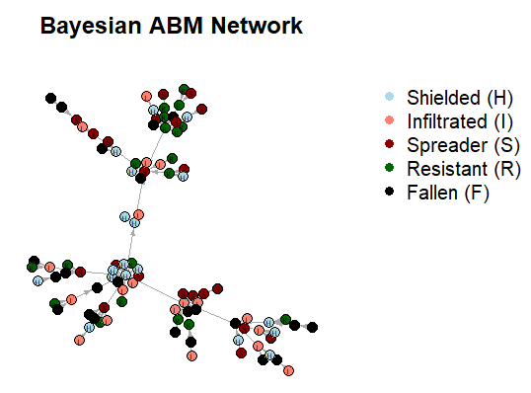

Slide 12
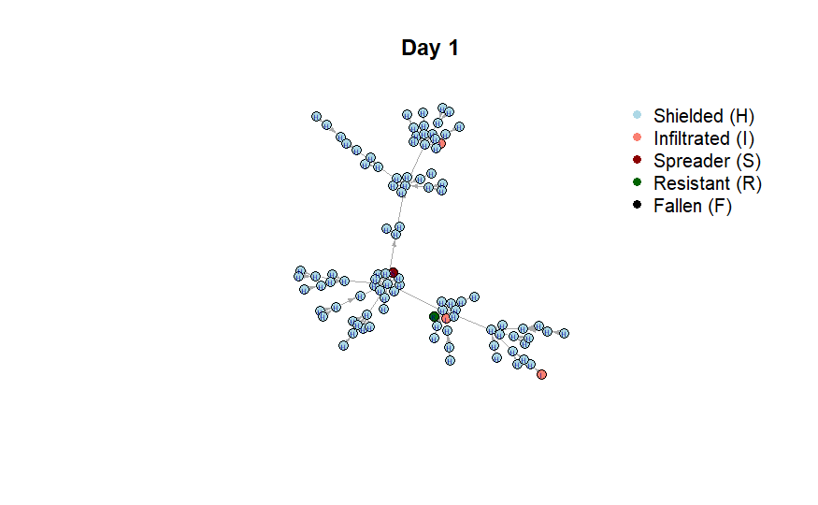
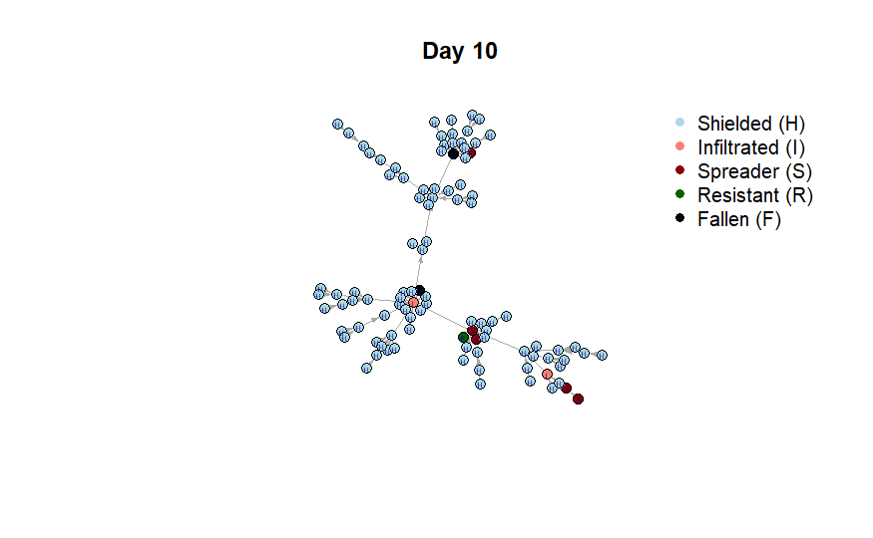

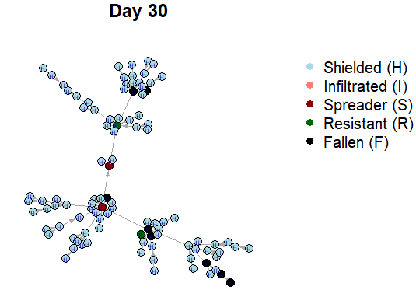

Slide 13


