Slide 1

Assessing BI Maturity and Developing a BI Dashboard for a Small Medium Enterprise (SME) in Nairobi
This presentation outlines a project aimed at assessing the Business Intelligence (BI) maturity of a Small Medium Enterprise (SME) in Nairobi and developing a customized BI dashboard to enhance their decision-making capabilities.

Slide 2
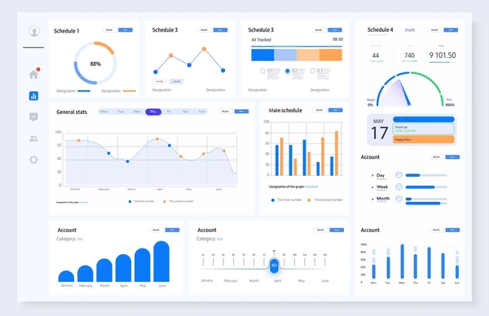
INTRODUCTION
Overview of the Project
This project aims to assess the BI maturity of a selected SME in Nairobi and develop a BI dashboard tailored to their specific needs.
Importance of BI for SMEs
Business Intelligence can significantly drive efficiency and growth for SMEs by providing valuable insights into their operations, customer behavior, and market trends.

Slide 3
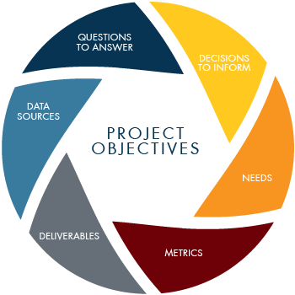

CONT’
Project Objectives
Project Scope
The project's objectives include assessing the current SME's BI maturity level, identifying key data sources, designing a BI dashboard and implementing it
The project scope will focus on the SME's data sources, BI maturity, developing a comprehensive BI dashboard, and providing training and support for the SME's staff.

Slide 4
SME SELECTION AND BUSINESS UNDERSTANDING
Description of the Chosen SME
Initial Contact and Business Understanding
SME's Industry, Target Market, and Business Processes
The chosen SME is Taifa Mobile, a telecommunications company in Nairobi. They offer a range of services, including USSD codes like \*567#, short codes, bulk SMS, send IDs, skiza, etc.
The project team conducted interviews with key personnel at Taifa Mobile to gain a comprehensive understanding of their services, customers, challenges, data storage practices, and BI knowledge.
Taifa Mobile serves a diverse clientele, including Safaricom, Aquila East Africa, County FM, West Media Ltd, and others. Their business processes focus on providing reliable and efficient telecommunications services to their target market.

Slide 5
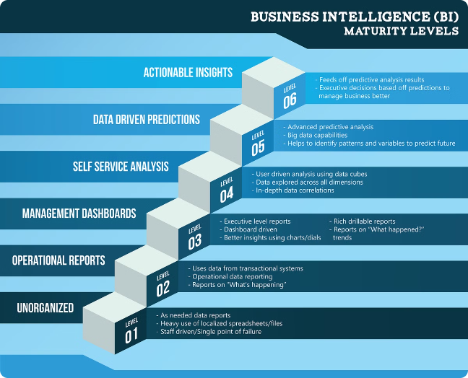
BI MATURITY ASSESSMENT
BI Maturity Model Used
The project employed a widely recognized BI Maturity Model to assess Taifa Mobile's current BI capabilities. This model provides a framework for evaluating the organization's maturity level in terms of data management, analysis, and reporting.
Methodology (Interviews, Surveys)
The assessment involved an interview with key employees to gather data on Taifa Mobile's BI practices, processes, and tools.
Key Findings and Gap Analysis
The assessment revealed that Taifa Mobile has a low BI maturity level, with gaps in data management, analysis, reporting, and no knowledge of BI.

Slide 6



DATA IDENTIFICATION AND ANALYSIS
Relevant Data Sources Identified
Key Trends, Patterns, and KPIs
Data Analysis Insights
The analysis provided valuable insights into Taifa Mobile's customer behavior, service performance, and financial performance.
Bulk SMS, cash flow, customer balances, customer invoices, supplier invoices, IT records.
The analysis identified key metrics and patterns in the data, such as customer churn rates, revenue trends, and service usage patterns.

Slide 7
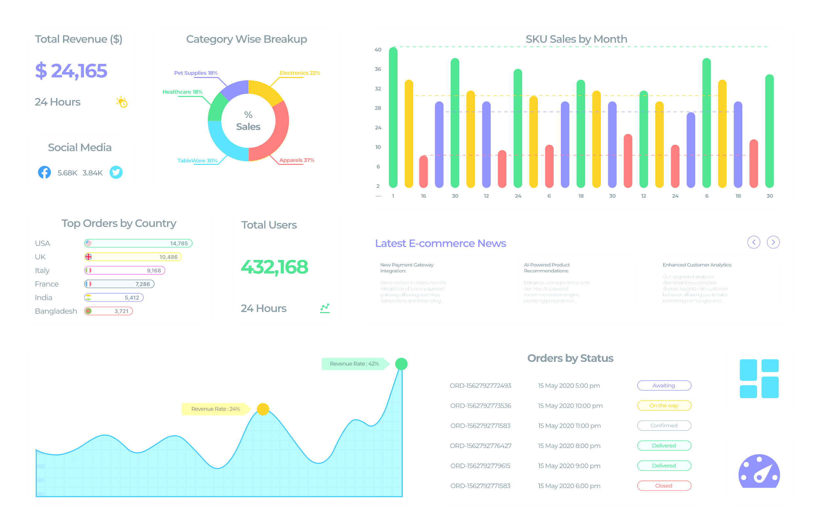
BI DASHBOARD DESIGN
Overview of the Dashboard Design
The BI dashboard was designed to provide a comprehensive and user-friendly overview of Taifa Mobile's key performance indicators (KPIs) and business trends.
Chosen BI Tools and Technologies
The project team selected industry-leading BI tools like Power BI and technologies to develop the dashboard, ensuring its functionality, scalability, and ease of use.
Key Features and Functionalities
The dashboard will include interactive visualizations, like charts, graphs, and tables to provide users with a detailed understanding of the data.

Slide 8
1
Steps for Implementing the Dashboard
The dashboard was implemented in phases, starting with data integration and visualization.
Reporting
2
IMPLEMENTATION PLAN
We reported our findings and presented the work to Taifa Mobile's staff.
Recommendations
3
The project team provided recommendations, such as training sessions for Taifa Mobile's staff on how to use the BI dashboard effectively.

Slide 9

Overview of the User Guide
USER DOCUMENTATION AND MANUAL
We provided a comprehensive user manual guide to using the BI dashboard, covering its features, functionalities, and navigation.
Instructions for Using the Dashboard
The manual includes step-by-step instructions on how to use the dashboard, navigate its various sections, like data filtering and drill-down capabilities, and interpret the data visualizations.
Troubleshooting Tips
The manual also includes troubleshooting tips to help users resolve common issues and provide solutions to maximize their experience with the BI dashboard. For example, dashboards not loading.

Slide 10



FEEDBACK AND FUTURE RECOMMENDATIONS
Future Recommendations for BI Development
Feedback from Taifa Mobile
Additional BI Tools and Techniques Suggested
Based on the feedback and the project's findings, the team provided recommendations for further enhancing Taifa Mobile's BI capabilities like data integration, advanced analytics and predictive modeling.
The team suggested additional BI tools and techniques that could be explored to further optimize Taifa Mobile's data analysis and decision-making processes.
The project team received valuable feedback from Taifa Mobile on the BI dashboard, highlighting its strengths and areas for improvement.

Slide 11

LIVE DEMONSTRATION
The presentation concludes with a live demonstration of the BI dashboard, showcasing its key features and functionalities. The demonstration will highlight how the dashboard can be used to make informed decisions based on real-time data insights.

Slide 12
GROUP MEMBERS
Sharon J Nalubiri — 666248
1
Sharon Kendi — 666503
2
Rachael Nderitu — 666062
3
Rodrigue Irampa — 666252
4
Michael Vukasu — 667866
5

