Slide 1
Credit Default Risk Scoring
Building a credit loan score from the UCI credit card default dataset
Chris Tchinda
May 2026

Slide 2
Agenda
01
Problem & Dataset
What we are trying to solve and the data we use
02
Exploratory Analysis
Key patterns in repayment, utilization, and demographics
03
Data Cleaning & Features
How we prepared the data and built risk signals
04
Modeling
Comparing models and selecting the best one
05
Credit Score & Risk Bands
Turning probabilities into an actionable score
06
Calibration
Making sure the probabilities are reliable
07
Results & Takeaways
Final performance and what it means

Slide 3
Problem Statement
Goal
Build a credit loan score that predicts whether a client will default on their next payment. The score should be transparent, reliable, and designed to support a simple approve / review / reject policy prototype.
Why it matters
A good credit score helps the bank decide who to lend to. It reduces losses from defaults while keeping the approval rate reasonable. The score needs calibrated probabilities so the bank can set thresholds based on their risk appetite.
Approach
Explore the data, clean it carefully, engineer features based on credit risk logic, compare several models, calibrate probabilities, and convert them into a score with risk bands.

Slide 4
Dataset Overview
30,000
23
22.1%
0
Clients
Features
Default Rate
Missing Values
Feature Groups
Credit Limit (X1)
Total credit line including family supplementary credit
Demographics (X2-X5)
Gender, education, marital status, age
Repayment History (X6-X11)
Monthly repayment status from April to September 2005
Bill Amounts (X12-X17)
Monthly bill statement amounts over the same 6 months
Payment Amounts (X18-X23)
Monthly amounts paid over the same 6 months
Target
Binary default indicator (1 = default next month, 0 = no default)

Slide 5
Exploratory Analysis: Key Findings
Repayment Status is the #1 Signal
Delinquency Frequency Matters
Clients with PAY_0 >= 2 (two months late) have a 69% default rate vs. 13% for those who pay on time. This is the single strongest predictor.
Counting months with delays is more stable than just looking at the latest status. Clients with 6+ late months default at 70%.
Lower Credit Limits = Higher Risk
22% Default Rate = Imbalanced
Clients in the bottom credit-limit decile default more often. The credit limit already encodes part of the bank's risk assessment.
Accuracy is misleading here. A dummy model that always predicts 'no default' gets 78% accuracy. We need PR-AUC, recall, and F1.
High Correlation Among Bills
Undocumented Category Codes
Adjacent monthly bill amounts are correlated at 0.95 because balances roll over. This affects linear models and interpretation.
EDUCATION has 345 rows with codes outside 1-4, MARRIAGE has 54 rows outside 1-3. We group them as 'other/unknown' instead of dropping.

Slide 6
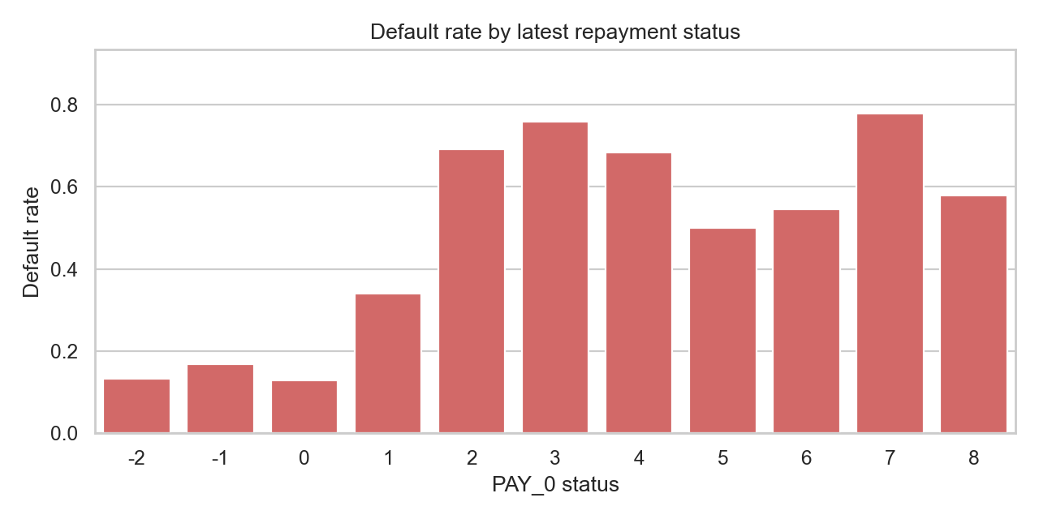
Default Rate by Repayment Status (PAY_0)
Key Insight
The most recent repayment status is the strongest single predictor of default. Clients who are 2+ months late have a default rate above 69%, compared to about 13% for those who pay on time.
This motivated us to build aggregated repayment features (delinquency count, max delay, severe delinquency months) that capture this signal in a more stable way.

Slide 7
Data Cleaning & Preparation
Our cleaning philosophy: keep all 30,000 rows and preserve information, not throw it away.
No rows dropped
All 30,000 observations are kept. Rare codes and edge cases might carry risk signal, so removing them would lose information.
Undocumented codes grouped
EDUCATION codes 0/5/6 and MARRIAGE code 0 are mapped to 'other_unknown' instead of being treated as missing data.
Negative bills flagged, not removed
1,930 rows have negative bill amounts. These represent credits or adjustments. We keep the raw values and add binary flags.
Bills above limit flagged
3,931 rows have bills exceeding the credit limit. Instead of dropping them, we flag them as a utilization-stress signal.
No leakage in preprocessing
Scaling, encoding, and feature selection are learned only on training data inside pipelines. Nothing is fitted on validation or test data.

Slide 8
Feature Engineering
We went from 25 raw columns to 63 modeling features. The idea was to translate raw credit data into features that reflect how credit risk analysts actually think about risk.
Repayment Behavior
Utilization Ratios
Recent delay status, max delay, delinquency count, severe delinquency months, months paid duly
Bill-to-limit ratios (per month), max utilization, mean utilization, bills above limit indicator
Payment Capacity
Accounting Flags
Payment-to-bill ratios, payment-to-limit ratios, total payment amount, zero-payment months count
Negative bill months, non-positive bill months, months revolving credit, months with no consumption

Slide 9
Modeling Approach
Train / Validation / Test Split
Train 70% (n=21,000)
Validation 15% (n=4,500)
Test 15% (n=4,500)
All splits are stratified to preserve the 22.1% default rate.
Models Compared
Dummy Baseline
Always predicts majority class. Used as a sanity check.
Logistic Regression (L2)
Simple linear model. Good baseline for interpretability.
Random Forest
Bagging ensemble with balanced class weights.
Hist Gradient Boosting
Sklearn's fast gradient boosting with balanced weights.
XGBoost
Gradient boosting with scale_pos_weight for class imbalance.
LightGBM
Fast gradient boosting with balanced class weights.
CatBoost (3 variants)
Handles categorical features natively. Plain, balanced, and sqrt-balanced.

Slide 10
Validation Results: Model Comparison
Selection Logic
We selected the model based on validation PR-AUC, because defaults are the minority class and we care about catching them.
CatBoost Plain wins with PR-AUC = 0.579 and the best Brier score (0.130), meaning its probabilities are also well calibrated out of the box.
The threshold was then tuned on validation F1 (not fixed at 0.50). Best threshold: 0.30, which improves recall from 37% to 54%.
PR-AUC is the main metric because accuracy alone is misleading with 22% default rate.

Slide 11
Top 10 Feature Importances
What This Tells Us
Repayment behavior dominates.
The top 3 features are all related to past payment delays. This confirms what the EDA showed: how a client has been paying is the strongest predictor of whether they'll default.
Credit limit and amounts matter too.
LIMIT_BAL and BILL_AMT1 appear in the top 6, showing that exposure and balance size carry useful signal.
Engineered features rank high.
Features we built (delinquency_months, severe_delinquency_months, mean_positive_delay) are in the top 10, validating our feature engineering.

Slide 12
Final Test Set Results
CatBoost Plain, retrained on Train + Validation, evaluated once on the held-out test set.
0.789
0.573
0.133
0.549
ROC-AUC
PR-AUC
Brier Score
F1 Score
Good ranking ability
Strong for imbalanced data
Well-calibrated probabilities
Balanced precision/recall
Confusion Matrix (threshold = 0.30)
Reading the Matrix
 | Predicted No Default | Predicted Default
Actual No Default | 3,072 | 433
Actual Default | 455 | 540
We correctly identify 540 out of 995 defaulters (54.3% recall) while keeping precision at 55.5%.
The lowered threshold (0.30 vs 0.50) catches more true defaults at the cost of some extra false alarms, which is the right trade-off for a credit risk application.

Slide 13
Credit Score Construction
Score Scale
We use a traditional odds-based score scale, similar to FICO scoring methodology. The base score (600) is set at the portfolio default rate. Points-to-double-odds (PDO) = 50, meaning every 50 extra points doubles the odds of being a good client.
Score = Offset + Factor x ln( Good / Bad Odds )
Base Score = 600 | PDO = 50 | Factor = 72.1 | Offset = 509.2
Risk Bands (Test Set)
Risk Band | Score Range | Default Rate | Decision | Share
A - Very Low Risk | 688 - 773 | 4.9% | Approve | 19%
B - Low Risk | 656 - 687 | 9.1% | Approve | 20%
C - Medium Risk | 625 - 655 | 15.3% | Approve | 21%
D - High Risk | 561 - 624 | 24.5% | Manual Review | 20%
E - Very High Risk | 350 - 560 | 57.0% | Reject | 20%

Slide 14
Probability Calibration
Why calibrate?
The credit score is built from predicted default probabilities, so these probabilities need to be reliable. If the model says 20% default probability, roughly 20% of those clients should actually default. We tested multiple calibration approaches to check and improve this.
What we tested
Raw models
CatBoost, LightGBM, Logistic Regression without any post-hoc calibration
Sigmoid (Platt)
Fits a logistic curve to map raw outputs to calibrated probabilities
Isotonic regression
Non-parametric mapping, more flexible but can overfit on small samples
Result
CatBoost Plain (raw) was already well calibrated, with an expected calibration error (ECE) of just 0.009 on the test set. Sigmoid and isotonic calibration did not improve it significantly. We still built a calibrated score pipeline as a safety net, but in this case the raw model probabilities were already reliable.

Slide 15
Key Decisions & Assumptions
Keep all rows
PR-AUC over accuracy
Rare categories and edge cases may contain risk signal. Dropping rows loses information and biases the sample. We flag anomalies instead of removing them.
With 22% defaults, accuracy is misleading. PR-AUC directly measures how well we catch defaulters with high confidence.
Tune threshold on validation F1
Retrain on train+validation for test
The default 0.50 threshold is not optimal for an imbalanced problem. Tuning it on validation data gives better recall without overfitting to the test set.
Once the model and threshold are chosen, we retrain on all non-test data to maximize the information available to the final model.
Simple initial policy
Odds-based score with PDO=50
The approve/review/reject cutoffs are starting rules. In production, they would be tuned based on the bank's loss function and risk appetite.
This is standard in the credit industry. It makes the score interpretable: every 50 extra points means the client is twice as likely to be good.

Slide 16
Summary & Takeaways
30K rows
63 features
CatBoost
Calibrated
Score
→
→
→
→
Raw data
Engineered
Best model
Probabilities
350-773
Key Results
ROC-AUC of 0.789 and PR-AUC of 0.573 on the test set
Well-calibrated probabilities (ECE = 0.009) without post-hoc adjustment
Score range 350-773 with monotonic default rates across 5 risk bands
Simple policy: 60% approved (10% default rate), 20% manual review, 20% rejected
Repayment behavior is the dominant risk factor, confirming domain intuition
All preprocessing inside pipelines, no data leakage, reproducible workflow

Slide 17
Thank You
Chris Tchinda | chrisdonald.tchinda@ensae.fr

