Slide 1
COVID-19 TIMESERIES FORECASTING on vaccination data with deep learning
Eric Rodriguez
4/19/21
Notes:
Good afternoon my name is eric rodirguez, I’m a consultanted hired by the mass department of health to perform covid 19 times eries modeling on vaccination data

Slide 2
TABLE OF CONTENTS
01.
02.
03.
04.
INTRODUCTION
METHODOLOGY
RESULTS
CONCLUSION

Slide 3
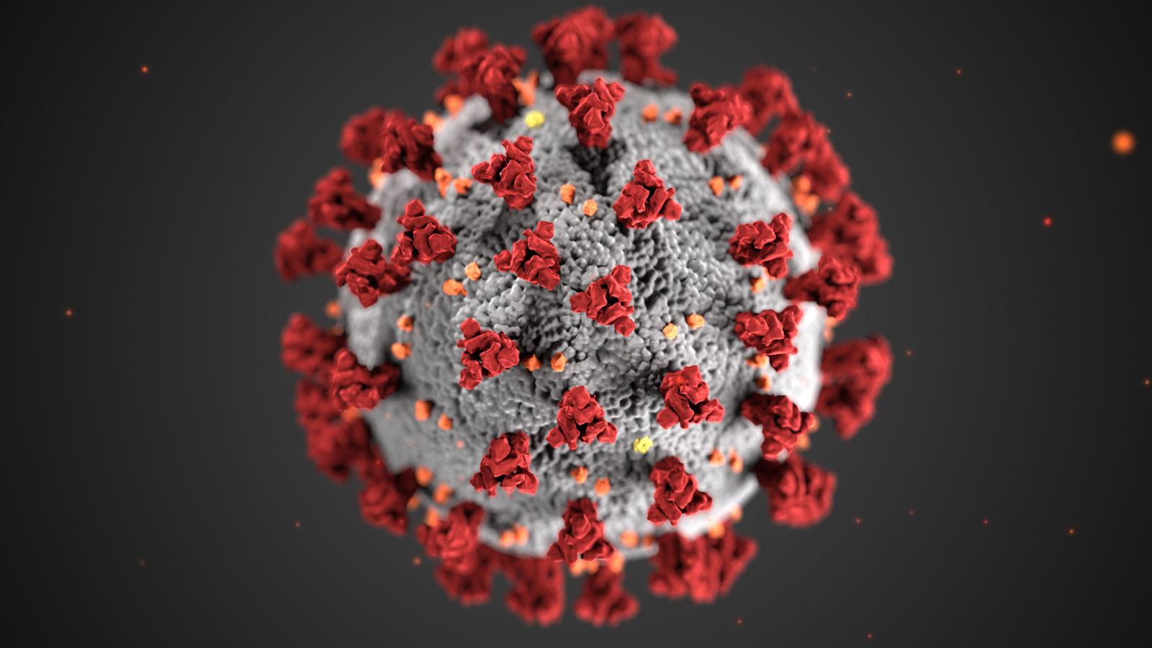
01.
INTRODUCTION

Slide 4
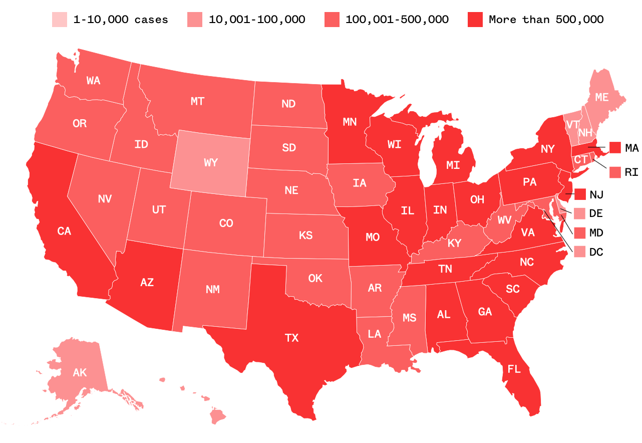
INTRODUCTION
The COVID-19 pandemic prevails as an ultimatum to the global economic growth and the wellbeing of society
The global spread of COVID-19 is increasing day by day, creating a larger risk of disease or death as well as a strain on the economy¹
Notes:
31.7 million covid cases in the US – 141 million worldwide
567 thousands deaths – 3 million world wide
Large strain on US as wella s g.obal economy
Global spread continues to go up

Slide 5
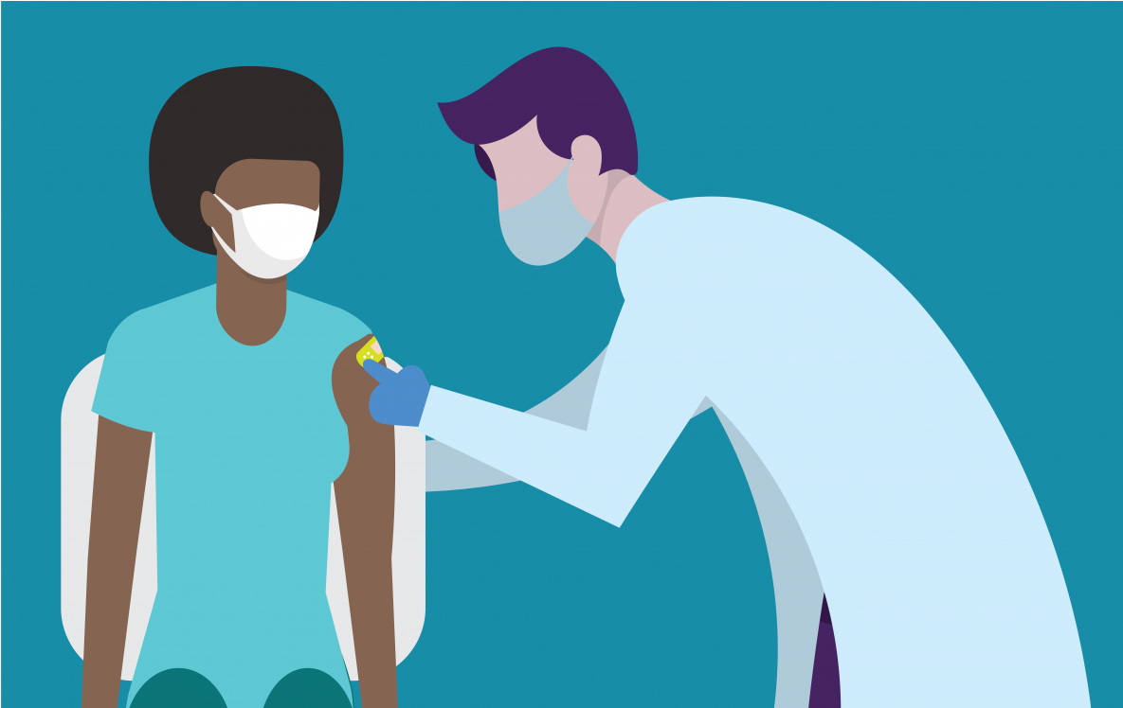
Vaccines!
There are currently three vaccines that have received emergency authorization from the FDA²
Pfizer
Moderna
Johnson & Johnson*
Notes:
BUT HAVEN O FEAR! Vaccines are here!!!
At the time of the creation of the slide there were 3 vaccines that
- Recently JOHN and j was put on hold, but regardless, stil was authorized

Slide 6
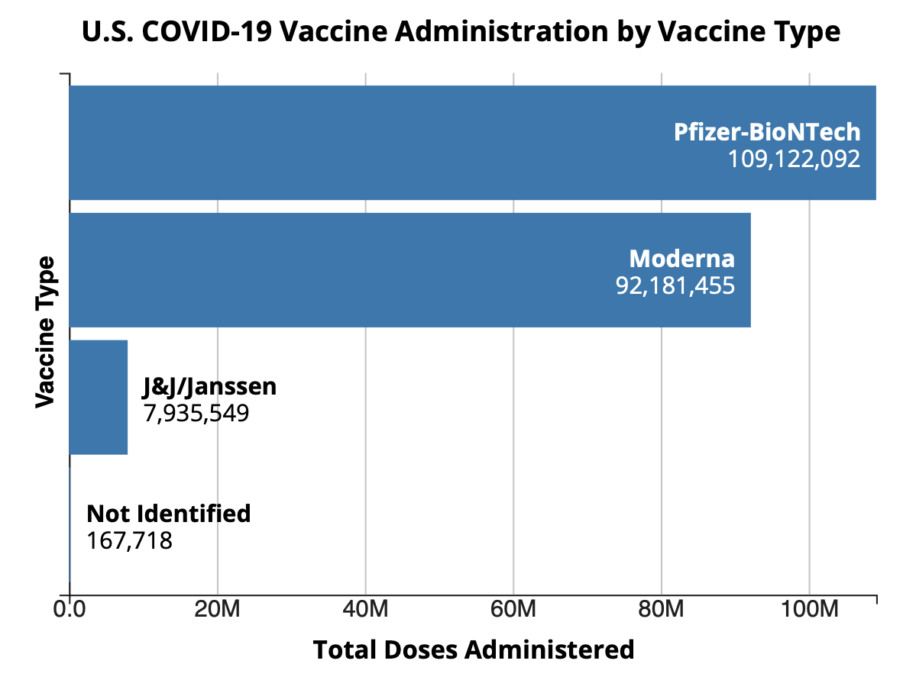
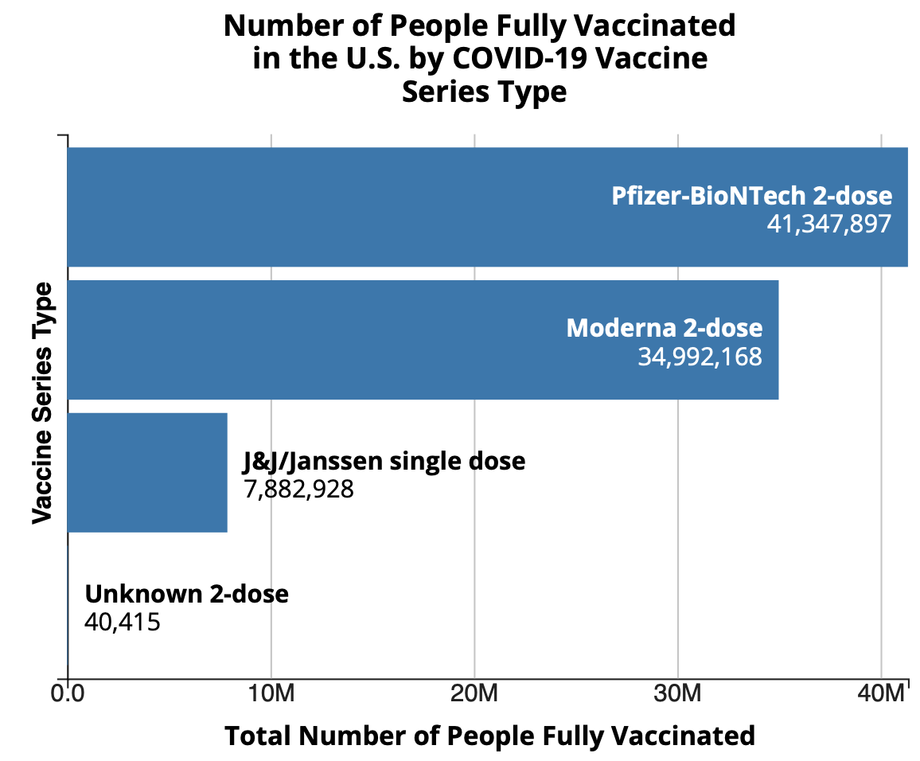
DNA
RNA
Total doses administered as of 4/18/21¹
Number of people fully vaccinated as of 4/18/21¹
Notes:
As of 4/18/21, according to the CDC, 25% of the US adults are fully vaccinated! Which is very excited and really important because the key to returning back to “normal” life is ensuring tha thte vast majority of the population is vaccinated and can’t get covid
https://covid.cdc.gov/covid-data-tracker/#vaccinations

Slide 7
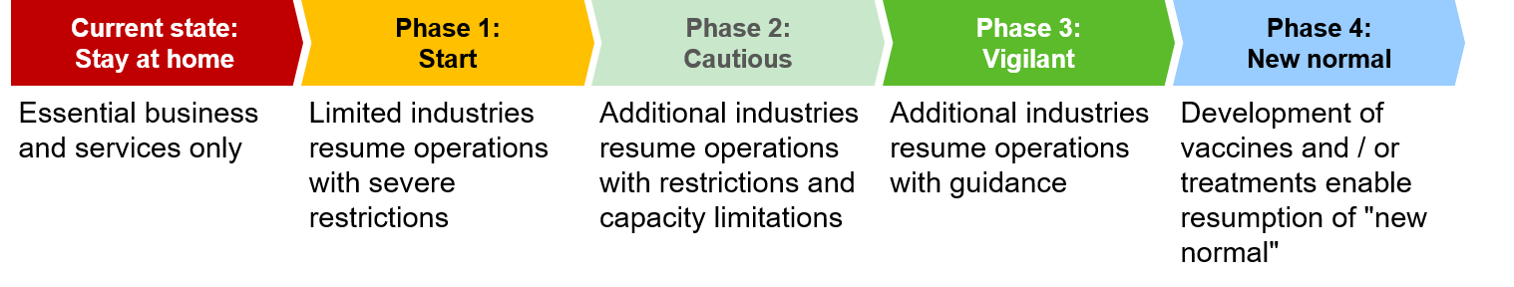
Massachusetts Reopening Plan
³
Can one week worth of total covid vaccination data be predicted with a lower RMSE than a baseline?
Notes:
673 thousand cases in. Massachusetts
17,462 deaths
30% of adults in mass have been vaccinated, which means they are doing beter than the national average
We are in stage 4 in the new normal
But, there are still a multitude of restirctions on business and on individuals who live in MA, with little guidance as to when things will be opening up more. If we were to be able to predict this data, the state of mass could give more concrete guidance to businesses and citizens in thes tate so that they can prepare for various reopenings
The state of mass want’s to know – can we predict two weeks worth fo daily covid vaccination data with an accuracy score of 80%. And we’re going to see if we can use RNN to answer that question

Slide 8
02.
Methodology

Slide 9
Methodology
Data Import
EDA
Pulled from “Our World in Data” github repository⁴
Data checked for missing values, autocorrelation, stationarity
Pre-processing
Models
Data set up in three dimensions to be processed by RNN
Three LSTM RNN models with different hyperparameters
Notes:
This repository contained data from the CDC as wellas jHU
EDA – values in the beginning dropped – row values predicted
Data set up properly in pre processing
Ran three types of models –
As areminder recurrent neural. Netwrorks ,or RNNs, are networks where connections between nodes form a directed graph along a temporal sequence. This allows it to exhibit temporal dynamic behavior.
Gated recurrent units, or GRU is an RNN architecture that introduces a memory unit, and long shor tterm memory or LSTM is an RNN architechture that introduces additional gates
The reason the altter two were created, is because it can be difficult for RNN model to learn to preserve information over many timesteps, and so gru/lstm were created as a solution to this problem, which is known as a vanishing gradient

Slide 10
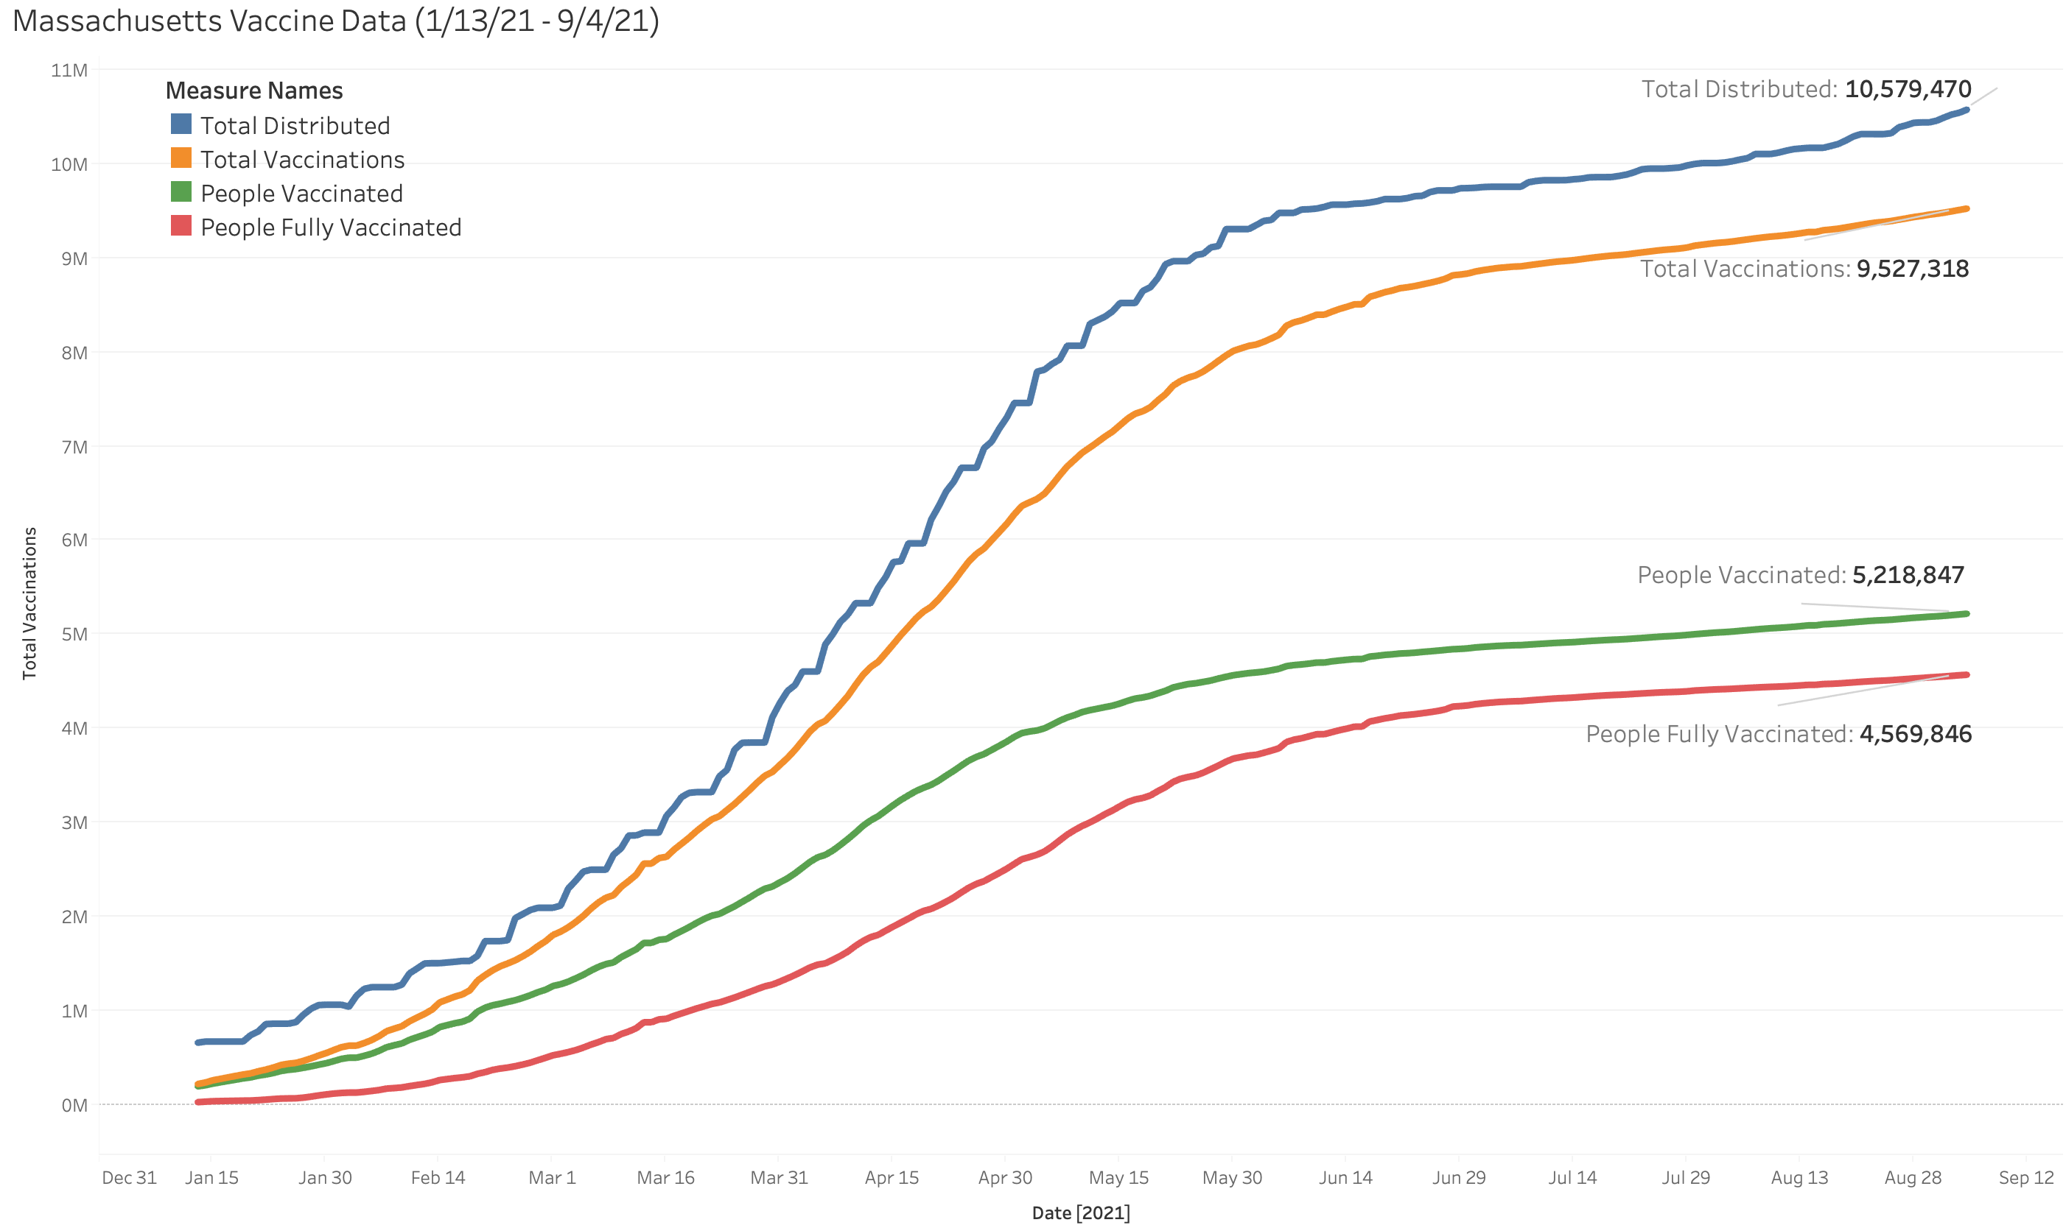
Massachusetts Vaccinations
MERCURY
SATURN
You can edit this graph
JUPITER
Edit the data on the sheet
Notes:
Vaccinations in ma have just surpassed 90k a day, and clearly has an upward trend
Stationary with a difference of 1 – but the models weren’t any better really, so went with undifferenced data

Slide 11
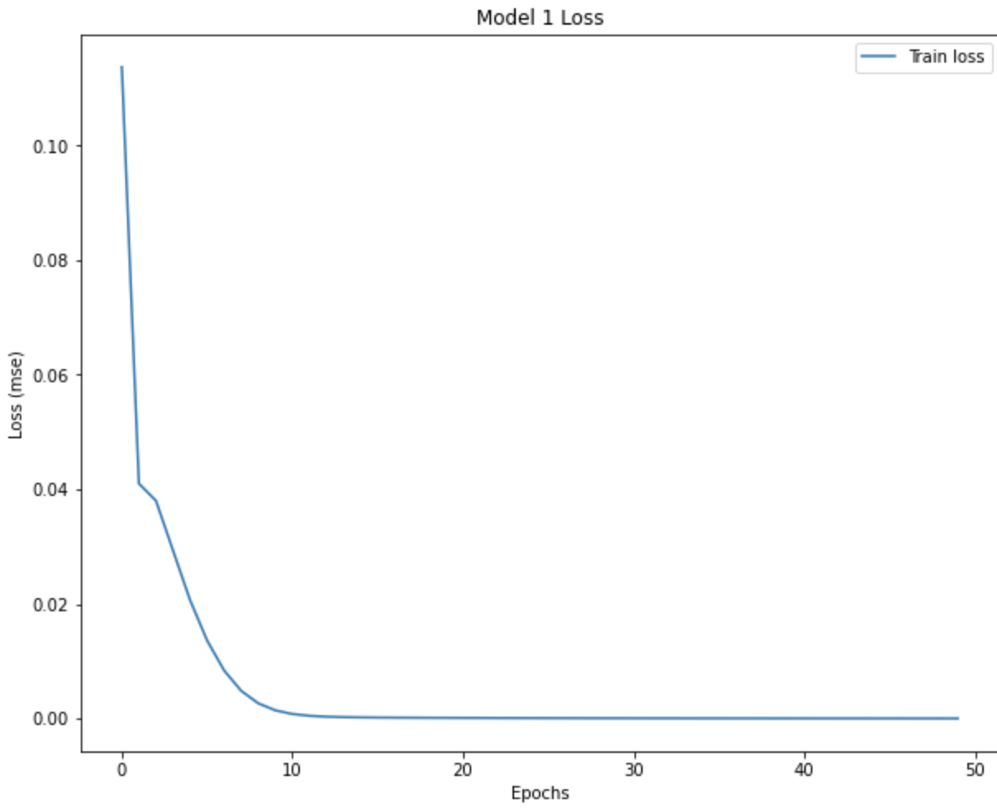
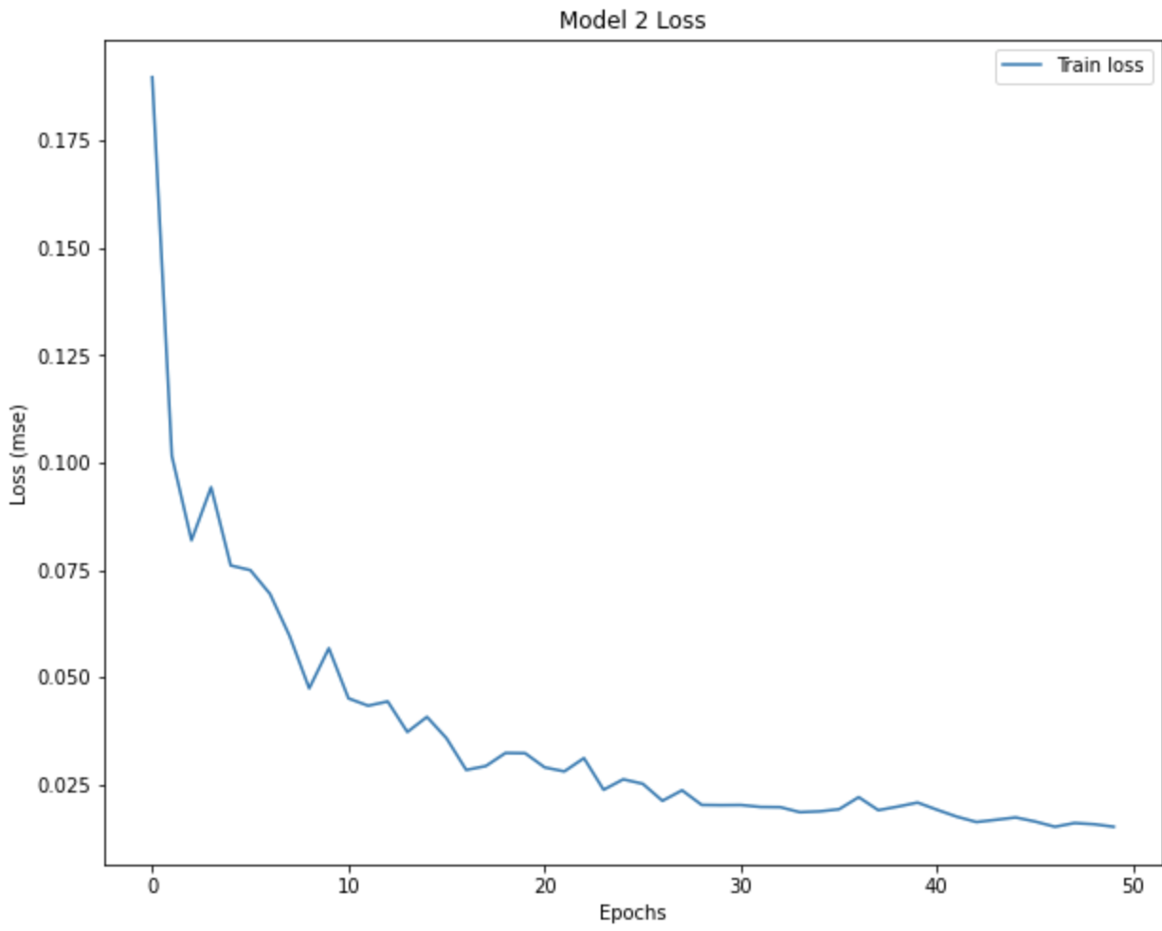
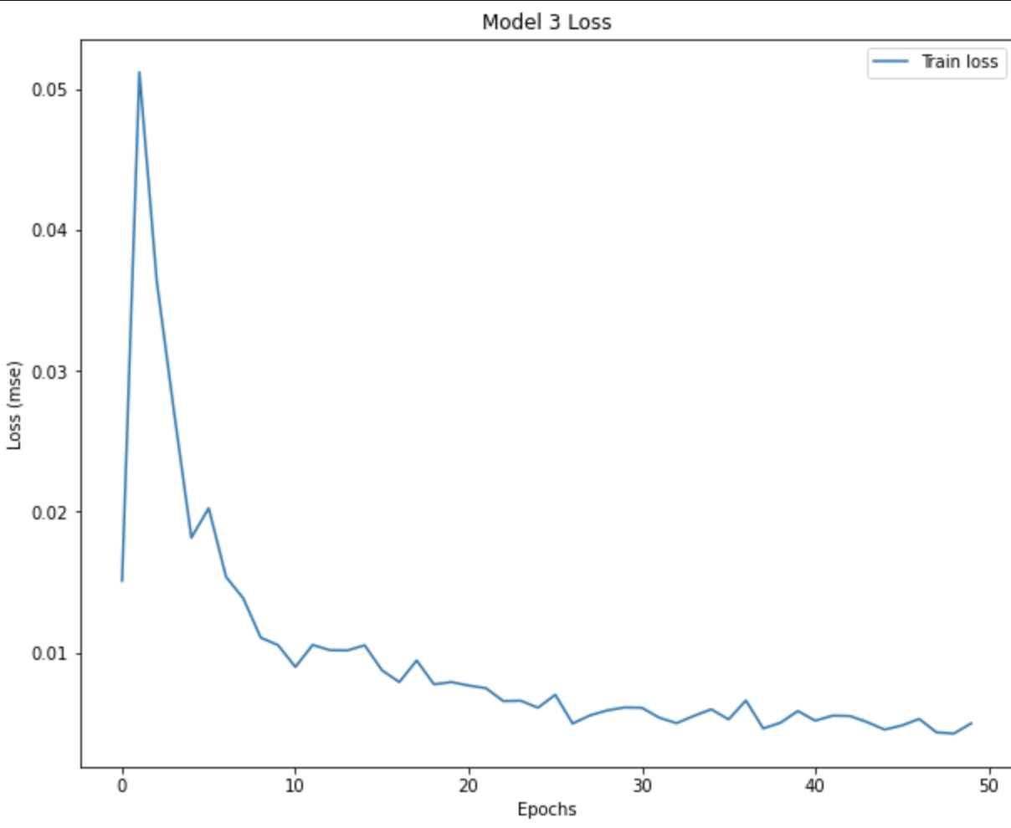
03.
Results
Notes:
These are the loss graphs of the three models that were fit
Hyperparameters were gridsearched, model one is the simplest, with model 2 and 3 having higher number of neurons ,as wella s dropout values of .8
And when created networks that had only one layer, they performed better

Slide 12
Root Mean Squared Error and MAPE
 | One-Step RMSE MAPE |  | Multi-Step RMSE MAPE
Model 1 | 4917.93 | 0.04% | 13999.36 | 0.12%
Model 2 | 105338.02 | 1.11% | 458262.63 | 4.32%
Model 3 | 138232.56 | 1.46% | 532559.40 | 5.09%
Notes:
OVERFIT

Slide 13
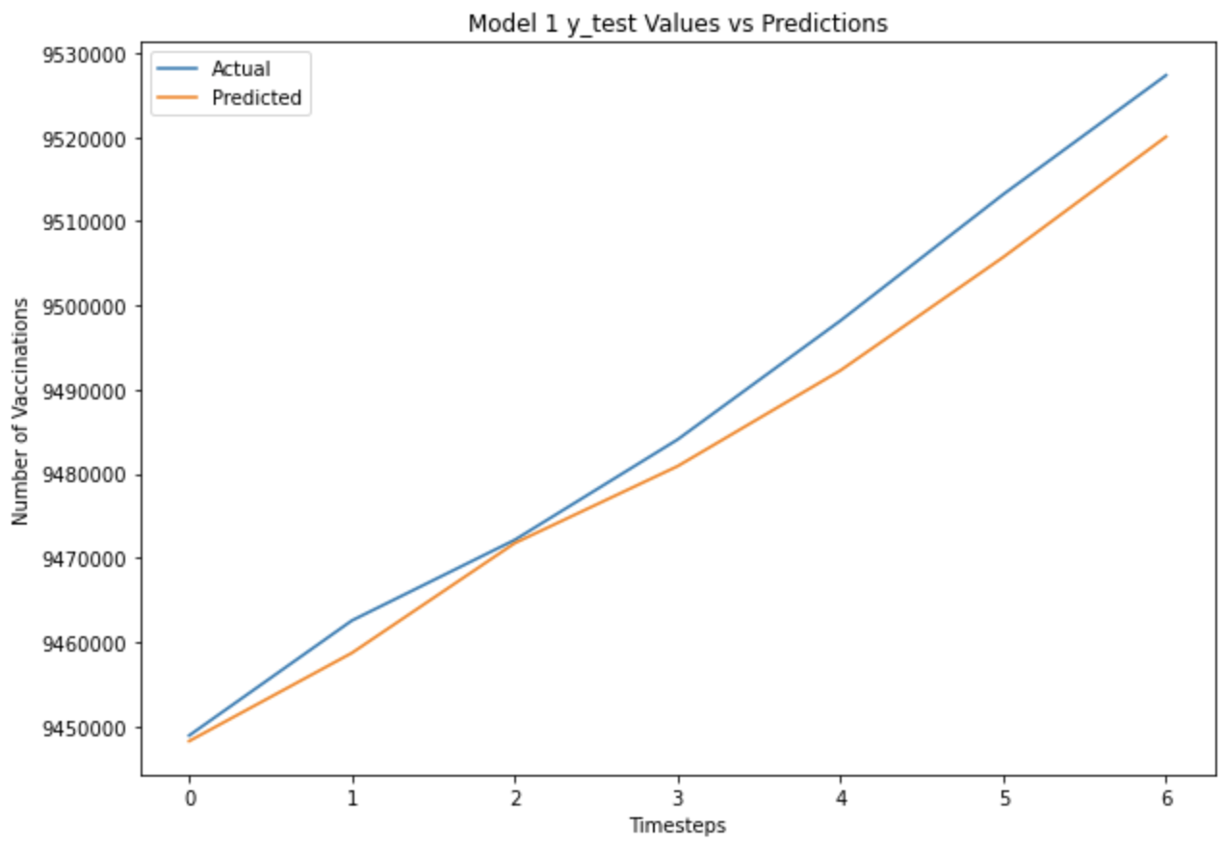
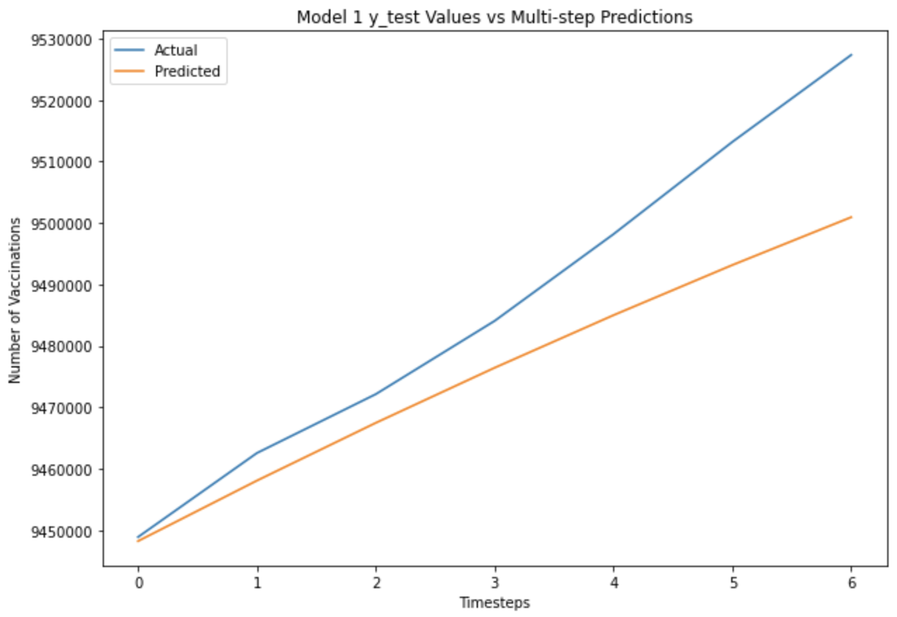
Model 1 Seven-Day Forecast

Slide 14
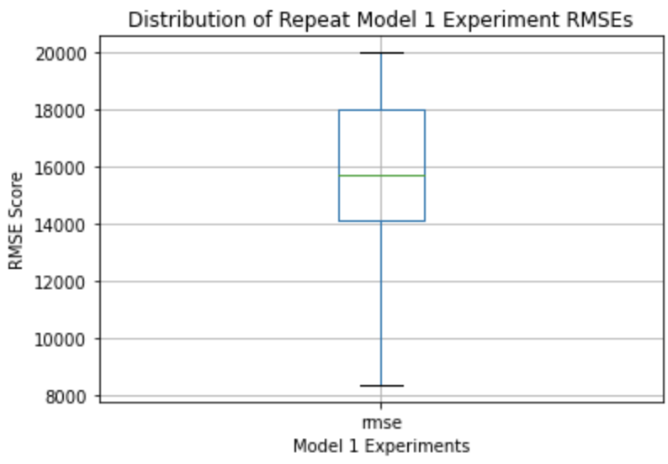
What If We Repeat The Forecast?

Slide 15
04.
Conclusion

Slide 16
Conclusions
Future Work
LSTM RNNs can be used to perform timeseries forecasting on vaccination data
The simplest model worked the best, most likely because of the size of the data set
Differenced Data
Multivariate Model
Larger Windows/Timesteps
Streamlit that updates weekly to visualize predictions

Slide 17
Citations
https://covid.cdc.gov/covid-data-tracker/#datatracker-home
https://www.fda.gov/vaccines-blood-biologics/vaccines/emergency-use-authorization-vaccines-explained
https://www.mass.gov/info-details/reopening-massachusetts
https://github.com/owid/covid-19-data

Slide 18
THANKS!
Do you have any questions?
Rodriguez.n.eric@gmail.com
703-380-7619
RodriguezNEric.github.io

