Slide 1
How do economic factors affect visitors of theme parks?
Rodrigo Vilar
Economic study about Disney World’s parks Visitors

Slide 2
Content:
1. Questions & hypothesis
2. Approach and analysis
3. Limitations
4. Q1. Unemployment
5. Q2. Interest Rate
6. Q3. Inflation
7. Q4. Share price
8. Q5. Park differences
9. Q6. Family and Thrill rides
10. Results

Slide 3
Questions and Hypothesis
Questions to be answered:
1. Is Unemployment related to Disney World visitors?
2. Is Interest rate related to Disney World Visitors?
3. Is Inflation related to Disney World Visitors?
4. Is the Disney company share price related to Disney World Visitors?
5. Are the parks having differences in how this affect them?
6. Are these economic factors affect families more than other groups of travelers?
Hypothesis:
1. Yes, unemployment is one of the factors that affects people’s decision
2. I believe it would be a determinant for people’s decision
3. Answered in 2
4. Since it is a highly diversified company, the share price should not be highly affected by how many visitors the theme parks division has.
5. I believe Magic Kingdom will have more noticeable changes
6. Family travelling involves higher expenses which makes them more responsive to economic factors

Slide 4
Approach and analysis
Data downloaded from Touringplans.com, FRED and NASDAQ
Data cleaned and compiled in one file
Graphical data visualization implemented

Slide 5
Limitations
Wait times might be influenced by other factors (closures, change in operations)
Walt Disney Company's stock price may be influenced by external factors beyond the performance of its theme park division
There is some data missing from certain months, especially during the COVID-19 Pandemic.

Slide 6
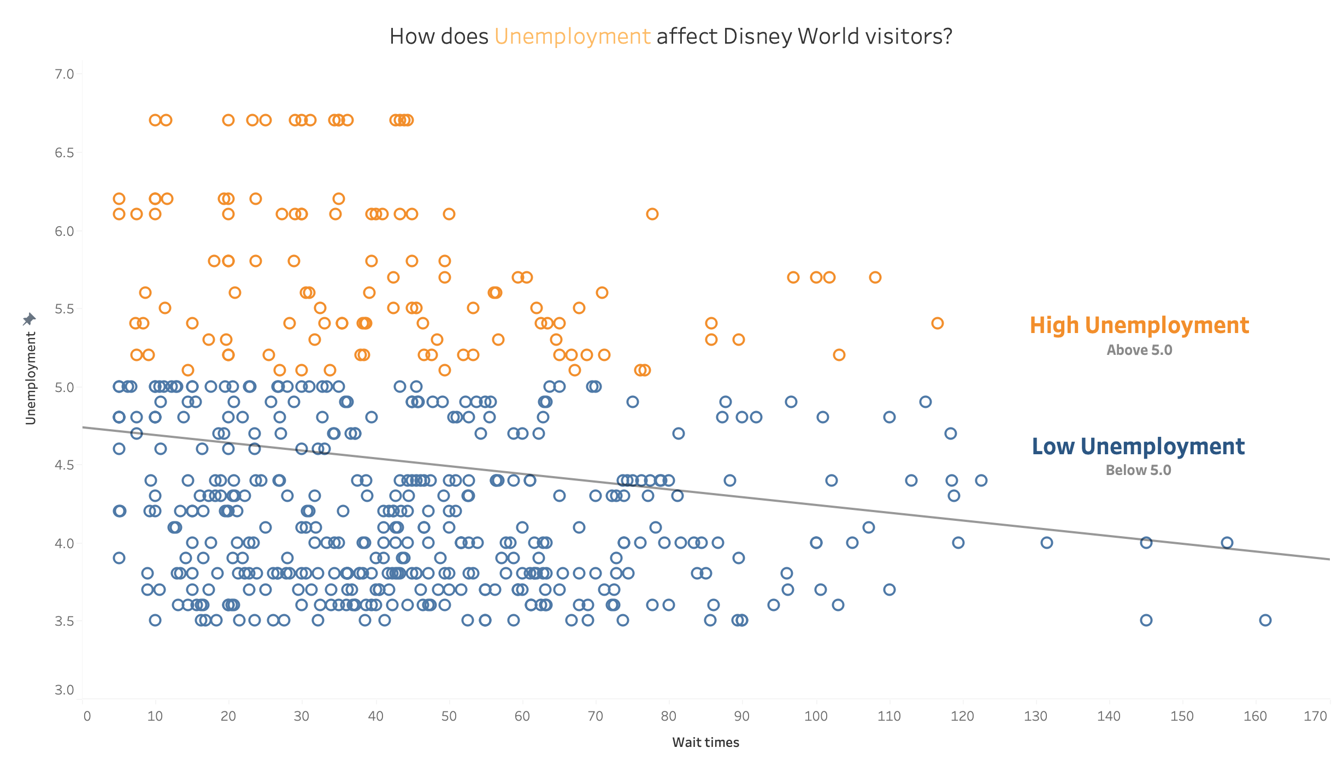
Q1: Unemployment
the trend line showed a noticeable relationship, the correlation was not strong enough to make significant assumptions.

Slide 7
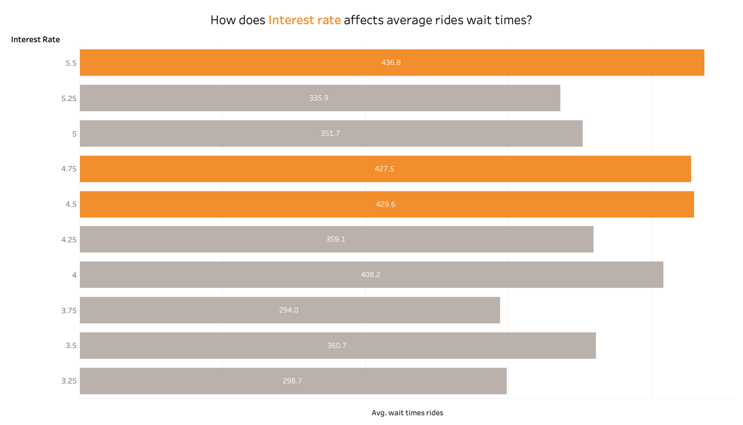
Q2: Interest rate
There is an inverse relationship between the interest rate and the average ride wait times. The data shows that a 5.5% interest rate resulted in the highest average ride wait times, even though it was the highest interest rate in the study.

Slide 8
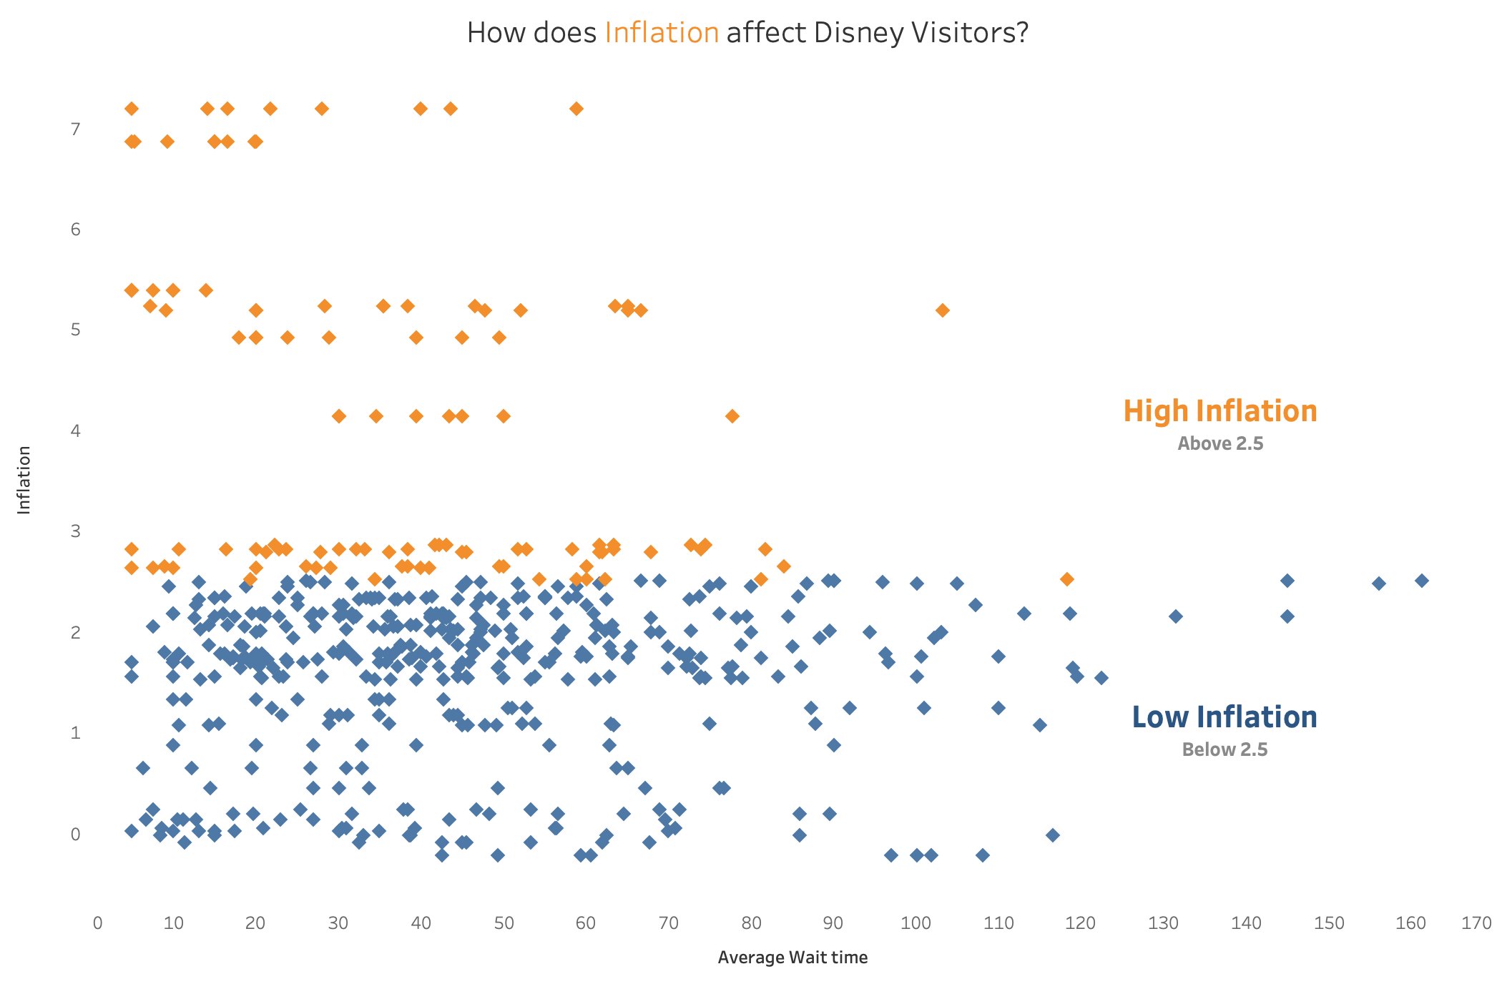
Q3: Inflation
The correlation seems to be present, but in a small way. It could have an effect, but not in an abrupt manner.

Slide 9
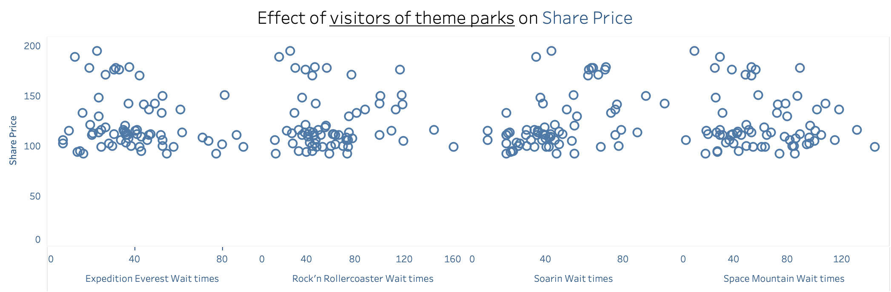
Q4: Share price
There is no relation between Disney visitors and the share price

Slide 10
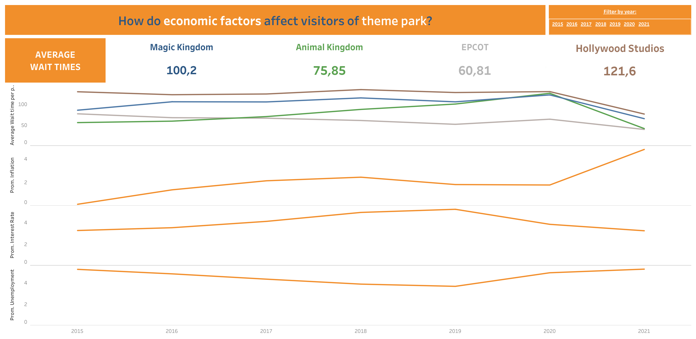
Q5: Park differences
Comparing the different parks, it appears that economic factors are impacting Animal Kingdom more significantly.

Slide 11
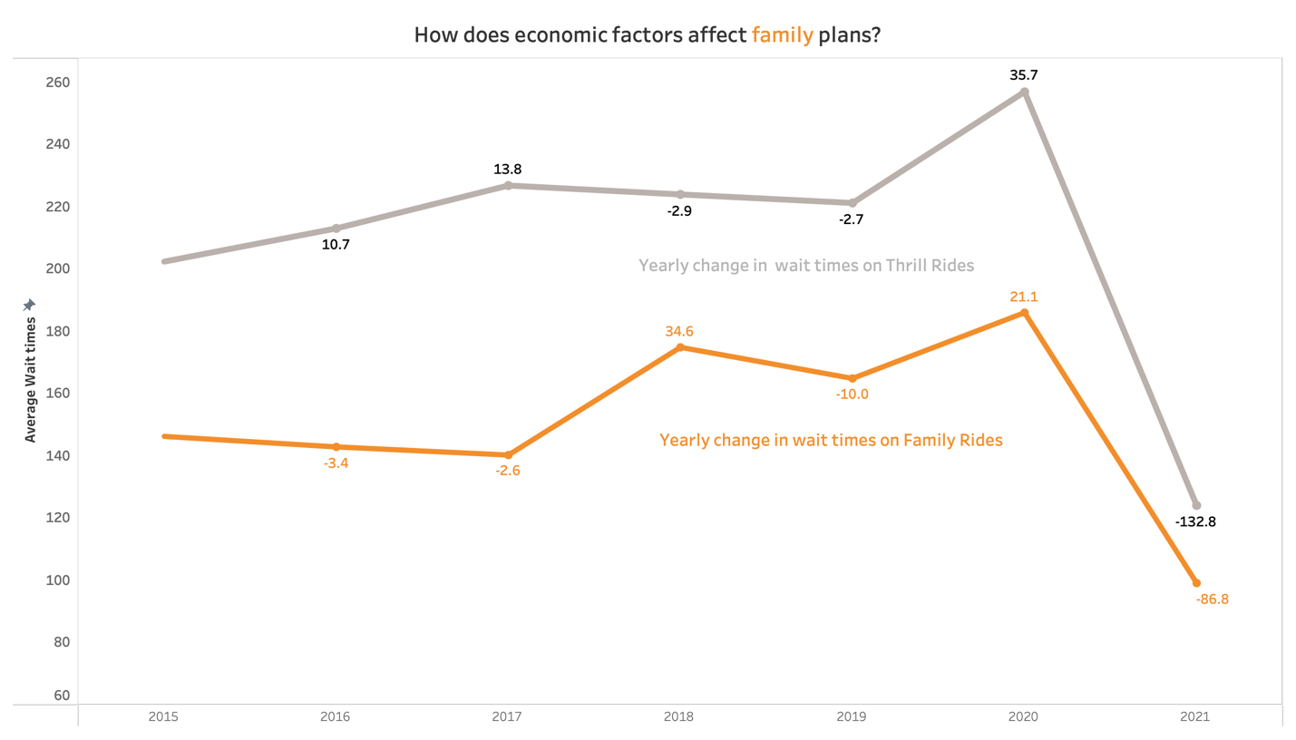
Q6: Family and Thrill rides
The graph shows that the economic downturn in 2021, following the pandemic, has had a more severe impact on wait times for thrill rides.

