Slide 1
Lecture Notes on Mathematical Morphology: Binary Images

Slide 2
What is Mathematical Morphology?
It is:
nonlinear,
built on Minkowski set theory,
part of the theory of finite lattices,
for image analysis based on shape,
extremely useful, yet not often used.

Slide 3
Uses of Mathematical Morphology
image enhancement
image segmentation
image restoration
edge detection
texture analysis
particle analysis
feature generation
skeletonization
shape analysis
image compression
component analysis
curve filling
general thinning
feature detection
noise reduction
space-time filtering

Slide 4
Notation and Image Definitions
An image is a mapping, I, from a set, S_{P} , of pixel coordinates to a set, G, of values such that for every coordinate vector, p = (r,c) in S_{P} , there is a value I(p) drawn from G. S_{P} is also called the image plane.
A binary image has only 2 values. That is, G = {v_{fg} , v_{bg}}, where v_{fg}, is called the foreground value and v_{bg} is called the background value.
Often, in the literature, the foreground value is v_{fg} = 0 and the background is v_{bg} = –∞. (That is to be consistent with the mathematical morphology of intensity images.) Other possibilities are {v_{fg} , v_{bg}} = {0,∞}, {0,1}, {1,0}, {0,255}, and {255,0}.
In this lecture {v_{fg} , v_{bg}} = {255, 0}, or {v_{fg} , v_{bg}} = {0, 255}, although the foreground is often displayed in different colors for contrast.

Slide 5
Notation and Image Definitions
S _{p} is the set of of all pixel locations in the image, i.e., the pixel grid, or the support of the image.
The foreground of binary image I is
i.e. the set of locations, p, where I(p) = v_{fg}. Similarly, the background is
The two sets form a partition of the image:
Moreover,
The background is the complement of the foreground and vice-versa.

Slide 6
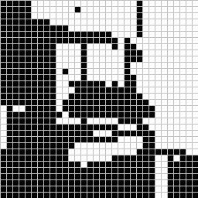
A Binary Image
foreground:
background
This represents a digital image. Each square is one pixel.

Slide 7
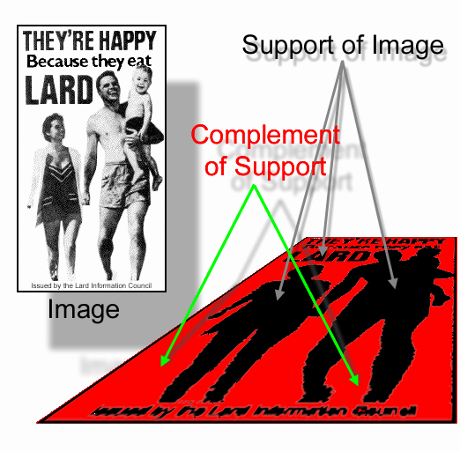
Support of an Image
The support of a binary image is often defined as the set of locations of the foreground pixels. I.e.,
In that case, the complement of the support is the set of background pixel locations within the image plane.
But other times, the support is defined as the set of all pixel locations in the image both foreground and background.

Slide 8
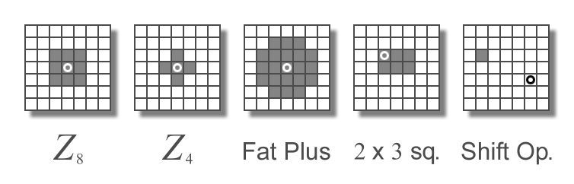
Structuring Element (SE)
A structuring element is a small image – used as a moving window – whose support delineates pixel neighborhoods in the image plane.
Example SEs
FG is gray ;
BG is white
It can be of any shape, size, or connectivity (more than 1 piece, have holes). In the figure the circles mark the location of the structuring element’s origin which can be placed anywhere relative to its support.

Slide 9
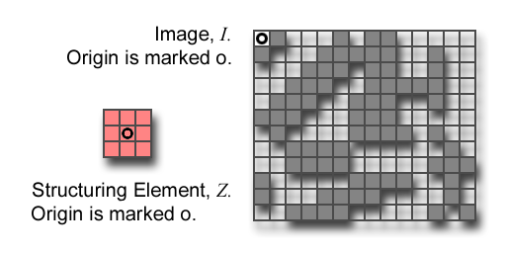
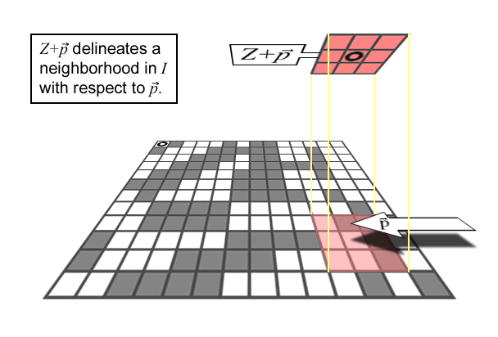
Structuring Element
S _{p} is the set of of all pixel locations in the image.
Let I be an image and Z a SE.
Z+p means that Z is moved so that its origin coincides with location p in S_{P}.
Z+p is the translate of Z to location p in S_{P}.
The set of locations in the image delineated by Z+p is called the Z-neighborhood of p in I denoted N{I,Z}(p).

Slide 10
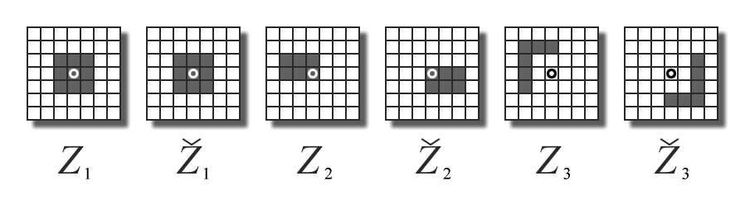
Reflected Structuring Elements
Let Z be a SE and let S be the square of pixel locations that contains the set {(r,c), (−r,−c) | (r,c)∈supp(Z)}. Then
is the reflected structuring element.
rotated by 180º around its origin.

Slide 11
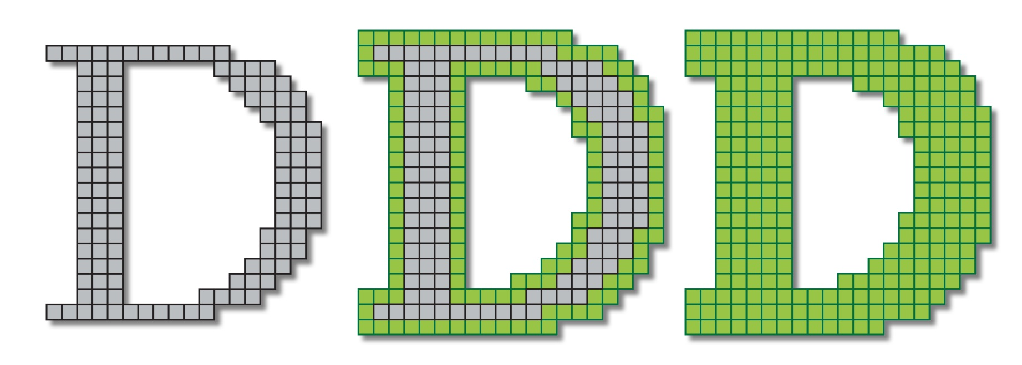
Dilation

Slide 12
Dilation of Binary Images
There are a number of equivalent definitions of dilation. Three of them that apply to binary images are:
The set of all pixel locations, p, in the image plane where the intersection of Ž+p with the foreground of I is not empty.
The union of copies of the SE, one translated to each pixel location in the forground of the image.
The union of copies of the image, one translated to each pixel location in the foreground of the SE.

Slide 13

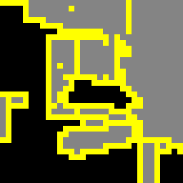
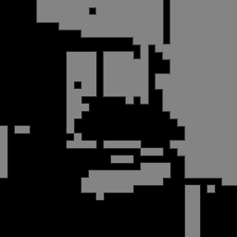
Dilation
The locus of pixels p∈S_{P} such that ∅.
dilated image
original / dilation
original image
SE = Z₈
This is a piece of a larger image. Boundary effects are not apparent

Slide 14
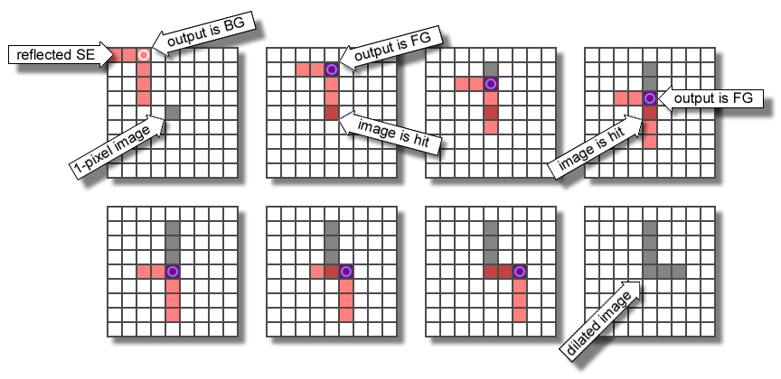
Dilation using a Reflected SE

Slide 15
Fast Computation of Dilation
The fastest way to compute binary dilation is to use the union-of-translates-of-the-image definition. That is, use
Assume the dimensions of I are R×C, the dimensions of Z are N×M, and Z’s origin is offset from the upper left hand corner (ULHC) by ρ rows and χ columns. Allocate a scratch image, T, that is (R+N−1)×(C+M−1) and initialized to zeros. Then, for each FG pixel loc (v, u) in Z (measured from the ULHC of Z ) perform a logical OR between I+(v, u) and T. Put the results in T. When done, copy to J the R×C subarray of T starting at (ρ,χ).

Slide 16
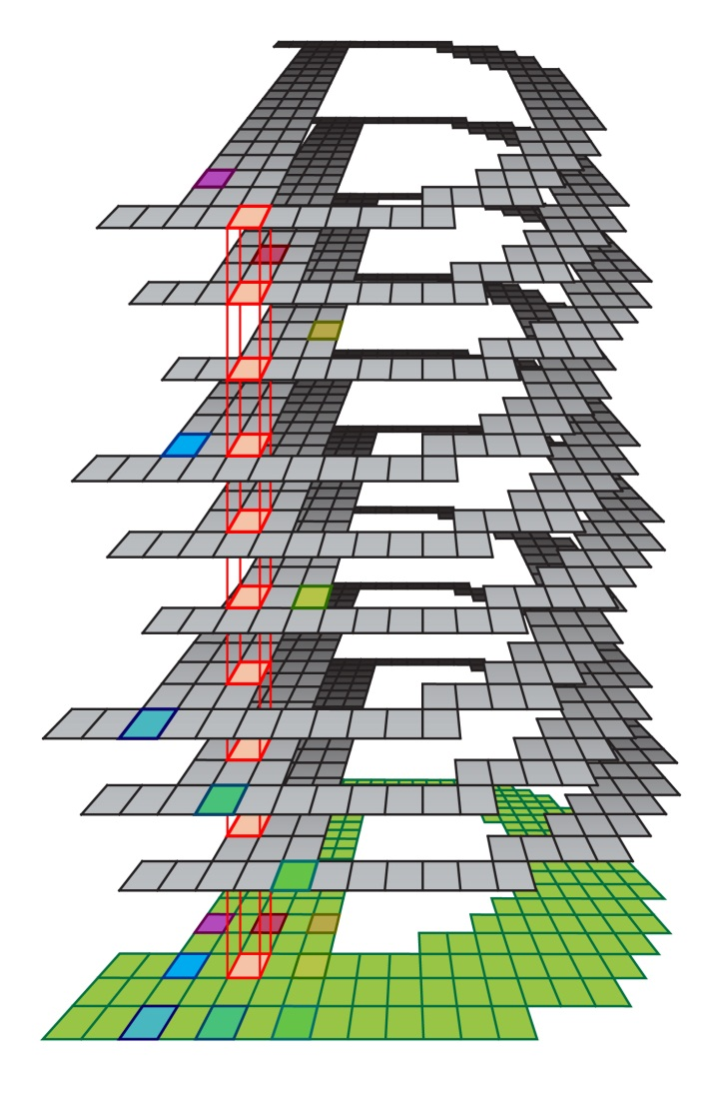
Dilation through Image Shifting

Slide 17
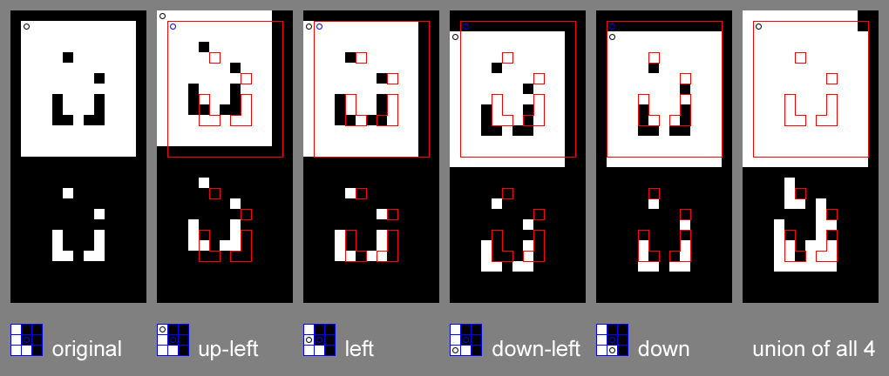
Dilation through Image Shifting
The red outlines indicate the positions of the features in the original images.

Slide 18

Erosion

Slide 19
Erosion of Binary Images
There are a number of equivalent definitions of erosion. Three of them that apply to binary images are:
The set of all pixel locations, p, in the image plane where Z+p is contained in fg{I}.
The intersection of copies of the refl. SE, one translated to each pixel location in the foreground of the image.
The intersection of copies of the image, one translated to each pixel location in the foreground of the refl. SE.

Slide 20



Erosion
The locus of pixels p∈S_{P} such that .
eroded image
erosion / original
original image
SE = Z₈
This is a piece of a larger image. Boundary effects are not apparent

Slide 21
Fast Computation of Erosion
The fastest way to compute binary erosion is to use the intersection-of-translates-of-the-image definition. That is, use
Assume the dimensions of I are R×C, the dimensions of Z are N×M, and Z’s origin is offset from the upper left hand corner (ULHC) by ρ rows and χ columns. Allocate a scratch image, T, that is (R+N−1)×(C+M−1) and initialized to I. Rotate¹ Z by 180º. Then, for each FG pixel loc (v, u) in Ž (measured from the ULHC of Ž ) perform a logical AND between I+(v, u) and T. Put the results in T. When done, copy to J the R×C subarray of T starting at (N−ρ, M−χ).
¹In matlab the fastest way to rotate Z by 180º is » Zrefl = flipud(fliplr(Z));

Slide 22


Comparison of Erosion and Dilation
original contains erosion
dilation contains original
erosion / original
erosion / original / dilation
original / dilation
SE = Z₈
This is a piece of a larger image. Boundary effects are not apparent

Slide 23
Erosion from Dilation / Dilation from Erosion
Dilation and erosion are duals of each other with respect to complementation:
That is, dilation with the reflected SE of the complement of a binary image is the complement of the erosion. Erosion with the reflected SE of the complement of the image is the complement of the dilation. It follows that,
erosion can be performed with dilation and vice versa. That implies that only one or the other must be implemented directly.

Slide 24
Opening and Closing
Opening is erosion by Z followed by dilation by Z.
The opening is the best approximation of the image FG that can be made from copies of the SE, given that the opening is contained in the original. I □ Z contains no FG features that are smaller than the SE.
Closing is dilation by Ž followed by erosion by Ž.
The closing is the best approximation of the image BG that can be made from copies of the SE, given that the closing is contained in the image BG. I • Z contains no BG features that are smaller than the SE.

Slide 25
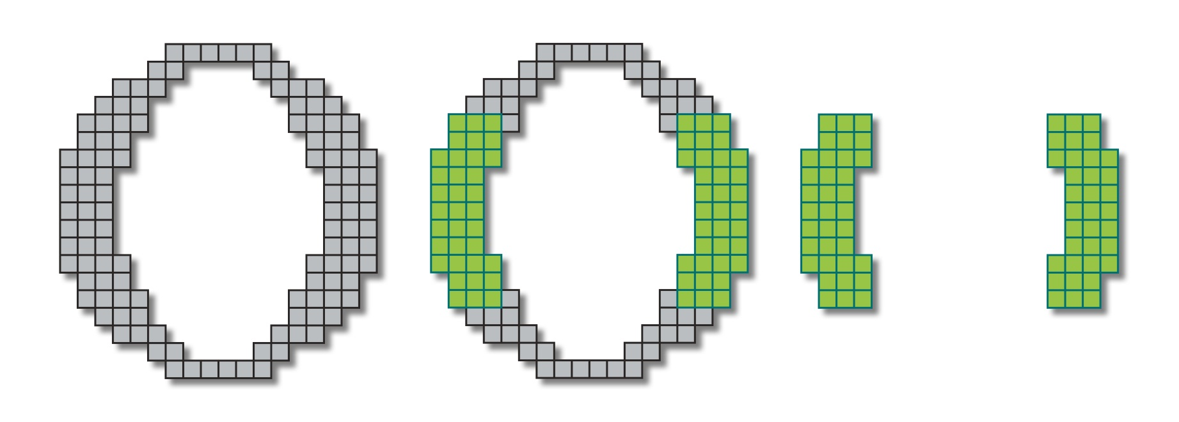
Opening

Slide 26
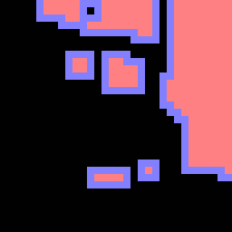
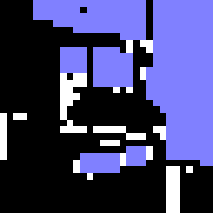
Opening is Erosion Followed by Dilation
erode the original
dilate the erosion
dilated erosion
erosion / original
erosion / opening
opening / original
SE = Z₈
This is a piece of a larger image. Boundary effects are not apparent

Slide 27
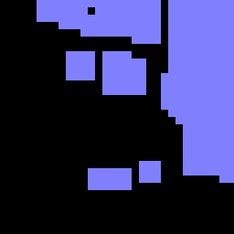
Opening is Erosion Followed by Dilation
original image
eroded image
dilated erosion
original
erosion
opening
SE = Z₈
This is a piece of a larger image. Boundary effects are not apparent

Slide 28
Opening
SE = Z₈
The union of translates of Z such that .
open image
opening / original
original image
The opening of I by Z is the best approximation of I that can be made by taking the union of translated copies of Z, subject to the constraint that the opening be contained by the original image.

Slide 29
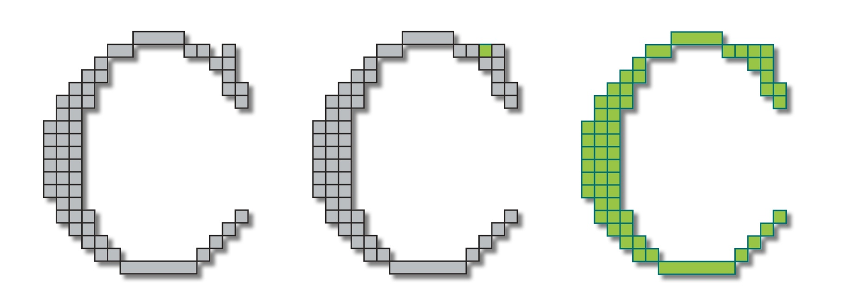
Closing

Slide 30


Closing is Dilation Followed by Erosion¹
original image
erode the dilation
to get the closing
original / dilation
closing / dilation
closing / original
SE = Z₈
¹using the reflected SE, Ž

Slide 31

Closing is Dilation Followed by Erosion¹
original image
dilated image
eroded dilation
original
dilation
closing
SE = Z₈
¹using the reflected SE, Ž

Slide 32
Duality Relationships
Erosion in terms of dilation:
Dilation in terms of erosion:
Opening in terms of closing:
Closing in terms of opening:
I^{C} is the complement of I and Ž is the reflected SE.

Slide 33
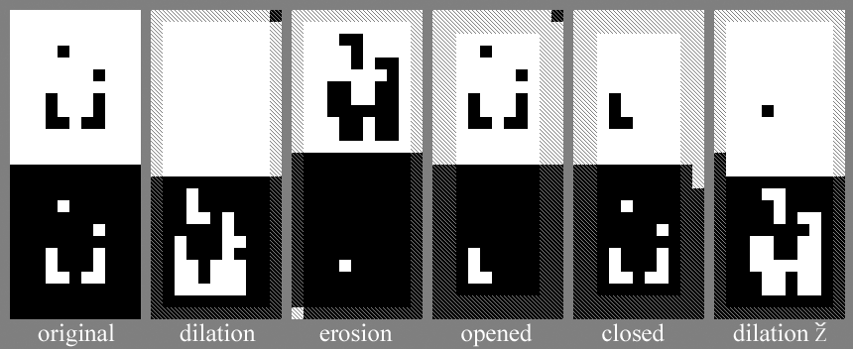
Binary Ops with Asymmetric SEs
“L” shaped SE
Foreground: white pixels
Cross-hatched pixels are indeterminate.
O marks origin
Background: black pixels

Slide 34
Border Effects
co_{SE}
C_{I} - C_{SE} +co_{SE}
Erosion & Dilation
Since morph. ops. are neighborhood ops., there is a band of pixels around the border of the resultant image where the values are indeterminate.
ro_{SE}
R_{SE}
C_{SE}
R_{I} - R_{SE} +1
deterministic region
R_{I} - R_{SE} +ro_{SE}
The actual values of pixels in the indet. region depend on the specific algorithm used.
C_{I} - C_{SE} +1

Slide 35
Border Effects
C_{SE}
C_{I} - C_{SE} +1
Opening & Closing
Since opening & closing iterate erosion & dilation, the boundaries of the deterministic region are 2x as far from the image border as are those of erosion or dilation.
R_{SE}
deterministic region
R_{I} - 2R_{SE} +1
R_{I} - R_{SE} +1
C_{I} - 2C_{SE} +1

Slide 36

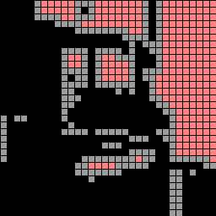
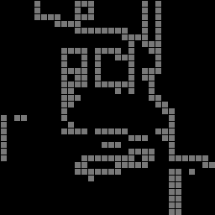
Boundary Extraction
binary image
8-connected SE
4-conn inside bdry
original
erosion by square
difference
This is a piece of a larger image. Boundary effects are not apparent

Slide 37

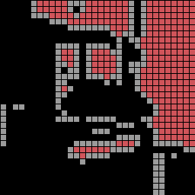
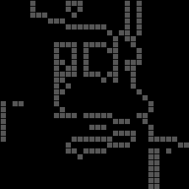
Boundary Extraction
binary image
4-connected SE
8-conn inside bdry
original
erosion by plus
difference
This is a piece of a larger image. Boundary effects are not apparent

Slide 38
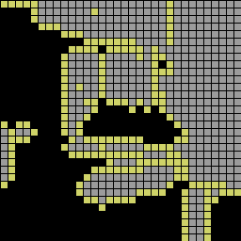

Boundary Extraction
binary image
4-connected SE
8-conn outside bdry
original
dilation by plus
difference
This is a piece of a larger image. Boundary effects are not apparent

Slide 39
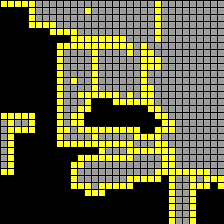
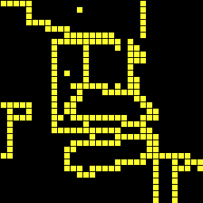
Boundary Extraction
binary image
8-connected SE
4-conn outside bdry
original
dilation by square
difference
This is a piece of a larger image. Boundary effects are not apparent

Slide 40
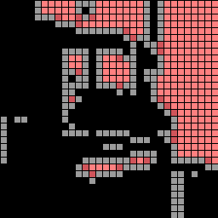

Boundary Extraction
binary image
erosion by square is
8-conn inside bdry is
original
in erosion by plus
in 4-conn inside bdry
This is a piece of a larger image. Boundary effects are not apparent

Slide 41
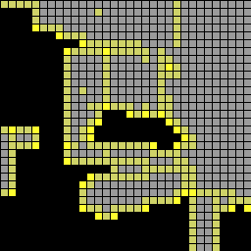
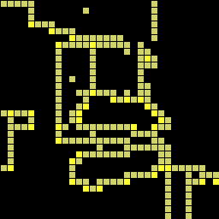
Boundary Extraction
binary image
dilation by plus is
8-conn outside bdry is
original
in dilation by square
in 4-conn outside bdry
This is a piece of a larger image. Boundary effects are not apparent

Slide 42
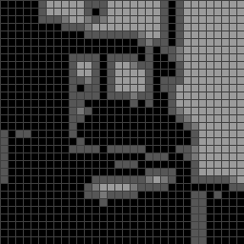
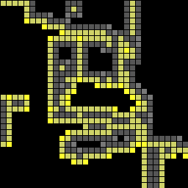
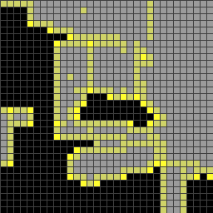
Boundary Extraction
inside boundaries
are disjoint from
outside boundaries
8-bdry/4-bdry/orig
all 4 boundaries
orig/8-bdry/4-bdry
This is a piece of a larger image. Boundary effects are not apparent

Slide 43
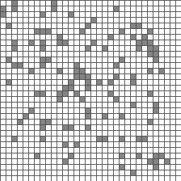
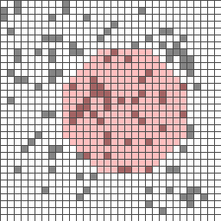
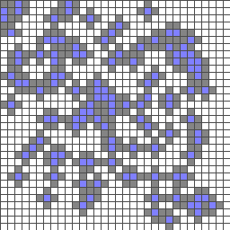
Conditional Dilation
original image
mask over original
dilated original
dilation inside a mask

Slide 44
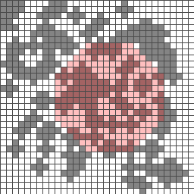
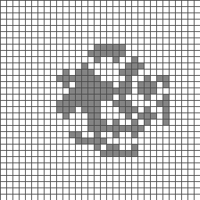
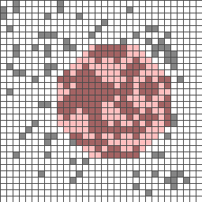
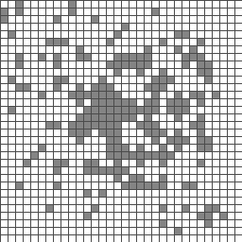
Conditional Dilation
mask
over
dilated
masked
dilated
masked
dilated
union with
original
conditionally
dilated with
respect to
mask

Slide 45
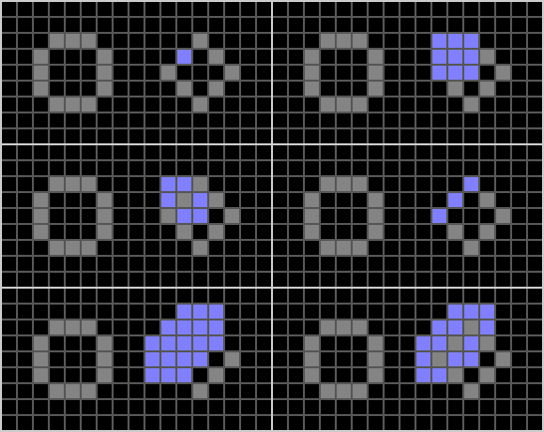
Connected Component Extraction
tag
dilated
tag
masked
dilated
tag
tags
dilated
tags
masked
dilated
tags

Slide 46
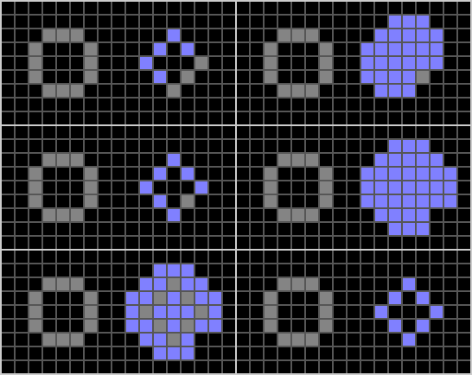
Connected Component Extraction
tags
dilated
tags
masked
tags
dilated
tags
masked
dilated
tags
connected
component

Slide 47



Binary Reconstruction
Used after opening to grow back pieces of the original image that are connected to the opening.
original
opened
reconstructed
Removes of small regions that are disjoint from larger objects without distorting the small features of the large objects.

Slide 48
Algorithm for Binary Reconstruction
1. J = I o Z, where Z is any SE.
2. T = J,
3. J = J ⊕ Z_{k}, where k=4 or k=8,
4. J = I AND J,[Take only those pixels from J that are also in I .]
5. if J ≠ T then go to 2,
6. else stop; [ J is the reconstructed image. ]
This is the same as connected component extraction with the opened image, J, containing the tags. The choice of Z_{k} determines the connectivity of the result.

Slide 49
Algorithm for Binary Reconstruction
Usually a program for reconstruction will take both J and I as inputs. E.g,
K = ReconBin(I,J,Z);
Then the algorithm starts at step 2.
1. J = I o Z, where Z is any SE.
2. T = J,
3. J = J ⊕ Z_{k}, where k=4 or k=8,
4. J = I AND J,[Take only those pixels from J that are also in I .]
5. if J ≠ T then go to 2,
6. else stop; [ J is the reconstructed image. ]
This is the same as connected component extraction with the opened image, J, containing the tags. The choice of Z_{k} determines the connectivity of the result.

Slide 50
Skeletonization
Let Skel(I,r) be the set of pixels in I such that if p ⊆ Skel(I,r) then D_{p}(r), is a maximal disk of radius r in I. That is, Skel(I,r) is the locus of centers of maximal disks of radius r in I. Then
That is, the skeleton of I is the union of all the sets of centers of maximal disks.
Note that for any actual image I, the union will not be infinite, since I is bounded (not infinite in extent).

Slide 51
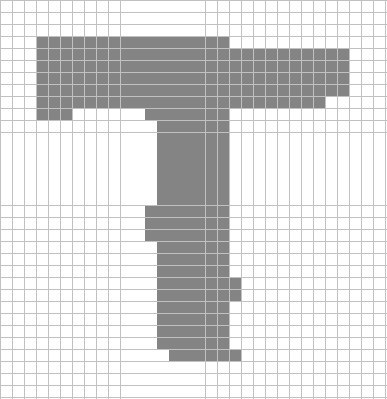
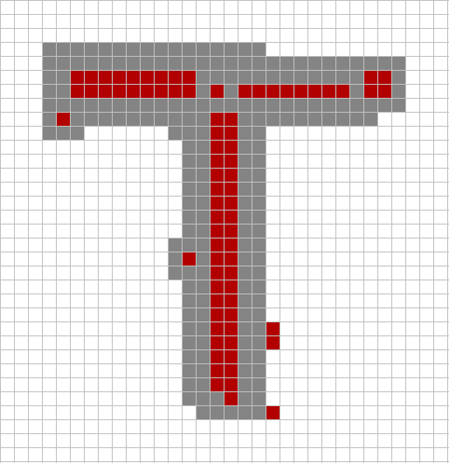
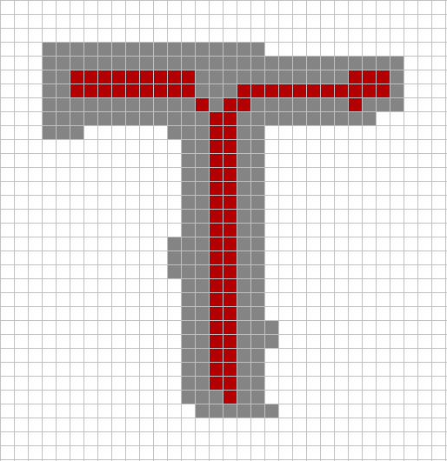
Skeletonization
Original shape
Raw skeleton (red)
Pruned and connected
is the locus of centers of maximal disks.
skeleton

Slide 52
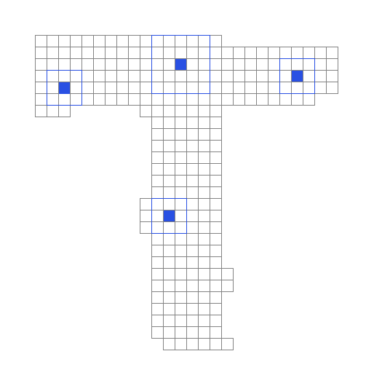
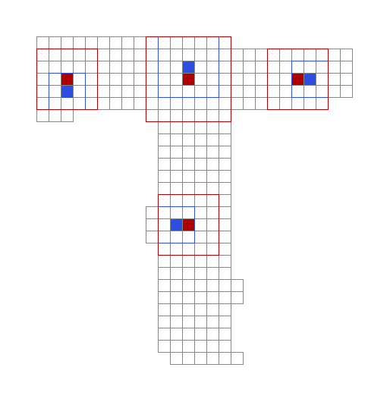
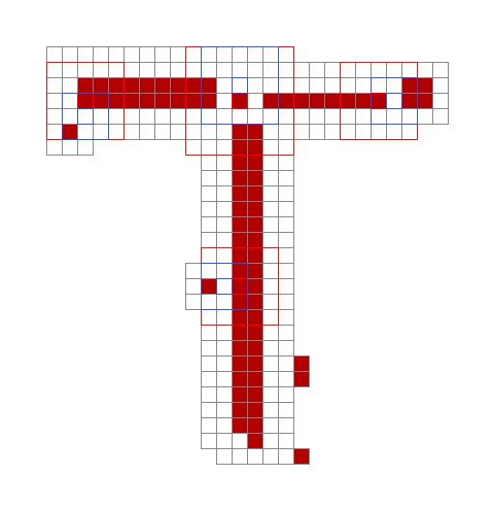
Skeletonization: Maximal Disks
non maximal “disks”
maximal disks (red)
non max & max disks
“disks” are squares
non max disks (blue)
over skeleton
The maximal disk at pixel loc p is the largest disk in the fg that includes p.

Slide 53
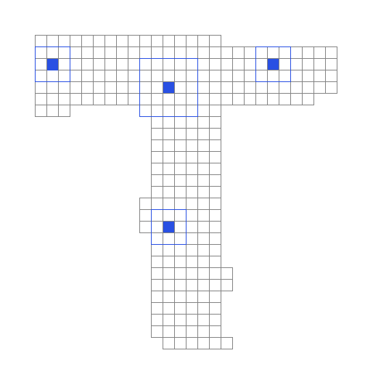
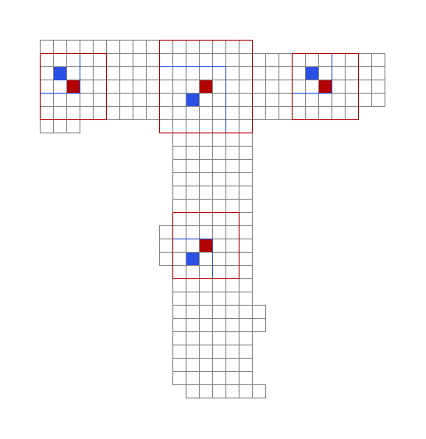
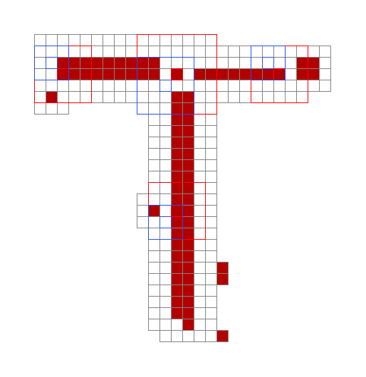
Skeletonization: Maximal Disks
non maximal “disks”
maximal disks (red)
non max & max disks
“disks” are squares
non max disks (blue)
over skeleton
The maximal disk at pixel loc p is the largest disk in the fg that includes p.

Slide 54

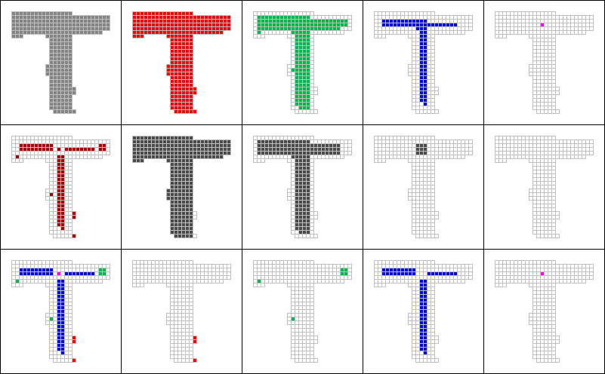
Computation of the Skeleton
SE = Z₈ = = Sq(3)
n = 0: SE = 1 pixel
n = 1: SE = Sq(3)
n = 2: SE = Sq(5)
n = 3: SE = Sq(7)
original
erode n=0
erode n=1
erode n=2
erode n=3
open above
w/ Z (n=1)
open above
w/ Z (n=1)
open above
w/ Z (n=1)
open above
w/ Z (n=1)
skeleton
Note that the
result is
disconnected
and has
spurious points.
union of all 4
to the right
top - middle
Skel( I, 0 )
Skel( I, 1 )
Skel( I, 2 )
Skel( I, 3 )
top - middle
top - middle
top - middle

Slide 55



Skeletonization: Delete Spurious Pixels
raw skeleton
def. spurious pixels as
pruned skeleton
has spurious pixels
conn. comp. of < 3 pix.
raw less spurious

Slide 56



Skeletonization: Reconnect Components
2 components of
2 other components
Intersection of
pruned skel. dilated.
of pruned skel dilated.
dilated components.

Slide 57

Skeletonization
raw skeleton
pruned skeleton
reconnected skeleton

