Slide 1

Food Microbiome Exposure
and the Human Gut Ecosystem
Linking Food and Human Microbiome Datasets to Predict Gut
Stability, Diversity, and Structure
Bar-Ilan University | Introduction to Data Science | Final Project
Roee Winter • Gal Ariel • Orel Atia • Yonatan Koren

Slide 2

Project Question
Does exposure to “food microbiomes” — the microbial communities living in fermented foods — measurably affect the stability, diversity, and community structure of the human gut microbiome on the following day?
...and can this be answered despite the food and human-gut datasets sharing no common identifier?
2

Slide 3


Two Datasets, Two Different Worlds
Dataset 1: cFMD
Dataset 2: dietstudy
curated Food Metagenomic Data
“MCTs” human gut longitudinal study
3,441 food samples (cheese, beer, salami, pickles...)
5,057 taxa x 3,393 samples taxonomic matrix
85 source studies, microbiology-driven categories
Describes what could be eaten - not tied to any person
32 participants, daily stool samples (up to 17 days)
532 metadata rows, 483 matched microbiome profiles
Daily food diaries (7,625 eating events) + nutrition logs
Randomized: 16 MCT-oil vs. 16 olive-oil (EVOO) arm
Carlino et al., 2024, Cell [1]
Johnson et al., 2019, Cell Host & Microbe [2]
3

Slide 4
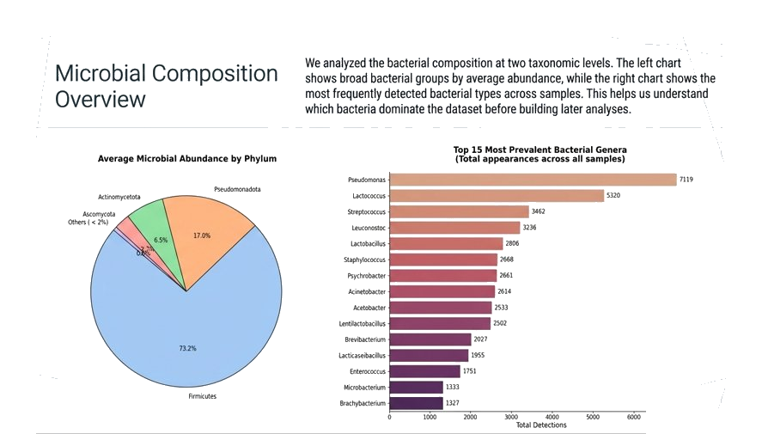

Slide 5
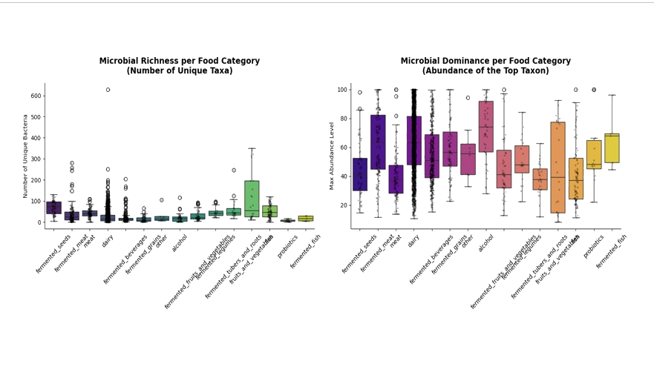

Slide 6
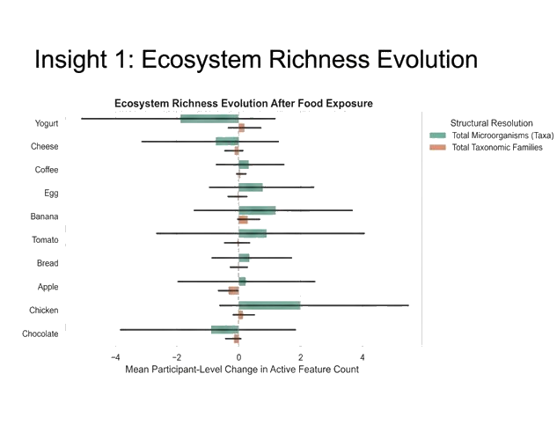

Slide 7
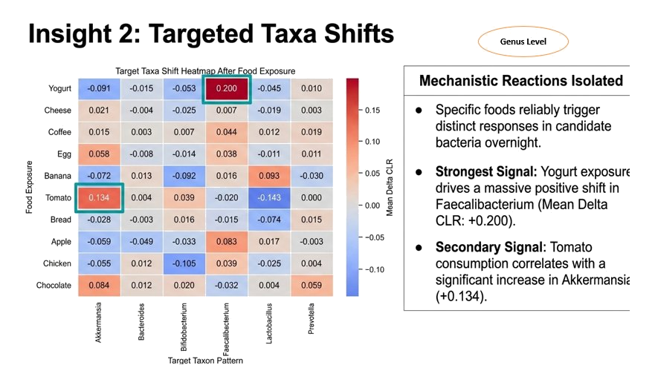

Slide 8
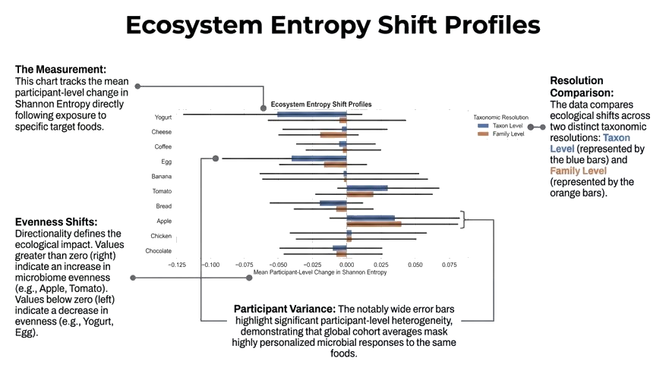

Slide 9

The Challenge: No Shared Field Between Them
cFMD describes food by microbiology process; the diary describes food by USDA nutrition category. There is no common column to join on.
cFMD side
Diary side (USDA)
category = “dairy”
subtype = “Cheddar”
L1 = Milk_and_Milk_Products
L2 = Cheeses
?
Naive shortcuts that fail:
“meat = meat” merges fermented salami with a plain cooked hamburger
Keyword search alone matches “Yogurt dressing” as if it were real yogurt
Picking 10 “convenient” diary categories (coffee, chicken...) without checking whether cFMD even covers them
4

Slide 10


Our Solution: An Evidence-Validated Mapping
Instead of guessing, we built a brand-new bridge key - food_category_unified - validated in two stages before any mapping was written.
Stage 1: Find real overlap
Stage 2: Build explicit allow-lists
Inspect subtypes of every cFMD category; cross-check against diary keywords - before writing any mapping rule.
Item-by-item lists per category, excluding smoked meats, condiments, and dressings that only superficially match.
Result: 4 of 15 cFMD categories had a validated, real counterpart in the diary
Unified Category | cFMD source | n (cFMD) | Diary rule
dairy_fermented | dairy | 2,296 | All cheeses + 13 real yogurt items
beverage_alcoholic_fermented | fermented_beverages + alcohol | 483 | All alcoholic beverages
meat_cured_fermented | fermented_meat | 156 | Salami, pepperoni, cured sausage only
vegetable_fermented | fermented_fruits_and_vegetables | 52 | 12 pickle / sauerkraut / olive items
5

Slide 11
From Mapping to a Number: the FME Score
A category label alone means nothing to a model. For each validated category we computed a real microbial signature from cFMD, then combined it with how much a participant ate.
FME = Σ categories z-score( grams eaten × category richness )
Microbial signature per category (from cFMD taxonomic profiles):
Category | Richness | Diversity
Cured meat | 37.4 | 1.21
Pickled vegetables | 31.5 | 1.73
Dairy (cheese/yogurt) | 25.4 | 1.06
Alcoholic beverages | 17.9 | 1.30
6

Slide 12





Main Steps of the Analysis Pipeline
1
2
3
4
5
6
Validate & Map
Build FME
Temporal Backbone
Define Targets
Grouped CV
Validate
Evidence-based category linkage
Microbial signature x diet diary
Pair every T-1 -> T daily transition
Stability / Diversity / Structure
Train & evaluate, no participant leakage
Permutation testing for significance
7

Slide 13

What Are We Actually Predicting?
Day T-1
Day T
350 valid transitions
32 participants
Gut state + FME (diet) +
nutrition + supplement arm
Did the gut ecosystem
change, and how?
predicts
Stability
Diversity
Structure
Taxon turnover (gained/gone) between days
Change in Shannon entropy of the community
Change in how distinctly families separate
8

Slide 14
Avoiding a Critical Pitfall: Participant Leakage
A participant's supplement arm and baseline gut signature stay constant across their own days. A naive random split lets a model “cheat” by memorizing identity instead of learning real diet-gut relationships.
Naive random split
GroupKFold by participant
Same participant's rows appear in BOTH train and test
Every fold tests on participants never seen in training
Result observed in earlier project work: a classifier scored accuracy = 1.00 — a red flag, not a success.
Used consistently for every model in this project, confirmed via 100-permutation testing against chance.
❌ Looks great. Means nothing.
✅ Genuine generalization signal.
9

Slide 15




Models Evaluated
Four tree-ensemble algorithms, identical conservative hyperparameters, no formal tuning (to avoid shrinking an already-small training set).
Random Forest
Gradient Boosting
XGBoost
LightGBM
Bagging: many independent trees, averaged
Sequential trees fit to residual error
Regularized boosting, 2nd-order splits
Histogram-based, leaf-wise tree growth
Breiman, 2001 [10]
Friedman, 2001 [11]
Chen & Guestrin, 2016 [5]
Ke et al., 2017 [6]
scikit-learn [4] | hyperparameters fixed (n_estimators 200-300, max_depth 3-4, learning_rate 0.1, random_state=42)
10

Slide 16
Main Results: Answering the Research Question
Dimension | AUC | Permutation p
Stability | 0.747 | < 0.001
Structure | 0.612 | 0.010
Diversity | 0.588 | 0.010
All 3 dimensions are statistically significant — not chance.
Null distributions (100 random-label permutations) center near AUC = 0.50, confirming no leakage in the protocol.
Stability shows the strongest, most learnable signal.
11

Slide 17
Primary Model: GutStable (LightGBM)
68.3% accuracy on participants never seen in training - clearly above the 50% random baseline.
 | Predicted: Unstable | Predicted: Stable
Actual: Unstable (172) | 122 | 50
Actual: Stable (178) | 61 | 117
Sensitivity (Stable): 65.7% recall for stable days
Specificity (Unstable): 70.9% recall for unstable days
Precision (Stable): 70.1%
Error analysis: misclassified transitions cluster near the median turnover threshold itself - an expected, largely irreducible source of error for a median-split target. Per-participant accuracy ranges widely (15%-100%), echoing personalized diet-microbiome response.
12

Slide 18
What Actually Drives the Prediction?
Reading the chart
~48% baseline gut state (teal)
~33% daily nutrition (gold)
~18% FME, fermented food (sage)
FME contributes a real, secondary signal - not the dominant one. Consistent with cFMD's own finding that food microbes average only ~3% of the adult gut [1].
13

Slide 19
A Complementary Model: Diet-Arm Prediction
Can a participant's assigned dietary-fat arm (MCT oil vs. olive oil) be predicted from their gut state and FME? All four algorithms agree closely.
XGBoost selected
AUC = 0.711, Accuracy = 0.660
Close clustering across 4 very different algorithm families (0.698-0.711) - strong evidence this is a real, robust signal, not one model's artifact.
Feature importance: dominated by baseline gut entropy (~36%); FME contributes ~21%, concentrated in dairy & alcoholic-beverage exposure.
14

Slide 20

Key Conclusions
Going back to our question: does food-microbiome exposure measurably affect gut stability, diversity, and structure?
Answer: Yes — for all three dimensions, though to markedly different degrees — and yes, the two datasets could be linked despite sharing no native identifier.
The two datasets CAN be linked
through an evidence-validated 4-category mapping - not a literal shared field.
All 3 research dimensions are significant
Stability (AUC 0.747, p<0.001), Structure (0.612, p=0.010), Diversity (0.588, p=0.010).
FME is real but secondary
~18-21% of feature importance - alongside baseline gut state and macro-nutrient intake.
Robust across 4 algorithms
and validated with participant-grouped CV plus permutation testing throughout.
15

Slide 21
Thank You
Questions?
Bar-Ilan University | Introduction to Data Science | Final Project

