Slide 1
RT Telemetric (TLM) SW DR
26.08.18

Slide 2
RT TLM Requirements
RTC shall record system status and events using read / write to internal FLASH memory in the following conditions:
Write rate = The telemetric data base will be saved at the flash memory once in a 100 msec (100 msec equal to the fastest rate level). The write to flash operation will use HBS method: p_CDS_write.
Read rate = The RTC VTU module will read the telemetric data in cyclic loop once in a 1 second (using TLM module SW API), this data will be parsing and present in the RT viewer application. The read from flash operation will use HBS method: p_CDS_read.
Read upon request – The telemetric module will consist an SW API to export the telemetric data at any request time.
The write to flash operations will be protected in thread safe (this protection will be a part of the HBS API).
The RTC telemetric operation shall be:
Cyclic – replace old stored data with new values when cycle time elapsed.
Deterministic – Each cycle is defined by time (each parameter has its own sample time interval) and record same data structure on each cycle iteration.
Each RTC software module has its own telemetric data structure. This structure consist all the internal data members that need to be recorded in the telemetric cycle.
Each RTC module has its own data base files (*.c, *,h) that defined the module telemetric data fields that need to be sampled during telemetric record process. Using windows software application tool the system user can edit the telemetric data base parameters.
Each data member that is part of the telemetric data base has its own: rate level (sampled time: fast, normal, slow), data type, Current data value, visually and rate level.
At future step the telemetric data should be export via VTU module in order to analyze the exported data in the RT viewer application. This data will be represent in textual or graphic way. (RT viewer will need to be update in order to support this issue)

Slide 3
RT TLM Requirements
Data member structure:
Offset [void*]: pointer to address of the real location of the module data member.
Data type [One of the list below]: Data type for specific data member.
Data value [Data type]: Current data value of the parameter.
Visually [Boolean]: If the data will be show in RT viewer application.
Flash (Boolean): Store parameter in flash (flag = true), otherwise the parameter will not be save in the flash.
Rate level [Enum RATE_LEVEL]: sample time interval (fast, normal, slow).
When
Data member type range: int (interger), uint, real (double), char, uchar, ushort, short.
Rate level (sample time interval [msec]): fast – 100, normal – 300, slow – 500.

Slide 4
RT TLM parameters configuration Solution A – ICD messages
Each telemetric plan will be in an ICD file format (.grep file).
The telemetric plan members will be build throw GDE application.
Each telemetric plan member will consist fields as described in the previous slides (RATE_LEVEL, flash flag, etc …).
In this solution the VTU (and therefore the RT viewer) and the RTC telemetric module will share same software building units (same data types, structures, etc…)

Slide 5
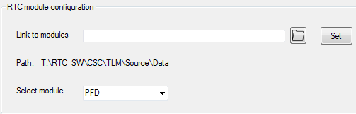
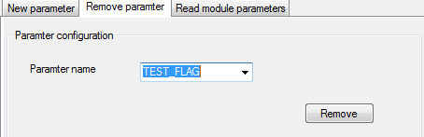
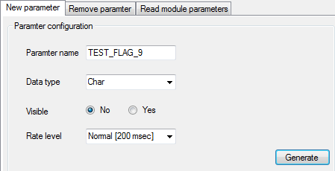
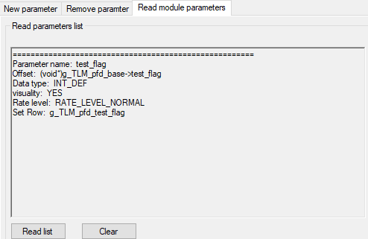
RT TLM parameters configuration Solution B – Parameters configurator tool
Parameters configurator tool goal is to add ability to insert / remove / view parameters for a chosen RTC module.
Configure path to DB files and module
Remove parameter from module DB
Insert new parameter
View module parameters

Slide 6
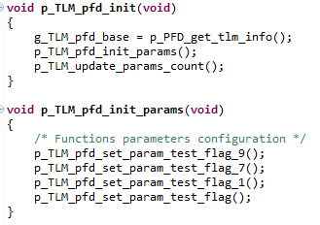
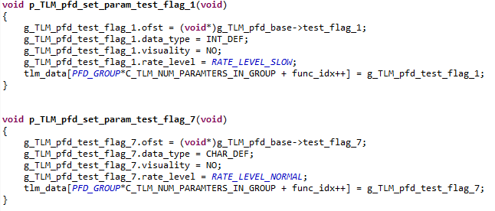

RT TLM parameters configuration Solution B – Parameters configurator tool
The tool actually edit the implementation data base files for the selected module.
Add the parameter function configuration
to module initialization procedure.
Create configuration function for the new parameter
Update parameters module counter with amount of objects
Create Telemetric object (in *.h file) with the given name (e.g. “TEST_FLAG”).

Slide 7
RT telemetric – high level module diagram
RTC
TLM
UDP
Viewer
Registry
Registry
Registry
HKY
RTI
ETC.

Slide 8
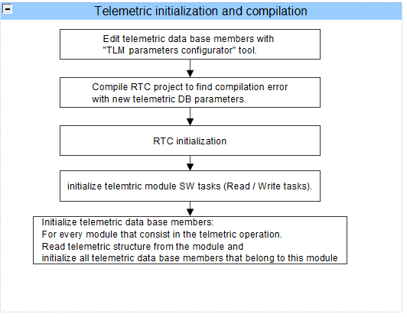
Telemetric SW flow – Initialization and compilation process

Slide 9
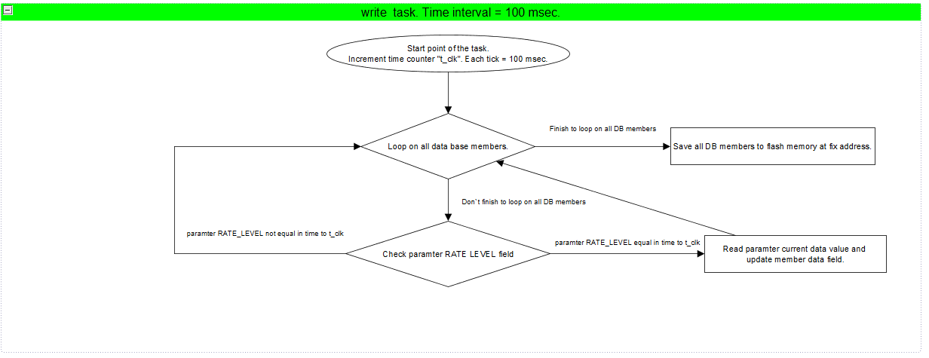
Telemetric SW flow – Write process

Slide 10
The End.

