Slide 1
RT Telemetric (TLM) SW DR DR: 1.03
11.11.18

Slide 2
RT TLM General Requirements
RTC shall record system status and events from RTC SW modules and export them to RT viewer using UDP connection.
The telemetric module will consist data base files (*.c, *,h) for each RTC module. This files will consist all the data members that need to be sample throw the telemetric procedure.
Each telemetric member will consist the following information fields:
Module: the RTC module that the data member belong to (e.g. PFD, UAV, etc.…) [up to 32 groups].
Data index: The member location at the telemetric RTC module structure [ up to 255 parameters in module].
Offset [void*]: memory address of the data at the RTC module.
Data type: Data type of the data [INT8, UINT8, INT16, UINT16, INT32, UINT32, INT64, UINT64, FLOAT, DOUBLE ].
Visually: Indicate that the data will be show in RT viewer application (visually = true).
Flash: Indicate that the data will be saved at Flash. (Flash = true).
Group number: Indicate the rate sample in mSec (up to 10 possible groups) (Each group rate [mSec] is configurable throw “offline parameters” table).
The data for each telemetric member shall be saved in bytes.

Slide 3
RT telemetric – high level module diagram
RTC
TLM
UDP
Viewer
Registry
Registry
Registry
HKY
RTI
ETC.

Slide 4
RT TLM Flash – general requirements
RTC shall record system status and events using read / write to internal FLASH memory in the following conditions:
Each telemetric member shell be belong to one of 10 possible programs according to his rate sample.
Each telemetric program shall contain data buffers that consist telemetric members that belong to this group number.
Each program (1 – 10 possible groups) will have Flash section (memory space) to store all the telemetric members that belong to this program.
The program address limits at the Flash will be calculate once during the boot time process. The calculation will be based on the number of members in the program multiple by each member data type in bytes.
The System Engineer will have the available memory space for each program on Flash. With this information the System Engineer shell supply the number of iterations for each program to save.

Slide 5
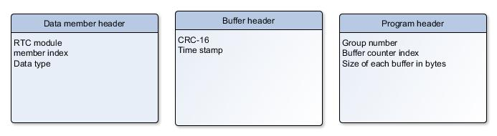
RT TLM Flash – general requirements
Flash data blocks headers
The following shell present the headers for each data block:
When
RTC module: the RTC module that the data member belong to (e.g. PFD, UAV, etc.…) [up to 32 groups].
Member index: Position of this data member in the module telemetric structure.
Data type: Data type of the data [INT8, UINT8, INT16, UINT16, INT32, UINT32, INT64, UINT64, FLOAT_DOUBLE ].
Time stamp: The time that this buffer save to Flash memory section.
Group number: : Indicate the rate sample in mSec (up to 10 possible groups) (Each group rate [mSec] is configurable throw “offline parameters” table).
Buffer counter index: Number of buffers that placed in the Flash memory section.

Slide 6

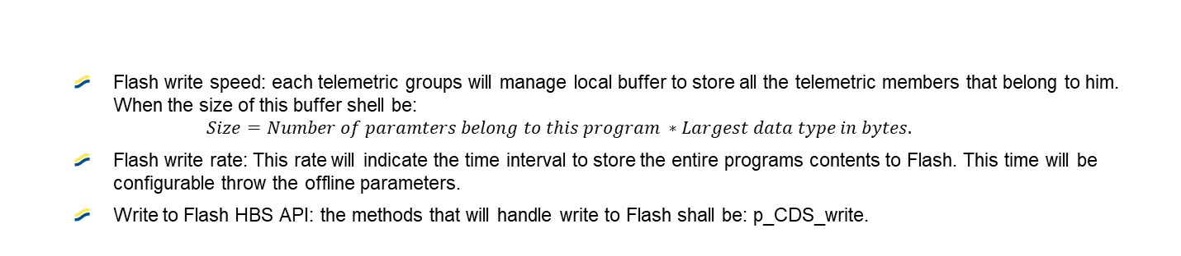


RT TLM Flash – Read / write requirements
FLASH - Write
Flash write speed: each telemetric groups will manage local buffer to store all the telemetric members that belong to him. When the size of this buffer shell be:
$$Size=Number of paramters belong to this program ∗Largest data type in bytes.$$
Flash write rate: This rate will indicate the time interval to store the entire programs contents to Flash. This time will be configurable throw the offline parameters.
Write to Flash HBS API: the methods that will handle write to Flash shall be: p_CDS_write.
Read from Flash: The RT viewer shall be read all programs contents upon user request from RT viewer. The user shall select to read contents from Flash by mark this options at RT Viewer interface.
The write to flash operations will be protected in thread safe (this protection will be a handle by HBS SW layer).
Read from Flash HBS API: the methods that will handle read from Flash shall be: p_CDS_read.
FLASH - Read

Slide 7
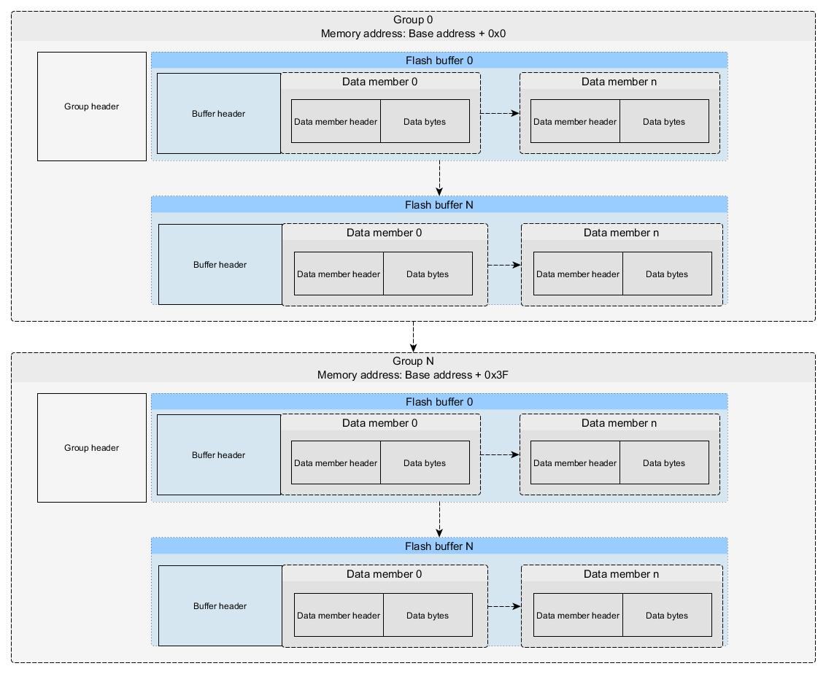
RT TLM Flash – Memory description

Slide 8
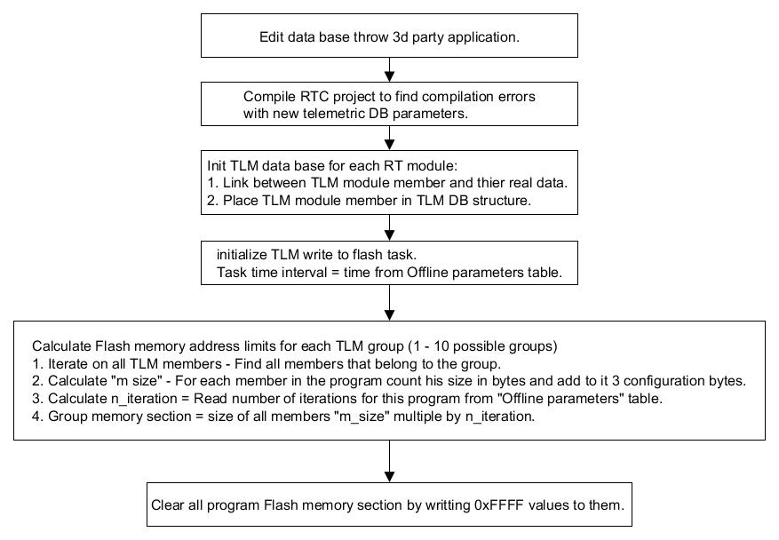
Telemetric SW flow Initialize TLM module

Slide 9
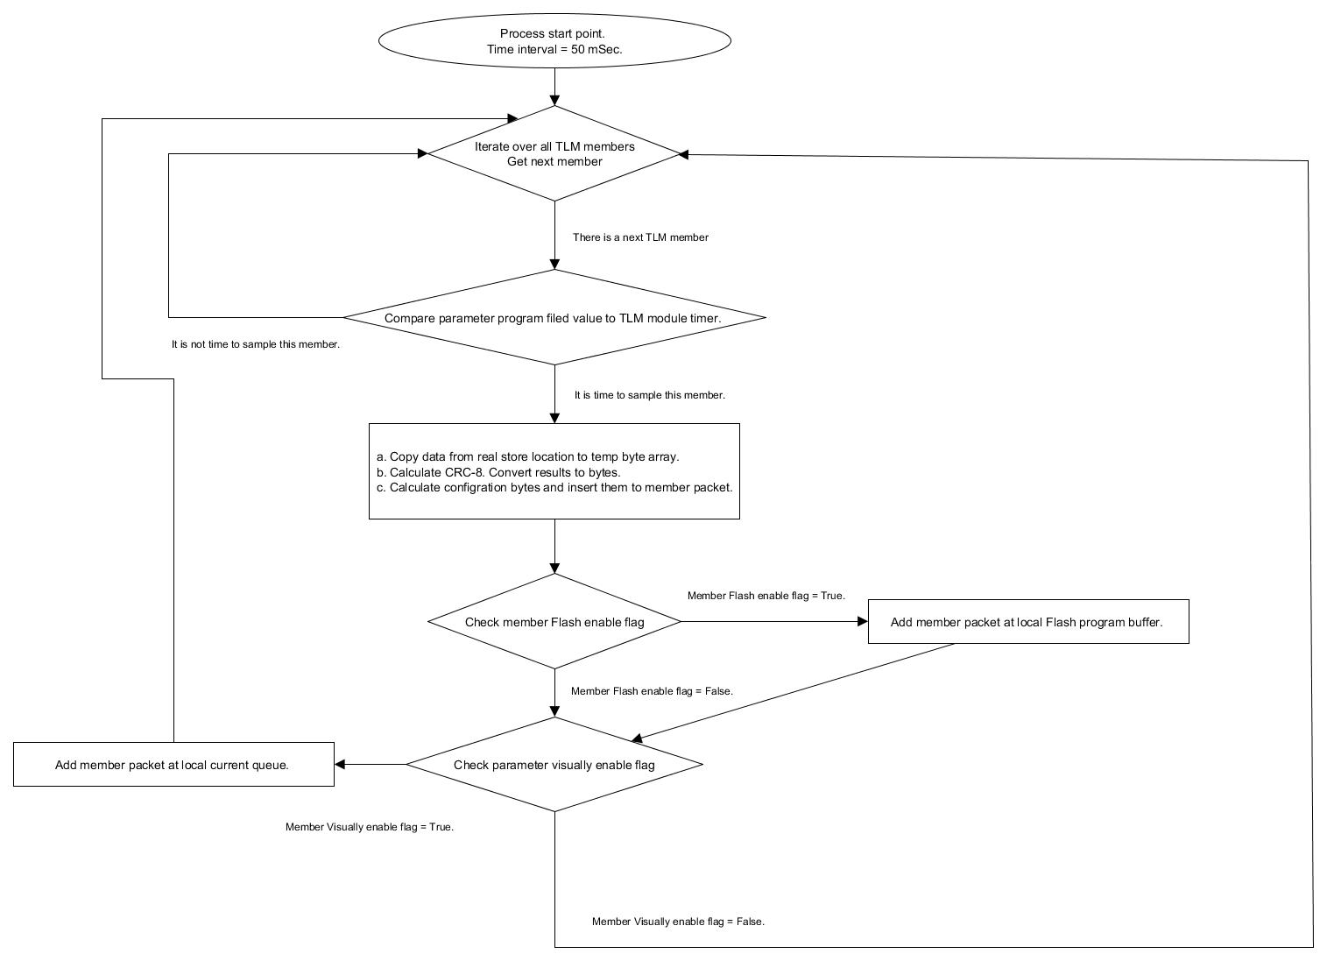
Telemetric SW flow Update members process

Slide 10
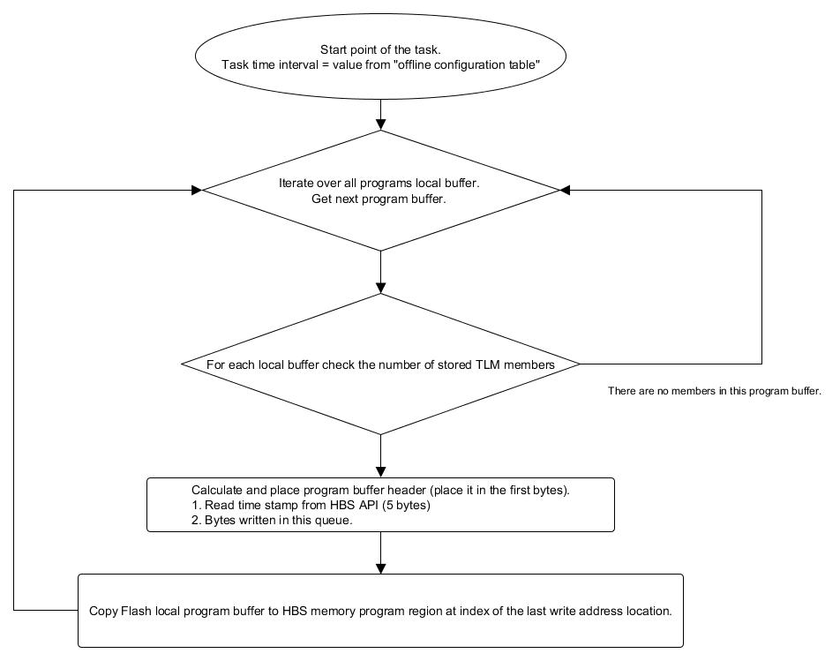
Telemetric SW flow Flash store process

Slide 11
RT TLM Telemetric current state - requirements
RTC shall record current system data and present it in RT viewer upon user request and based on the following conditions:
Each TLM member shall be saved on Current status queue in the order of the time he arrive to queue.
Upon any given read the telemetric data the timestamp shall be read as well .

Slide 12
RT TLM RT viewer requirements
The RT viewer shell present telemetric data from upon user request at any given time from 3 different sources:
Current data: Current condition of the RTC telemetric members.
Flash data: All Flash blocks that had been written to Flash (from latest to oldest).
File: raw data that had been previous stored (format of text file).
The RT viewer shell present the telemetric data at the following way:
Table of all members: This table will consist all telemetric members information one after one. This data can be view at:
Sort values: The user will be able to sort those data from low to high, low to high or group them by RTC module.
Data view: The user will be able to view members data by bytes or by original data values.
Visual way: The user will able to search after data member by his name or index and by his group. Then the RT viewer shell present for this selected member a 2D figure and table of results by time stamp.
The RT viewer shall present telemetric members by his names:
The telemetric members names will be read from generated file. This file generate by 3d application.
The RT viewer shall saved output files:
Upon user request the RT viewer shell generate the following output files:
Table of all members – At text file.
Raw data of the incoming data.
Picture (format *.jpg) of the 2D figure.

Slide 13
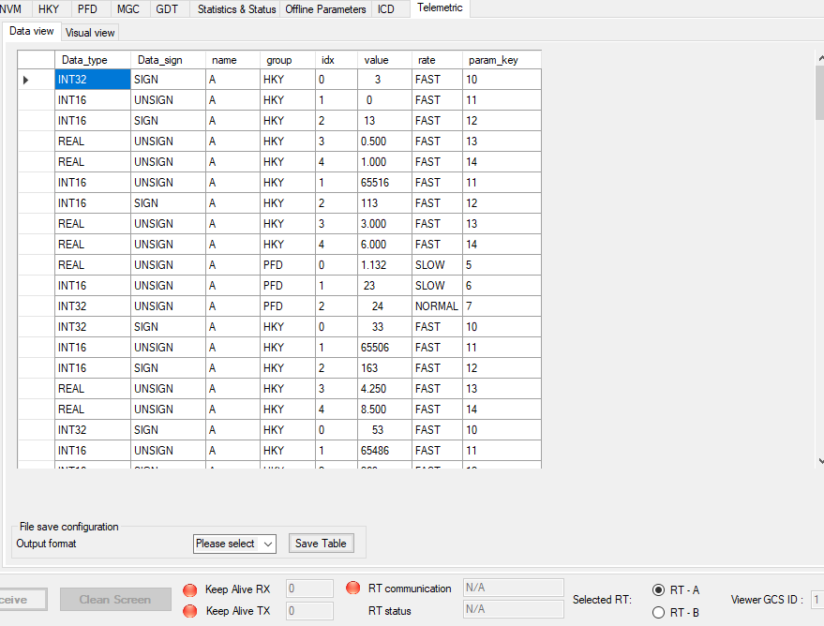
RT TLM RT viewer - Presentation 1 / 3
TLM values table

Slide 14
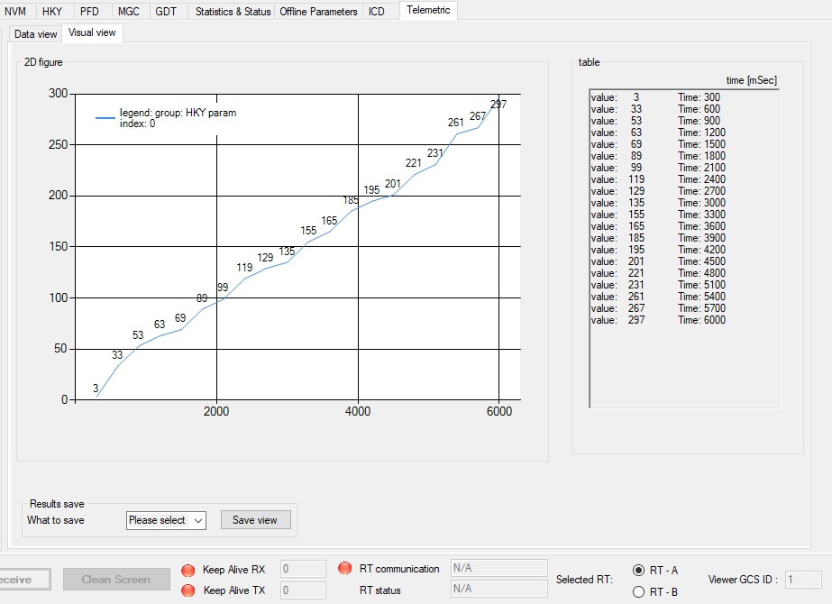
RT TLM RT viewer - Presentation 2 / 3
TLM member figure

Slide 15
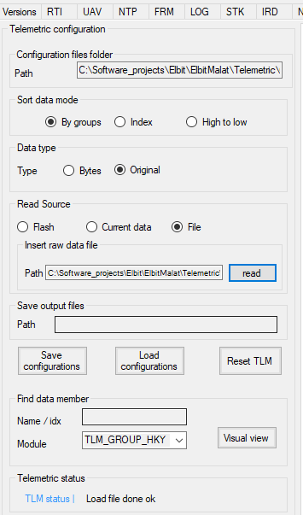
RT TLM RT viewer - Presentation 3 / 3
TLM Configuration and status

Slide 16
RT TLM parameters configuration Solution A – ICD messages
Each telemetric plan will be in an ICD file format (.grep file).
The telemetric plan members will be build throw GDE application.
The ICD message will be form by system engineers.

Slide 17
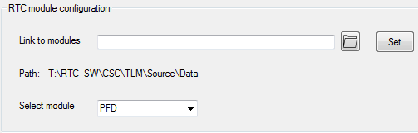
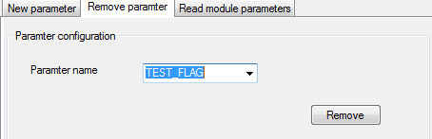
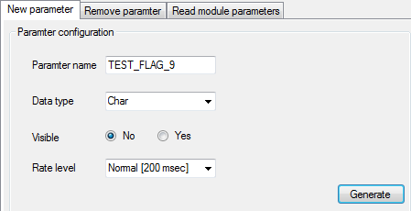
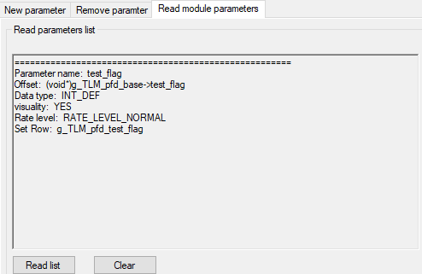
RT TLM parameters configuration Solution B – Parameters configurator tool
Parameters configurator tool goal is to add ability to insert / remove / view parameters for a chosen RTC module.
Configure path to DB files and module
Remove parameter from module DB
Insert new parameter
View module parameters

Slide 18
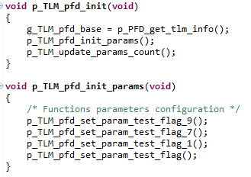
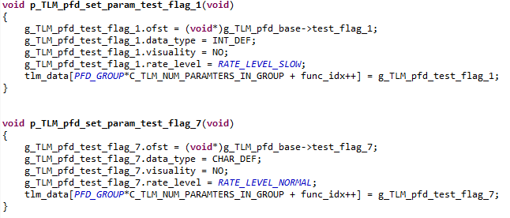

RT TLM parameters configuration Solution B – Parameters configurator tool
The tool actually edit the implementation data base files for the selected module.
Add the parameter function configuration
to module initialization procedure.
Create configuration function for the new parameter
Update parameters module counter with amount of objects
Create Telemetric object (in *.h file) with the given name (e.g. “TEST_FLAG”).

Slide 19
The End.

