Slide 1
RT Telemetric (TLM) SW DR DR: 1.02
26.08.18

Slide 2
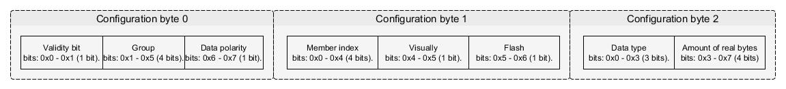
RT TLM General Requirements
RTC shall record system status and events from RTC SW modules and export them to RT viewer using UDP connection.
The telemetric module will consist data base files (*.c, *,h) for each RTC module. This files will consist all the data members that need to be sample throw the telemetric procedure.
Each telemetric data member will consist the following information fields:
Group: the RTC module that the data member belong to (e.g. PFD, UAV, etc.…) [up to 32 groups].
Data index: The member location at the telemetric RTC module structure [ up to 255 parameters in module].
Offset [void*]: memory address of the data at the RTC module.
Data type: Data type of the data [INT1_INT8, INT16, INT32, INT64, FLOAT_DOUBLE ].
Data sign: polarity of the data [sign, unsinged].
Visually: Indicate that the data will be show in RT viewer application (visually = true).
Flash: Indicate that the data will be saved at Flash. (Flash = true).
Rate level: Rate sample of the data member [fast, normal, slow] (can be configured throw “offline parameters”).
Each telemetric data member that will saved to Flash / Current structure will be saved at the following form:
Data: The member data will be convert and compress to bytes (bytes without leading spaces).
Information bytes (3 bytes): This bytes consist the telemetric member information by bit fields at the following order:

Slide 3
RT telemetric – high level module diagram
RTC
TLM
UDP
Viewer
Registry
Registry
Registry
HKY
RTI
ETC.

Slide 4

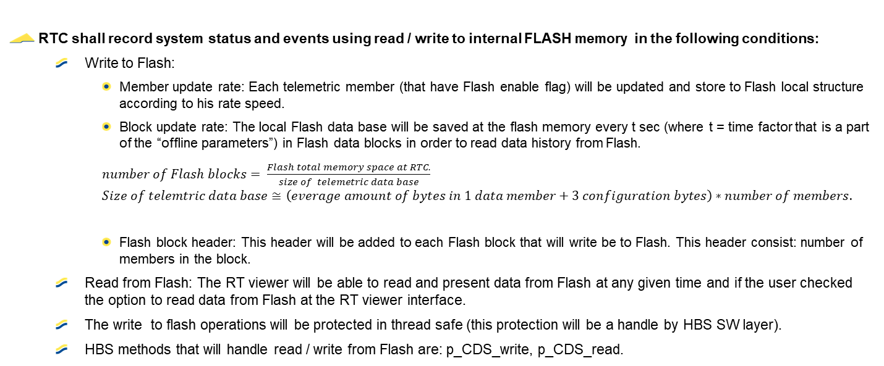


RT TLM Flash / current data requirements
FLASH
RTC shall record system status and events using read / write to internal FLASH memory in the following conditions:
Write to Flash:
Member update rate: Each telemetric member (that have Flash enable flag) will be updated and store to Flash local structure according to his rate speed.
Block update rate: The local Flash data base will be saved at the flash memory every t sec (where t = time factor that is a part of the “offline parameters”) in Flash data blocks in order to read data history from Flash.
$number of Flash blocks= \frac{Flash total memory space at RTC.}{size of telemetric data base}$
$$Size of telemtric data base≅\left(everage amount of bytes in 1 data member+3 configuration bytes\right)∗number of members.$$
Flash block header: This header will be added to each Flash block that will write be to Flash. This header consist: number of members in the block.
Read from Flash: The RT viewer will be able to read and present data from Flash at any given time and if the user checked the option to read data from Flash at the RT viewer interface.
The write to flash operations will be protected in thread safe (this protection will be a handle by HBS SW layer).
HBS methods that will handle read / write from Flash are: p_CDS_write, p_CDS_read.
Current data
RTC shall save current condition of the telemetric data base to be able to read upon user request from the RT viewer interface at any given time. The members that will be save have to be visually enable flag.
Read current data: The RT viewer will be able to read and present current data at any given time and if the user checked the option to read current data at the RT viewer interface.

Slide 5
RT TLM RT viewer requirements
The RT viewer shell present telemetric data from upon user request at any given time from 3 different sources:
Current data: Current condition of the RTC telemetric members.
Flash data: All Flash blocks that had been written to Flash (from latest to oldest).
File: raw data that had been previous stored (format of text file).
The RT viewer shell present the telemetric data at the following way:
Table of all members: This table will consist all telemetric members information one after one. This data can be view at:
Sort values: The user will be able to sort those data from low to high, low to high or group them by RTC module.
Data view: The user will be able to view members data by bytes or by original data values.
Visual way: The user will able to search after data member by his name or index and by his group. Then the RT viewer shell present for this selected member a 2D figure and table of results by time stamp.
The RT viewer shall present telemetric members by his names:
The telemetric members names will be read from generated file. This file generate by 3d application.
The RT viewer shall saved output files:
Upon user request the RT viewer shell generate the following output files:
Table of all members – At text file.
Raw data of the incoming data.
Picture (format *.jpg) of the 2D figure.

Slide 6
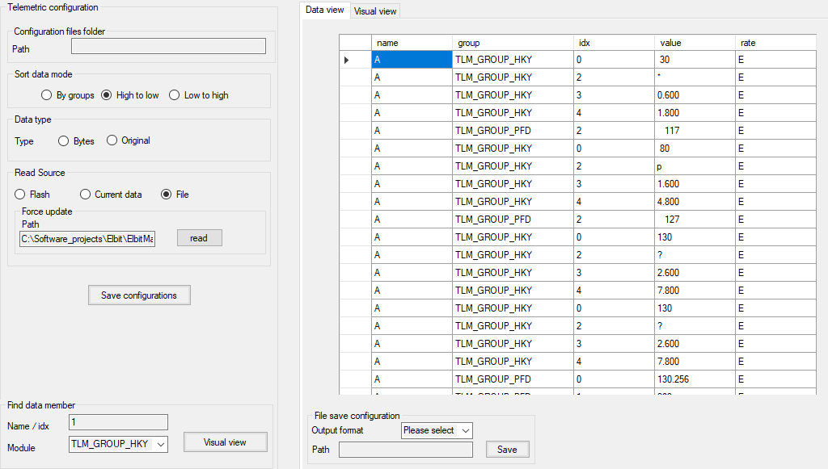
RT TLM RT viewer - Presentation of table

Slide 7
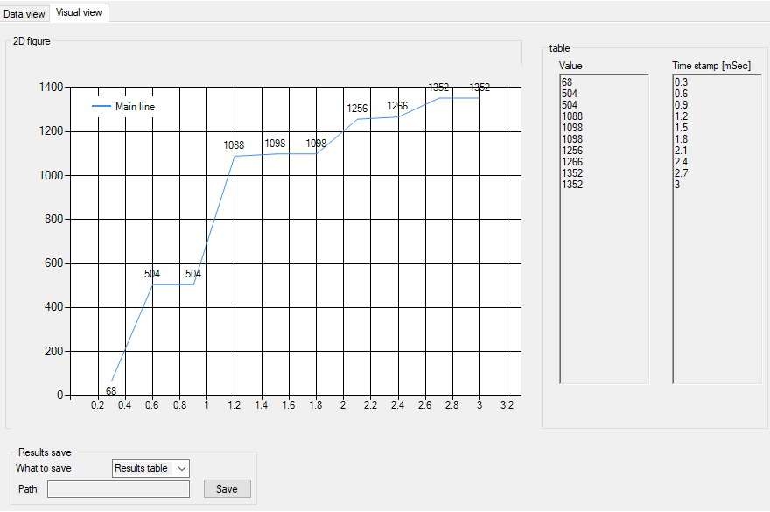
RT TLM RT viewer - Presentation of table

Slide 8
RT TLM parameters configuration Solution A – ICD messages
Each telemetric plan will be in an ICD file format (.grep file).
The telemetric plan members will be build throw GDE application.
The ICD message will be form by system engineers.

Slide 9
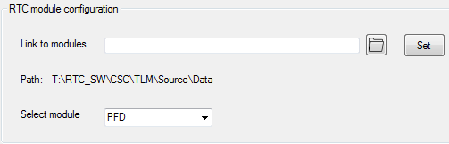
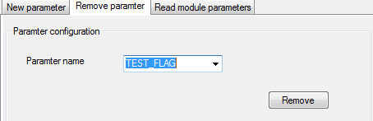
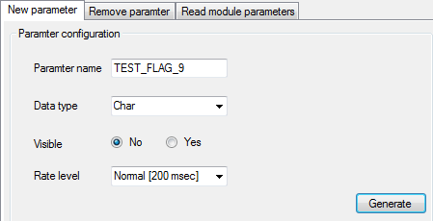
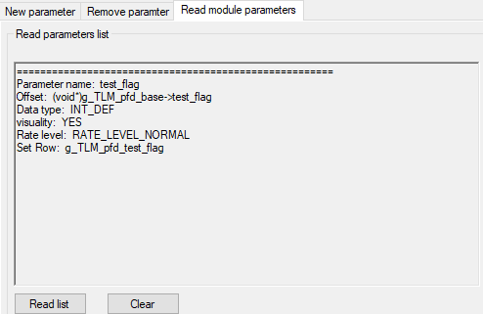
RT TLM parameters configuration Solution B – Parameters configurator tool
Parameters configurator tool goal is to add ability to insert / remove / view parameters for a chosen RTC module.
Configure path to DB files and module
Remove parameter from module DB
Insert new parameter
View module parameters

Slide 10
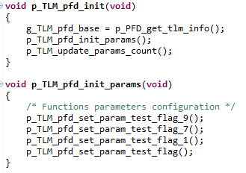
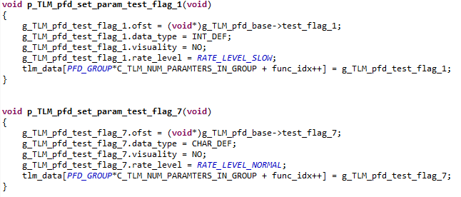

RT TLM parameters configuration Solution B – Parameters configurator tool
The tool actually edit the implementation data base files for the selected module.
Add the parameter function configuration
to module initialization procedure.
Create configuration function for the new parameter
Update parameters module counter with amount of objects
Create Telemetric object (in *.h file) with the given name (e.g. “TEST_FLAG”).

Slide 11
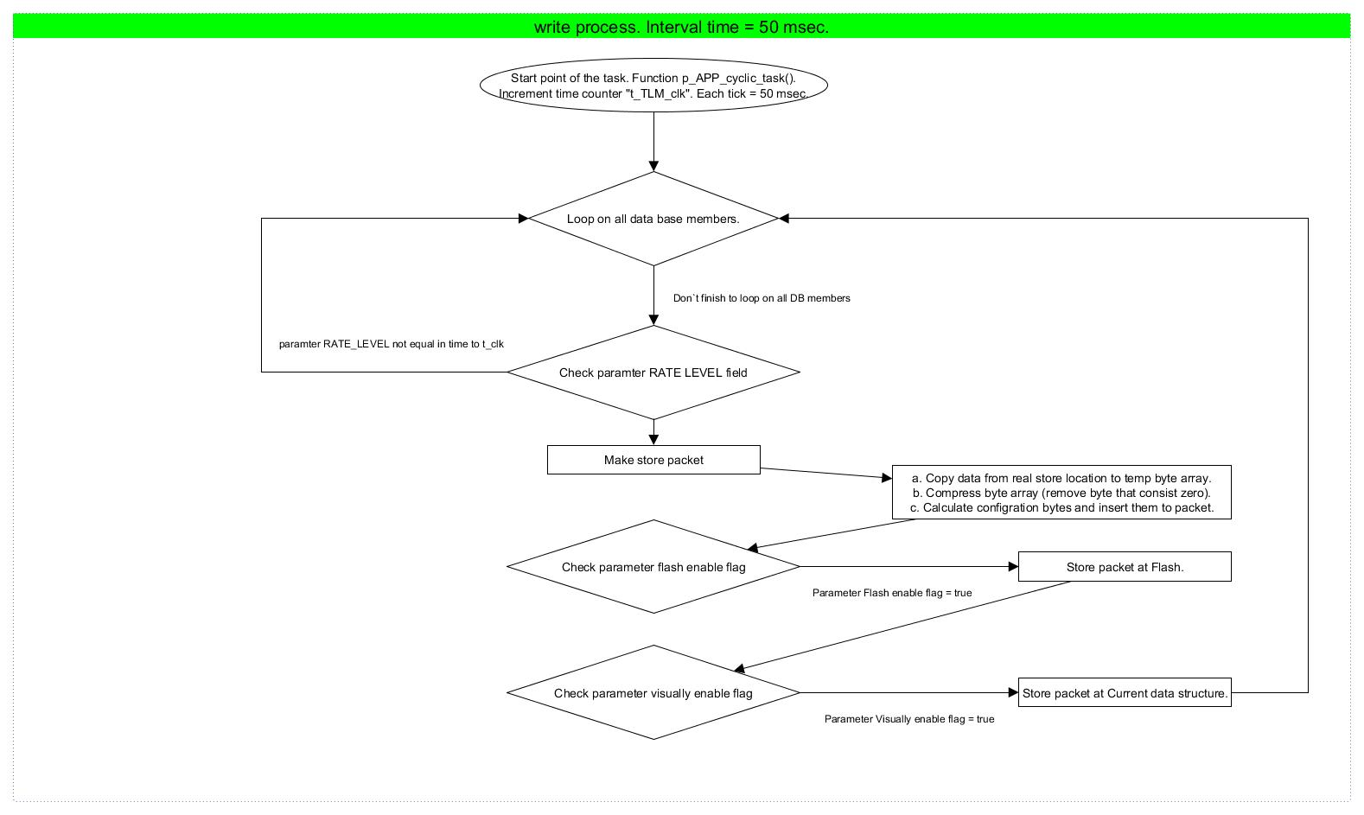
Telemetric SW flow Write process

Slide 12
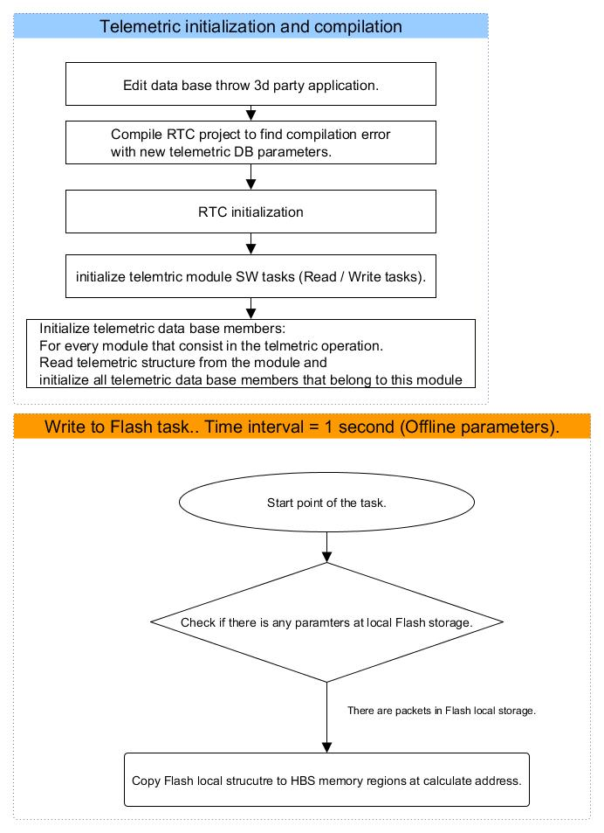
Telemetric SW flow Flash write task, initialize process

Slide 13
The End.

