Slide 1
Training
Data
Transformers
&
Base model
Clustering methods
&
Discretized model
Extraction of automata
Analysis
Paths to target
Data
Automata
Behavioral changes (segmentations)

Slide 2
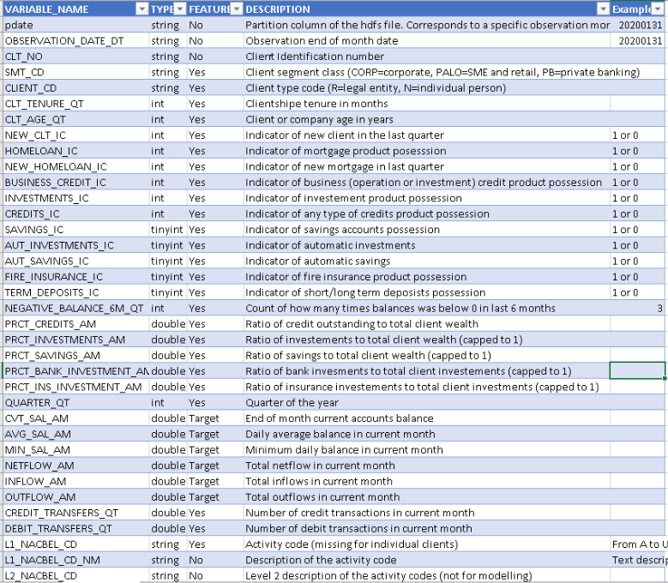
Data
Description:
3.5 years of monthly data
1.8 M costumers
34 features at each time point
We used a reduced version:
14 features (only the numerical ones)
Filter by business, CLIENT_CD == N (800K after filtering)
15K customers
Task:
Predict the next month AVG_SAL_AM

Slide 3
Analysis Goals
Find “path” to your customer goal:
Find actions to get the customer for a desired outcome:
Find solutions under constrains (features that can’t move / bounded).
Find few alternatives of paths in different lengths (longer paths but less dramatic changes).
Analysis of segmentations:
Find segments for each customer data (regime changes)
Get analysis of each segment (feature importance / features effects on the output)
Breaking points analysis:
What change in the input causes this breaking point?
How could I prevent / uplift it?

Slide 4
Training
Data
Transformers
&
Base model
Clustering methods
&
Discretized model
Extraction of automata
Analysis
Paths to target
Data
Automata
Behavioral changes (segmentations)

Slide 5
Base models
Hidden models
Regular models
Input layer
Hidden layer
output
Input layer
output
1. Model trained on input and output as usual.
2. Has a hidden layer, that also can be used as input (feed in the hidden states and not only the input)

Slide 6
Training
Data
Transformers
&
Base model
Clustering methods
&
Discretized model
Extraction of automata
Analysis
Paths to target
Data
Automata
Behavioral changes (segmentations)

Slide 7
Discretized Model
In base models – inputs are p dimensional vectors; output is a scalar.
In discretized model – inputs are vectors out of C1 classes. output is a scalar out of C2 classes.
Decrease the Base model complexity – from a machine that its inputs and outputs are from infinite spaces, to a machine that its inputs and outputs are finite number of classes
Hidden models
Regular models
Hidden layer
Output
Input layer
Hidden layer
Input layer
Output
Input layer
Hidden layer
output

Slide 8
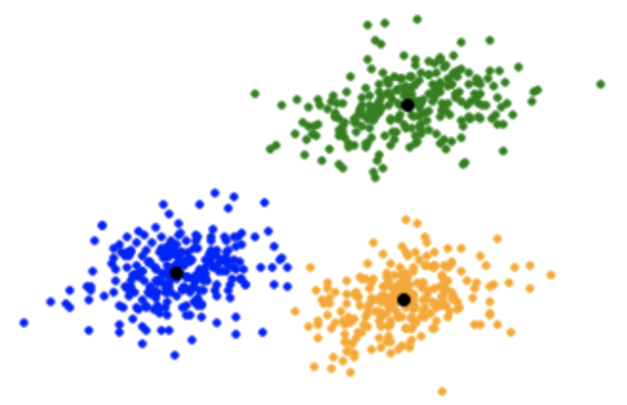
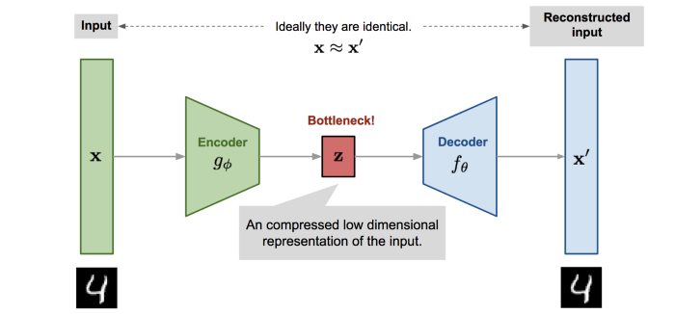
Clustering methods
The goal - finding the sweet spot – get data representatives, such that the drop in performance of the model is minimal, but the decrease in complexity is maximal.
We are using 2 methods:
K means cluster in a raw feature space
Auto Encoder - cluster in the latent space. Much more “efficient” (=less drop in performance)
K-means
Auto Encoder / VAE

Slide 9
Training
Data
Transformers
&
Base model
Clustering methods
&
Discretized model
Extraction of automata
Analysis
Paths to target
Data
Automata
Behavioral changes (segmentations)

Slide 10
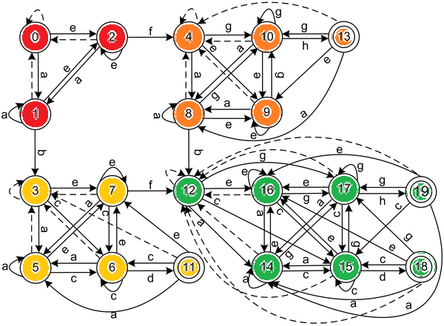
Automata as classifier –
Finite input classes (a, b, c… g) [C1 classes]
Finite output classes (red – orange – yellow - green) [C2 classes]

Slide 11
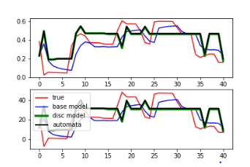
Automata Extraction
C1 classes are representatives of the input data
Hidden models
Regular models
C2 classes are representatives of the hidden states
C2 classes are ranges of y (target ranges)
Extraction of Automata –
Exact learning method
Using exponential number of queries of the discretized model
(which is basically the base model)

Slide 12
Training
Data
Transformers
&
Base model
Clustering methods
&
Discretized model
Extraction of automata
Analysis
Paths to target
Data
Automata
Behavioral changes (segmentations)

Slide 13
Analysis Goals
Automata Method
Find “path” to your costumer goal:
Find actions to get the costumer for a desired outcome:
Find solutions under constrains (features that can’t move / bounded).
Find few alternatives (options for the customer to choose) in different length (longer paths but less dramatic changes).
Analysis of segmentations:
Find division of costumers to different segments
Get analysis of each segment (feature importance / effect on output)
Breaking points analysis:
What change in the input causes this breaking point?
How could I prevent / uplift it?
Search in graph after the sequence of inputs (classes) that causes the desired output
Constrains on the representatives
Find ALL paths from state to a certain output class
Decrease the complexity of searching after input sequence by a lot.
Analysis of segmentations (for hidden models)
Analyze each one of the segments as a static model (as we capture the effect of time by modeling it with time series model)
Analyze breaking points (the points where costumer “change color”)
Analyze critical points in time (change that would shift the path completely)

Slide 14
Technical issues
Future Steps
Environment issues (2 weeks).
GPU version didn’t work when loading models (probably environment issue).
Disconnections.
Improve the base models.
Integrate AE and constrains.
Segmentation analysis.

Slide 16

So Far, Not so Good
Time | Zip Code | Gender | Income | Checking Account | Savings account | Expands | Churn Rate
Black Box Model
Churn rate of next month
0.47

Slide 17
Time | Zip Code | Gender | Income | Checking Account | Savings account | Expands | Churn Rate
Deltika Model
Courses of actions to Churn rate of 0.2
Churn rate of next month
Segmentations
0.47
Breaking points
Feature importance
Time | Zip Code | Gender | Income | Checking Account | Savings account | Expands | Churn Rate
7
8
9
Time | Zip Code | Gender | Income | Checking Account | Savings account | Expands | Churn Rate
7
8
9
Time | Zip Code | Gender | Income | Checking Account | Savings account | Expands | Churn Rate
7
8
9

Slide 18
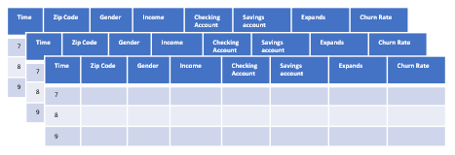

Platform
Core Technology
Platform
Automata
Segmentations
User Data
Breaking points
Feature importance
Churn rate of next month & Feature importance
0.47
Analysis
Realistic and actionable courses to Churn rate of 0.2
User Preference and Restrictions

Slide 19
Automata

Slide 20
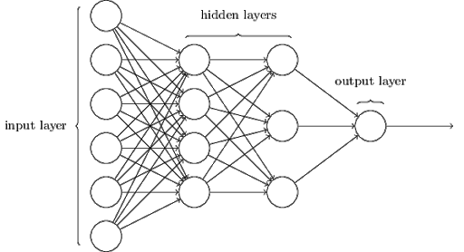
Training
Base Models
Automata
Discretized model

Slide 21
Base models
Hidden models
Regular models
Input layer
Hidden layer
output
Input layer
output
1. Model trained on input and output as usual.
2. Has a hidden layer, that also can be used as input (feed in the hidden states and not only the input)

Slide 22
Discretized Model
In base models – inputs are p dimensional vectors; output is a scalar.
In discretized model – inputs are vectors out of C1 classes. output is a scalar out of C2 classes.
Decrease the Base model complexity – from a machine that its inputs and outputs are from infinite spaces, to a machine that its inputs and outputs are finite number of classes
Hidden models
Regular models
Hidden layer
Output
Input layer
Hidden layer
Input layer
Output
Input layer
Hidden layer
output

Slide 23
Clustering methods
The goal - finding the sweet spot – get data representatives, such that the drop in performance of the model is minimal, but the decrease in complexity is maximal.
We are using 2 methods:
K means cluster in a raw feature space
Auto Encoder - cluster in the latent space. Much more “efficient” (=less drop in performance)
K-means
Auto Encoder / VAE

Slide 24
Automata Model
Automata as classifier –
Finite input classes (a, b, c… g) [C1 classes]
Finite output classes (red – orange – yellow - green) [C2 classes]

Slide 25
Automata Extraction
C1 classes are representatives of the input data
Hidden models
Regular models
C2 classes are representatives of the hidden states
C2 classes are ranges of y (target ranges)
Extraction of Automata –
Exact learning method
Using exponential number of queries of the discretized model
(which is basically the base model)

Slide 26
Analysis

Slide 27
Task - Find “path” to your costumer goal. Find actions to get the costumer for a desired outcome:
Find solutions under constrains (features that can’t move / bounded).
Find few alternatives (options for the customer to choose) in different length (longer paths but less dramatic changes).
Automata Solution - Search in graph after the sequence of inputs (classes) that causes the desired output
Constrains on the representatives
Find ALL paths from state to a certain output class
Task - Analysis of segmentations (for hidden models)
Analyze each one of the segments as a static model (as we capture the effect of time by modeling it with time series model)
Analyze breaking points (the points where costumer “change color”)
Analyze critical points in time (change that would shift the path completely)
Automata Solution - Analysis of segmentations:
Find division of costumers to different segments
Get analysis of each segment (feature importance / effect on output)
Breaking points analysis:
What change in the input causes this breaking point?
How could I prevent / uplift it?

Slide 28
Results

